Slide 1
Predictive Analysis MDTS4214
Topics covered
Linear regression
Life Expectancy Project
SLR, MLR, dummy variables, regression diagnostics
Bias–variance tradeoff
KNN regression, model complexity
Classification
Binary and multi-class logistic regression
Model selection
Stepwise selection, adjusted R², AIC/BIC
SRINJANA SEN PG SEM II ROLL: 735
Regularisation
Ridge, LASSO, Elastic Net
GLM
Logit link, contingency tables, log-linear models

Slide 2
Dataset Overview
WHO Global Health Observatory
2,938
22
193
16
observations
variables
countries
years (2000–2015)
Predictors
Targets
— Adult Mortality (per 1,000)
Regression
— Schooling — avg. years
Life Expectancy — continuous, years (36.3 → 89.0)
— Income composition (HDI proxy)
Classification
— BMI, Alcohol consumption
Development Status — Developed (512) vs Developing (2,426)
— HIV/AIDS mortality (per 1,000)
Missing data
GDP (448), Population (652), Hepatitis B (553), Alcohol (194). Complete-case analysis → 1,649 fully-observed rows used for modelling.
— GDP per capita
— Polio, Diphtheria, Hepatitis B rates
— Population, thinness, infant deaths

Slide 3
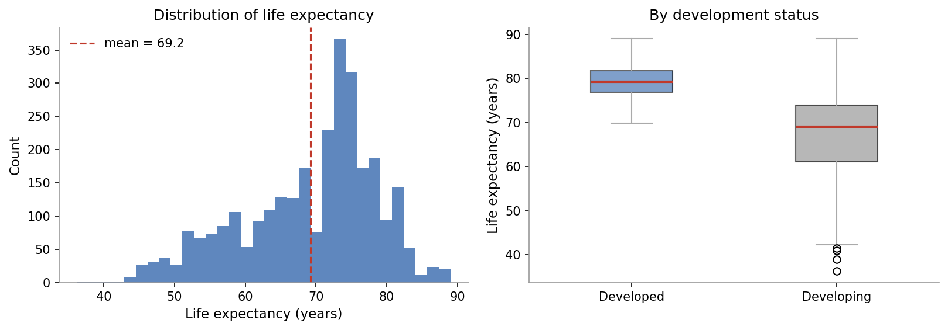
Exploratory Data Analysis
What the distribution shows:
The global mean is 69.2 years, but the spread is wide — from 36 years in the worst cases to 89 at the top end. The distribution is slightly left-skewed, with most observations clustered between 60 and 80. The boxplot makes the development gap immediate: Developed countries sit around a median of 79 years with little spread, while Developing countries are centred near 69 with far more variation. This gap drives a lot of the signal across every model we run.

Slide 4
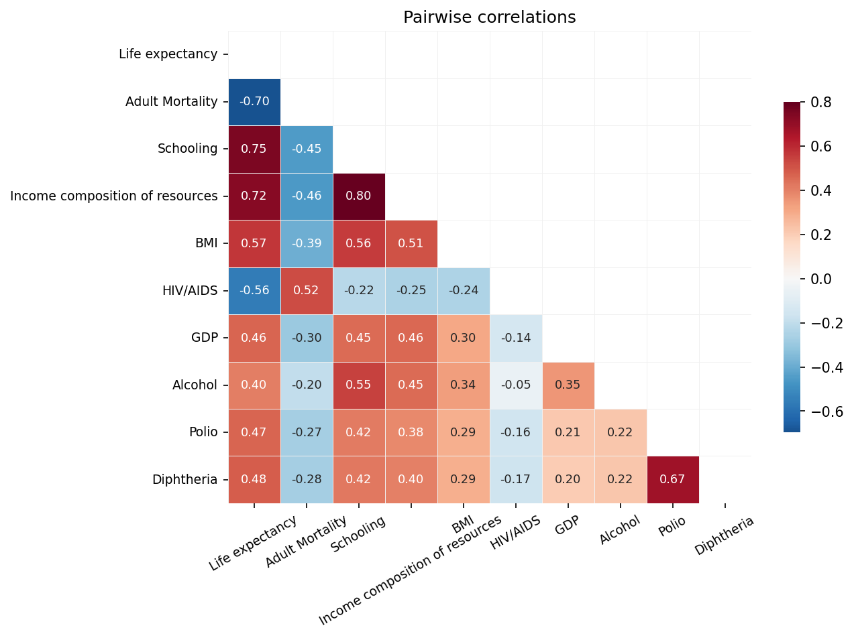
Correlation Analysis
Strongest signals:
Positive — higher values go with longer lives: Scholing (+0.75), Income composition (+0.72), BMI (+0.57), vaccination rates (~+0.47) Negative — higher values go with shorter lives: Adult Mortality (–0.70), HIV/AIDS (–0.56), Thinness (–0.47) Note: the two thinness variables (ages 1–19 and 5–9) correlate at r ≈ 0.93 with each other — we only keep one in the models to avoid near-perfect multicollinearity.

Slide 5
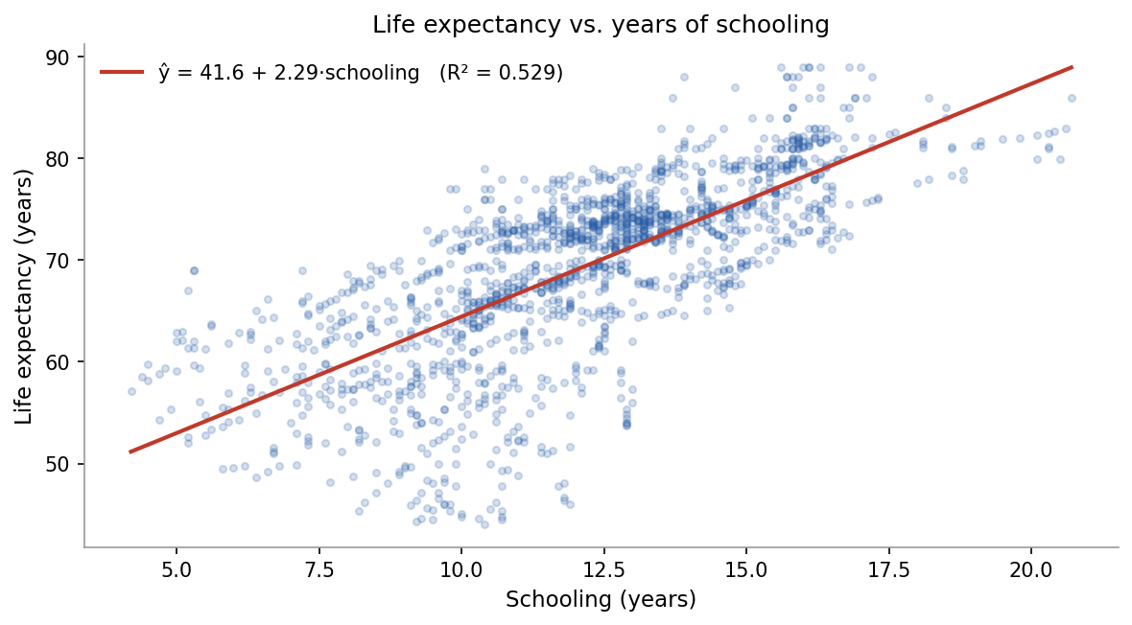
Simple Linear Regression
Model and results:
ŷ = 42.94 + 2.17 × Schooling
R² = 0.565
Each additional year of schooling is associated with about 2.2 more years of expected life. The relationship is fairly linear but noisy — schooling explains just over half the variance on its own. The residual spread suggests other factors (income, disease burden) matter too, which motivates the multiple regression.
OLS minimises SSR = Σ(yᵢ – ŷᵢ)²

Slide 6
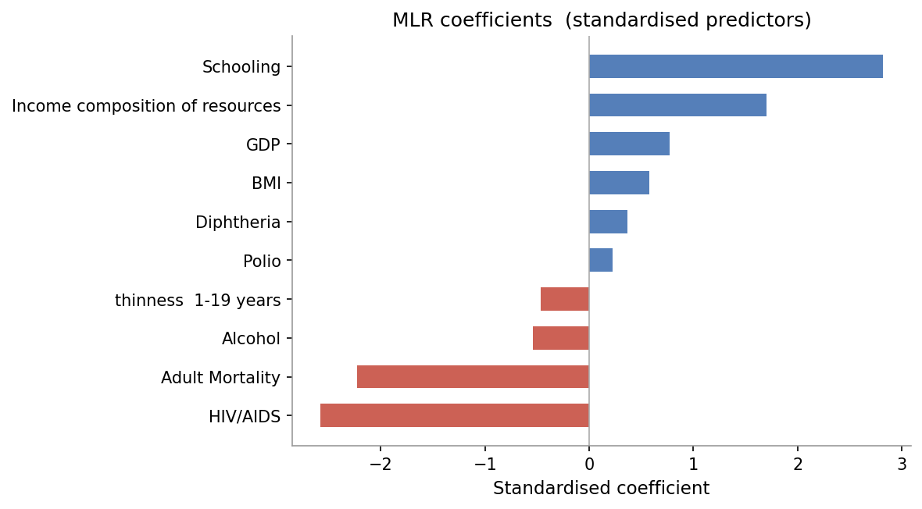
Multiple Linear Regression
Results:
Train R²
0.821
Test R²
0.802
Adding nine more predictors drops RMSE from 6.3 to 3.75 years — a meaningful improvement over the single-predictor model. The dummy variable for Status (Developed = 1, Developing = 0) captures the structural gap between country groups that raw health metrics alone do not fully explain. Largest positive coefficients: Income composition, Schooling. Largest negative: Adult Mortality, HIV/AIDS.

Slide 7
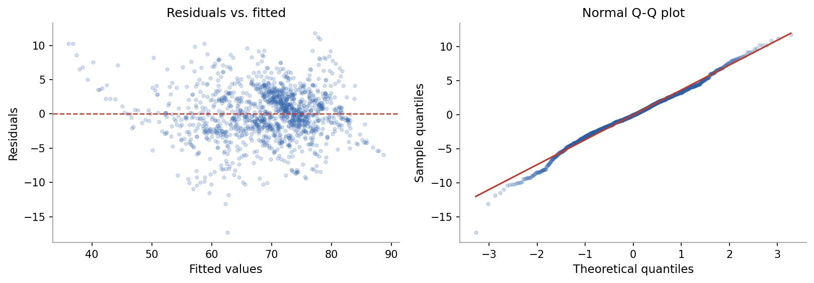
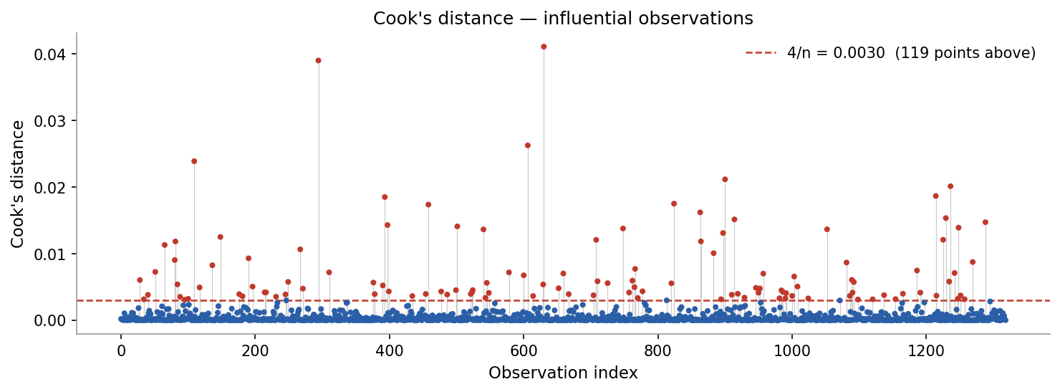
Regression Diagnostics
Residuals vs. fitted:
No obvious funnel pattern — variance is reasonably constant across the fitted range. A few outliers visible, particularly near the low end.
Q-Q plot:
Residuals follow the normal line closely in the middle. Tails deviate slightly, which is typical for health data at this scale. Not a concern for n = 1,649.
Cook's Distance:
Identifies observations that disproportionately pull the fitted line. Threshold: 4/n ≈ 0.0024. Several small island nations — with unusual demographic profiles relative to their size — flag as influential. We keep them in: they represent real variation, not data errors.

Slide 8
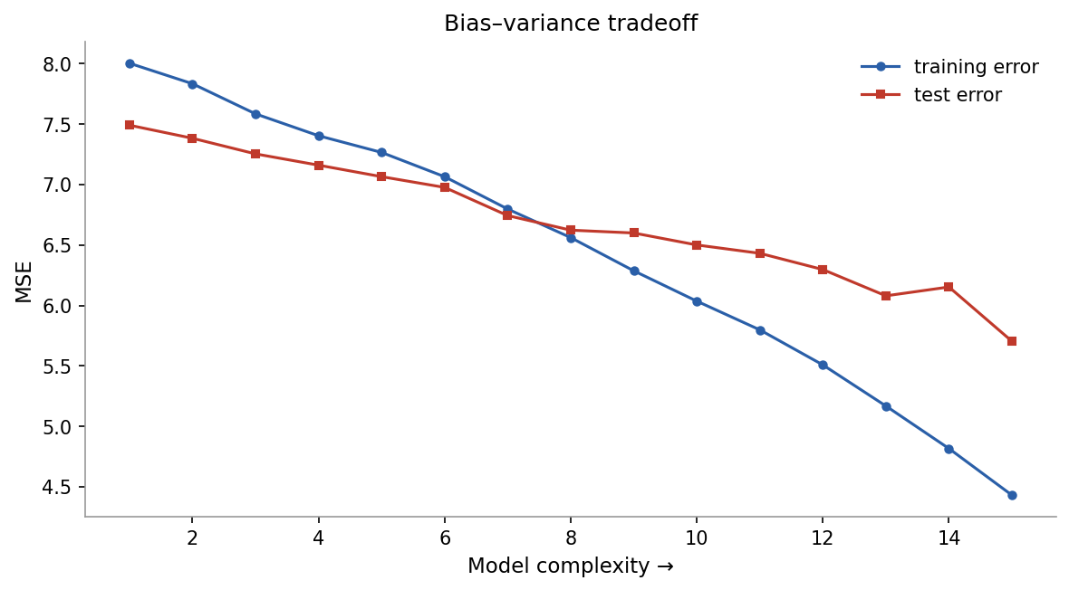
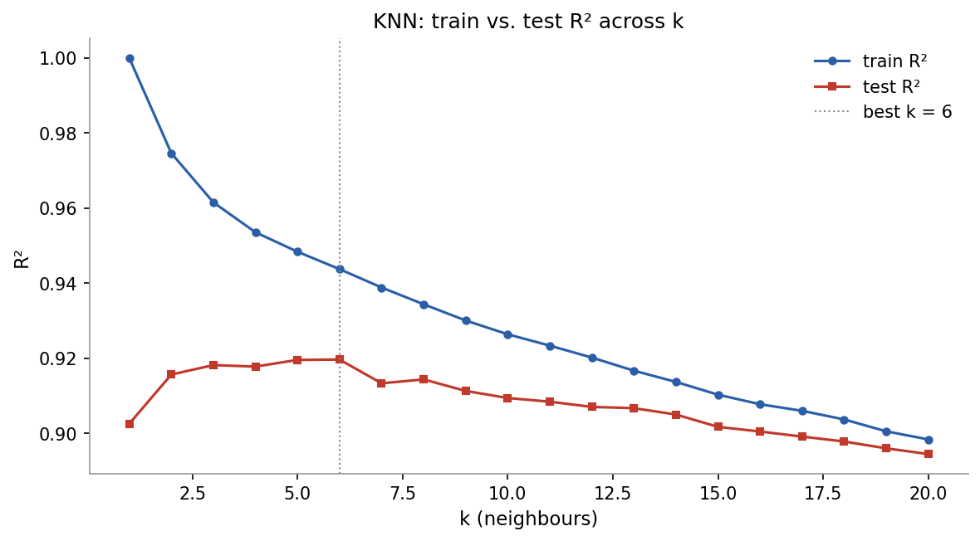
Bias–Variance Tradeoff & KNN Regression
At low k, the model is essentially memorising the training data — train R² is near 1.0 but test performance is poor. As k increases, both curves converge but we start to underfit. The sweet spot is around k = 6 or 7, where test R² peaks at roughly 0.91. Beyond that, averaging over more and more neighbours loses the local structure that makes KNN useful. KNN at k = 7 gives test R² ≈ 0.91, slightly better than the 0.80 from MLR — but at the cost of interpretability. There is no coefficient to report, no significance test, no way to say "schooling matters by X units."

Slide 9
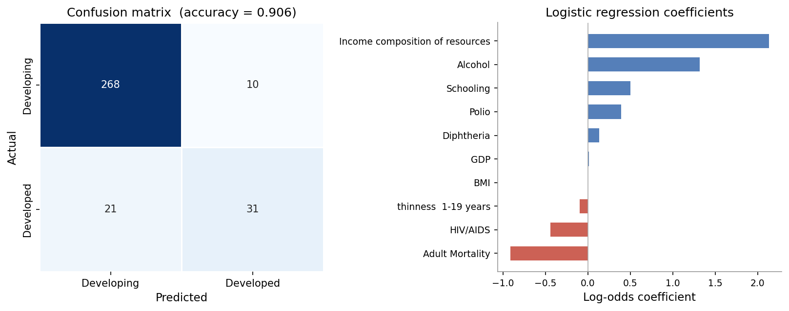
Binary Logistic Regression
Model:
log( p / 1−p ) = Xβ
where p = P(Developed | X). Fitted by maximum likelihood; coefficients are log-odds ratios.
Accuracy
90.6 %
Precision
87.4 %
Recall
76.2 %
F1
81.5 %
Income composition and Schooling push strongly toward Developed. Adult Mortality and HIV/AIDS push toward Developing. The coefficient plot on the left makes this visible.

Slide 10
Multi-Category Logistic Regression
Setup:
Results:
We split life expectancy into three ordered groups: Low — below 65 years Medium — 65 to 75 years High — above 75 years Two approaches were compared: One-vs-Rest (OvR), which trains three separate binary classifiers, and multinomial logistic, which estimates all classes simultaneously via softmax.
OvR accuracy
85.2 %
Multinomial accuracy
84.8 %
Easiest class
High LE — distinct feature profile
Hardest class
Medium LE — overlaps both extremes
Softmax probability (multinomial):
P(y = k | X) = exp(Xβₖ) / Σⱼ exp(Xβⱼ)
The main confusion is between Medium and High LE — the boundary near 75 years is not sharp in the data. Countries just below and just above the cutoff share similar profiles, so misclassification in both directions is expected.
Each observation is assigned to the class with the highest posterior probability.

Slide 11
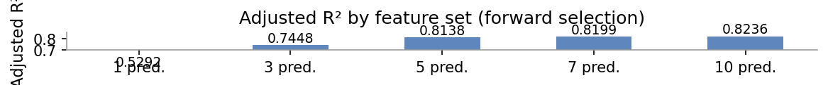
Subset Selection
Forward and backward stepwise with adjusted R² and AIC/BIC
How the methods work:
Forward stepwise: start with no predictors, greedily add whichever variable gives the largest improvement in adjusted R² at each step. Stop when no addition helps. Backward stepwise: start with all 10 predictors, remove the least significant variable (highest p-value) one at a time. Both methods converge to a 7-predictor model. AIC and BIC both penalise unnecessary parameters. BIC's stronger penalty produces the same result here — 7 predictors is the stable optimum.
Adjusted R² plateaus after 7 predictor — adding the remaining three yields almost nothing.

Slide 12
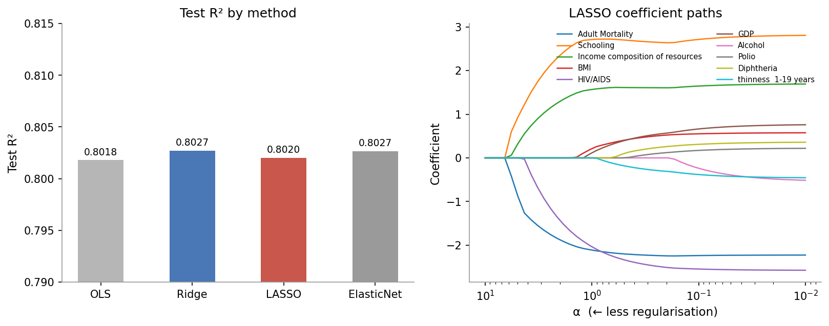
Ridge, LASSO & Elastic Net
How they differ:
Ridge adds λΣβ² — shrinks everything, removes nothing. Good when many small effects are present. LASSO adds λΣ|β| — drives some coefficients to exactly zero, acting as variable selection. Best α = 0.014 here; 3 of 10 predictors are zeroed. ElasticNet blends both penalties — useful when predictors are correlated. Slight edge over Ridge on this data. All three land at R² ≈ 0.80–0.803 — almost identical to plain OLS. This is actually reassuring: it means the OLS solution is not overfitting, and the predictors that survived stepwise selection are genuinely informative.

Slide 13
GLM — The Three Components
1. Random component
Y must follow a distribution from the exponential family. For our binary classification task (Developed / Developing), we use Y ~ Binomial(n, π), where π = P(Developed | X). The expected value is E[Y] = μ = π.
2. Systematic component
A linear predictor η combines the covariates: η = β₀ + β₁X₁ + β₂X₂ + … + βₚXₚ X includes Schooling, Income composition, HIV/AIDS, Adult Mortality, BMI, and others.
3. Link function — logit
The link g(μ) connects μ to η, mapping probabilities in (0, 1) onto the full real line: g(μ) = logit(μ) = log( μ / 1 − μ ) = η Inverting: μ = exp(η) / (1 + exp(η)). This is the logistic curve.

Slide 14
Model Performance Summary
Model | Task | Test R² | Remarks
Simple LR — Schooling only | Regression | 0.565 | Baseline
Multiple LR — 10 predictors | Regression | 0.802 | Includes Status dummy
KNN — k = 7 | Regression | 0.810 | Best by CV
Ridge | Regression | 0.803 | L2, α = 0.01
LASSO | Regression | 0.802 | L1, α = 0.014; 3 zeroed
ElasticNet | Regression | 0.803 | L1 + L2
Binary Logistic | Classification | — | Developed vs Developing
Multi-Class Logistic | Classification | — | Low / Medium / High LE
GLM — Logit link | Classification | — | Equivalent to binary logistic
Best regression: KNN k = 7 (R² = 0.810) — though MLR is preferred for reporting. Regularisation adds marginal value — OLS was already stable.

Slide 15
Key Findings
Education is the strongest positive driver
Schooling correlates at r = 0.75 — the highest of any single variable. Each additional year is associated with roughly 2.2 more years of life after controlling for other factors. Education likely proxies access to healthcare information, higher income, and better nutrition simultaneously.
The development gap is classifiable
Binary logistic achieves 90.6 % accuracy predicting Developed vs Developing from health and economic variables alone. The gap is not just a label — it is embedded throughout every feature in the dataset.
Vaccination rates carry a clear signal
Polio and Diphtheria rates correlate at r ≈ 0.47–0.48. Developed countries average over 90 % coverage. Unlike many predictors here, vaccination is a direct policy lever — this association is one of the more actionable findings in the dataset.
Regularisation confirms model stability
Ridge, LASSO and ElasticNet all give R² ≈ 0.80–0.803. The marginal improvement over OLS is negligible. This means the original OLS solution was not overfitting, and the predictors selected by stepwise are genuinely informative.

Slide 16
Thank you
Predictive Analysis — Life Expectancy Project
WHO Global Health Observatory · 193 countries · 2000–2015 Methods: OLS · KNN · Logistic Regression · Ridge · LASSO · Elastic Net · GLM

