Slide 1


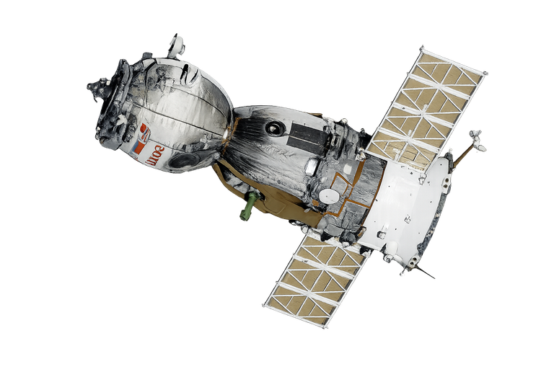

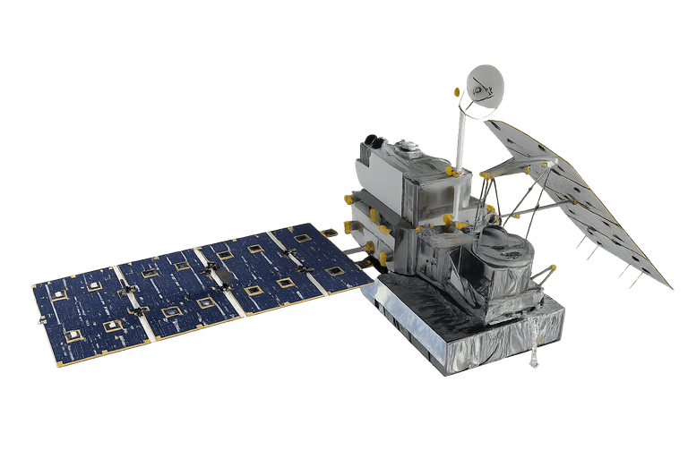
DEVCRAFT: SIMON’S COMMAND LINE
DOMAIN: ARTIFICIAL INTELLIGENCE
TEAM FAHH
  Project Name: CELESTIS
  Tagline: Autonomous Satellite Mission Control Platform
  Team Name: FAHH
  Event: DevCraft: Simon’s Command Line
  Date: 06/04/2026
  Domain: Artificial intelligence

Slide 2
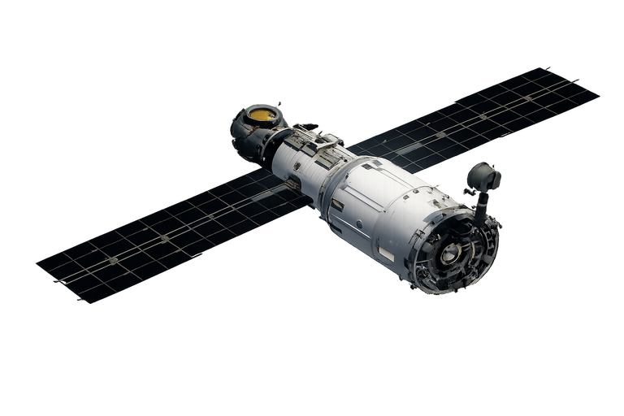
PROBLEM STATEMENT
"Indian Satellites Are Flying Blind Into Solar Storms"
  Geomagnetic storms supercharge Earth's upper atmosphere, increasing drag on LEO satellites by 10x to 50x.
  NRLMSISE-00 is the global standard atmospheric model underestimates storm time density by 30–80%.
  2022 Starlink Disaster: 38 of 49 satellites re-entered atmosphere in 72 hours, accounted for a 50+ Million dollars lost, this was because the drag was under predicted by 45%.
  2024 Gannon Storm (Kp=9): Strongest storm in 21 years, the satellite drag was 2 to 5x higher than models predicted.
  ISRO's I-STAR constellation (ISR satellites at ~500 km LEO) has no real time AI system to predict or respond to storm induced orbital decay.
  With Gaganyaan, Indian Space Station, and commercial growth solving this is a national imperative.
The Core Technical Failure: Every space agency in the world relies on NRLMSISE-00, which systematically underestimates thermospheric density during geomagnetic storms by 30–80%. This blind spot has already caused $50M+ in losses.

Slide 3
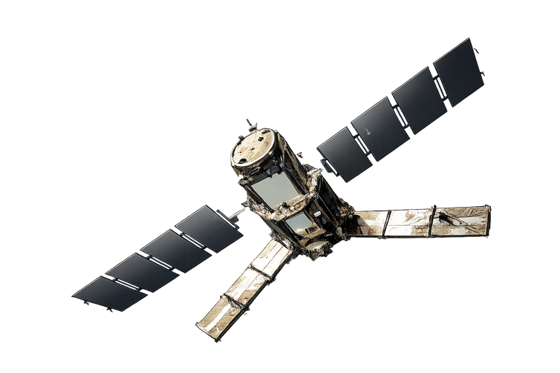
TARGET AUDIENCE
  ISRO & Government Space Agencies: Primary buyer. ISRO operates the I-STAR constellation and manages India's upcoming Gaganyaan crewed mission and the Indian Space Station. With India targeting a $44B space economy by 2033, protecting satellite infrastructure is a national priority. No Indian built storm response tool exists for their fleet today.
  Indian NewSpace Startups: Agnikul Cosmos, Skyroot Aerospace, Pixxel, Dhruva Space, and Bellatrix are all launching LEO satellites. None have dedicated storm resilience software. They cannot afford enterprise tools ($50K+/year) and currently rely on manual monitoring with open source TLE trackers.
  International Constellation Operators: Companies like OneWeb (648 sats), Telesat Lightspeed, and Amazon Kuiper are building mega constellations in LEO. The 2022 Starlink storm event proved that even well funded operators misjudge storm time drag. Hence they need AI augmentation for physics models.
  Defence & Strategic Assets: Military satellites in LEO cannot afford unplanned orbital decay or debris exposure. Storm events increase both risks simultaneously. CELESTIS addresses both in one platform.

Slide 4
EXISTING SOLUTION
  NRLMSISE-00 (Physics Model): The global standard for atmospheric density. Free and widely used but purely physics based. During geomagnetic storms, it underestimates thermospheric expansion by 30–80%, exactly when accuracy matters most. It has no awareness of real time solar wind or CME data.
  AGI Systems Tool Kit / STK: The industry gold standard for satellite mission analysis. Extremely powerful, but costs $50,000–$150,000/year per licence. Requires PhD level operators. No AI based drag correction. No autonomous maneuver execution. Inaccessible to startups and emerging space nations.
  Manual Ground Teams: Most operators still rely on human analysts who manually download TLEs, run separate tools, compute maneuvers in spreadsheets, and escalate decisions through a chain of command. During the 2022 Starlink storm, SpaceX's team had hours to respond but 38 satellites were lost anyway, the storm evolved faster than human reaction time.
  NASA ODAS / ESA DISCOS: Government internal databases for debris cataloguing and conjunction screening. Not available as real time operational tools for third parties. Focus on cataloguing, not autonomous response.

Slide 5
GAPS AND OPPORTUNITIES
  No AI+Physics hybrid for storm drag: Every existing tool is either pure physics (NRLMSISE-00, JB2008) or pure ML (single GBM, LSTM). No production tool combines both, meaning physics models miss storm anomalies and ML models violate orbital mechanics. This hybrid gap is CELESTIS's core innovation.
  No storm phase decomposition: A geomagnetic storm has 3 physically distinct phases, sudden commencement, main phase and recovery. All existing ML models treat the storm as a single event.
  No affordable autonomous maneuver platform: 58,000+ satellites are projected to be in LEO by 2030. Manual monitoring of each is impossible. Yet the only autonomous operations tools today are proprietary, closed source, and cost millions to integrate. The market for affordable autonomous mission control is completely open.
  No Indian built SSA platform: India is spending ₹1,000 crore+ on the I-STAR program and has 50+ space startups active as of 2024. Yet every space situational awareness (SSA) and mission control tool in use is American or European. India has zero indigenous autonomous mission control capability, a strategic and commercial gap of enormous scale.

Slide 6
YOUR SOLUTION
CELESTIS - Autonomous Satellite Mission Control Software
We built CELESTIS a complete software that is an intelligent mission control center for satellite fleets. It monitors the Solar storm indications, predicts danger, automates satellite manuvers and takes action to keep satellites safe all in real time.
  Monitoring solar storm predictions: Pulls live data every 55 seconds from 5 government space weather agencies (NOAA, NASA, GOES, DSCOVR, Space-Track) to know when a solar storm is coming.
  Predicts the Damage: Uses a custom built AI model (Physics Informed Neural Network) that combines physics and machine learning to predict exactly how much a satellite will drop during a storm, something that existing tools get wrong by 30–80%.
  Detects Debris Collisions: Scans 200+ pieces of real space debris every 15 minutes and alerts if any object is on a collision course with our satellites.
  Takes Protective Action: Automatically calculates the exact engine burn needed to move a satellite out of harm’s way, and can execute it with or without human approval.
  Viewer Dashboard: A mission control screen with a 3D globe showing all 36 satellites along with 34,000 debris objects, fleet health, and one click maneuver controls.
What Makes It Special: Unlike regular AI that can give wrong answers, our AI is built with physics rules baked into it. It is physically incapable of making an impossible prediction. This makes it trustworthy enough for real aerospace use.

Slide 7
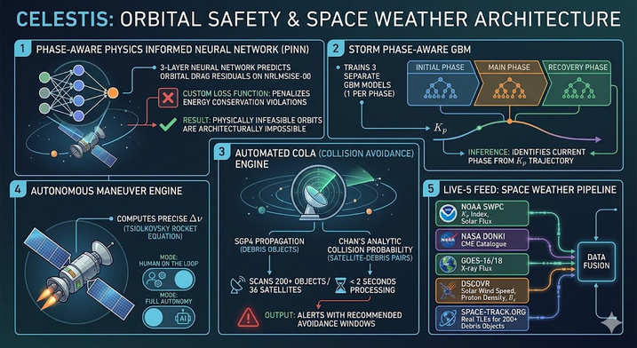
KEY FEATURES
  Phase Aware Physics Informed Neural Network (PINN): A 3 layer neural network that predicts orbital drag residuals on top of NRLMSISE-00. Trained with a custom loss function that penalizes any prediction that violates orbital energy conservation. Making it architecturally impossible to predict an infeasible orbit.
  Storm Phase Aware GBM: Instead of one regression model, CELESTIS trains 3 separate Gradient Boosted Models, one for each storm phase. During inference, the system identifies the current phase from the Kp trajectory and routes to the correct model.
  Automated COLA Engine: Runs full SGP4 propagation for every debris object in the monitored band. Computes Chan's analytic collision probability formula for each satellite debris pair. Scans 200+ objects across 36 satellites in under 2 seconds. Triggers alerts with recommended avoidance windows.
  Autonomous Maneuver Engine: Computes the precise Delta V required per satellite using the Tsiolkovsky rocket equation with real spacecraft parameters. Supports two modes: Human on the Loop and Full Autonomy.
  Live 5 Feed Space Weather Pipeline — Fuses NOAA SWPC (Kp, solar flux), NASA DONKI (CME catalogue), GOES-16/18 (X-ray flux), DSCOVR (solar wind speed, proton density, Bz), and Space-Track.org (real TLEs for 200+ debris objects).

Slide 8
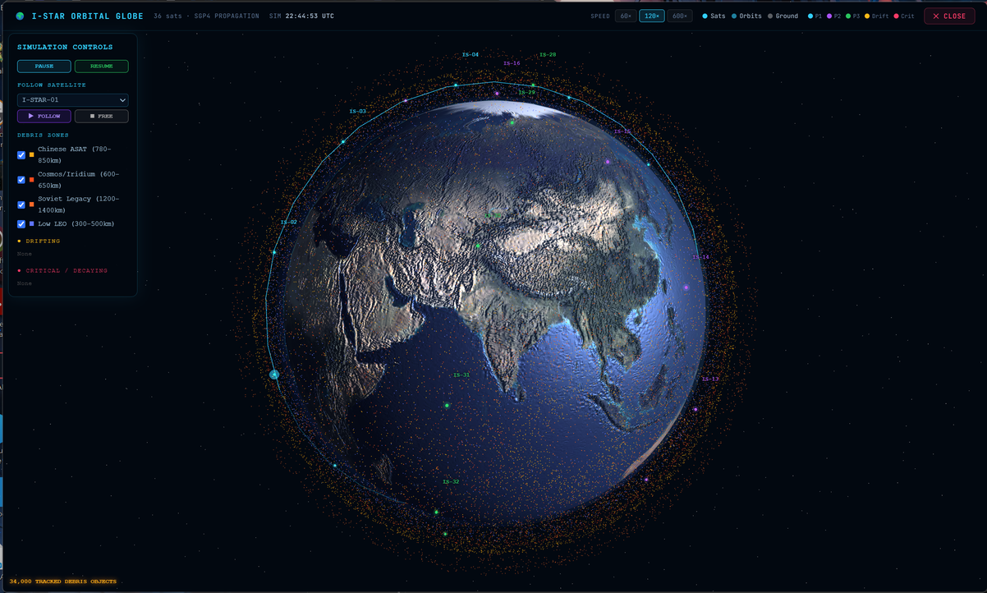
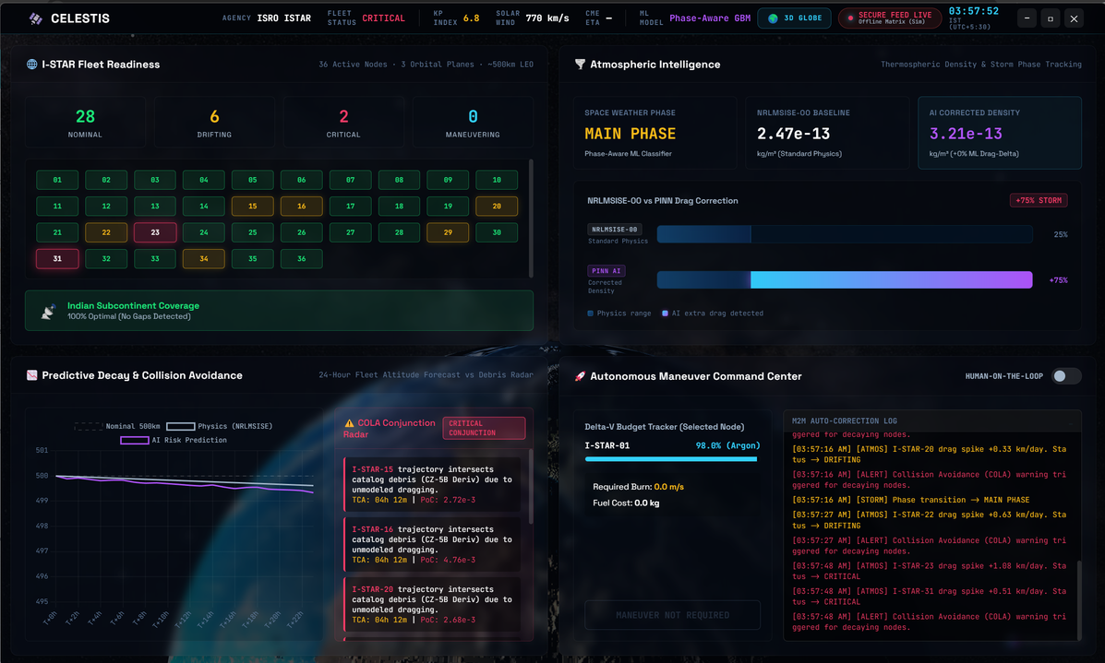
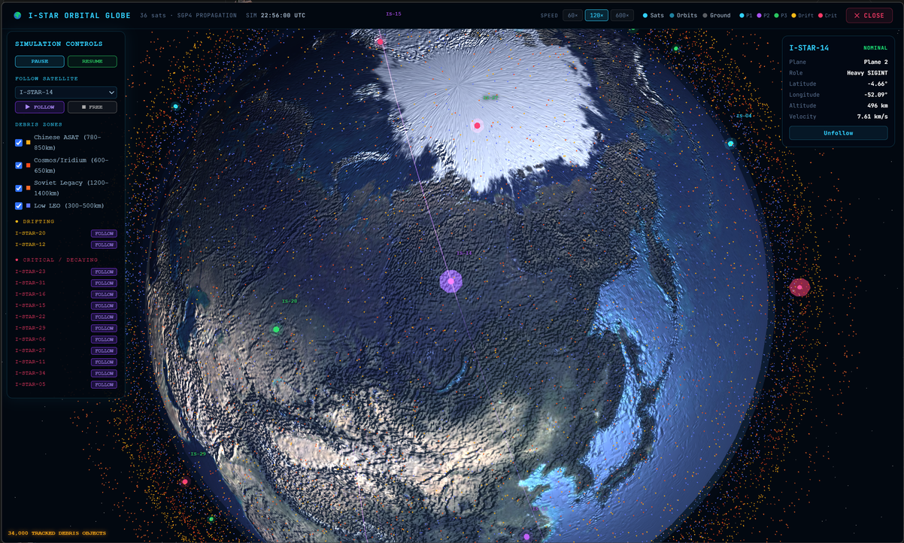
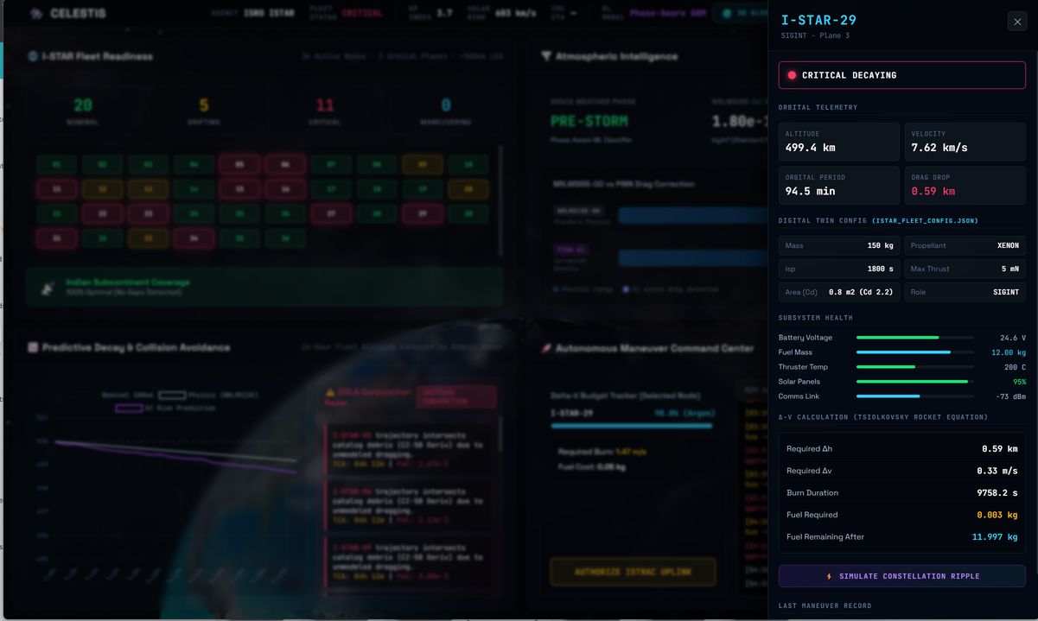
ARCHITECTURE DIAGRAM

Slide 9
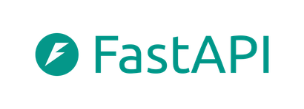
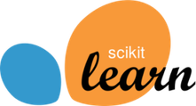
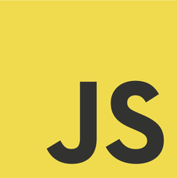
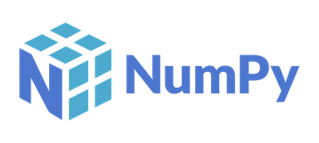

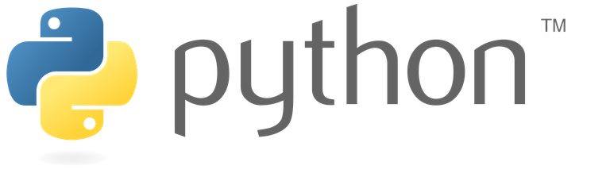


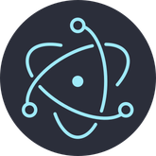

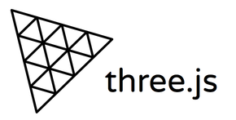


TECHNOLOGY STACK
AI/ML:
PyTorch: For PINN training with custom physics constrained loss function.
Scikit-learn: For phase Aware GBM benchmark model and StandardScaler.
Backend:
FastAPI (Python): Used for high performance async REST API serving physics and AI predictions
Pymsis: To model NRLMSISE-00 atmospheric density model
SGP4: For modeling SGP4 orbital propagation (NORAD gold standard)
Frontend:
Electron: For Native desktop application (frameless, dark theme).
Chart.js: Used to integrate real time altitude decay charts
Three.js and satellite.js: Modelled 3D orbital globe with 34,000 debris particles
Data:
NOAA SWPC and NASA DONKI: For fetching live data such as Live Kp, solar wind, X-ray, CME data
Space-Track.org: Fetching real debris TLEs (200 objects per altitude band).
Pipeline:
NumPy and Pandas: For ground truth dataset from real Space-Track TLEs

Slide 10
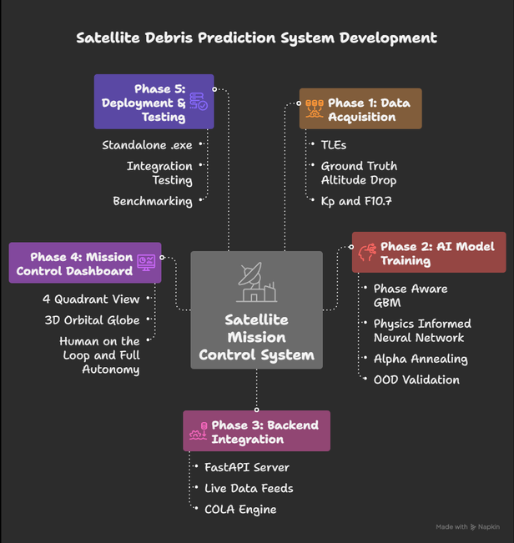
WORKFLOW
  Storm Detection (Every 55 seconds): CELESTIS continuously pulls live data from 5 government feeds. All feeds are fused into a unified storm state vector. When Kp > 5, the system activates.
  AI Drag Prediction: The storm parameters are fed into a 3 layer Physics Informed Neural Network (PINN). First, NRLMSISE-00 computes the baseline density prediction. The PINN then predicts the residual error that physics alone misses, constrained by orbital mechanics so it cannot produce physically impossible outputs. As a Result altitude drop forecast per satellite for the next storm phase.
  Debris Collision Analysis (Every 15 minutes): The COLA engine propagates 200+ real debris objects using SGP4 orbital mechanics over 1,440 time steps (24 hours). For each satellite debris pair, it computes miss distance and applies Chan's formula to calculate collision probability.
  Maneuver Planning: For flagged satellites, the Maneuver Engine calculates the exact Delta V burn needed using the Tsiolkovsky rocket equation. The system generates a maneuver recommendation within 1 second per satellite.
  Operator Decision: The Viewer dashboard presents all predictions, alerts, and maneuver options in a 4 quadrant layout. The operator can: (a) approve and execute in Human on the Loop mode, or (b) set Full Autonomy and let CELESTIS execute maneuvers without human input.

Slide 11
IMPACT
Performance Benefits:
  58.3% more accurate than physics only models at predicting satellite drag during storms
  Full maneuver recommendation generated in under 1 second per satellite
Real World Impact:
  Prevents Multi Million Dollar Losses. A single storm like Starlink 2022 destroyed $50M+ in satellites. CELESTIS could have predicted and prevented that loss
  Enables Autonomous Operations. As India scales to 100+ satellites, manual monitoring becomes impossible. CELESTIS automates fleet protection end to end.
  Builds India’s Space Sovereignty. No dependence on foreign tools like STK ($50K+/licence). CELESTIS is fully indigenous.
  Saves crucial Scientist work Hours Per Storm. Teams manually download data, run separate models, compute maneuvers, and cross check results, a process that takes 20 to 40 hours per storm event. CELESTIS does all of this automatically in seconds, freeing scientists to focus on research instead of repetitive calculations.
CELESTIS turns an extremely reactive and highly time consuming manual process into a quick proactive, and very precise automated process.

Slide 12
FUTURE SCOPE
  Multi orbit support, extending from LEO to MEO and GEO asset protection.
  Transformer based sequence model for 24–72 hour storm forecasting.
  ISRO ISTRAC integration: direct telemetry link to ISRO's Tracking & Command network.
  Gaganyaan mission support: crew safety during geomagnetic storms for India's human spaceflight.
  Space debris remediation: extend COLA engine to support active debris removal planning.
  Bharatiya Antariksha Station (BAS): autonomous orbit maintenance for India's space station.
  International partnerships. ESA ESOC, NASA JSC, JAXA integration for global SSA network.
  Integrate GRACE-FO accelerometer data for highest quality drag ground truth available

Slide 13
TEAM INFO
Member 1: Srinjay Singh, AI/ML engineer
Member 2: Shivansh Gupta, Front End and Back End Developer
Member 3: S Shivapriyaa, Researcher

