Slide 1
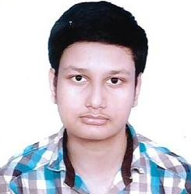

SRINJOY BANERJEE
WEB DEVELOPMENT AND DESIGNING INTERN AT
THE SPARK FOUNDATION
TASK-1 : Basic Banking System
#GRIPSEPTEMBER21

Slide 2
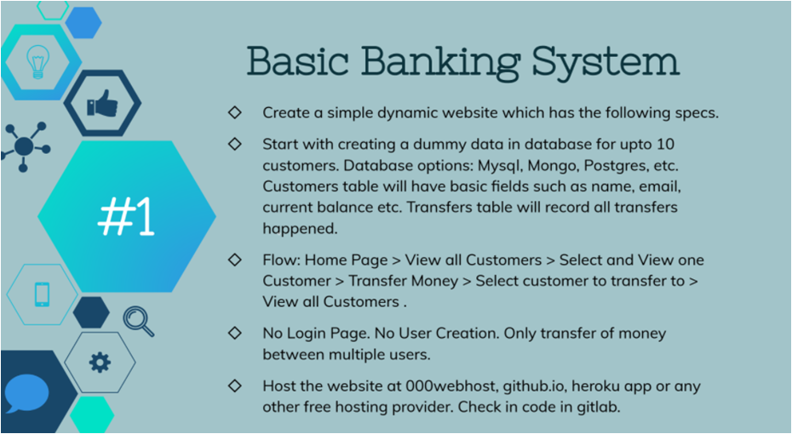

Slide 3
A Web Application which depicts a simple banking transaction system among 10 users.
Stack used :-
Front-end : HTML, CSS, Bootstrap & Javascript
Back-end : PHP
Database : MySQL Database

Slide 4
Thank You

