Slide 1

Project Title - Seasonal Agriculture Performance Analysis
College Name-College of Engineering & Management, Kolaghat
AICTE STU ID : STU688a6a797af421753901689
Student Name: Srinjoy Laha

Slide 2

PROBLEM STATEMENT
Agricultural activities are influenced by seasonal variations in environmental conditions, farming practices, resource availability and market conditions. As a result, agricultural performance may differ from one season to another. However, raw agricultural data does not clearly explain how agricultural performance changes across seasons or what patterns can be observed in different seasonal conditions. The problem is to analyze the given agricultural dataset and investigate seasonal differences in agricultural performance by identifying meaningful patterns, trends, relationships and variations within the available data.

Slide 3
Project Description
Analyzed 4,000 agricultural records to uncover seasonal patterns in crop yield, farm profitability, irrigation efficiency, rainfall, and resource usage. Using Python, Pandas, NumPy, Matplotlib, and Seaborn, the project performed data cleaning, statistical analysis, correlation analysis, and multi-level visualization to compare crops and seasons. The analysis found Kharif to be the strongest-performing season, identified Zaid as comparatively high-risk, and highlighted drip irrigation as a strong strategy for water-stressed conditions.

Slide 4

WHO ARE THE END USERS?
Farmers / Farm Owners – use insights on crop performance, seasonality, irrigation, and profitability to plan farming decisions.
Agricultural Consultants – use the analysis to recommend suitable crops, irrigation methods, and resource allocation.
Agribusiness Managers – use profitability and yield trends for production and investment planning.
Government / Agricultural Departments – use aggregated insights for agricultural planning, resource allocation, and policy decisions.
Agricultural Researchers / Analysts – use the dataset and analysis to study relationships between environmental factors, farming practices, yield, and profit.

Slide 5

Technology Used
  Standalone analytical workflow using a CSV dataset processed in Python/Jupyter Notebook. No client-server, network, or distributed topology was used.
  CSV Dataset → Python/Pandas → Data Cleaning & Processing → Statistical Analysis → Data Visualization → Insights & Recommendations

Slide 6
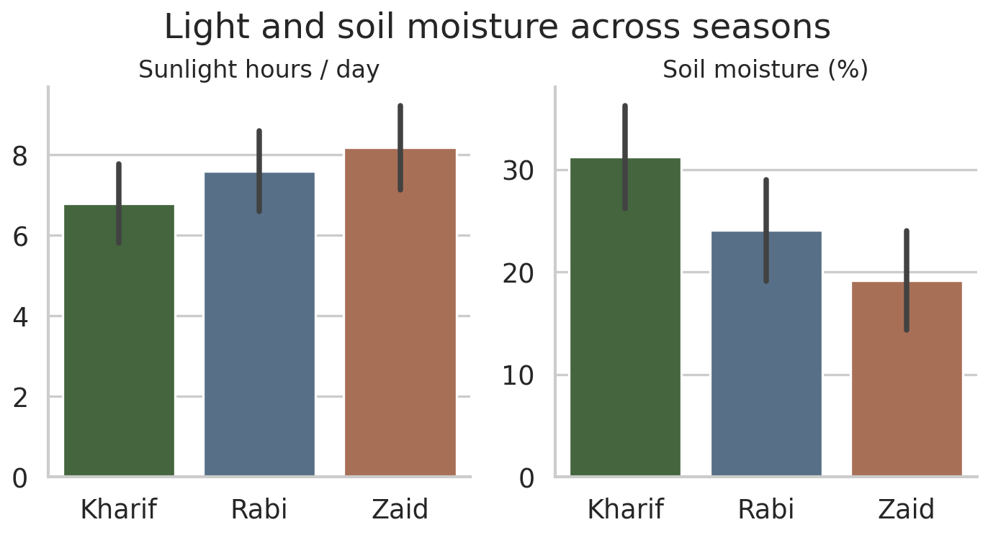
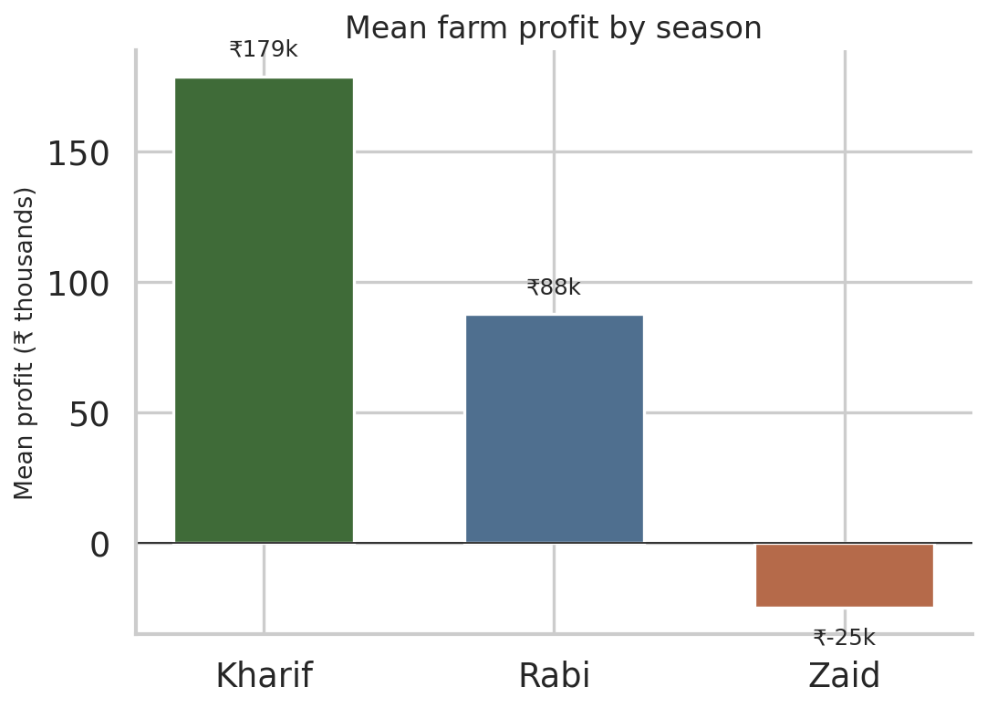
RESULTS

Slide 7
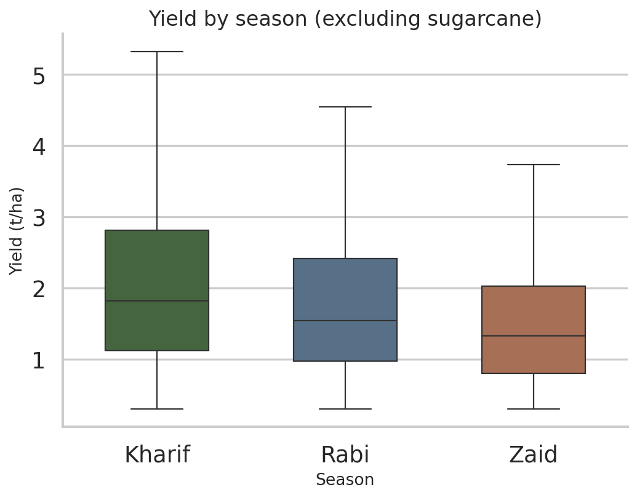
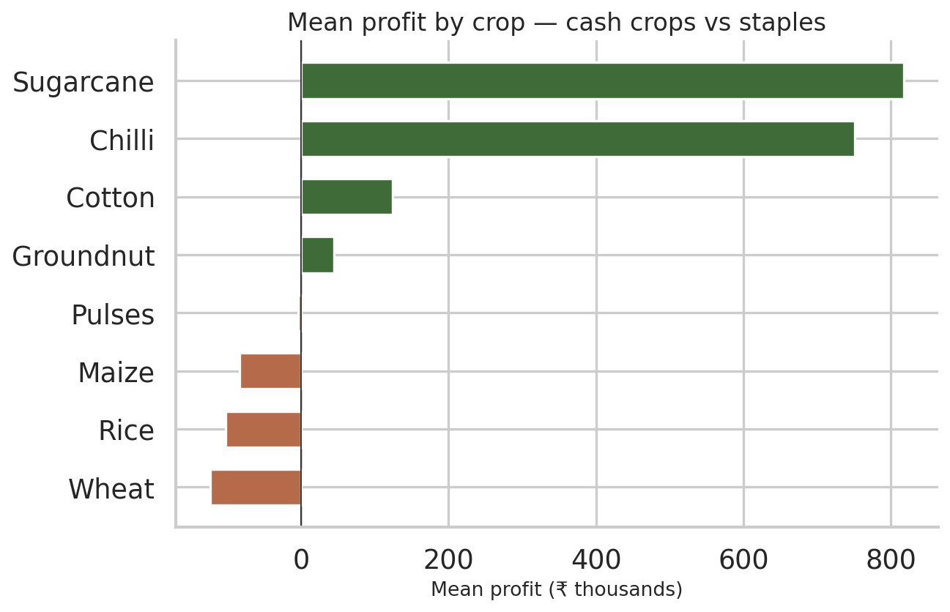
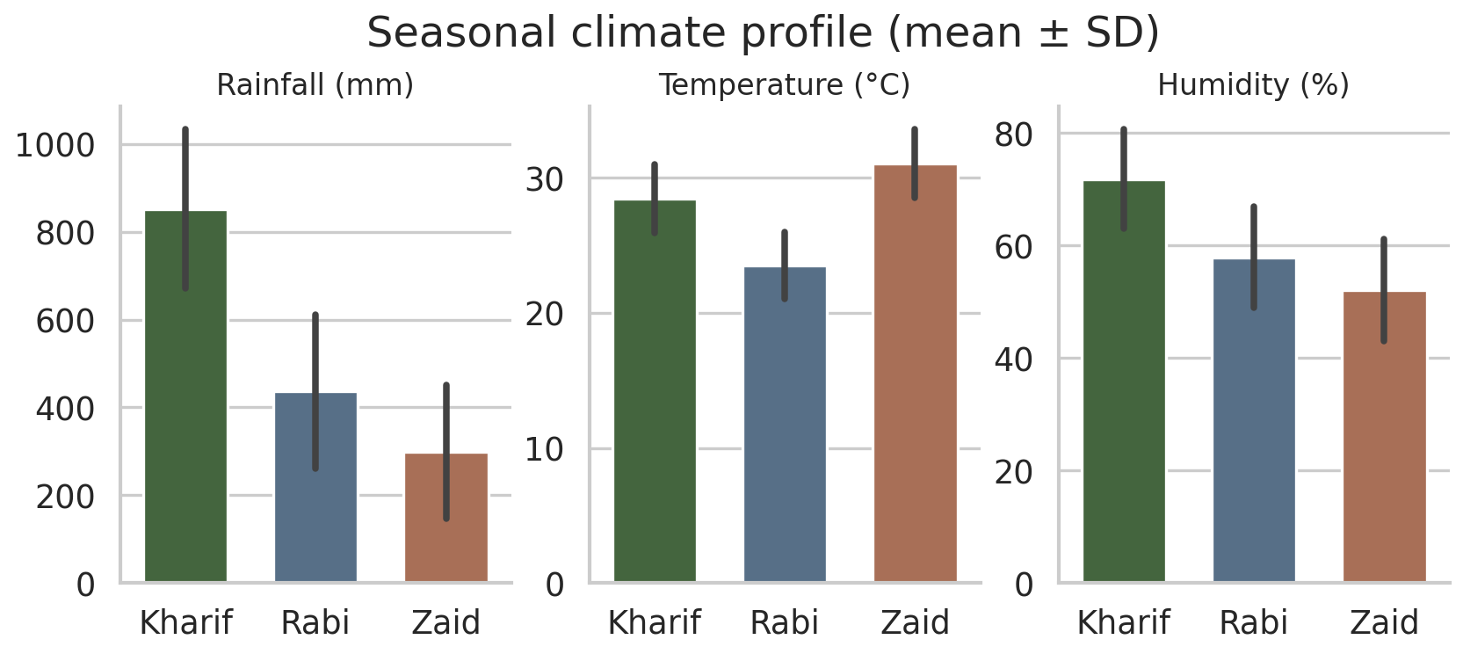
RESULTS

Slide 8
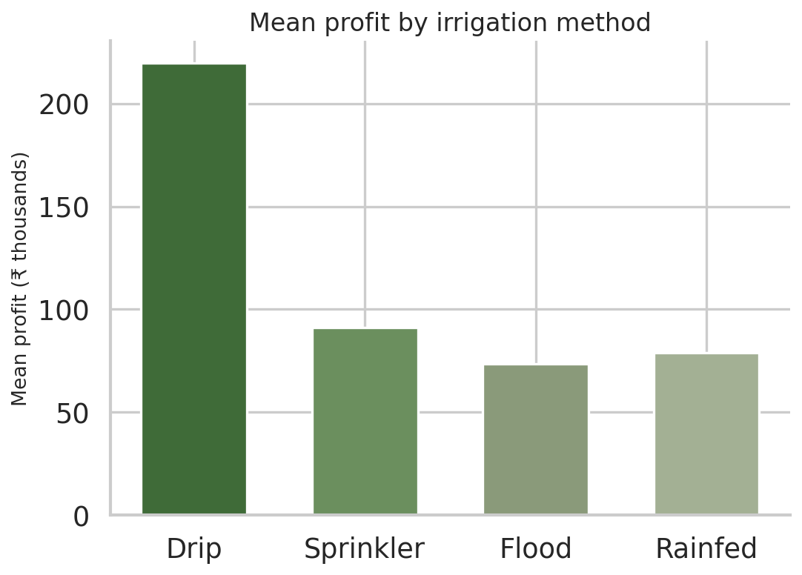
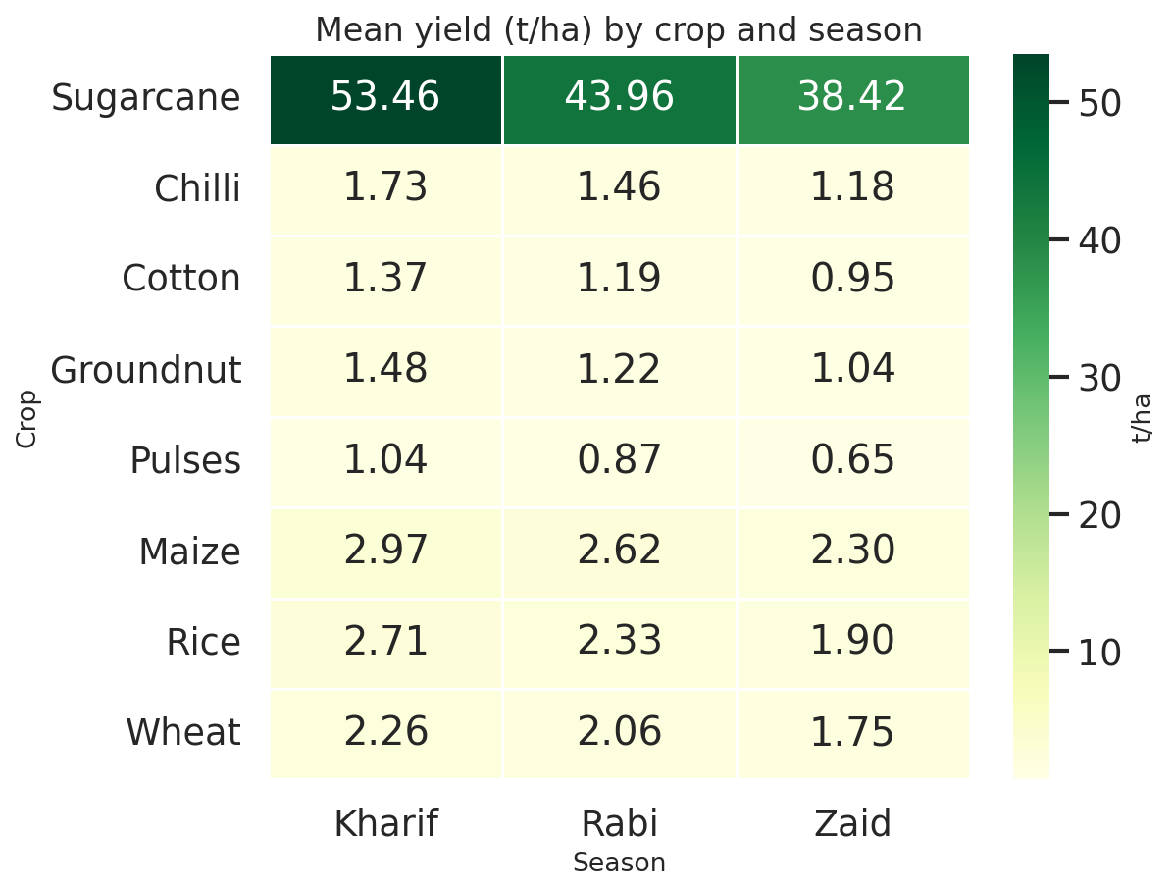
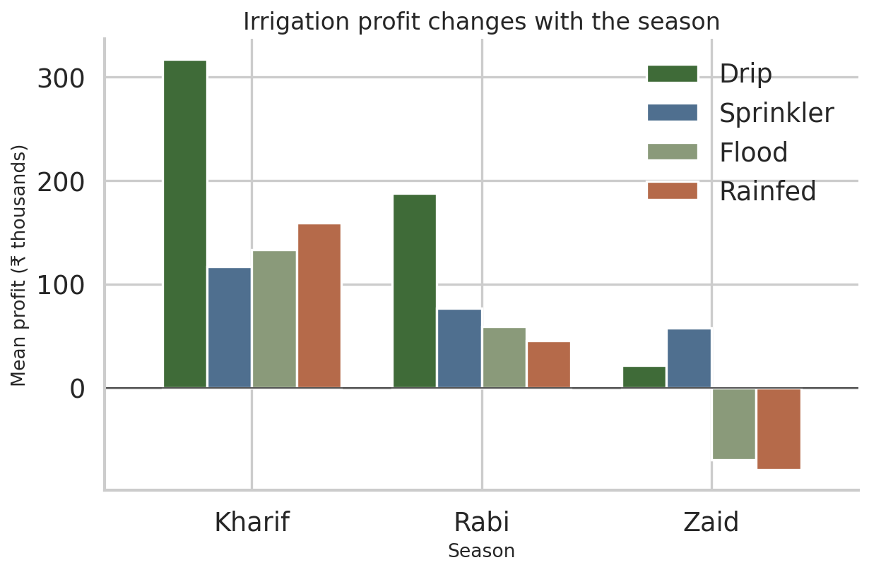
RESULTS

Slide 9
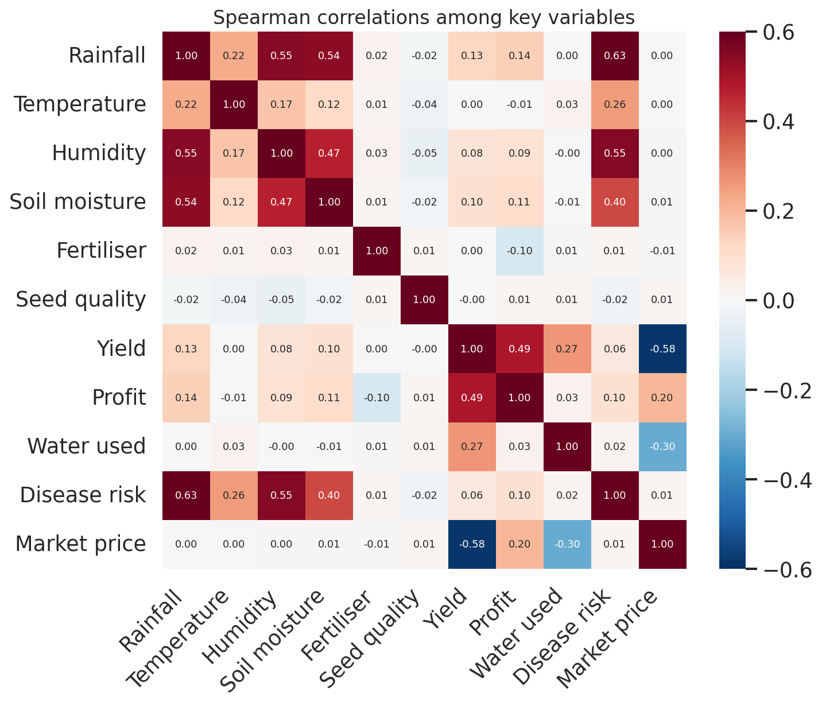
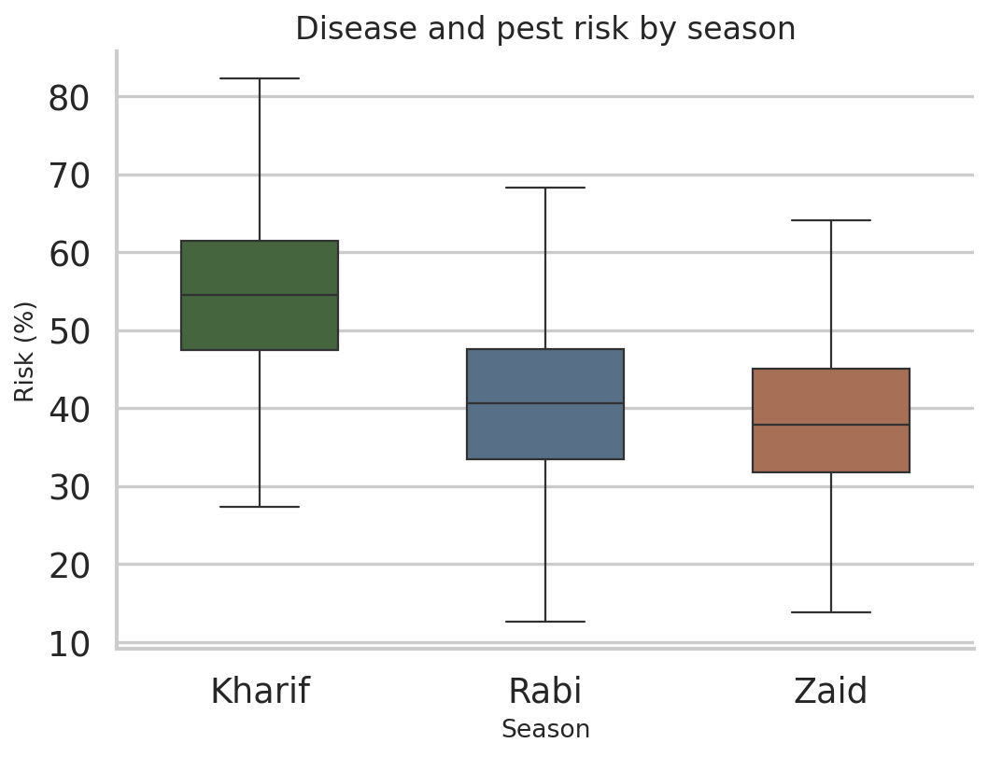
RESULTS

Slide 10
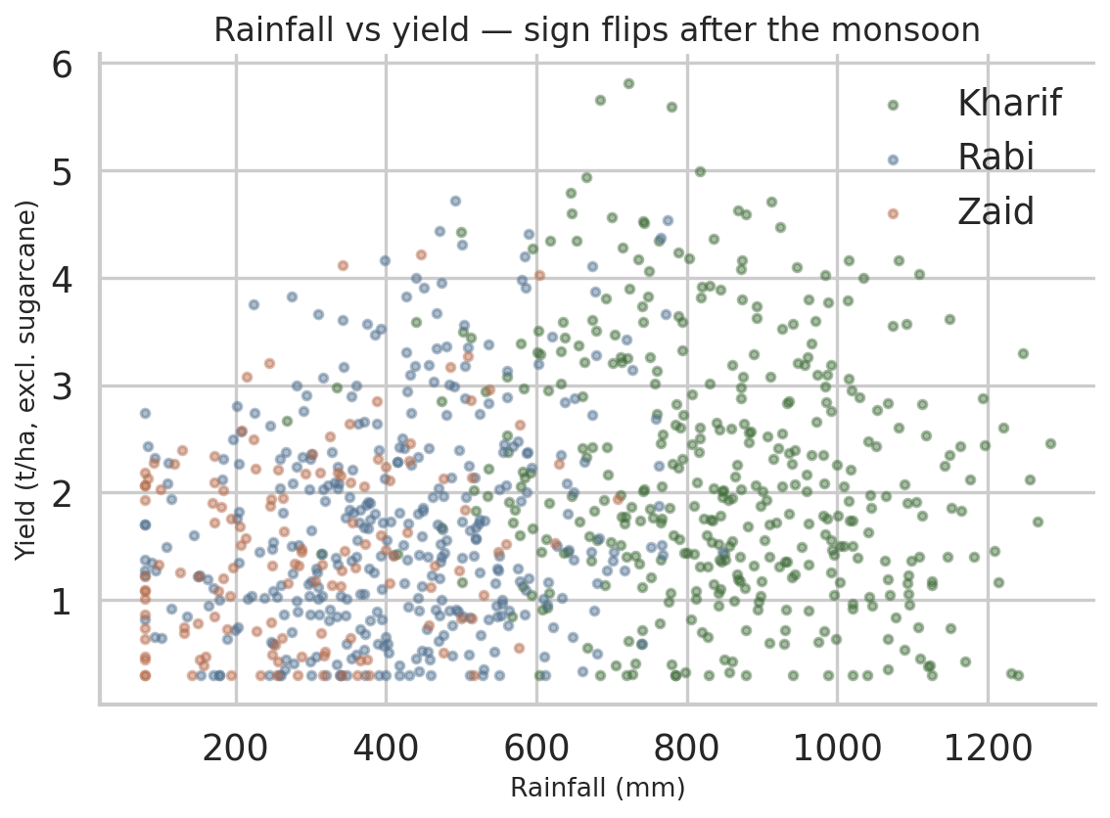
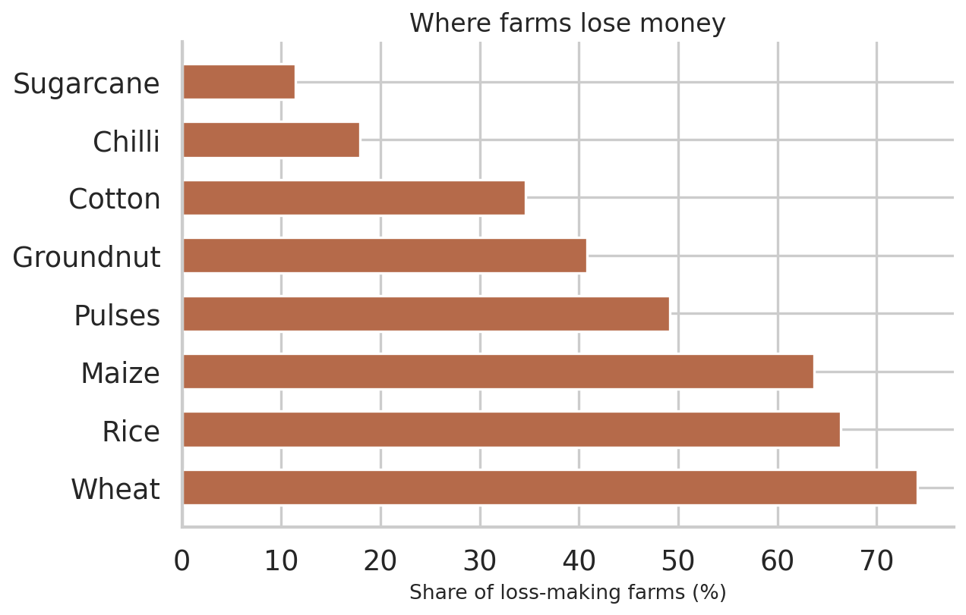
RESULTS

Slide 11
Future scope
1. Predictive Analytics: Develop ML models to predict crop yield and profitability for different seasons.
2. Weather Integration: Incorporate real-time rainfall, temperature, humidity, and weather forecasts.
3. Crop Recommendation: Build a recommendation system suggesting suitable crops based on season, soil, and environmental conditions.
4. Smart Irrigation: Integrate IoT sensors to monitor soil moisture and optimize irrigation.
5. Real-Time Dashboard: Develop a Power BI/Tableau or web dashboard for farmers and agricultural decision-makers.
6. Larger Datasets: Include multi-year and regional data to improve the reliability of insights.
7. Risk Prediction: Predict risks such as low yield, water shortage, and unfavorable seasonal conditions.
8. Cost Optimization: Analyze fertilizer, pesticide, water, and labor costs to identify ways to improve farm profitability.

Slide 12
GitHub Link
https://github.com/srinjoylaha01/VOIS_PROJECT.git

Slide 13

VOIS Course completion certificate -
Course name- Data Visualization
https://voisfortech.com/certificate-verification/VFLMS26_160943/301

Slide 14
Thank you
.
.

