Slide 1
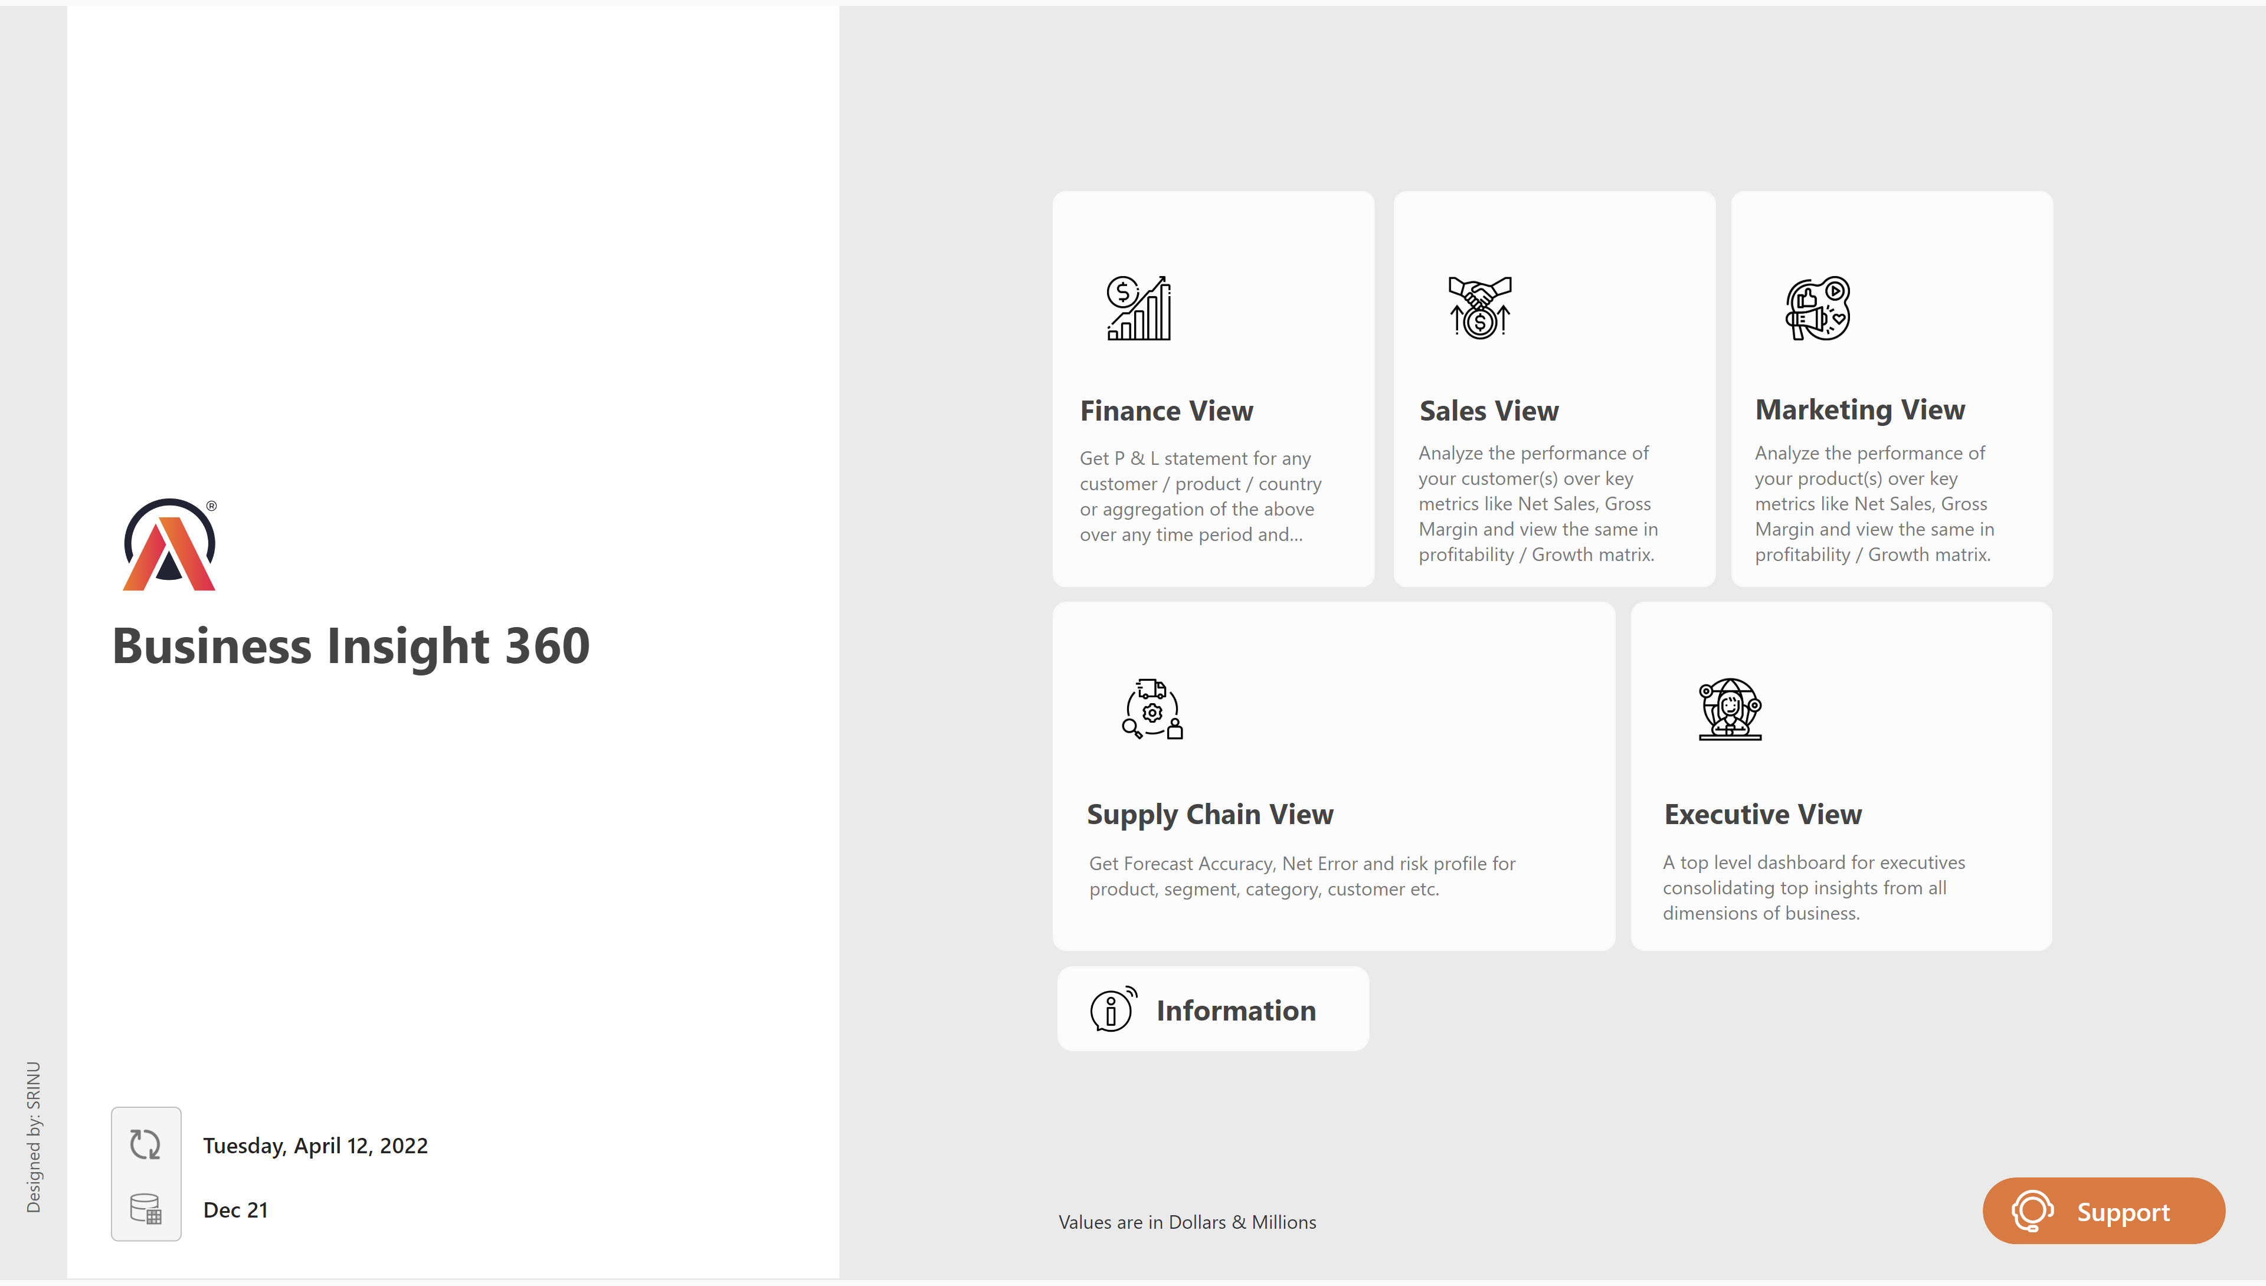
NEW Home
Notes:
image
No alt text provided
image
No alt text provided
actionButton
No alt text provided
shape
No alt text provided
shape
No alt text provided
shape
No alt text provided
image
No alt text provided
image
No alt text provided
image
No alt text provided
cardVisual
No alt text provided
cardVisual
No alt text provided
shape
No alt text provided
shape
No alt text provided
shape
No alt text provided
image
No alt text provided
shape
No alt text provided
shape
No alt text provided
shape
No alt text provided
shape
No alt text provided
shape
No alt text provided
actionButton
No alt text provided
shape
No alt text provided
shape
No alt text provided
shape
No alt text provided
shape
No alt text provided
image
No alt text provided
actionButton
No alt text provided
actionButton
No alt text provided
actionButton
No alt text provided
shape
No alt text provided
shape
No alt text provided
shape
No alt text provided
shape
No alt text provided
shape
No alt text provided
shape
No alt text provided
actionButton
No alt text provided
image
No alt text provided
image
No alt text provided
actionButton
No alt text provided
shape
No alt text provided
actionButton
No alt text provided
actionButton
No alt text provided
shape
No alt text provided
actionButton
No alt text provided
actionButton
No alt text provided
actionButton
No alt text provided
actionButton
No alt text provided
image
No alt text provided
shape
No alt text provided
actionButton
No alt text provided
shape
No alt text provided
shape
No alt text provided
shape
No alt text provided
shape
No alt text provided
shape
No alt text provided
shape
No alt text provided
shape
No alt text provided
shape
No alt text provided
shape
No alt text provided
shape
No alt text provided
actionButton
No alt text provided
shape
No alt text provided
shape
No alt text provided
Support Button
No alt text provided
AB Signature
No alt text provided

Slide 2
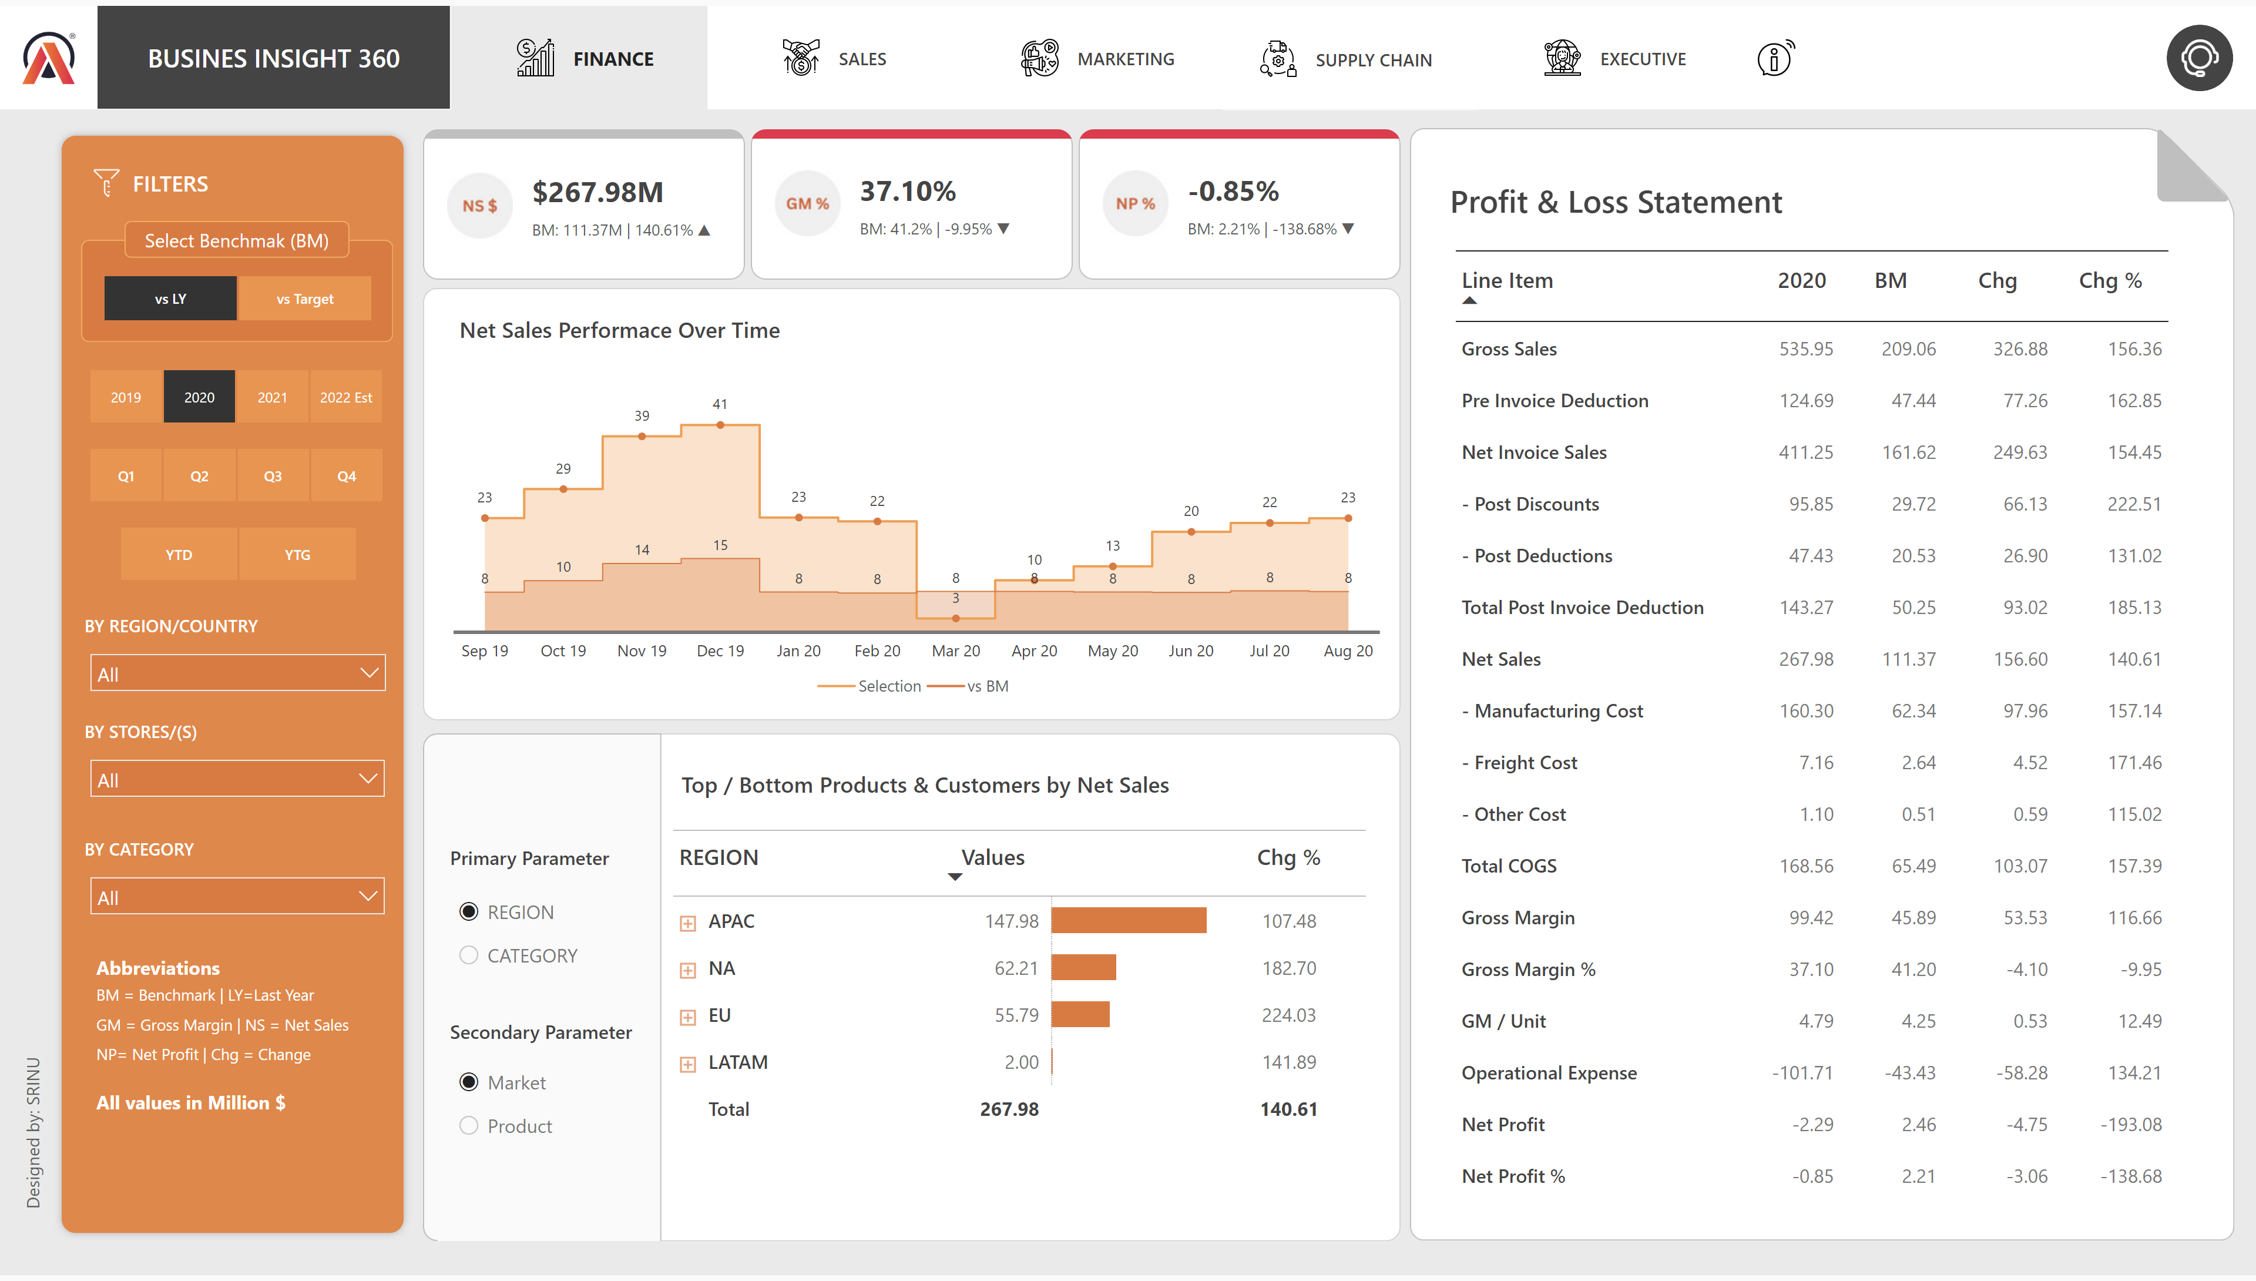
Finance View NEW
Notes:
pivotTable
No alt text provided
Support Button
No alt text provided
shape
No alt text provided
Net Sales Performace Over Time
No alt text provided
pivotTable
No alt text provided
image
No alt text provided
shape
No alt text provided
shape
No alt text provided
shape
No alt text provided
shape
No alt text provided
shape
No alt text provided
shape
No alt text provided
shape
No alt text provided
slicer
No alt text provided
shape
No alt text provided
slicer
No alt text provided
actionButton
No alt text provided
actionButton
No alt text provided
actionButton
No alt text provided
actionButton
No alt text provided
actionButton
No alt text provided
shape
No alt text provided
actionButton
No alt text provided
shape
No alt text provided
shape
No alt text provided
Net Sales
No alt text provided
shape
No alt text provided
actionButton
No alt text provided
shape
No alt text provided
shape
No alt text provided
shape
No alt text provided
shape
No alt text provided
shape
No alt text provided
shape
No alt text provided
shape
No alt text provided
shape
No alt text provided
shape
No alt text provided
shape
No alt text provided
actionButton
No alt text provided
shape
No alt text provided
shape
No alt text provided
actionButton
No alt text provided
shape
No alt text provided
actionButton
No alt text provided
actionButton
No alt text provided
shape
No alt text provided
actionButton
No alt text provided
actionButton
No alt text provided
actionButton
No alt text provided
actionButton
No alt text provided
image
No alt text provided
slicer
No alt text provided
slicer
No alt text provided
slicer
No alt text provided
BY REGION/COUNTRY
No alt text provided
BY CATEGORY
No alt text provided
BY STORES/(S)
No alt text provided
slicer
No alt text provided
shape
No alt text provided
shape
No alt text provided
shape
No alt text provided
shape
No alt text provided
shape
No alt text provided
image
No alt text provided
shape
No alt text provided
shape
No alt text provided
shape
No alt text provided
shape
No alt text provided
AB Signature
No alt text provided

Slide 3
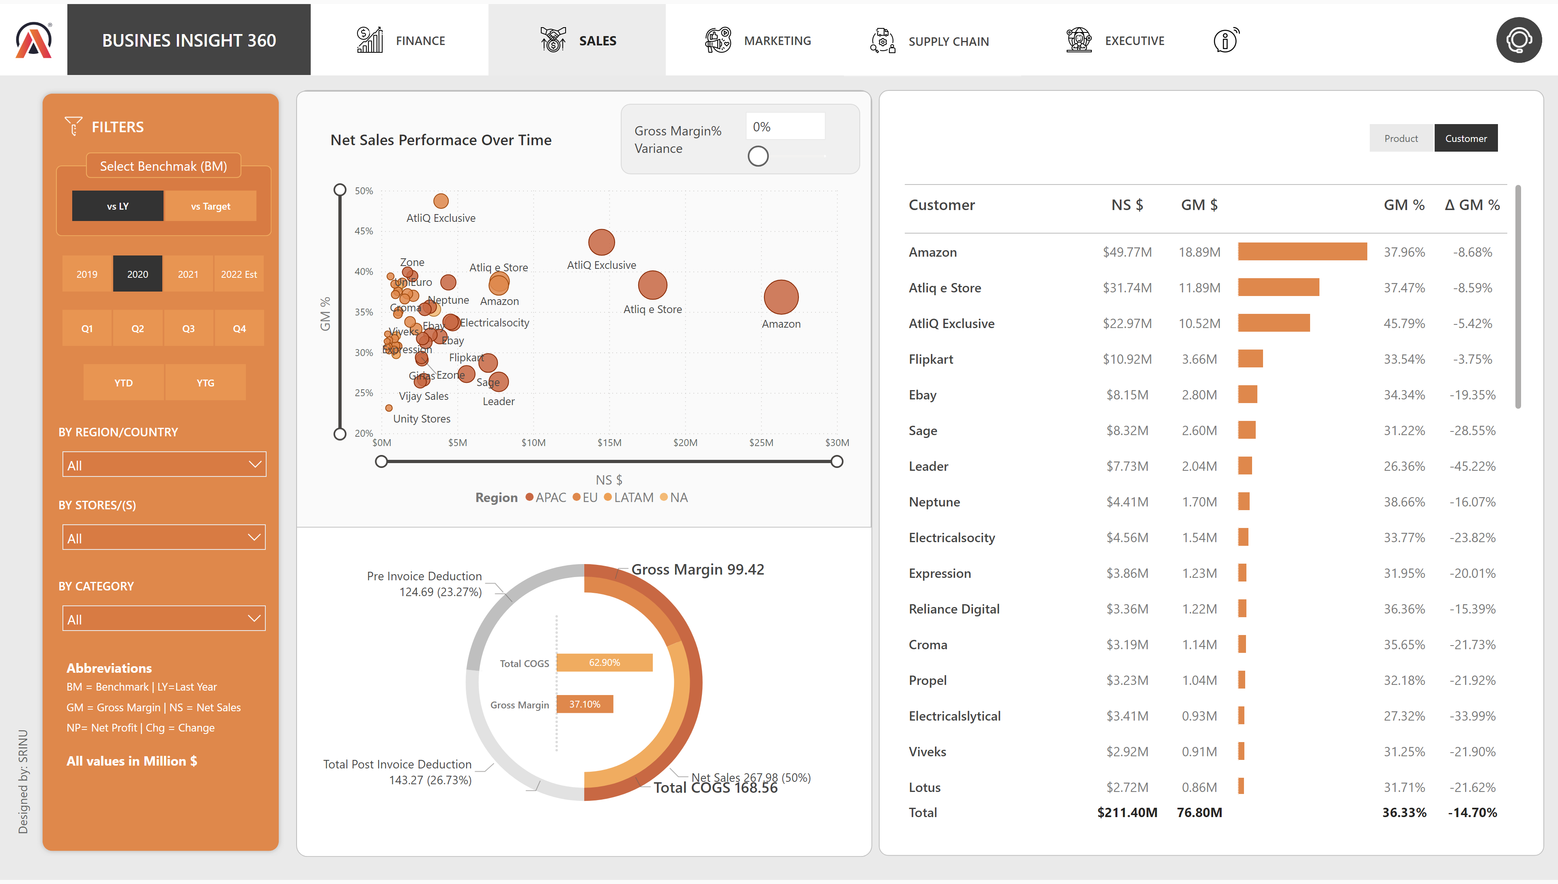
Sales View New
Notes:
image
No alt text provided
shape
No alt text provided
shape
No alt text provided
actionButton
No alt text provided
actionButton
No alt text provided
actionButton
No alt text provided
actionButton
No alt text provided
actionButton
No alt text provided
shape
No alt text provided
actionButton
No alt text provided
pivotTable
No alt text provided
shape
No alt text provided
scatterChart
No alt text provided
slicer
No alt text provided
shape
No alt text provided
shape
No alt text provided
shape
No alt text provided
donutChart
No alt text provided
clusteredBarChart
No alt text provided
donutChart
No alt text provided
slicer
No alt text provided
shape
No alt text provided
shape
No alt text provided
actionButton
No alt text provided
shape
No alt text provided
shape
No alt text provided
shape
No alt text provided
shape
No alt text provided
shape
No alt text provided
shape
No alt text provided
shape
No alt text provided
shape
No alt text provided
shape
No alt text provided
shape
No alt text provided
actionButton
No alt text provided
shape
No alt text provided
shape
No alt text provided
Support Button
No alt text provided
actionButton
No alt text provided
shape
No alt text provided
actionButton
No alt text provided
actionButton
No alt text provided
shape
No alt text provided
actionButton
No alt text provided
actionButton
No alt text provided
actionButton
No alt text provided
actionButton
No alt text provided
image
No alt text provided
AB Signature
No alt text provided
slicer
No alt text provided
slicer
No alt text provided
slicer
No alt text provided
BY REGION/COUNTRY
No alt text provided
BY CATEGORY
No alt text provided
BY STORES/(S)
No alt text provided
slicer
No alt text provided
shape
No alt text provided
shape
No alt text provided
shape
No alt text provided
shape
No alt text provided
shape
No alt text provided
image
No alt text provided
shape
No alt text provided
shape
No alt text provided
shape
No alt text provided
shape
No alt text provided

Slide 4
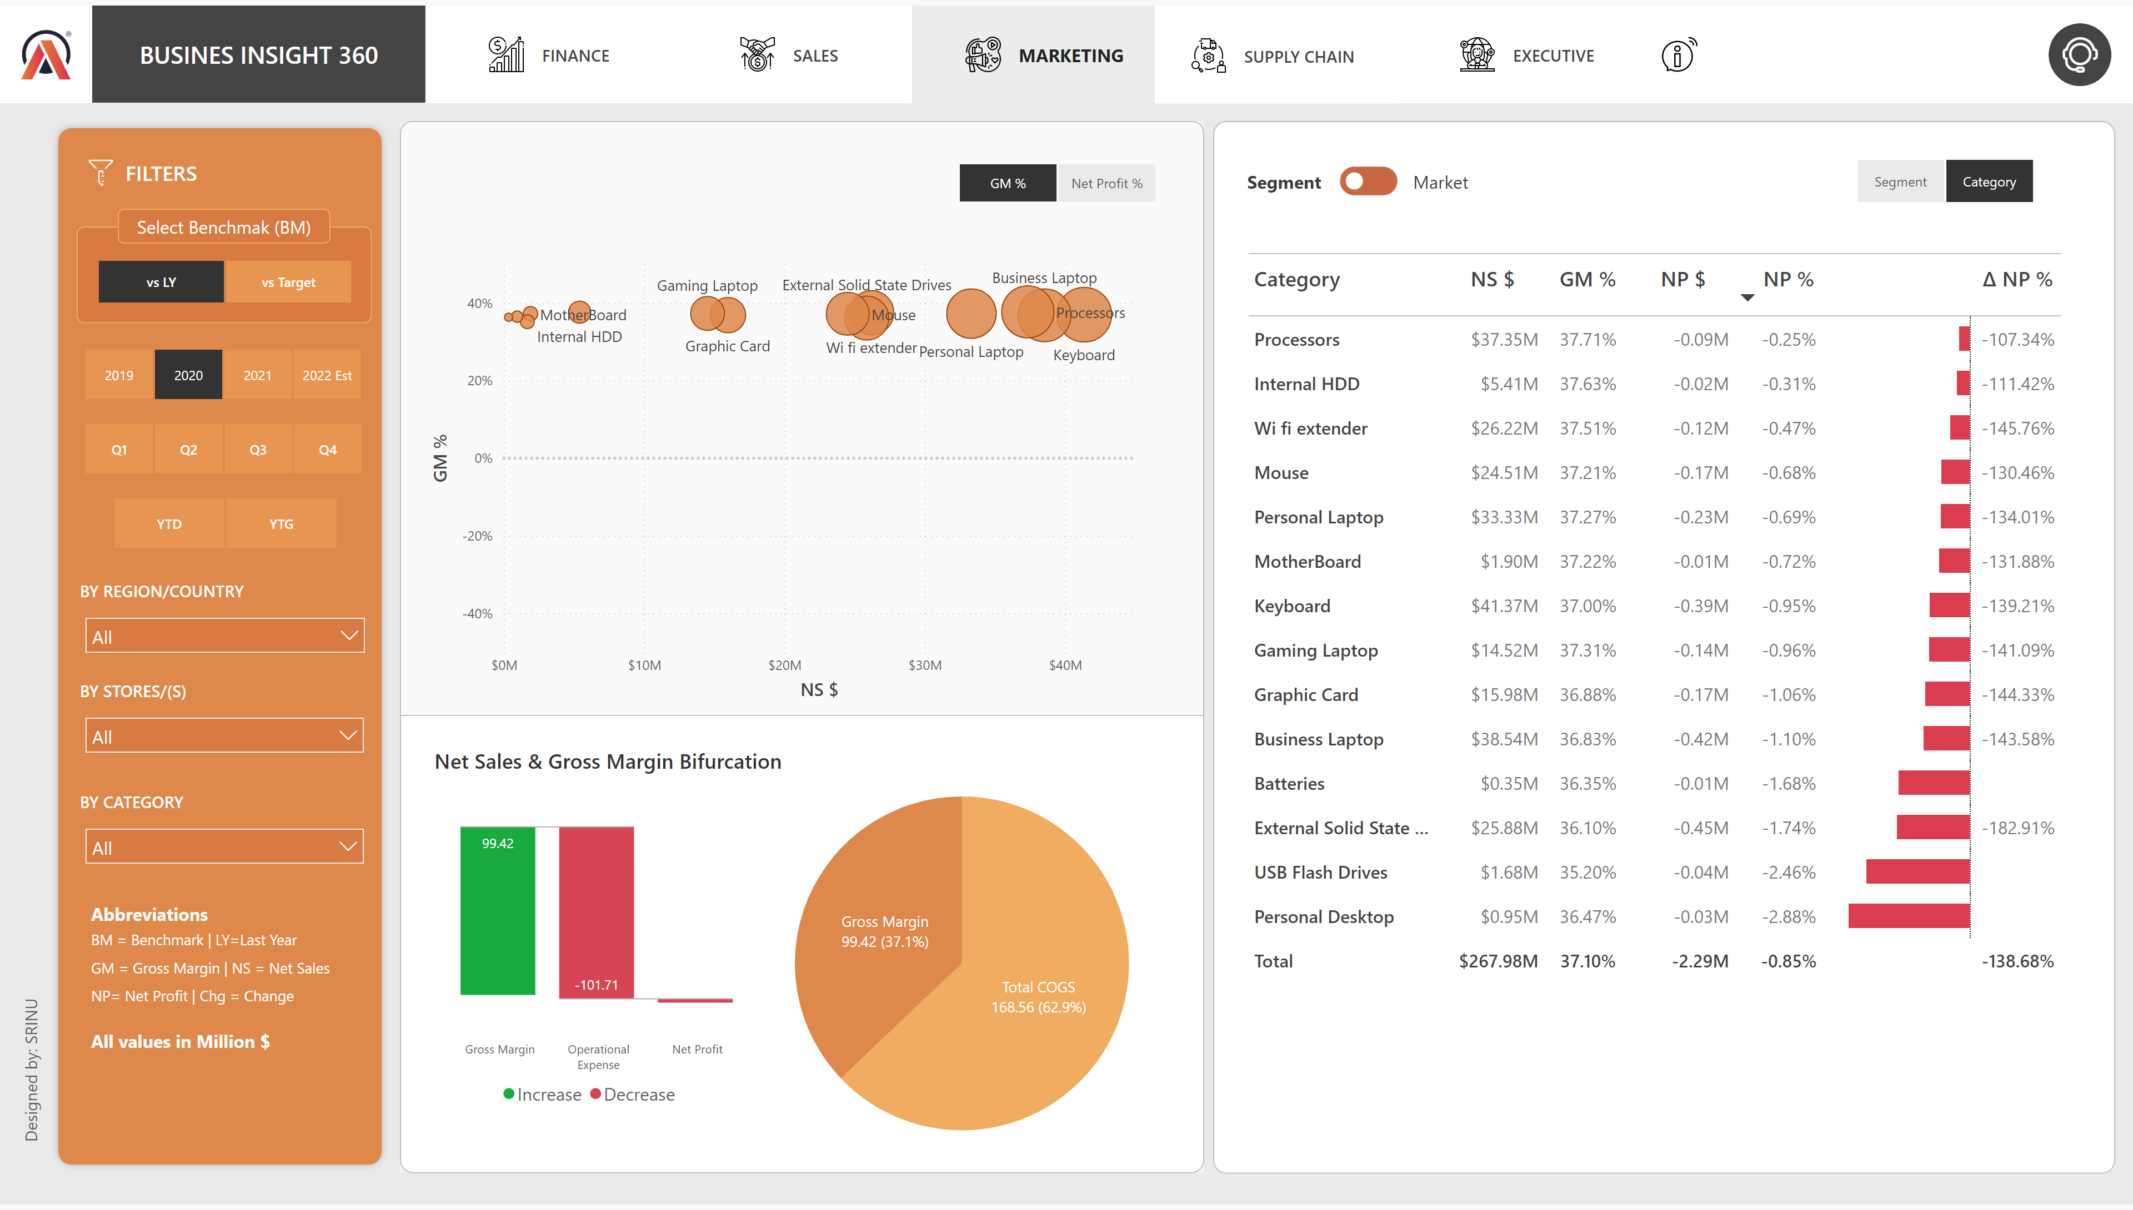
Marketing View New
Notes:
image
No alt text provided
shape
No alt text provided
shape
No alt text provided
actionButton
No alt text provided
actionButton
No alt text provided
actionButton
No alt text provided
actionButton
No alt text provided
actionButton
No alt text provided
shape
No alt text provided
actionButton
No alt text provided
shape
No alt text provided
pieChart
No alt text provided
shape
No alt text provided
slicer
No alt text provided
waterfallChart
No alt text provided
shape
No alt text provided
Lbl TopN Normal
No alt text provided
Lbl All - selected
No alt text provided
pivotTable
No alt text provided
scatterChart
No alt text provided
Toggle Segment ON
No alt text provided
Slicer - PARAM MARKT 03
No alt text provided
scatterChart
No alt text provided
shape
No alt text provided
shape
No alt text provided
pivotTable
No alt text provided
image
No alt text provided
shape
No alt text provided
slicer
No alt text provided
shape
No alt text provided
actionButton
No alt text provided
shape
No alt text provided
shape
No alt text provided
shape
No alt text provided
shape
No alt text provided
shape
No alt text provided
shape
No alt text provided
shape
No alt text provided
shape
No alt text provided
shape
No alt text provided
shape
No alt text provided
actionButton
No alt text provided
shape
No alt text provided
shape
No alt text provided
Support Button
No alt text provided
actionButton
No alt text provided
shape
No alt text provided
actionButton
No alt text provided
actionButton
No alt text provided
shape
No alt text provided
actionButton
No alt text provided
actionButton
No alt text provided
actionButton
No alt text provided
actionButton
No alt text provided
image
No alt text provided
AB Signature
No alt text provided
slicer
No alt text provided
slicer
No alt text provided
slicer
No alt text provided
BY REGION/COUNTRY
No alt text provided
BY CATEGORY
No alt text provided
BY STORES/(S)
No alt text provided
slicer
No alt text provided
shape
No alt text provided
shape
No alt text provided
shape
No alt text provided
shape
No alt text provided
shape
No alt text provided
image
No alt text provided
shape
No alt text provided
shape
No alt text provided
shape
No alt text provided
shape
No alt text provided

Slide 5
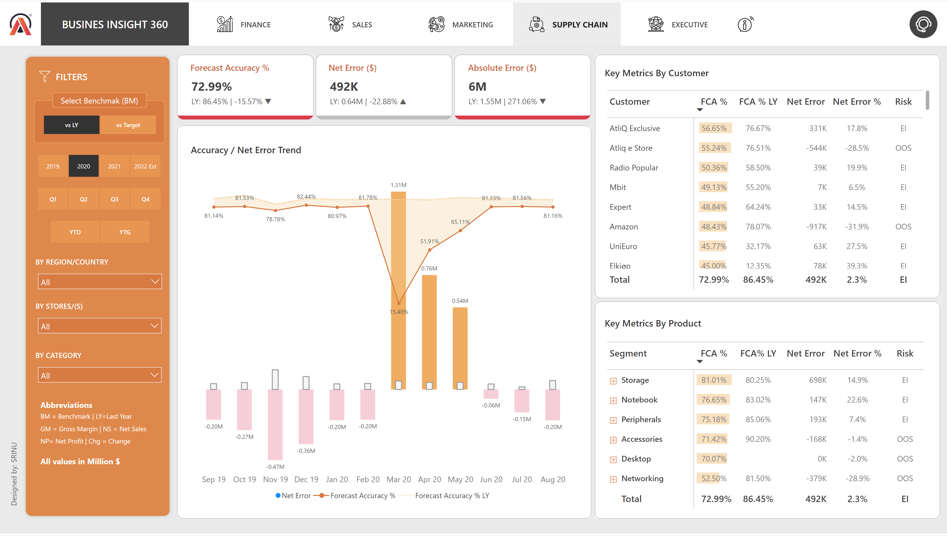
Supply Chain View NEW
Notes:
image
No alt text provided
shape
No alt text provided
shape
No alt text provided
shape
No alt text provided
actionButton
No alt text provided
actionButton
No alt text provided
actionButton
No alt text provided
actionButton
No alt text provided
actionButton
No alt text provided
shape
No alt text provided
actionButton
No alt text provided
shape
No alt text provided
Net Sales
No alt text provided
Net Sales Performace Over Time
No alt text provided
pivotTable
No alt text provided
shape
No alt text provided
shape
No alt text provided
pivotTable
No alt text provided
shape
No alt text provided
shape
No alt text provided
actionButton
No alt text provided
shape
No alt text provided
shape
No alt text provided
shape
No alt text provided
shape
No alt text provided
shape
No alt text provided
shape
No alt text provided
shape
No alt text provided
shape
No alt text provided
shape
No alt text provided
shape
No alt text provided
actionButton
No alt text provided
shape
No alt text provided
shape
No alt text provided
actionButton
No alt text provided
shape
No alt text provided
shape
No alt text provided
shape
No alt text provided
actionButton
No alt text provided
shape
No alt text provided
actionButton
No alt text provided
actionButton
No alt text provided
shape
No alt text provided
actionButton
No alt text provided
actionButton
No alt text provided
actionButton
No alt text provided
actionButton
No alt text provided
image
No alt text provided
AB Signature
No alt text provided
slicer
No alt text provided
slicer
No alt text provided
slicer
No alt text provided
BY REGION/COUNTRY
No alt text provided
BY CATEGORY
No alt text provided
BY STORES/(S)
No alt text provided
slicer
No alt text provided
shape
No alt text provided
shape
No alt text provided
shape
No alt text provided
shape
No alt text provided
shape
No alt text provided
image
No alt text provided
shape
No alt text provided
shape
No alt text provided
shape
No alt text provided
shape
No alt text provided

Slide 6
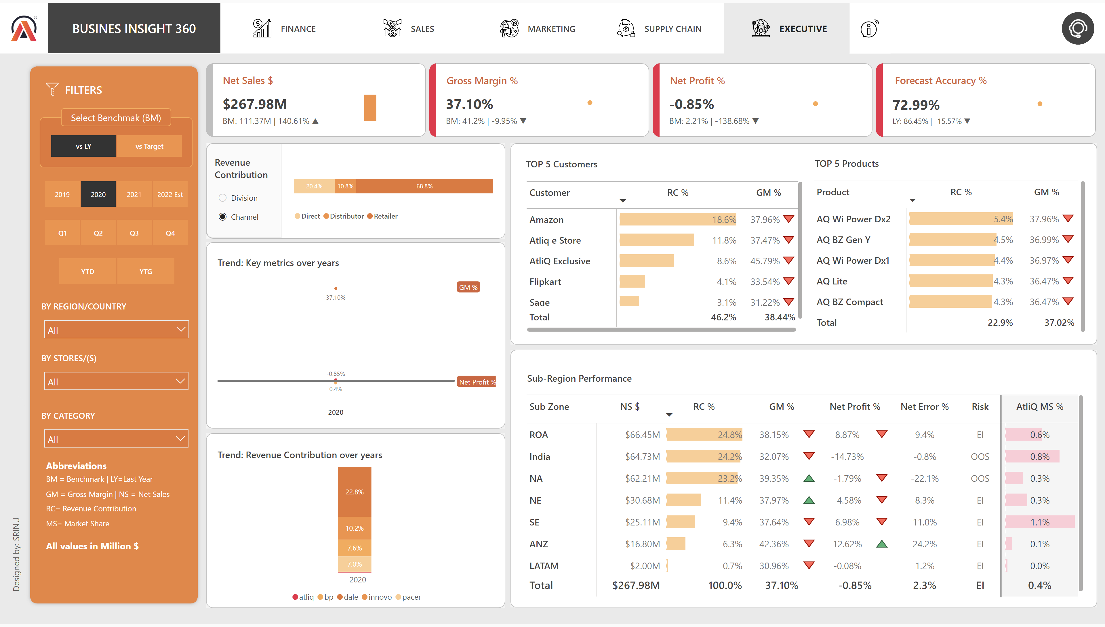
Executive View NEW
Notes:
image
No alt text provided
shape
No alt text provided
shape
No alt text provided
shape
No alt text provided
actionButton
No alt text provided
actionButton
No alt text provided
actionButton
No alt text provided
actionButton
No alt text provided
actionButton
No alt text provided
shape
No alt text provided
actionButton
No alt text provided
Support Button
No alt text provided
shape
No alt text provided
Net Sales
No alt text provided
ribbonChart
No alt text provided
shape
No alt text provided
areaChart
No alt text provided
clusteredColumnChart
No alt text provided
shape
No alt text provided
shape
No alt text provided
shape
No alt text provided
pivotTable
No alt text provided
shape
No alt text provided
pivotTable
No alt text provided
slicer
No alt text provided
areaChart
No alt text provided
areaChart
No alt text provided
hundredPercentStackedBarChart
No alt text provided
pivotTable
No alt text provided
shape
No alt text provided
shape
No alt text provided
shape
No alt text provided
shape
No alt text provided
shape
No alt text provided
shape
No alt text provided
shape
No alt text provided
shape
No alt text provided
shape
No alt text provided
areaChart
No alt text provided
shape
No alt text provided
shape
No alt text provided
shape
No alt text provided
shape
No alt text provided
shape
No alt text provided
shape
No alt text provided
shape
No alt text provided
shape
No alt text provided
shape
No alt text provided
shape
No alt text provided
shape
No alt text provided
actionButton
No alt text provided
actionButton
No alt text provided
shape
No alt text provided
shape
No alt text provided
actionButton
No alt text provided
shape
No alt text provided
actionButton
No alt text provided
actionButton
No alt text provided
shape
No alt text provided
actionButton
No alt text provided
actionButton
No alt text provided
actionButton
No alt text provided
actionButton
No alt text provided
image
No alt text provided
AB Signature
No alt text provided
slicer
No alt text provided
slicer
No alt text provided
slicer
No alt text provided
BY REGION/COUNTRY
No alt text provided
BY CATEGORY
No alt text provided
BY STORES/(S)
No alt text provided
slicer
No alt text provided
shape
No alt text provided
shape
No alt text provided
shape
No alt text provided
shape
No alt text provided
shape
No alt text provided
image
No alt text provided
shape
No alt text provided
shape
No alt text provided
shape
No alt text provided
shape
No alt text provided
shape
No alt text provided

Slide 7
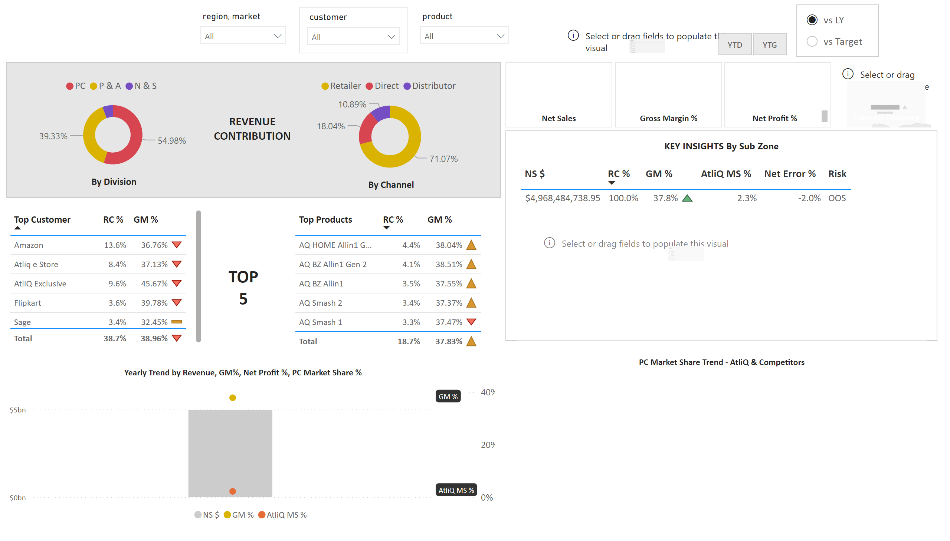
Page 1
Notes:
card
No alt text provided
tableEx
No alt text provided
textbox
No alt text provided
shape
No alt text provided
textbox
No alt text provided
donutChart
No alt text provided
textbox
No alt text provided
donutChart
No alt text provided
shape
No alt text provided
textbox
No alt text provided
textbox
No alt text provided
lineClusteredColumnComboChart
No alt text provided
textbox
No alt text provided
tableEx
No alt text provided
tableEx
No alt text provided
textbox
No alt text provided
slicer
No alt text provided
slicer
No alt text provided
slicer
No alt text provided
slicer
No alt text provided
slicer
No alt text provided
Benchmarks
No alt text provided
slicer
No alt text provided
kpi
No alt text provided
textbox
No alt text provided
kpi
No alt text provided
textbox
No alt text provided
kpi
No alt text provided
textbox
No alt text provided
kpi
No alt text provided
textbox
No alt text provided

