Slide 1

TASTEHUB: A CROSS-PLATFORM FOOD ORDERING SYSTEM USING MERN AND REACT NATIVE
Seshadri Rao Gudlavalleru Engineering College, Gudlavalleru
Department of Computer Science and Engineering
By
T. Yasasvi Sai Sree 22481A05N3
V. Srinu 22481A05O0
V. Vivek 22481A05O6
P. Sowmya 22481A05K2
Under the guidance of
Mr. M. N. Satish Kumar, M.Tech (PhD)
Assistant Professor, Department of CSE

Slide 2
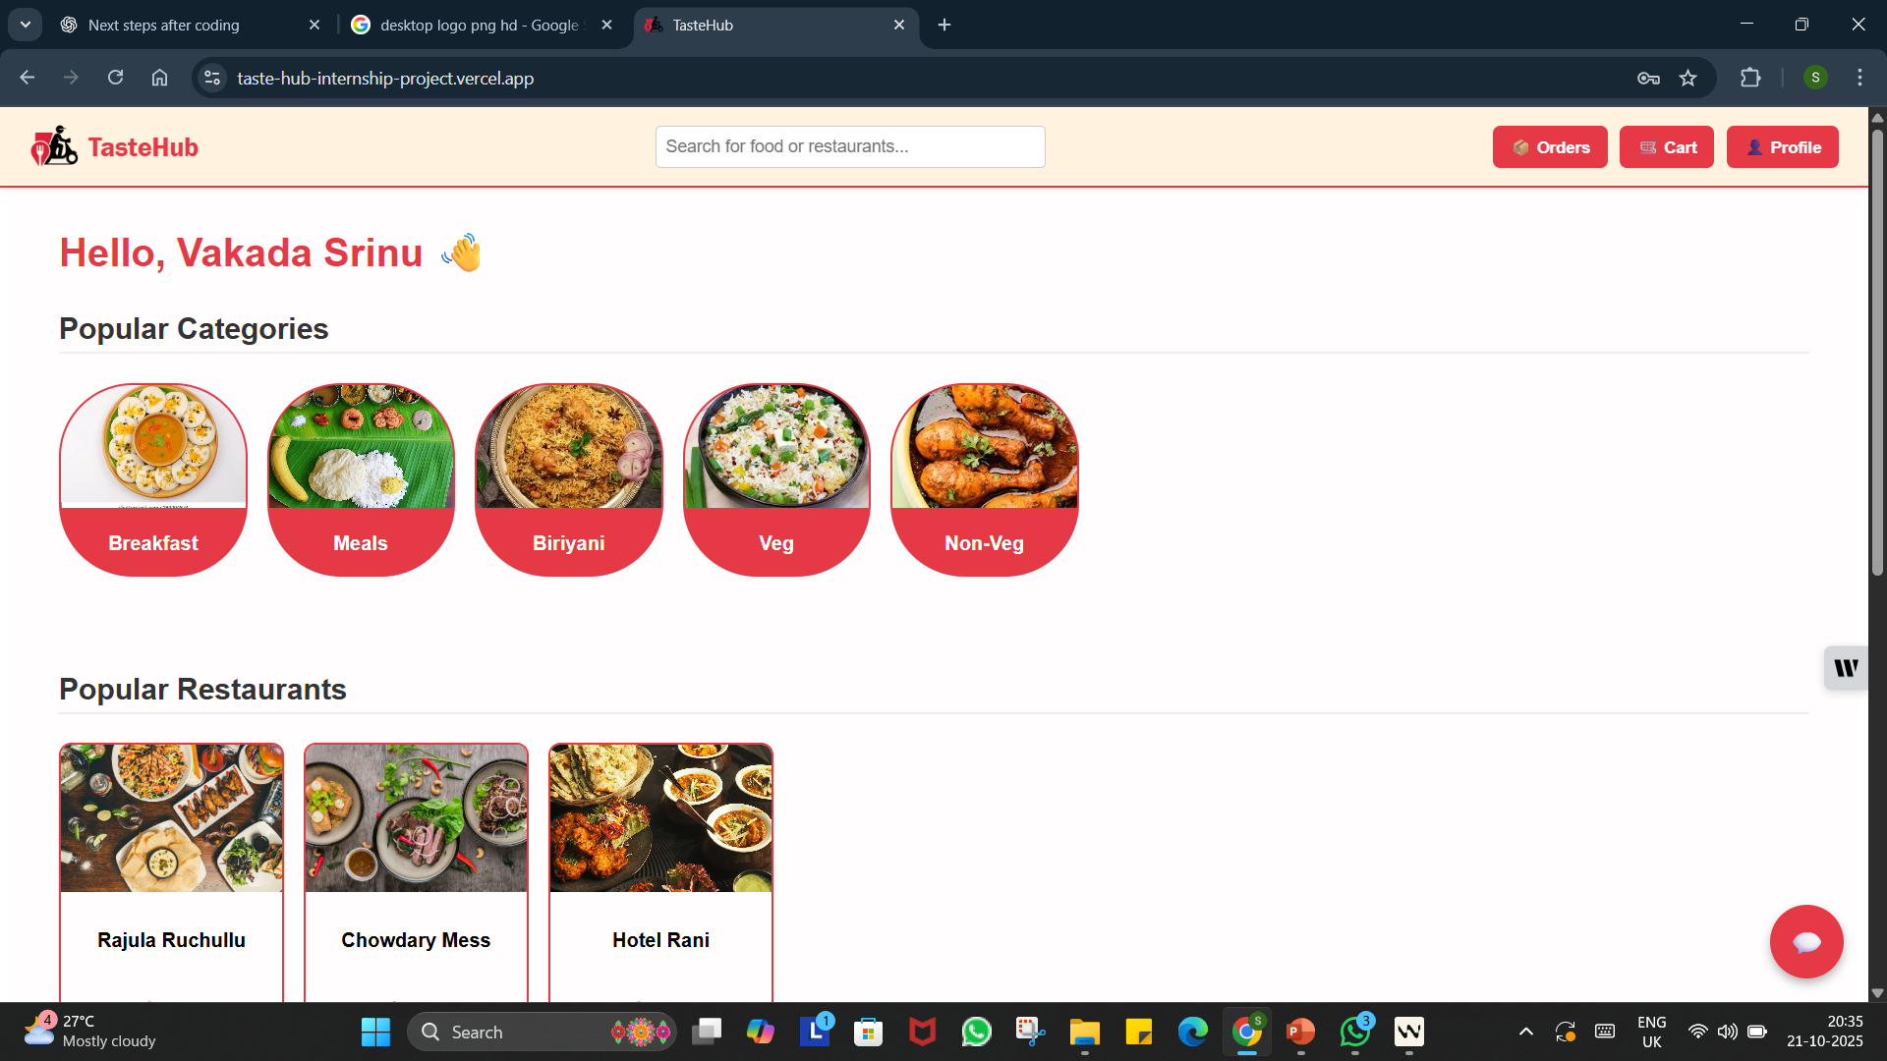

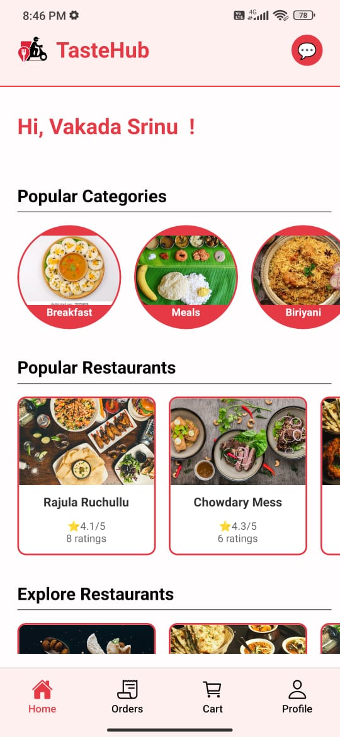
TasteHub: A Cross-platform Food Ordering System Using Mern And React Native

Slide 3
Abstract
Taste Hub is a cross-platform food ordering system designed to provide a smooth and convenient experience for customers. Users can browse a variety of restaurants, explore detailed menus with images and categories, add items to their cart, place orders, and track delivery status in real time. To enhance user interaction and support, the system integrates an AI intelligent chatbot named Taste Bot, which assists users by answering queries, suggesting dishes, and providing restaurant recommendations thereby improving engagement and accessibility. Restaurants can also manage their menus, view incoming orders, and track order status, making the platform useful for both customers and restaurant owners.

Slide 4
Objectives
Develop a cross‑platform food ordering system: Build TasteHub for web and mobile to let users discover nearby restaurants, browse digital menus, place online orders, and track deliveries in real time.
Enhance UX with intelligent chatbot integration: Integrate TasteBot (AI chatbot) to answer queries, recommend dishes/restaurants, view order status and adding/removing items to cart.
Provide restaurant management and order tracking: Enable partners to update menus, manage incoming orders, monitor statuses.
Ensure seamless synchronization across platforms: Use React, React Native, Node.js, Express, and MongoDB to synchronize menu changes, order status, and availability instantly across web and mobile.
Implement secure backend architecture: Design a robust backend with authentication, and fault tolerance; support concurrent users.
Deliver modern UI and accessibility: Create an intuitive, responsive interface with clear menu layouts, simple cart flows, and smooth transitions for inclusive access across devices.

Slide 5
Problem Statement
Users often open a food app and feel overwhelmed by a flood of options, making it hard to quickly decide what to eat or where to order from. Without clear guidance that reflects their tastes, dietary needs, and context, decision-making becomes slow and frustrating. At the same time, many checkout experiences still involve multiple screens and repetitive steps, so users want a quick, minimal‑tap ordering flow that gets them from discovery to confirmation in seconds. When questions arise—about availability, recommendations, or order issues—help isn’t instant; a smart assistant like TasteBot can provide conversational answers, dish suggestions, and shortcuts to actions right when they’re needed

Slide 6
Literature Review
Online food delivery platforms enhance user convenience by connecting customers with multiple restaurants through a single digital interface.
Restaurant management systems improve operational efficiency by digitizing menus, orders, and customer interactions.
Chatbot-assisted ordering increases user engagement and simplifies the ordering process through conversational interfaces.
MERN stack–based applications provide scalability, modularity, and faster development for full-stack web solutions.
Secure authentication, responsive design, and API-based communication foster reliability and real-time performance in food ordering systems.

Slide 7
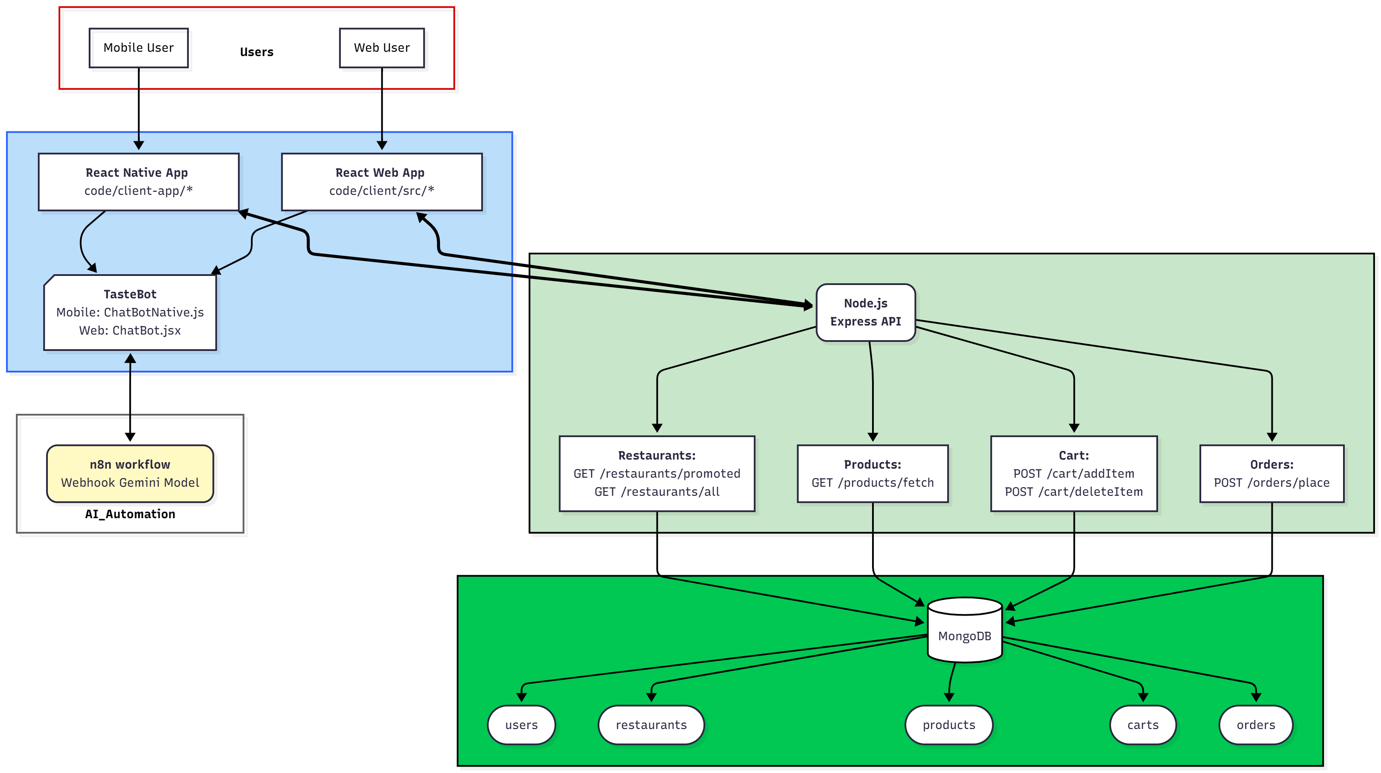



Methodology
Frontend
Backend
Database

Slide 8
Implementation
The TasteHub system is developed using the MERN Stack:
MongoDB: NoSQL database. Stores data in collections.
Express.js: Backend framework to build RESTful APIs and handle server requests.
React.js: Frontend library to design responsive and dynamic web interfaces.
Node.js: Server-side runtime for handling concurrent user requests efficiently
Backend Implementation
NodeJS and ExpressJS
REST APIs
Routes and controllers
Passwords hashing using bcrypt
Database connected via Mongoose
Frontend Implementation
React and React Native
Axios for API calls
React Context
Postman API Testing
Expo Go for app development
MongoDB Database
Collections created using Models
Collections:
Users, Restaurants
Admin
Cart
Product
Orders

Slide 9
User Modules
User registration and login with validation.
View all restaurants and promoted ones.
Browse food categories and updates cart.
Place, track, and cancel orders in real-time.
Chatbot Modules
Integrated AI-based chatbot
Assists users in finding restaurants ,food items and updating Cart Items.
Visible only to authenticated users
Restaurant Modules
Register/login to access restaurant dashboard.
Add, update, or delete food products.
View and manage orders received from users.
Update order status in real time.
Admin Modules
Admin login and dashboard view.
Display total users and restaurants count.
Manages list of all and promoted restaurants.
Promotes restaurants in the dashboard.

Slide 10
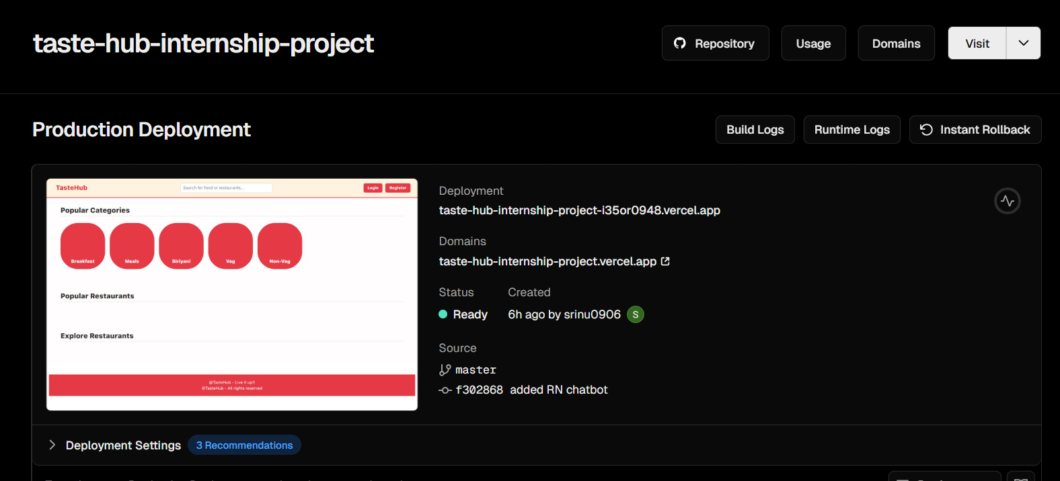
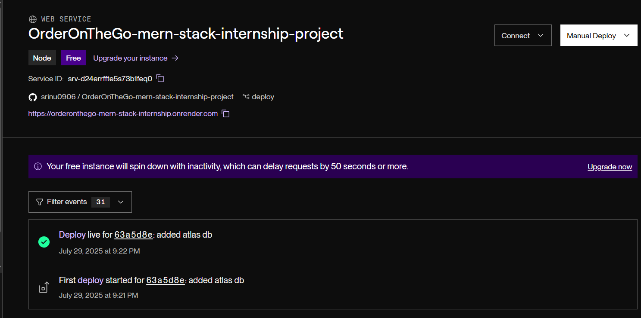
Deployment
Frontend
Web app : Deployed on Vercel.com
Android: Exported using Expo GO
Source code imported from Github repository.
Backend
Hosted on Render.com
Code imported from Github repository

Slide 11
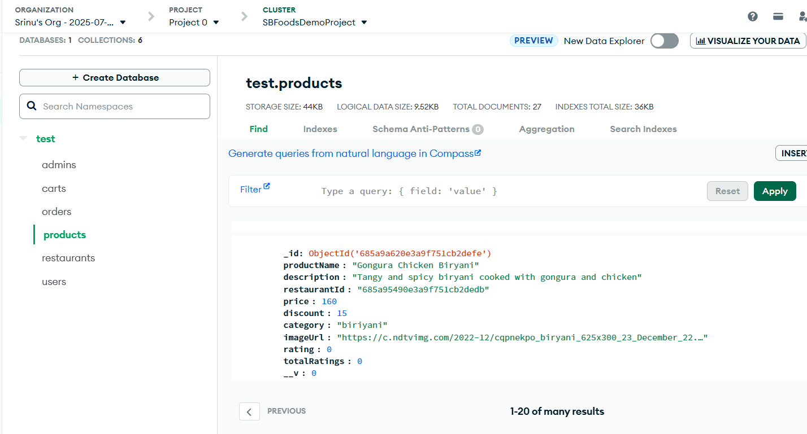
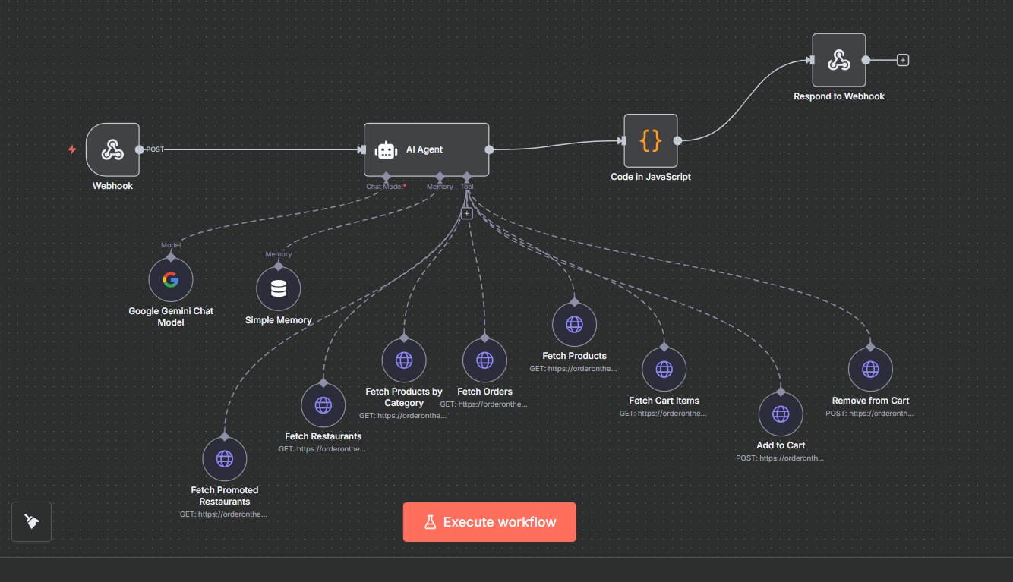
Database
Hosted in MongoDB Atlas
Free cluster supports upto 512mb data.
TasteBot
Created a workflow in n8n.
Uses Google Gemini chat model.
Responds through webhook.

Slide 12
Results
User Dashboards (web and android)

Slide 13
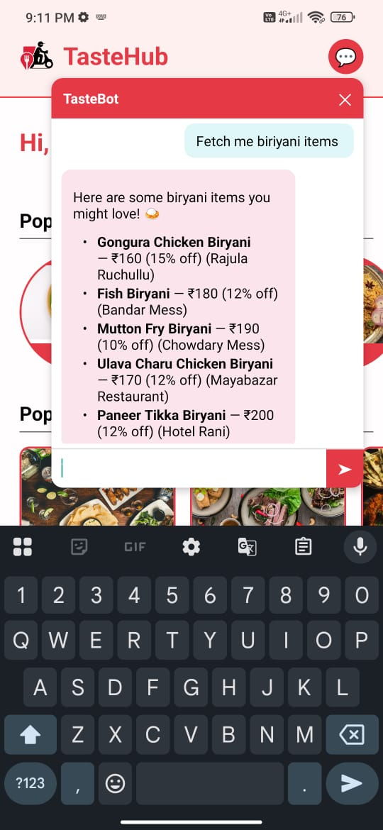
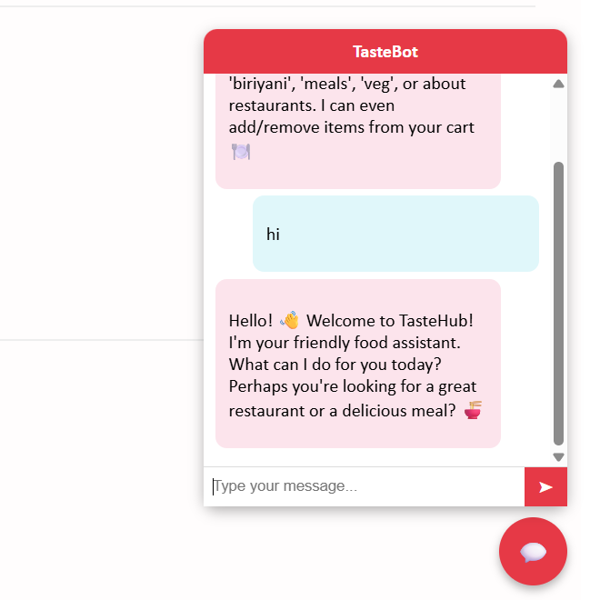
TasteBots (web and android)

Slide 14
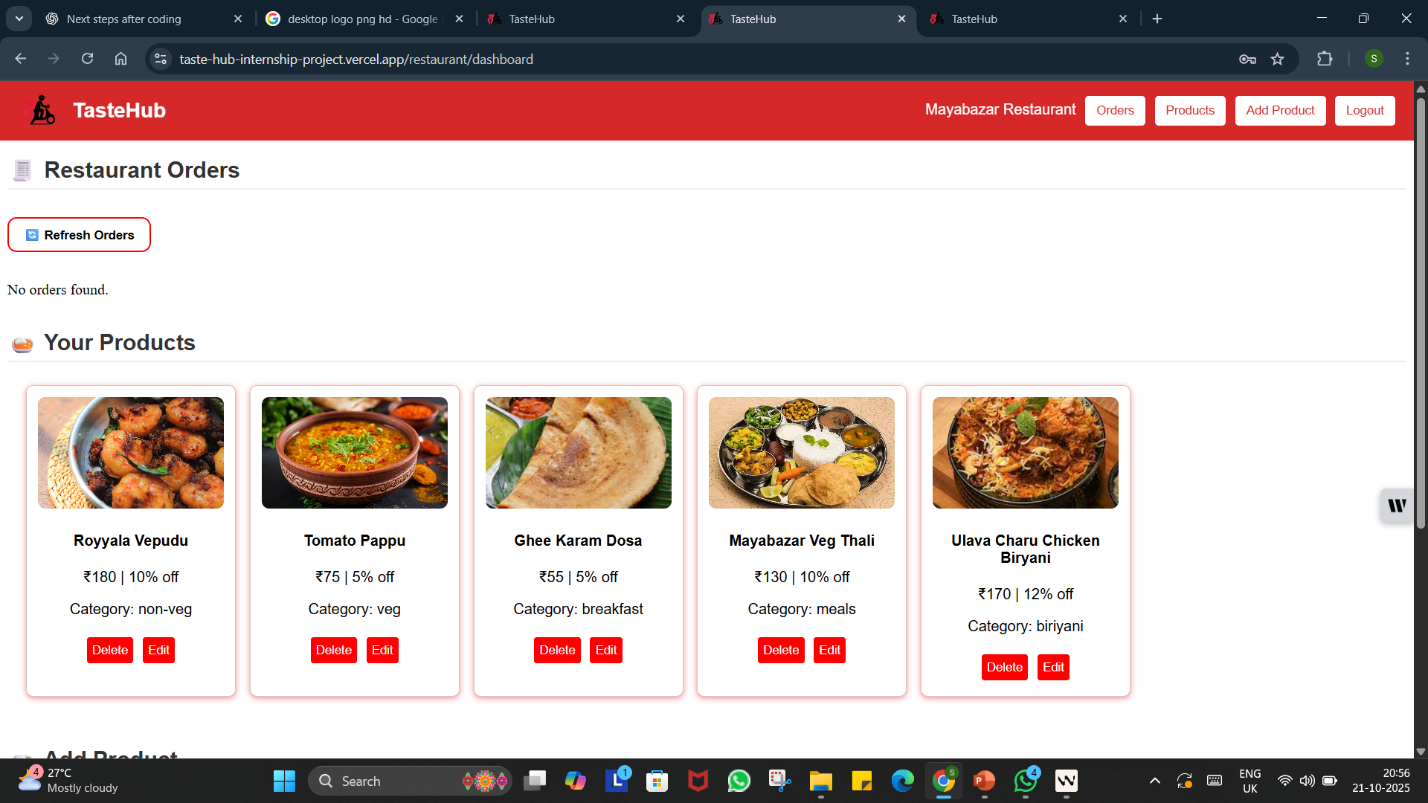
Restaurant Dashboard

Slide 15
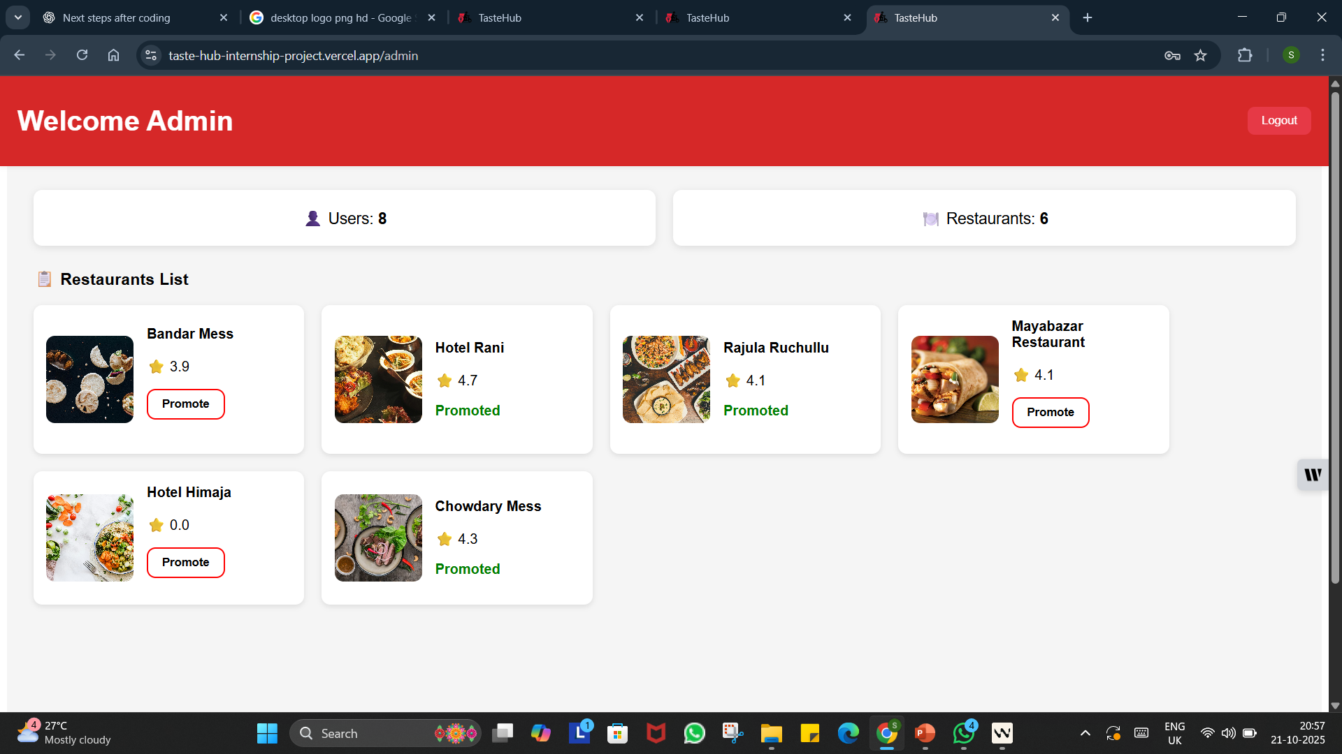
Admin Dashboard

Slide 16
Conclusion
The Taste Hub platform demonstrates an end-to-end online food ordering system connecting users, restaurants, and administrators through a unified interface. It enables customers to browse restaurants, explore menus, add items to cart, and place orders seamlessly. Restaurants can efficiently manage products, view and process orders, improving service efficiency. The admin dashboard ensures platform-wide control by managing restaurants and promotions. The integration of a chatbot assistant (Taste Bot) enhances user engagement by offering instant responses and suggestions. Overall, the project provides a scalable, user-friendly, and interactive food ordering solution, reflecting real-world application scenarios.

Slide 17

THANK YOU____

