Slide 1
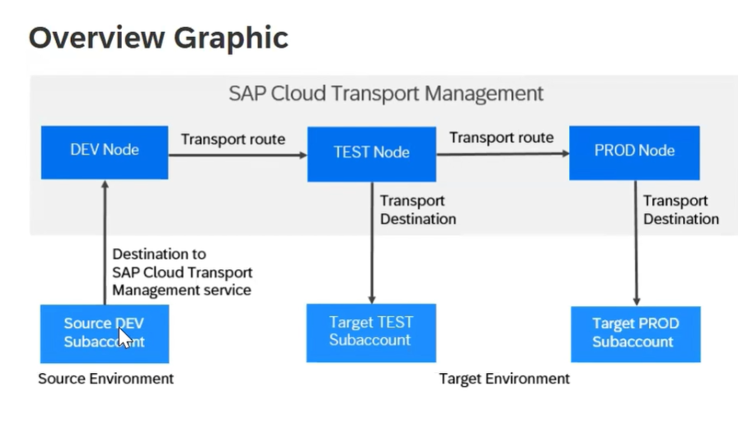
CTMS

Slide 2
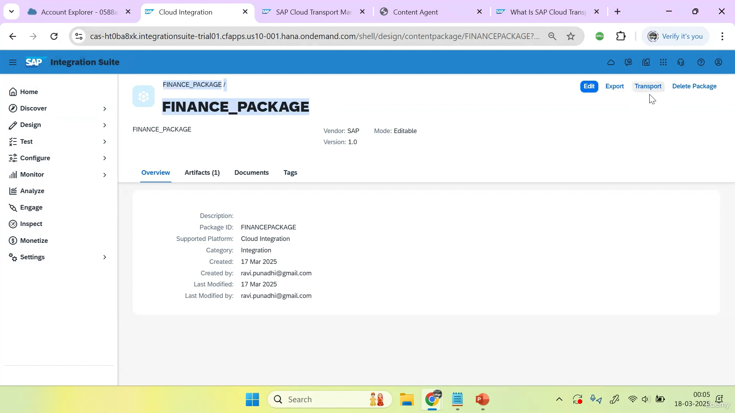
click on transport

Slide 3
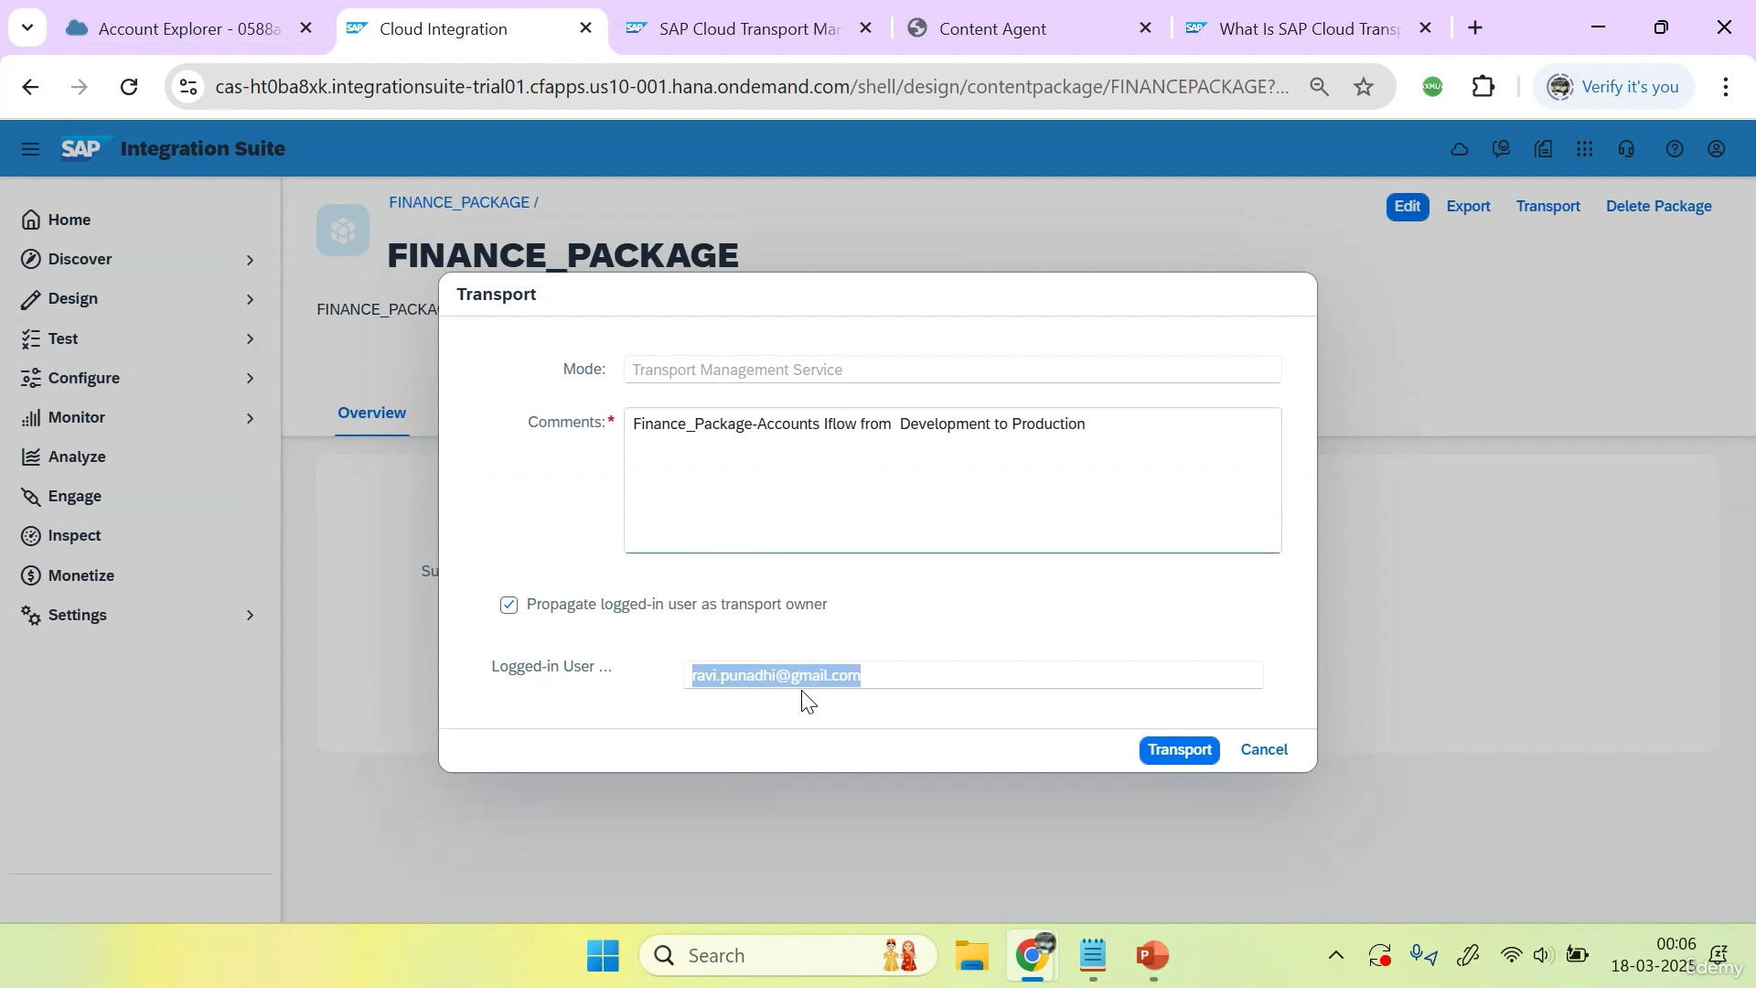
Give the comment and check propagate and click on the transport

Slide 4
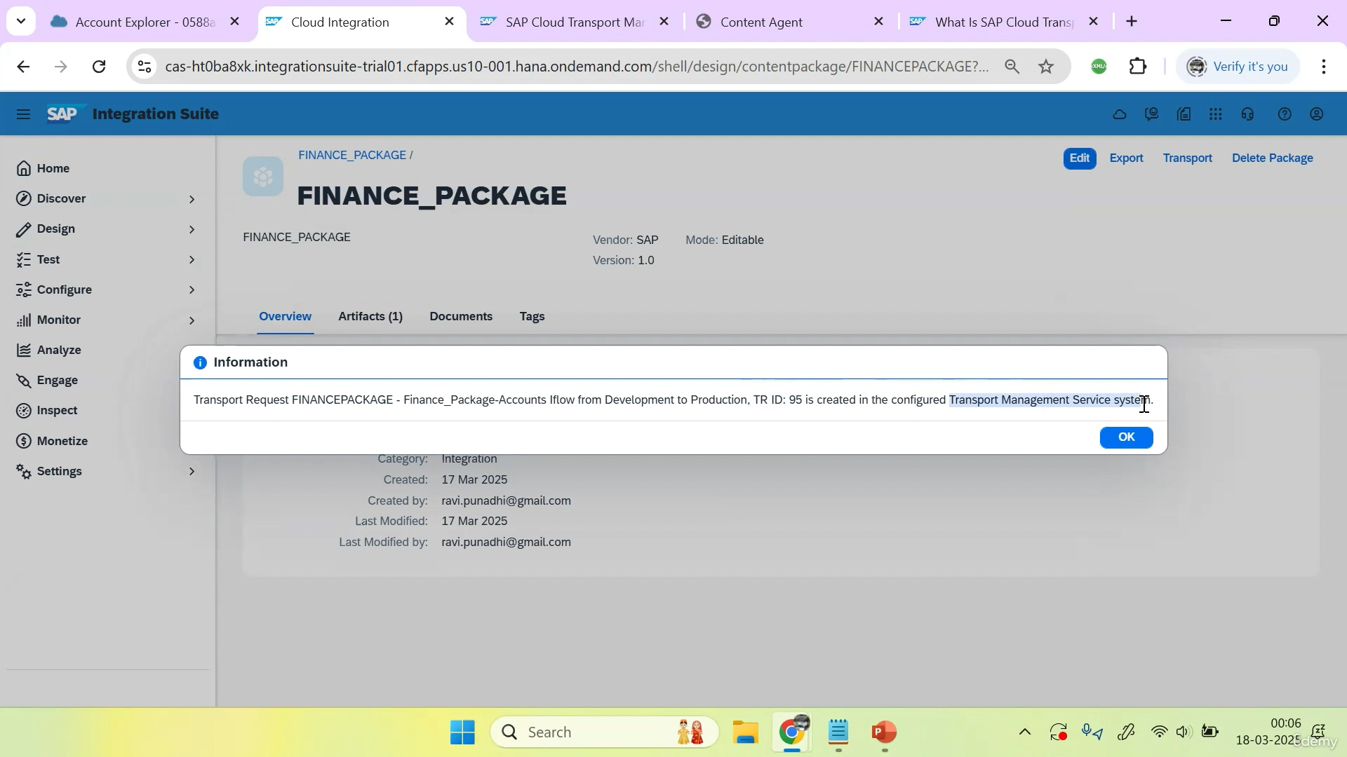

Slide 5
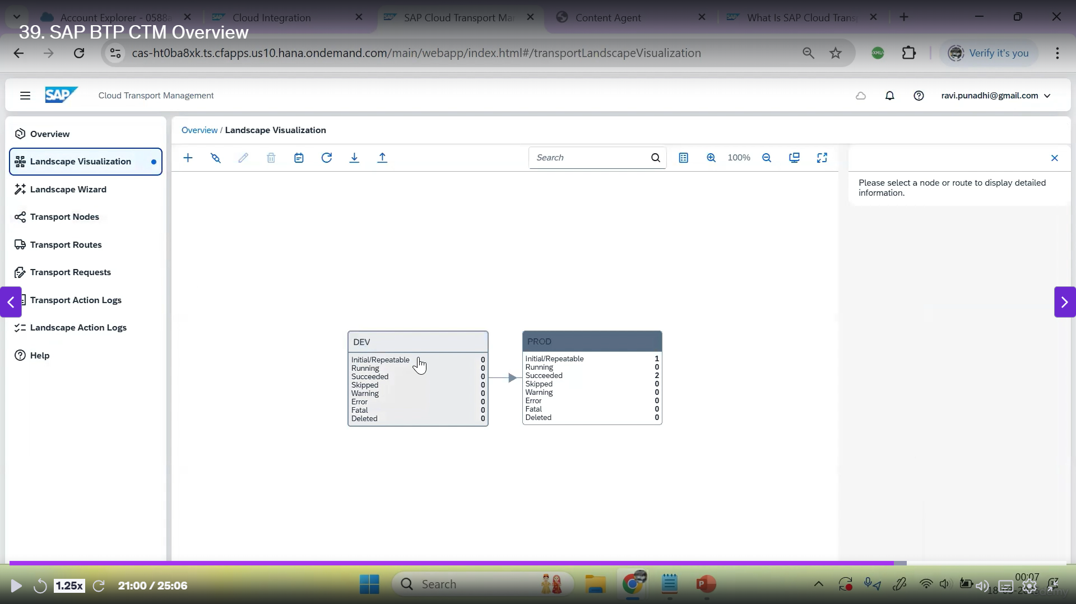
Now go to cloud transport management and go to landscape visualization

Slide 6
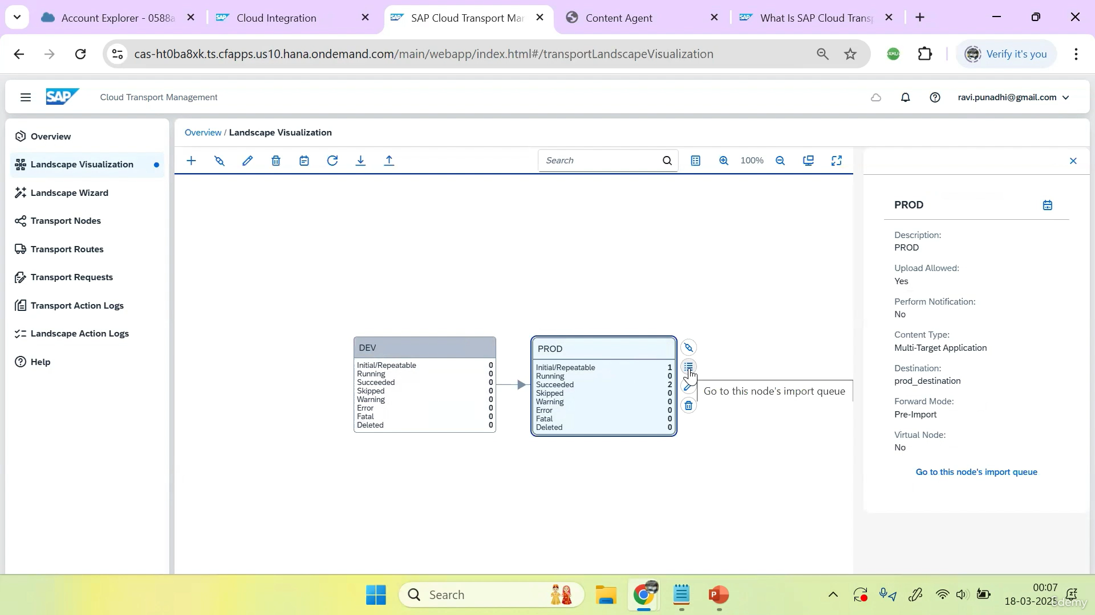
Click on production and go to nodes import queue

Slide 7
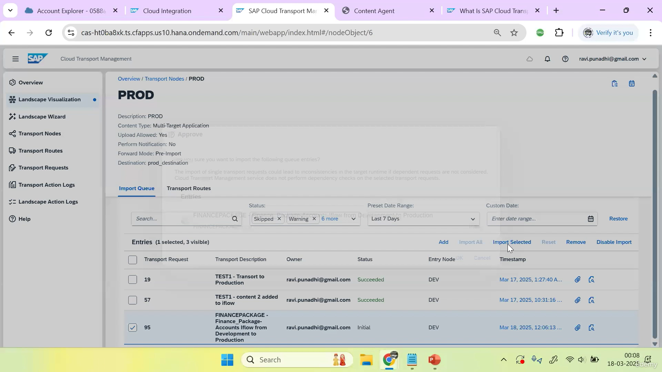
Now check desired package to import and click on the import selected

Slide 8
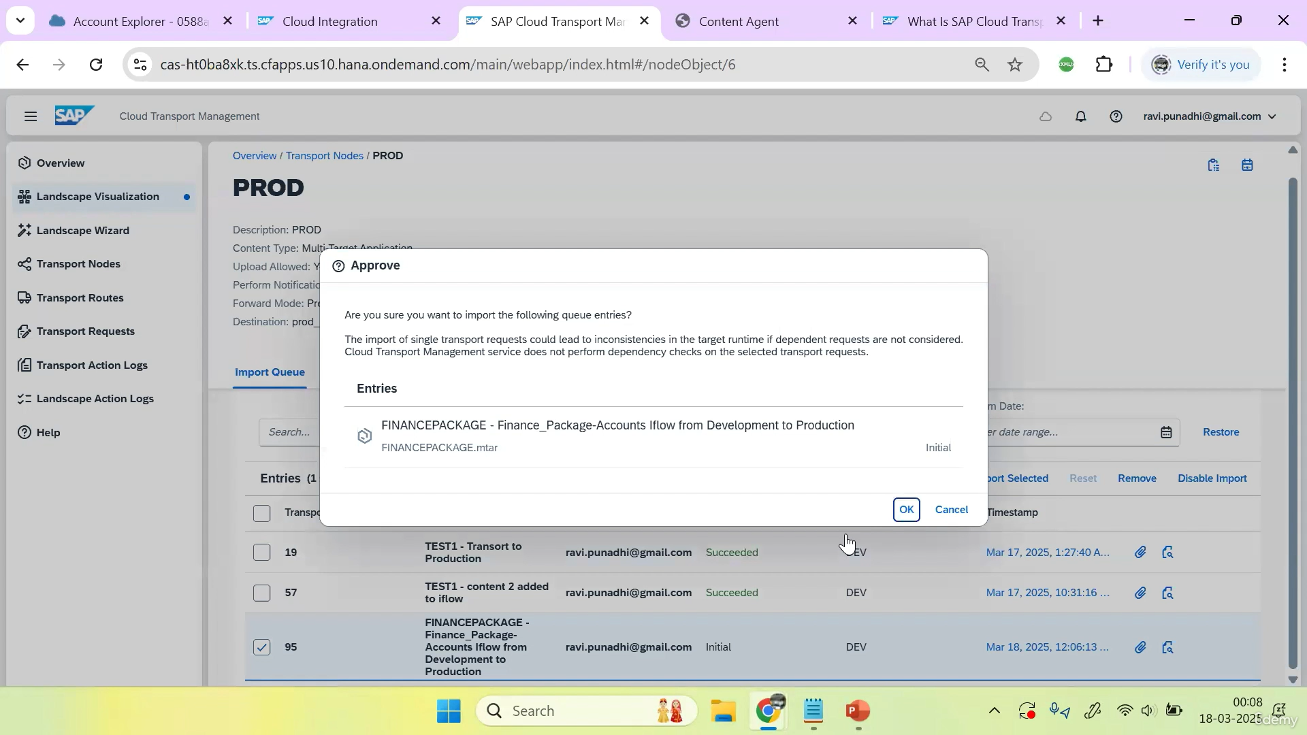
Now click on the ok

