Slide 1

Emotion classification in texts using Machine Learning approach.
Recognition using machine learning
SRINIVAS KASTURI
3078674
Under the guidance of
Prof. Sheela Ramanna

Slide 2
Index
Introduction
Problem Statement
Related Works
Theoretical Framework
Implementation
Block Diagram
System Architecture & Tools
Verification & Validation plans, Data
Results
References

Slide 3
Introduction
Emotion analysis refers to the use of natural language processing to identify and extract subjective information from source materials.
Basic task in emotion analysis is classifying the polarity of a given text using NLTK.
The evolution of social media has transformed the way companies view their customers. Our aim is to harvest data from reviews, texts and subject this information to detailed emotion analysis.

Slide 4
In this project, we implement the ensemble classifier for the sentiment analysis of textual data. This classifier implementation is aimed to overcome the basic drawbacks.
This system is based on mainly three types of the statistic learners such as Naive Bayes learner, Maximum Entropy learner and Support Vector Machine learner. This three learners association is formed by using the NL (natural language) toolkit.

Slide 5
Sentiment analysis and classification are mainly based on the machine learning approaches which were widely used in automatic recognition of emotions in texts. In general machine learning approach utilizes its algorithms to train learners for extraction of the emotional features. This classifier mainly uses the annotated corpus (it can also be provided with additional linguistic information, called 'annotation') for the purpose of training the learners.
Background

Slide 6
Related Works
Recognizing emotions in text using ensemble of classiﬁers. Isidoros Perikosn, Ioannis Hatzilygeroudis from the Department of Computer Engineering & Informatics- University of Patras had classified their texts using the NB, Maxent & Knowledbased tool.
Kamal and john have classified the texts as objective, positive and negative. In order to collect a corpus of objective posts, they retrieved text messages from pre downloaded tweets from twitter accounts of popular newspapers and magazine, such as “New York Times”, “Washington Posts” etc. Their classifier is based on the Maximum Entropy for text classification.

Slide 7
Current System
To obtain customer’s point of view from social medias and blogs such as twitter.
1) Pre-processing of texts.
2) Processing with Max entropy algorithm & SVM algorithm
3) Calculation of the scores
4) Analyzing the polarity of the texts.

Slide 8
* Machine learning algorithm mainly divided into two parts i.e. Supervised approach and unsupervised approach.
The success of both this learning methods is mainly depends on the selection and extraction of the specific set of features used to detect sentiment.
Theoretical Framework

Slide 9
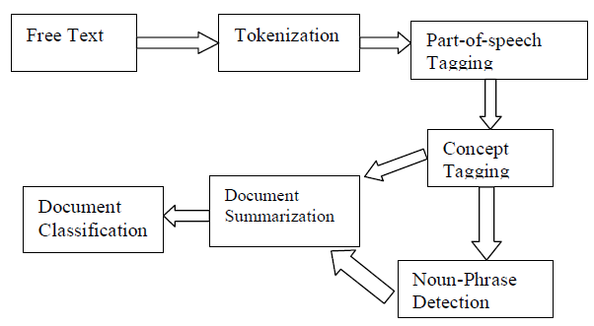
Natural language processing (NLP) is the ability of a computer program to understand human speech as it is spoken. NLP can mainly performs various functions shown in below figure.
There are various NLP toolkits available like stanford NLP, natural language toolkit(nltk), apache opennlp, apache lucene & solr. For this paper the natural language toolkit (NLTK) .
Natural Language Processing
Fig Source: Feeler: Emotion Classification of Text Using Vector Space Mode[2]

Slide 10
This classifier was developed by using the NLTK (natural language toolkit) to recognize the emotions .
These classifiers are based on the statistical approach. Naive Bayes and Maximum entropy algorithms, SVM were trained to extract the emotions in texts.
Ensemble Classifier
Fig Source: Recognizing emotions in text using ensemble of classifiers [1]

Slide 11
BOW (Bag of words) algorithm is very simple and easy to embed in our current process. This BOW will be performing the stop word functionality which is nothing but removal of the unwanted words and stemming the useful words.
Stemming: it will be performed at this stage for the grammatical transformation of the word.
Ex: running to run, ran to run
  Feature representation & extraction

Slide 12
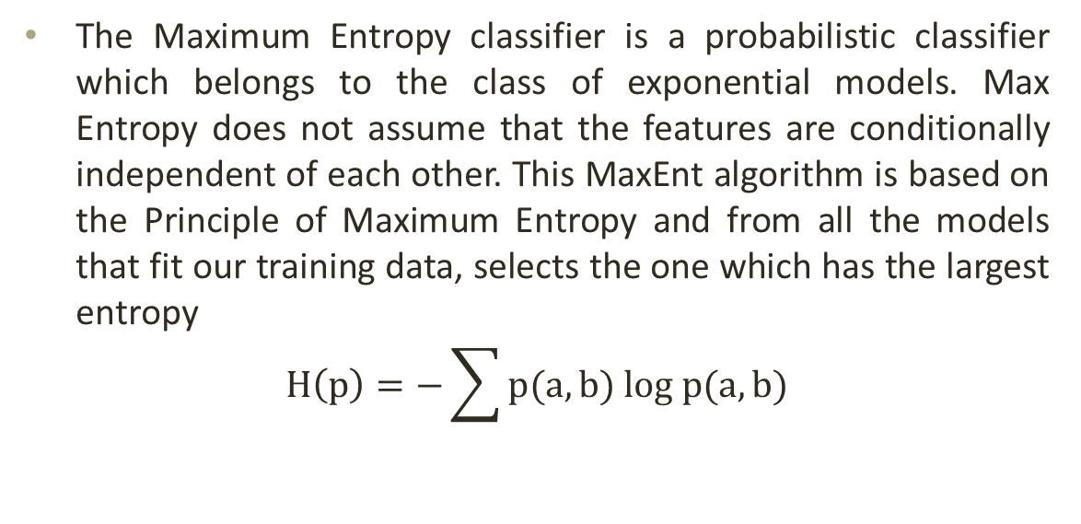
MaxEnt Algorithm
Fig Source: Recognizing emotions in text using ensemble of classifiers [1]

Slide 13
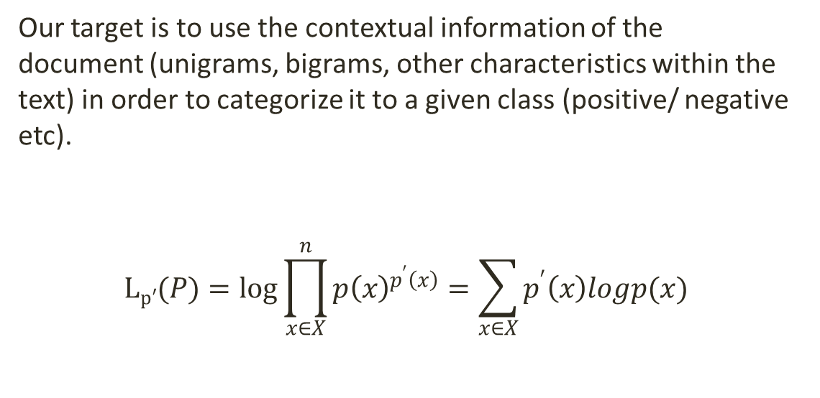
Max Entropy Algorithm
Fig Source: Recognizing emotions in text using ensemble of classifiers [1]

Slide 14
SVM Algorithm
SVM has defined input and output format. Input is a vector space and output is 0 or 1 (positive/negative).
Text document in original form are not suitable for learning. They are transformed into format which matches into input of machine learning algorithm input.
For this preprocessing on text documents is carried out. Then we carryout transformation. Each word will correspond to one dimension and identical words to same dimension. As mentioned before we will see TF-IDF for this purpose.

Slide 15
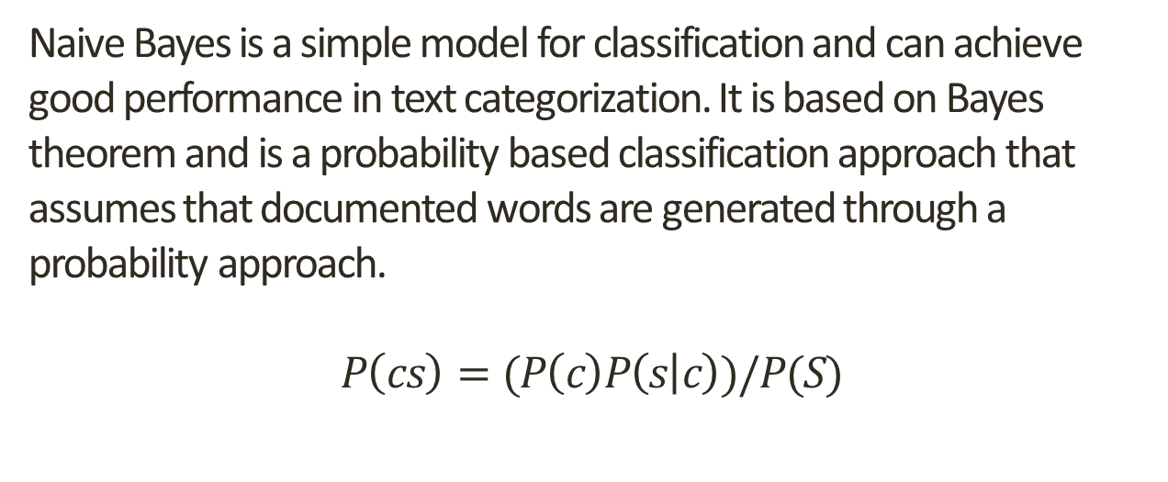
Naive Bayes Algorithm
Fig Source: Recognizing emotions in text using ensemble of classifiers [1]

Slide 16
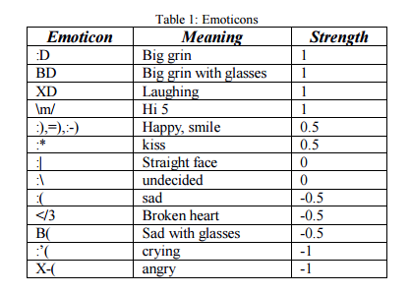
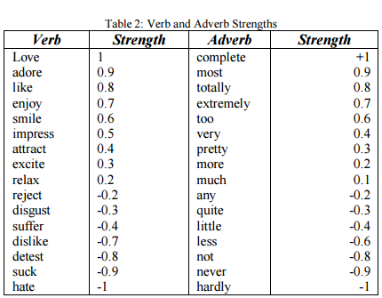
Strength/Base Polarity Table for manual calculation
Emoticon
Verb and Adverb Strength
Data source: John La_ertyy, Kamal Nigamy.: Using Maximum Entropy for Text Classifcation.

Slide 17

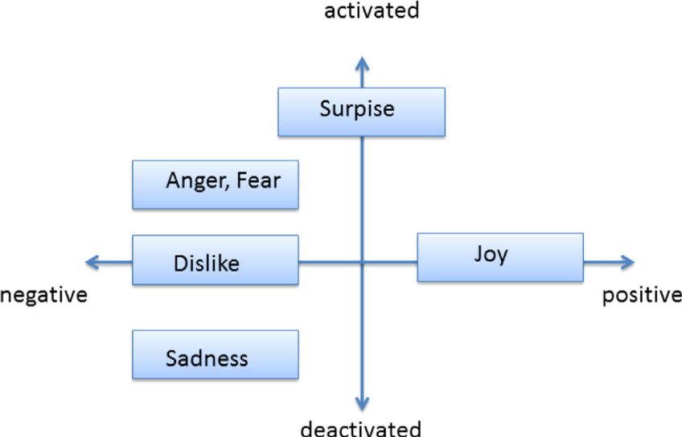
Polarity Mode
* Fig Source: Russels Polarity [1]

Slide 18
Metrics Computation
There are several metrics proposed for computing and comparing the results of our experiments. Some of the most popular metrics include: precision, recall, accuracy, f1-measure(each of these metrics is calculated individually for each class and then averaged for the overall classifier performance.) A typical confusion table for our problem is given below along with illustration of how to compute our required metric.
 | Predicted Positives | Predicted Negatives
Actual Positive | TP | FN
Actual Negative | FP | TN
Basic Confusion Matrix

Slide 19
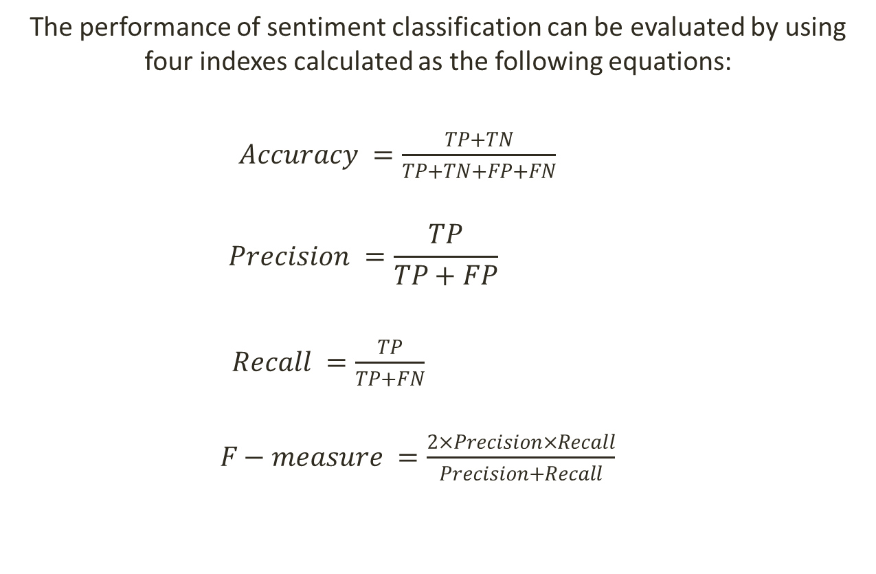

Slide 20
Implementation.
For the purpose of implementation, we need to use two sets of databases which were already labeled as the positive and negative texts by the human. These Text Reviews were from YELP Dataset are used to create training dataset. These data sets are selected 500 positive reviews (reviews having 5-star rating) and 500 negative reviews (reviews having 1-star rating) from Yelp dataset.

Slide 21
Steps of Implementation
As Part of the Step-1 below are the pre-processing tasks
Filtering the texts
Alpha filtering
Case rounding
Stemming

Slide 22
Steps of Implementation
Step-2:
Stop-words removal : Stop words are class of words which will not hold any of the information when they are used in the sentence. They can be treated as useless in this emotional analysis case. Example: a, an, the, he she, by, on…etc. They are removed because they can affect the polarity of the sentence by frequency approach.
Example: stopset = set(stopwords.words('english')) - set(('over', 'under', 'below', 'more', 'most', 'no', 'not', 'only', 'such', 'few', 'so', 'too', 'very', 'just', 'any', 'once'))
Step-3:
Parts-of-Speech Tagging: POS tagging is the process of assigning the feats/ a tag to each word in the sentence as to which POS they belongs to.
Ex: noun, verb, adverb…etc. After tagging of the features then these tagged words will be considered as the ‘feats’.

Slide 23
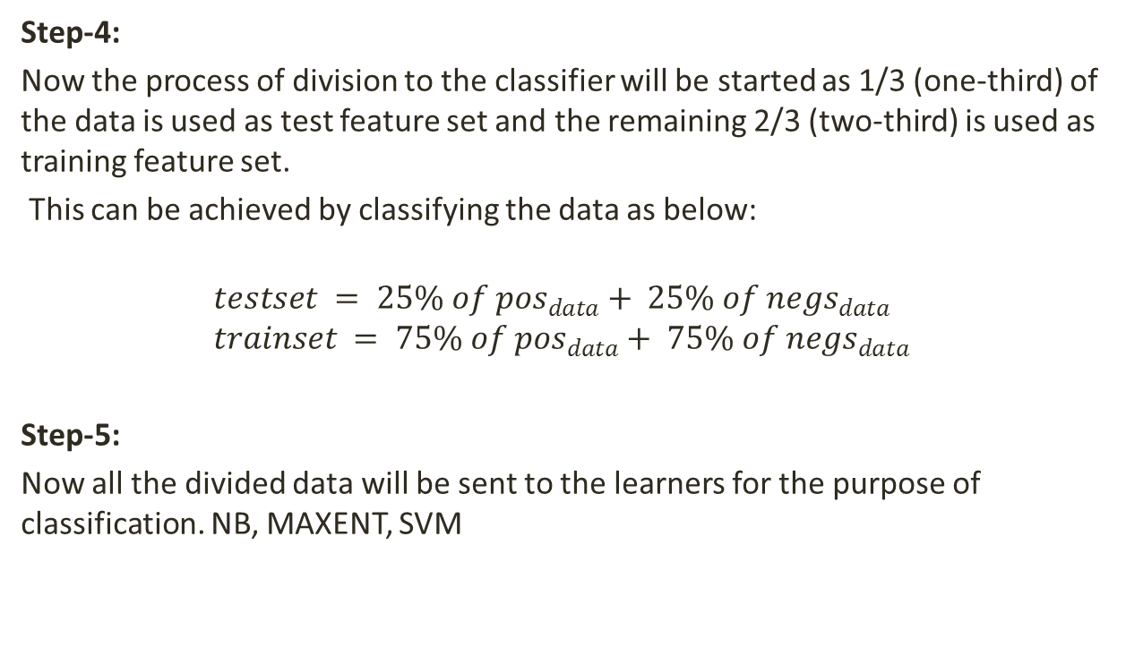
Steps of Implementation

Slide 24
Flow Chart

Slide 25
System Architecture & Tools
Software Architecture: Windows 7/10
Hardware Architecture:
  Processor: Intel®Core™i3-4010U CPU @ 1.70GHz /i5 with more capacity.
  Ram: Minimum of 2gb
  Development Tools:
    Python 2.0/Python 3.0
    Enthought Canopy
    Natural Language Tool Kit (NLTK)
    Scipy & Numpy Libraries
.

Slide 26
Experiments
We are going to calculate accuracy, precision, recall and f-measure for the given texts using three different algorithms.
We should use all the following features for the analysis of the given texts.
  word_feats (divided feats without stop words)
  stopword_filtered_word_feats (using stop words + feats)
  bigram_word_feats (using bigram words feats without stop word)
  bigram_word_feats_stopwords(using bigram words feats with stop word)
As a default option feature, ‘word_feats ’would be selected and classified output will be displayed

Slide 27
Verification & Validation Plans
Overall accuracy = (TP+TN)/ (TP+FP+TN+FN) Where TP, FP, TN, and FN are the number of true positives, false positives, true negatives and false negatives.
Furthermore, for testing any of the supervised classifiers as well as our hybrid method we use 10-fold cross validation.

Slide 28
Results
Overall Accuracy for the Yelp dataset:
 | SVM | NB | MAXENT
Word_feats | 82.2% | 81.3% | 80.5%
stopword_filtered_word_feats | 78.8% | 81.6% | 79.1%
bigram_word_feats | 87.7% | 82.7% | 83.0%
bigram_word_feats_stopwords | 79.8% | 79.9% | 79.9%
Words_feats output for the yelp dataset with n=5
 | SVM | 5 Fold SVM | NB | 5 Fold-NB
Accuracy | 0.884 | 0.842 | 0.712 | 0.842
Precision | 0.822 | 0.8428 | 0.8088 | 0.8428
Recall | 0.884 | 0.8411 | 0.712 | 0.8411
F-measure | 0.839 | 0.8421 | 0.6875 | 0.8412
* Maxent results were obtained from external source. http://textminingonline.com/tag/maximum-entropy-classifier

Slide 29
Results
The best performance of a sole classifier is achieved by the SVM classifier, which accuracy and precision are better than those of the Naïve Bayes in all the experiments. The Naïve Bayes classifier performance is slightly lower than that of naïve Bayes. It goes better in headline and article sentences, but its performance decreases in texts almost in the same degree as SVM.

Slide 30
Data
We currently planed to use these data with labelled tweets as positive, negative : This free data set is for training and testing sentiment analysis algorithms. It consists of 5513 hand-classified texts. Each text was classified with respect to one of four different topics. This has been obtained from the website of Sanders Analytics, a Seattle-based startup focused on data analytics & ISEAR (International Survey on Emotion Antecedents and Reaction).
Also we can use the free texts data from:
https://www.yelp.com/dataset_challenge

Slide 31
Conclusion
By this experiment we are able to calculate the polarity of the sentimental words using which we are able to calculate the metrics for the text classification. We are to produce the outputs for the SVM and Naïve Bayes successfully.
Running this algorithm for multiple number of data sets can give the classified data of those emotions.

Slide 32
References
Isidoros Perikos n, Ioannis Hatzilygeroudis: Recognizing emotions in text using ensemble of classifiers . Engineering Applications of Artificial Intelligence 51 (2016) 191–201
Taner Danisman, Adil Alpkocak .:Feeler: Emotion Classification of Text Using Vector Space Model In AISB 2008 Convention, Communication, Interaction and Social Intelligence, Vol. vol. 2 (April 2008)
Durgesh Patel 1, Sakshi Saxena 2,: Sentiment Analysis using Maximum Entropy Algorithm in Big Data DOI:10.15680/IJIRSET.2016.0505246
Vishal A. Kharde, S.S. Sonawane.: Sentiment Analysis of Twitter Data: A Survey of Techniques.International Journal of Computer Applications (0975 – 8887) Volume 139 – No.11, April 2016
Snehal L. Rathod, Sachin N.Deshmukh.: Sentiment Analysis Using SVM and Maximum Entropy. International Research Journal of Engineering and Technology (IRJET) e-ISSN: 2395 -0056 Volume: 03 Issue: 08 | Aug-2016
John La_ertyy, Kamal Nigamy.: Using Maximum Entropy for Text Classi_cation. 2010 IEEE ICE 10.1109/ICICISYS.2010.5658639

