Slide 1
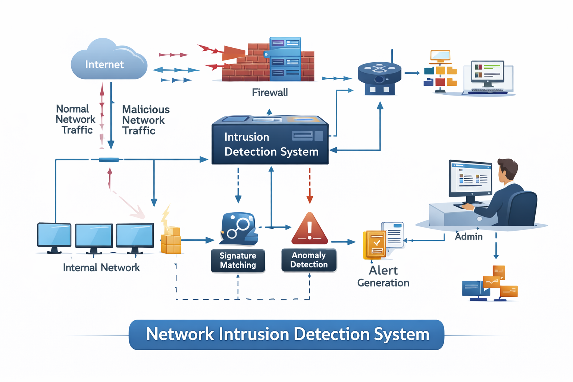
Network Intrusion Detection System
A Machine Learning–Based Cybersecurity Solution for Real-Time Attack Classification and Threat Monitoring
CSE DEPARTMENT · 2025–2026

Slide 2

Network Intrusion Detection System
A Machine Learning–Based Cybersecurity Solution for Real-Time Attack Classification and Threat Monitoring

Slide 3
Network Intrusion Detection System
Introduction
What is Network Intrusion Detection
Monitors Network Traffic
Continuously captures and analyzes incoming and outgoing packets.
Detects Malicious Activities
Identifies anomalies, unauthorized access attempts, and policy violations.
Classifies Attacks
Categorizes threats into specific types like DoS, Probe, U2R, and R2L.
Protects Organizational Data
Safeguards critical assets by providing early warning of breaches.
Why Machine Learning?
Traditional Limitation
Signature-based systems fail to detect Zero-Day Attacks (unknown threats) and struggle with high false positive rates.
ML Advantage
ML-based systems learn complex patterns, significantly improving detection accuracy and adaptability to new attack vectors.

Slide 4

What Is Network Intrusion Detection?
A Network Intrusion Detection System (NIDS) continuously monitors network traffic to identify, classify, and respond to malicious activity — before damage is done. Traditional signature-based _{systems} struggle with novel, unknown threats.
Monitor
Continuous analysis of inbound and outbound network traffic
Detect
Identify anomalies and known attack signatures in real time
Classify
Categorize threats by type for targeted incident response
ML-based IDS learns from patterns, enabling detection of zero-day attacks that rule-based systems routinely miss.
Protect
Safeguard organizational data and critical infrastructure

Slide 5
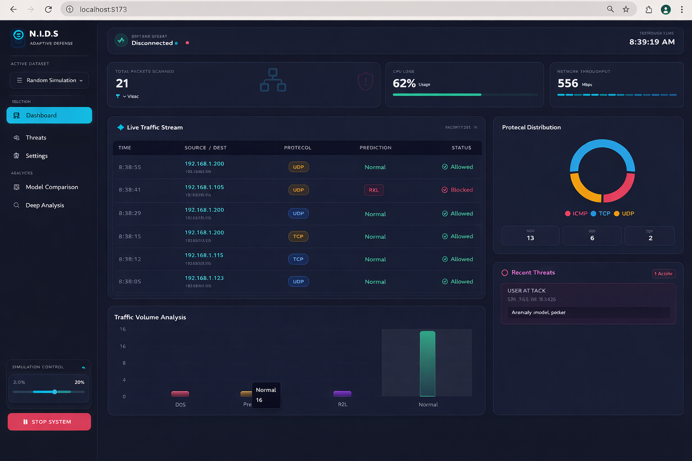

Slide 6





Problem Statement
Existing intrusion detection approaches suffer from critical gaps that leave networks exposed to modern, adaptive threats.
Unknown Attacks
High False Positive Rate
Signature-based systems cannot detect zero-day or novel attack variants not present in their rule sets.
Excessive false alarms cause alert fatigue, reducing analyst responsiveness to genuine threats.
Manual Rule Updates
Poor Visualization
Rule databases require constant expert maintenance, creating costly operational overhead.
Legacy tools lack actionable dashboards, hampering timely forensic investigation.
Core Need: An intelligent, real-time system capable of autonomous learning, accurate classification, and intuitive threat visualization.

Slide 7

PROJECT OBJECTIVES
What We Set Out to Build
01
ML-Based IDS
Design and implement an end-to-end intrusion detection pipeline driven by machine learning
02
>95% Accuracy Target
Achieve accuracy exceeding 95% across all attack classes on the NSL-KDD benchmark
03
Minimize False Positives
Drive false positive rate below 2% to ensure operational reliability
04
Compare 5 ML Models
Benchmark Random Forest, SVM, Neural Network, Logistic Regression, and Naive Bayes
05
Real-Time Dashboard
Deliver a production-ready React frontend with live threat monitoring and alerts

Slide 8
Dataset & Attack Taxonomy
The NSL-KDD dataset serves as the benchmark — a refined version of KDD Cup 1999 that eliminates duplicate records for more reliable model evaluation.
125K
22.5K
41
5
Training Records
Test Records
Input Features
Output Classes
DoS
Probe
R2L
U2R
Denial of Service — overwhelms resources to deny legitimate access
Network scanning to map vulnerabilities and open ports
Remote to Local — unauthorized access from a remote machine
User to Root — privilege escalation to gain admin control

Slide 9

System Architecture
A six-stage pipeline transforms raw network packets into classified alerts displayed on a live web dashboard.
Preprocess Data
Feature Engineering
Model Training
Classification Engine
Each stage is modular and independently replaceable, allowing new models or data sources to be integrated without redesigning the full system.

Slide 10

Data Pipeline: Preprocessing & Feature Engineering
Preprocessing Steps
Engineered Features
Remove duplicate and redundant records to reduce bias
src_bytes_rate
dst_bytes_rate
Source transmission rate — flags volumetric DoS patterns
Destination receive rate — identifies data exfiltration
Handle missing values via median imputation
Min-max normalize continuous features to [0,1]
error_rate
privilege_escalation
One-hot encode categorical attributes (protocol, service, flag)
Connection error ratio — signals scanning and probing
Detects U2R attempts via system call anomalies
Stratified 80/20 train-test split preserving class balance
suspicious_login_attempt
Flags repeated failed authentication — R2L indicator

Slide 11



Machine Learning Models Evaluated
Random Forest
SVM
Neural Network
Ensemble of decision trees; robust to noise and overfitting
Maximizes margin between classes; excellent specificity
128→64→32 neurons, ReLU + Softmax; highest F1 overall
Logistic Regression
Naive Bayes
Probabilistic baseline; interpretable and fast to train
Probabilistic classifier assuming feature independence

Slide 12
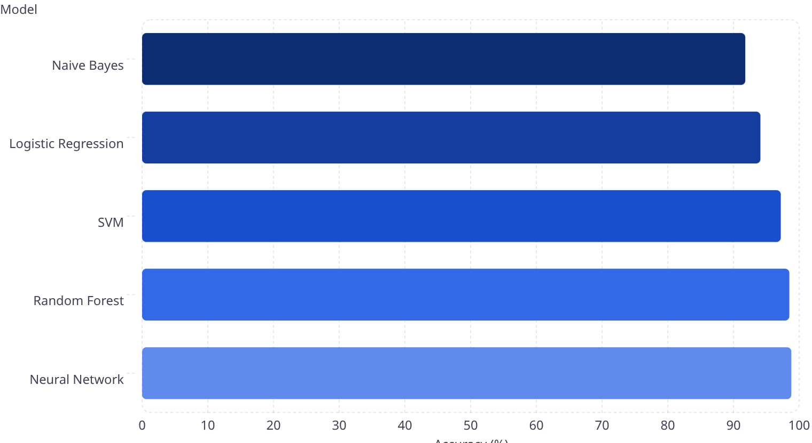

Model Performance Comparison
All five classifiers were evaluated on accuracy, F1 score, and false positive rate. The Neural Network achieved the highest overall performance.
🏆 Neural Network
Accuracy 98.8% · F1 Score 0.988 — Best overall model
Random Forest
Accuracy 98.5% · Highest stability across folds
SVM
Accuracy 97.2% · Best specificity at 99.3%
Avg. False Positive Rate
Only 1.2% across all models — exceeds target

Slide 13




Conclusions & Future Directions
What We Achieved
Future Enhancements
ML-based IDS built and validated on NSL-KDD benchmark
Live Packet Capture
Five algorithms benchmarked; Neural Network leads at 98.8%
Integrate real-time PCAP ingestion for production network environments
False positive rate held to just 1.2% — operationally viable
Explainable AI
Production-ready Flask + React dashboard with live alerts
Add SHAP-based explanations so analysts understand every decision
Federated Learning
Train across distributed nodes without centralizing sensitive traffic data

