Slide 1
Antifragile Software Design

Slide 2
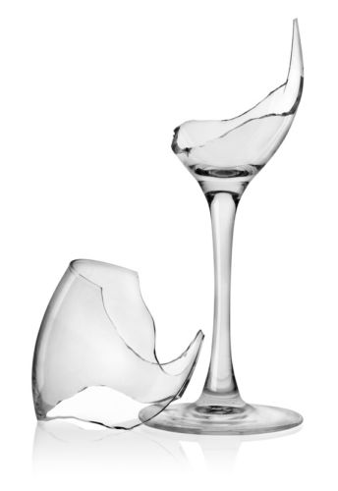
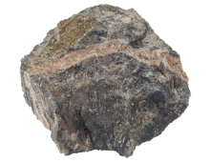
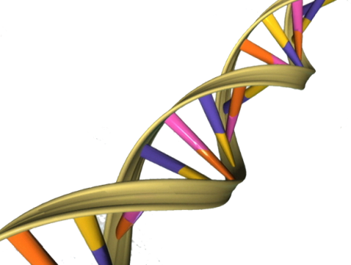
The Triad: Antifragility, Robustness, and Fragility
Fragile things are exposed to volatility, so that volatility is prejudicial to them.
Robust things are immune to volatility, so that volatility does not affect them.
Antifragile things enjoy volatility, so that volatility is beneficial to them.

Slide 3

The Triad Over Time
Fragile things: Break, erode or deteriorate.
Robust things: Stay the same.
Antifragile things: Evolve, improve, get better.

Slide 4

Antifragility vs. Resilience
“Antifragility is beyond resilience or robustness. The resilient resists shocks and stays the same; the antifragile gets better.”

Slide 5
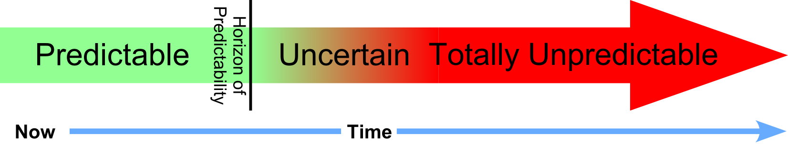
Nonpredictive Decision Making
“Sensitivity to harm from volatility is tractable, more so than forecasting the event that would cause the harm.”
Aligned with Agile principle:
“Responding to change over following a plan.”

Slide 6
Volatility in Software Design
In the case of software systems, volatility appears in the form of changes over time.
Changes are unavoidable, as expressed in the Lehman laws of software evolution:
“Continuing Change — A software system must be continually adapted or it becomes progressively less satisfactory.”

Slide 7
Changes in Software Design
Functional changes:
Required to implement new requirements, or to implement modifications in the requirements.
Have an impact on the system’s behavior and functionality.
Non-functional changes:
Required to improve the quality of the design.
Are normally the result of Refactoring and focus on the reduction of Technical Debt.
Should not affect the system’s behavior or functionality.

Slide 8

Barbell Strategy
“Barbell Strategy: A dual strategy, a combination of two extremes, one safe and one speculative, deemed more robust than a ‘monomodal’ strategy.”

Slide 9
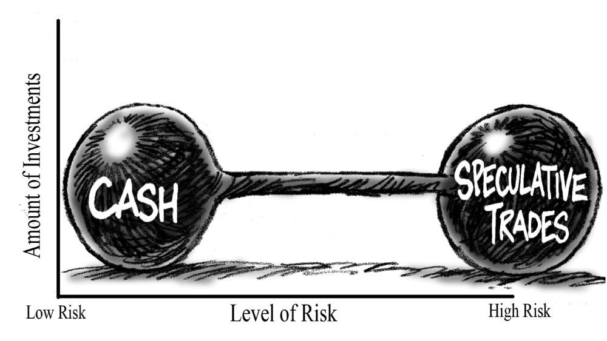
Example of Barbell Strategy
“An investment strategy in which half the portfolio is made up of long-term bonds and the other half of very short-term bonds.”

Slide 10
Barbell Strategy in Software
What is the software equivalent of a Barbell Strategy?
The answer is: Abstraction. Software systems should have a structure and organization based on different levels of abstraction.
The duality of the Barbell Strategy is expressed as the separation between high-level abstract elements and concrete implementation details.

Slide 11
Abstract and Concrete Elements
Abstract elements: Are robust, and should not be easily affected by changes.
Concrete implementation details: Are fragile, directly affected by changes.
Software systems should be built in such a way that the volatility (changes):
Does not affect its structure and organization, preserving the main, high-level abstractions.
Requires modifications only on the low-level, concrete implementation details

Slide 12
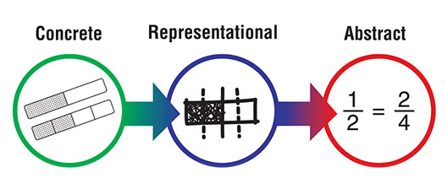
Applications of the Barbell Strategy
Information Hiding
Encapsulation
Open/Closed Principle
TDD
Inheritance Hierarchies
Frameworks

Slide 13
Information Hiding
Information Hiding was defined by David Parnas as a criterion to decompose a system into modules:
“Every module … is characterized by its knowledge of a design decision which it hides from all others. Its interface or definition was chosen to reveal as little as possible about its inner workings.”

Slide 14
Encapsulation
The mechanism of Encapsulation in Object Oriented Programming (OOP) is a direct application of Information Hiding.
The interface of a class is separated from its implementation, and thus the implementation may be changed without affecting the clients of the class.
Thanks to encapsulation, the clients of a class become less fragile to changes in its implementation details.

Slide 15
Open/Closed Principle
The Open-Closed Principle (OCP) was defined by Bertrand Meyer as:
“Software entities (classes, modules, functions, etc.) should be open for extension, but closed for modification.”
The implementation of the OCP requires the definition of an abstraction, so that each possible extension is a specialization of this abstraction.

Slide 16
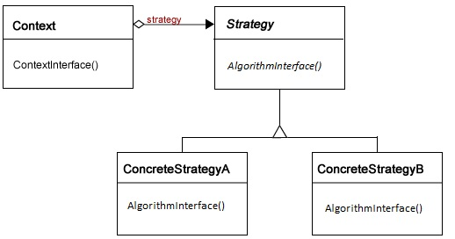
Strategy Design Pattern

Slide 17
TDD: Test-Driven Development
The fundamental idea of TDD is to write the tests before writing the code.
TDD focuses on the early separation between abstractions and concrete implementation details.
Requires the definition of abstract interfaces and behavior for the classes being tested.
Allows the code to be easily refactored, because the unit tests would catch any mistake.
The unit tests are less fragile to volatility (changes) because they are based on abstractions.

Slide 18
Inheritance Hierarchies
In OOP, an inheritance hierarchy organizes classes according to a generalization-specialization rationale.
Classes near the root of the hierarchy are more abstract than the classes on the leaves of the inheritance tree.
The abstract classes should be less fragile than the concrete classes, meaning that they should be less subject to impact caused by volatility, such as changes in the requirements or changes in the implementation details.

Slide 19
Frameworks
Frameworks provide reusable code that is not application-specific, defining abstractions and the relationships among them.
The software developer extends the framework, deriving concrete subclasses, and writing the implementation details to satisfy the requirements of a specific application.
These implementation details are fragile, but the framework is not, and may be reused with no changes on many applications.

Slide 20
Robust vs. Fragile
Robust | Fragile
Dependency on interface | Dependency on implementation details
Client of encapsulated class | Client of class with public members
Class that may be extended without modifications | Class that needs to be modified to be extended
Unit Tests | Implementation of the classes being tested
Abstract Class | Concrete Class
Generic Framework | Application-specific extension of the Framework

Slide 21
Conclusions so far
Software systems are subject to volatility in the form of changing requirements.
Concrete implementation details are fragile and directly affected by these changes
A Barbell Strategy defines concrete details as the specialization of higher-level abstractions.
Proper abstractions should be robust, surviving the impact of changes.
Details change over time, but the system structure and organization may be preserved because it is based on abstractions.

Slide 22
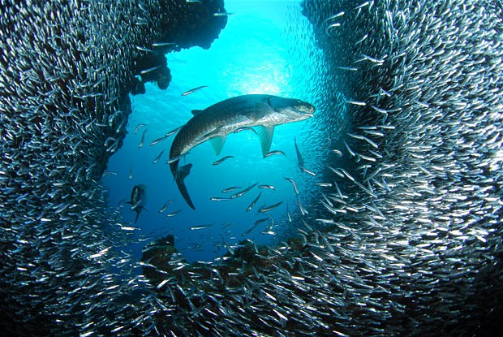
Antifragile Whole, Fragile Parts
“The antifragility of the whole often depends on the fragility of the parts.”

Slide 23
Componentization
It is common knowledge that systems should be divided into components.
The reaction to a change in the environment should only affect a few components, and not the entire system.
Thus, component-based systems are more robust than monolithic systems.

Slide 24
Antifragility through Componentization
To be Antifragile, a system must be able to benefit from changes in the environment.
Antifragility may be achieved when several systems share the same components.
When a specific component is improved, all systems using this component can benefit from this improvement.

Slide 25
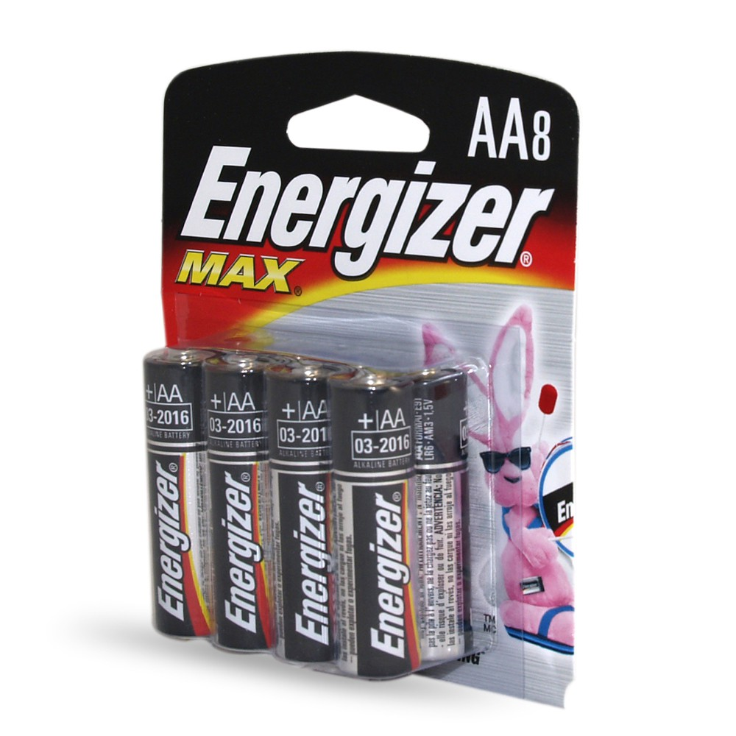
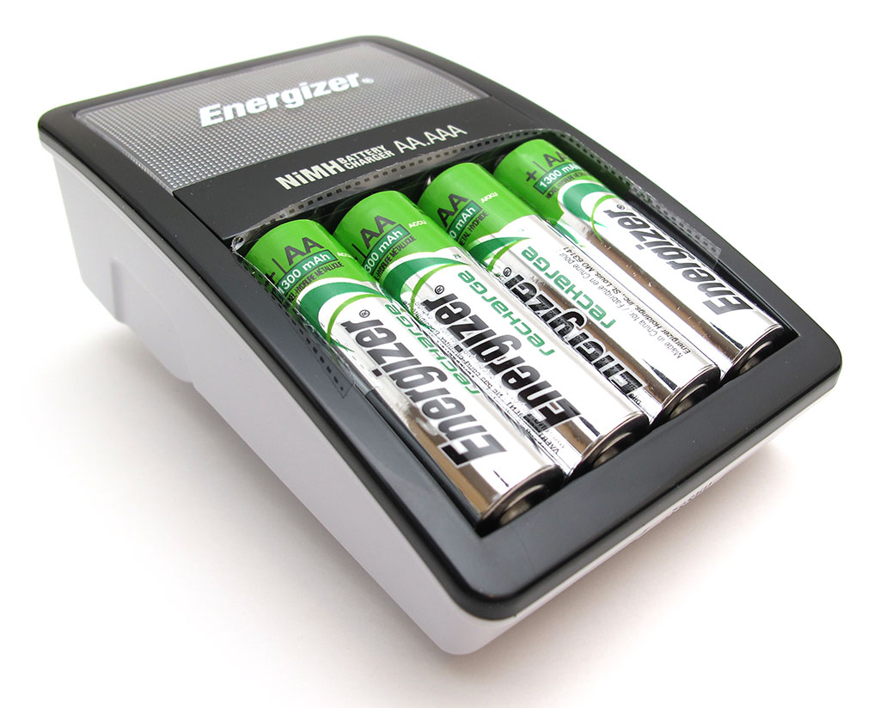
Example: Rechargeable Batteries
All users of traditional AA batteries can benefit from improved technology of rechargeable ones.

Slide 26
Coupling and Cohesion
Principles to guide the decomposition of large software systems into modules:
Coupling: The degree of dependency between two modules. We always want low coupling.
Cohesion: The measure of how strongly-related is the set of functions performed by a module. We always want high cohesion.

Slide 27
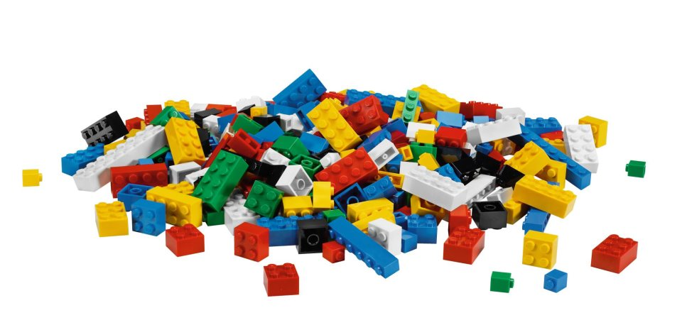
Applications of Componentization
DLLs
ORBs
SOA
Microservices
Software Product Lines

Slide 28
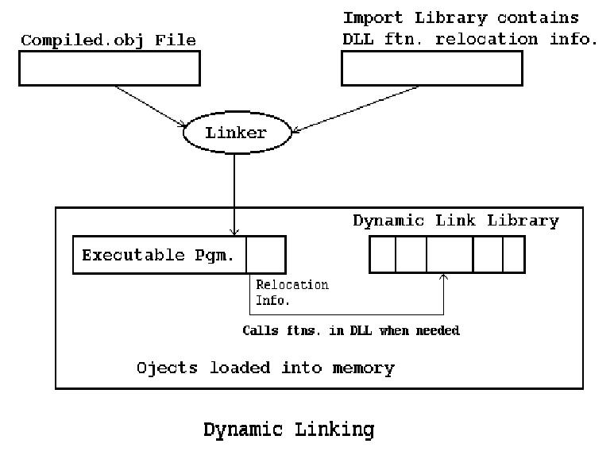
DLL: Dynamic Link Library
“DLLs provide a mechanism for shared code and data, allowing a developer of shared code/data to upgrade functionality without requiring applications to be re-linked or re-compiled.”

Slide 29
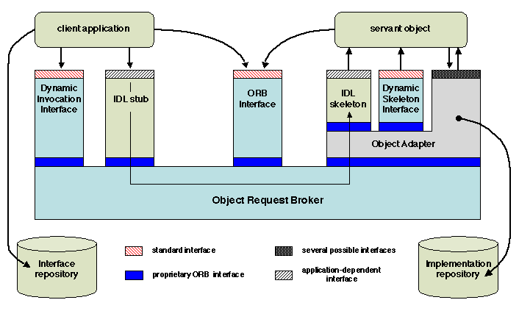
ORB: Object Request Broker
“An ORB acts as a broker between a client request for a service from a distributed object or component and the completion of that request.”

Slide 30
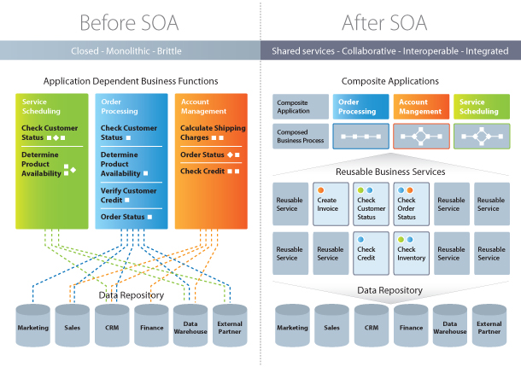
SOA: Service-Oriented Architecture

Slide 31
SOA Principles
Standardized Service Contracts
Service Loose Coupling
Service Abstraction
Service Reusability
Service Autonomy
Service Statelessness
Service Discoverability
Service Composability
Service Interoperability

Slide 32
Service Reusability
“Services contain and express agnostic logic and can be positioned as reusable enterprise resources.”
“Logic is divided into services with the intent of maximizing reuse.”
Thus services should not be part of a single system, they should be reused in multiple systems.

Slide 33
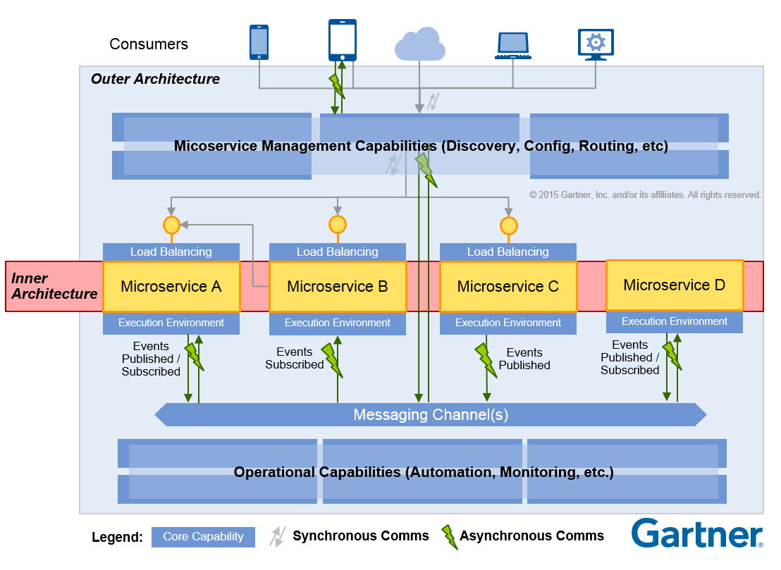
Microservices

Slide 34
Microservices Practices (I)
Separated Build:
Each Microservice is built independently and has its own version.
Independent Deployment:
Each Microservice may be deployed without affecting the others.
Separated Data Stores:
Microservices should not share data stores.
Independence of Platform:
Microservices should be deployed in containers.

Slide 35
Microservices Practices (II)
Individual Technology Choice:
Each Microservice may be implemented using a different technology.
Confinement of Failure:
If a failure occurs in a particular Microservice it should not propagate to the other ones.
Independent Scalability:
It should be possible to scale each Microservice independently of the others.

Slide 36
Systems, Services and Antifragility
At any point in time it is possible to deploy an enhanced version of one of the services without affecting the other ones.
If there are several systems based on shared services, each time one of these services is improved all the systems will be able to immediately benefit from the improvement.
While each system is robust, the collection of systems is Antifragile, because they benefit from the same changes at no added cost.

Slide 37
Software Product Lines
In a Software Product Line (SPL), a series of software products are based on the same components and differ only on their configuration.
In the case of SPLs there may be several coexisting versions for each component.
Each time a new component version is created, all the products using previous versions may benefit through simple configuration updates.

Slide 38
Antifragile vs. Fragile
Antifragile | Fragile
Several programs linking to the same DLLs | A specific version of a Dynamic Link Library
Several Client objects calling the same Servant object | The implementation details of a specific Servant object
Several Systems accessing the same Services | The implementation details of a specific Service
Several Applications using shared Microservices | The implementation details of a specific Microservice
Several Products based on the same Components | A specific version of a Component

Slide 39
Conclusions
A simple strategy for Antifragility is: Build component-based systems with shared components.
When one of the shared components is improved all the systems will be able to benefit from this improvement at no additional cost.

Slide 40
Thanks!
Q&A

