Slide 1
Polyglot Persistence

Slide 2
What is the Polyglots?
Using multiple Database Technologies in a Given Application
Using the right tool for the right job

Slide 3
What is the Polyglots?
Using multiple Database Technologies in a Given Application
Using the right tool for the right job
Derived from “polyglot programming”. Applications programmed from a mix of languages.

Slide 4
Why is the Polyglots?
Relational has been the dominant model
Higher performance requirements
Increasingly large datasets
Use of IaaS and commodity hardware

Slide 5
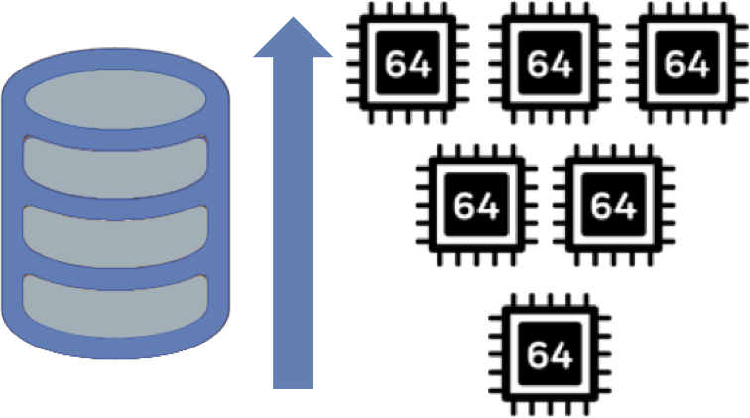
Vertical Scaling

Slide 6
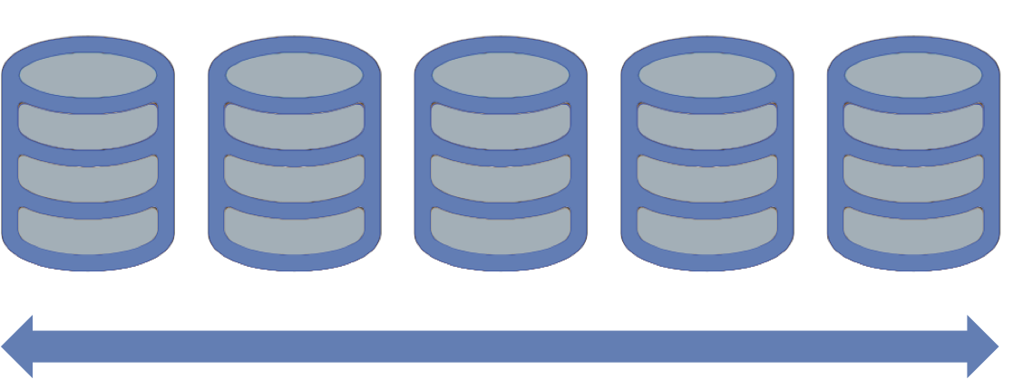
Horizontal Scaling

Slide 7
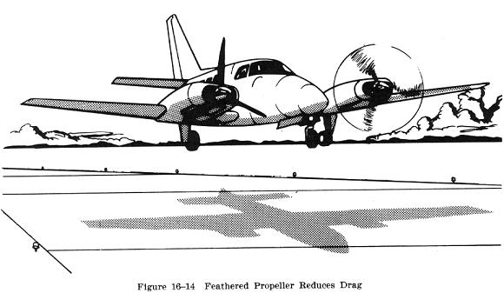
Availability
http://avstop.com/ac/flighttrainghandbook/imagel4b.jpg

Slide 8
Availability
Requirements
Maximize uptime
Minimize time to recover
http://avstop.com/ac/flighttrainghandbook/imagel4b.jpg

Slide 9
Availability
Requirements
Maximize uptime
Minimize time to recover
Hardware failures
Network partitions
Data center failures
Maintenance Operations
http://avstop.com/ac/flighttrainghandbook/imagel4b.jpg

Slide 10
Availability
Business critical systems require automatic fault detection and fail over
http://avstop.com/ac/flighttrainghandbook/imagel4b.jpg

Slide 11
Variant Data Models
ID
Name
Key-Value Store
45647
Democritus
52320
Hypatia
58842
Eratosthenes
78932
Euripides
88237
Shemp

Slide 12
Variant Data Models
Graph Databases
Democritus
Hypatia
Eratosthenes
Shemp
Euripides

Slide 13
Variant Data Models
{
maker : ”Agusta",
type : sportbike,
rake : 7,
trail : 3.93,
engine : {
type : "internal combustion",
layout : "inline"
cylinders : 4,
displacement : 750,
},
transmission : {
type : "cassette",
speeds : 6,
pattern : "sequential”,
ratios : [ 2.7, 1.94, 1.34, 1, 0.83, 0.64 ]
}
}
Document Databases

Slide 14
The Goals of Normalization
Model data an understandable form
Reduce fact redundancy and data inconsistency
Enforce integrity constraints

Slide 15
Polyglot Persistence
Key / Value
Session Data,
Shopping Carts
MongoDB
Product Catalog,
User Accounts,
Domain Objects
Application
Servers
RDBMS
Payment
Systems,
Reporting
Graph
Social Data,
Recommendations

Slide 16
Polyglot Persistence
Key / Value
Session Data,
Shopping Carts
MongoDB
Product Catalog,
User Accounts,
Domain Objects
Application
Servers
RDBMS
Payment
Systems,
Reporting
Graph
Social Data,
Recommendations

Slide 17
What are your requirements?
Availability
Scalability
Performance
Access Patterns
Data Model

Slide 18
Key Value Stores
ID
Name
Used for
Session data
Cookies
Shopping carts
45647
Democritus
52320
Hypatia
58842
Eratosthenes
78932
Euripides
88237
Shemp

Slide 19
Key Value Stores
ID
Name
Fast, if in memory
Single access pattern
Complex data parsed in client
45647
Democritus
52320
Hypatia
58842
Eratosthenes
78932
Euripides
88237
Shemp

Slide 20
Key Value Store
“{
maker : ‘Agusta’,
type : sportbike,
rake : 7,
trail : 3.93,
engine : {
type : ‘internal combustion’,
layout : ‘inline’,
cylinders : 4,
displacement : 750,
},
transmission : {
type : ‘cassette’,
speeds : 6,
pattern : ‘sequential’,
ratios : [ 2.7, 1.94, 1.34, 1, 0.83, 0.64 ]
}
}”

Slide 21
MongoDB
Self Defining Schema
{ _id: 78234974,
maker : ”Agusta",
type : sportbike,
rake : 7,
trail : 3.93,
engine : {
type : "internal combustion",
layout : "inline"
cylinders : 4,
displacement : 750,
},
transmission : {
type : "cassette",
speeds : 6,
pattern : "sequential”,
ratios : [ 2.7, 1.94, 1.34, 1, 0.83, 0.64 ]
}
}

Slide 22
MongoDB
Self Defining Schema
Nested Objects
{ _id: 78234974,
maker : ”Agusta",
type : sportbike,
rake : 7,
trail : 3.93,
engine : {
type : "internal combustion",
layout : "inline"
cylinders : 4,
displacement : 750,
},
transmission : {
type : "cassette",
speeds : 6,
pattern : "sequential”,
ratios : [ 2.7, 1.94, 1.34, 1, 0.83, 0.64 ]
}
}

Slide 23
MongoDB
Self Defining Schema
Nested Objects
Array types
{ _id: 78234974,
maker : ”Agusta",
type : sportbike,
rake : 7,
trail : 3.93,
engine : {
type : "internal combustion",
layout : "inline"
cylinders : 4,
displacement : 750,
},
transmission : {
type : "cassette",
speeds : 6,
pattern : "sequential”,
ratios : [ 2.7, 1.94, 1.34, 1, 0.83, 0.64 ]
}
}

Slide 24
MongoDB
{ _id: 78234974,
maker : ”Agusta",
type : sportbike,
rake : 7,
trail : 3.93,
engine : {
type : "internal combustion",
layout : "inline"
cylinders : 4,
displacement : 750,
},
transmission : {
type : "cassette",
speeds : 6,
pattern : "sequential”,
ratios : [ 2.7, 1.94, 1.34, 1, 0.83, 0.64 ]
}
}
Primary Key,
Auto indexed

Slide 25
MongoDB
{ _id: 78234974,
maker : ”Agusta",
type : sportbike,
rake : 7,
trail : 3.93,
engine : {
type : "internal combustion",
layout : "inline"
cylinders : 4,
displacement : 750,
},
transmission : {
type : "cassette",
speeds : 6,
pattern : "sequential”,
ratios : [ 2.7, 1.94, 1.34, 1, 0.83, 0.64 ]
}
}
Secondary
indexes

Slide 26
MongoDB
{ _id: 78234974,
maker : ”Agusta",
type : sportbike,
rake : 7,
trail : 3.93,
engine : {
type : "internal combustion",
layout : "inline"
cylinders : 4,
displacement : 750,
},
transmission : {
type : "cassette",
speeds : 6,
pattern : "sequential”,
ratios : [ 2.7, 1.94, 1.34, 1, 0.83, 0.64 ]
}
}
Projections
db.vehicles.find (
{_id:78234974 },
{ engine:1,_id:0 }
)

Slide 27
Data Model
RDBMS |  | MongoDB
Table, View | ➜ | Collection
Row | ➜ | Document
Index | ➜ | Index
Join | ➜ | Embedded Document
Foreign Key | ➜ | Reference
Partition | ➜ | Shard

Slide 28
Flexible Schemas
{ maker : "M.V. Agusta",
type : sportsbike,
engine : {
type : ”internal combustion",
cylinders: 4,
displacement : 750
},
rake : 7,
trail : 3.93
}
{ maker : "M.V. Agusta",
type : Helicopter
engine : {
type : "turboshaft"
layout : "axial”,
massflow : 1318
},
Blades : 4
undercarriage : "fixed"
}

Slide 29
Flexible Schemas
{ maker : "M.V. Agusta",
type : sportsbike,
engine : {
type : ”internal combustion",
cylinders: 4,
displacement : 750
},
rake : 7,
trail : 3.93
}
{ maker : "M.V. Agusta",
type : Helicopter
engine : {
type : "turboshaft"
layout : "axial”,
massflow : 1318
},
Blades : 4
undercarriage : "fixed"
}
Discriminator column

Slide 30
Flexible Schemas
{ maker : "M.V. Agusta",
type : sportsbike,
engine : {
type : ”internal combustion",
cylinders: 4,
displacement : 750
},
rake : 7,
trail : 3.93
}
{ maker : "M.V. Agusta",
type : Helicopter
engine : {
type : "turboshaft"
layout : "axial”,
massflow : 1318
},
Blades : 4
undercarriage : "fixed"
}
Shared indexing strategy

Slide 31
Flexible Schemas
{ maker : "M.V. Agusta",
type : sportsbike,
engine : {
type : ”internal combustion",
cylinders: 4,
displacement : 750
},
rake : 7,
trail : 3.93
}
{ maker : "M.V. Agusta",
type : Helicopter,
engine : {
type : "turboshaft”,
layout : "axial”,
massflow : 1318
},
Blades : 4,
undercarriage : "fixed"
}
Polymorphic Attributes

Slide 32
Tao of MongoDB
Model data for use, not storage
Avoid ad-hoc queries
Index effectively, index efficiently

Slide 33
Strong Consistency vs. Eventual Consistency

Slide 34
Availability

Slide 35
Availablity

Slide 36
Fail-over

Slide 37
Fail-over

Slide 38
Strong vs. Eventual Consistency

Slide 39
Strong vs. Eventual Consistency
Client 1
Node A
Node E
Node B
Client 2
Node D
Node C

Slide 40
Strong vs. Eventual Consistency
Client 1
Node A
Write
Node E
Node B
Client 2
Node D
Node C

Slide 41
Strong vs. Eventual Consistency
Client 1
Node A
Write
Node E
Node B
Read
Client 2
Node D
Node C

Slide 42
Strong vs. Eventual Consistency
Client 1
Node A
Write
Node E
Node B
Read
Client 2
Node D
Node C

Slide 43
Strong vs. Eventual Consistency
Client 1
Node A
Write
Node E
Node B
Read
Client 2
Node D
Node C

Slide 44
Analytics

Slide 45

Hadoop
A framework for distributed processing of large data sets
Terabyte and petabyte datasets
Data warehousing
Advanced analytics
Not a database
No indexes
Batch processing

Slide 46
Use Cases
Behavioral analytics
Segmentation
Fraud detection
Prediction
Pricing analytics
Sales analytics

Slide 47

Data Management
Hadoop
Offline Processing
Analytics
Data Warehousing
MongoDB
Online Operations
Application
Operational

Slide 48
Typical Implementations
Application Server

Slide 49

MongoDB as an Operational Store
Application Server

Slide 50



Data Flows
Hadoop
Connector
MapReduce & HDFS
BSON Files
Notes:
.

Slide 51

Cluster
SHARD A
SHARDB
Client
MONGOS
MONGOS
SHARD C
SHARD D
Notes:
Immutable data

Slide 53
Hadoop / Spark Trade-offs
Plus
Access to Analytics Libraries
Processes unstructured data
Handles petabyte data sets
Minus
Overhead of a separate distributed system
Writing MapReduce not for the faint of heart
Designed for batch oriented processing

Slide 54
Relational for Reporting & Business Intelligence
Plus
Existing ecosystem of BI tools
Lower overhead than Hadoop clusters
Large pool of expertise and talent

Slide 55
Oplog
Primary
RDBMS
ETL
Replication

Slide 56

Integrations & ETL
Primary
RDBMS

Slide 57
Integrations with Search Solutions
Oplog
Primary
Lucene
Mongo
Connector
Replication

Slide 58
Considerations
Increased system complexity
Operations overhead
Increased expertise

Slide 59
Thanks!
{ Name: ‘Bryan Reinero’,
Title: ‘Developer Advocate’,
Twitter: ‘@blimpyacht’,
Email: ‘bryan@mongdb.com’ }

