Slide 1

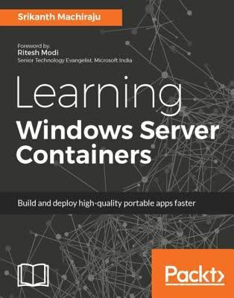
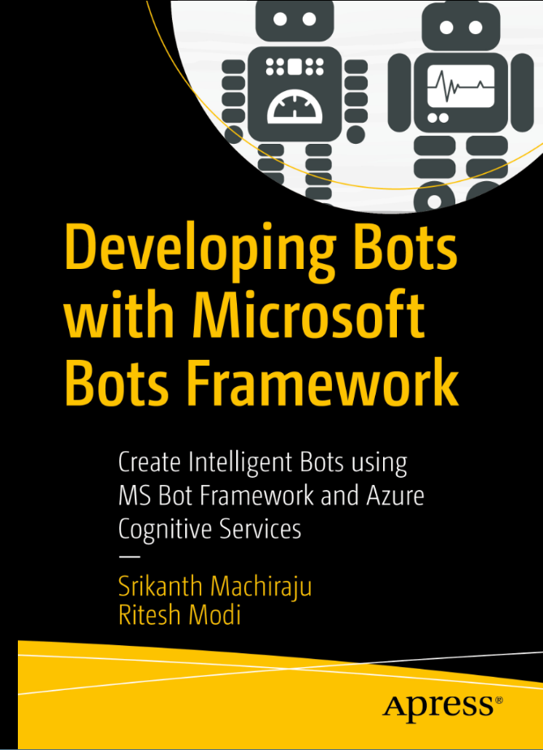
Srikanth Machiraju
www.linkedin.com/in/vishsrik
Run UI Automation Tests using Selenium Grid and Azure Container Service (AKS)
Senior Consultant | Author | Blogger
Microsoft, Hyderabad

Slide 2
Prerequisites
Visual Studio 2017 (Free Edition)
Microsoft Azure Subscription (Free Trial)
Source Code (Git Hub)

Slide 3

Problem Statement
Manually Testing a UI heavy application is cumbersome.
UI Automation Tests - The fastest and most productive way to test a UI intensive product.
UI Automation Tests are time consuming.
Sequential runs are not suitable for large applications.
Say, you have to run 1000 test cases on weekly basis – The test run takes 1.5 day.
Continuous Testing is must to enable quality and faster deployments and to meet market demands
How can we ensure the tests are running within minutes/few hours to ensure we can deploy faster?
Selenium-Grid allows you run your tests on different machines against different browsers in parallel

Slide 4
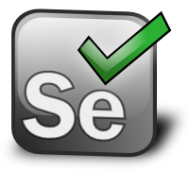
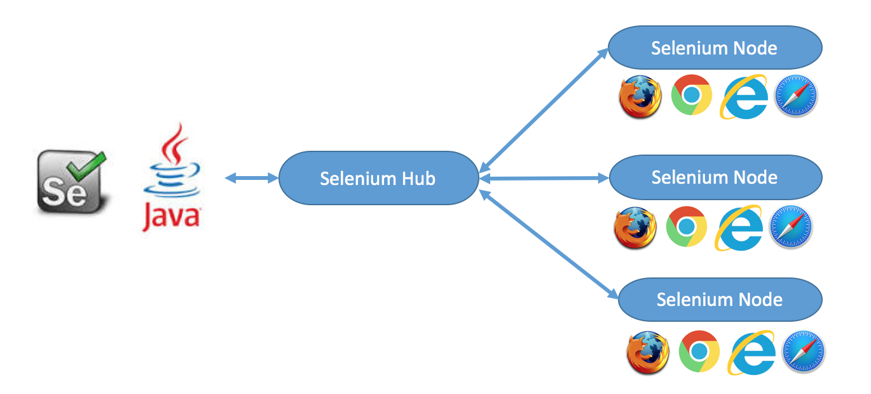
Selenium Grid
A Selenium Grid is a tool from Selenium which can be used to run UI automation tests in parallel, on different platforms or browsers.
It is build on Java
A Selenium Grid consists of a Hub and one more nodes
Selenium Hub helps you distribute the tests to the nodes.
More the number of nodes, higher the level of parallelism
java -jar selenium-server-standalone-2.44.0.jar -role hub
-------------------------------------------------------------------
java -jar selenium-server-standalone-2.44.0.jar -role node -hub http://localhost:4444/grid/register

Slide 5
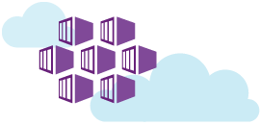
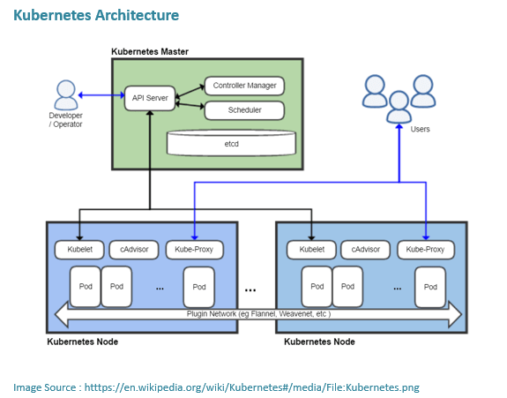
Azure Container Services (AKS)
A Container is a instance of a deployment
A Container Image a template for a container
A Pod is a unit of deployment in container world
A Service is an endpoint to reach the Pods
A Node is a host for Pods
A Master manages Jobs and Schedules Nodes
ACS (K) is a management Kubernetes Cluster which can be used to setup the above environment – Master is free, we pay only for Nodes

Slide 6

Run UI Automation Tests using Selenium Grid and Azure Container Service (AKS)

Slide 7
Create AKS Cluster using Azure-CLI
az login
az group create -g sg-rg-cu -l “centralus"
az aks create -g sg-rg-cu -n selenium-grid
az aks get-credentials -g sg-rg-cu -n selenium-grid
az aks browse -g sg-rg-cu -n selenium-grid
az aks delete -g sg-rg-cu -n selenium-grid

Slide 8
Manage Cluster using kubectl
kubectl run selenium-grid --image selenium/hub:3.3.0 --port 4444
kubectl expose deployment selenium-grid --type=LoadBalancer --name=selenium-grid
kubectl get service selenium-grid --watch
kubectl run selenium-node-chrome --image selenium/node-chrome:3.3.1 --env="HUB_PORT_4444_TCP_ADDR=selenium-grid" --env="HUB_PORT_4444_TCP_PORT=4444"
kubectl scale deployment selenium-node-chrome --replicas=10

Slide 9
References
Selenium Grid:
https://www.seleniumhq.org/docs/07_selenium_grid.jsp
Docker Containers
https://www.docker.com/what-container
Kubernetes
https://kubernetes.io/docs/concepts/
Kubectl
https://kubernetes.io/docs/reference/kubectl/overview/
Azure CLI
https://docs.microsoft.com/en-us/cli/azure/?view=azure-cli-latest

Slide 10
Q & A
vishwanath.srikanth@gmail.com

