Slide 1
Capstone Project- PGDMLAI
Srinivas Poluchalla

Slide 2
Contents
Nuveen Overview
Business objective
Data visuals
Regression Analysis
Marketing strategy
Classification Analysis
Acknowledgements
Appendix

Slide 3

About
Name : Srinivas Poluchalla
Education : Masters in Mechanical Engineer
Six sigma : Black Belt
Experience : Automotive, Consumer appliances, Oil & Gas
Location : Houston, Texas, USA.
LinkedIn: www.linkedin.com/in/srinuti GitHub: https://github.com/srinuti Kaggle: https://www.kaggle.com/srinuti

Slide 4





















Overview
Channels
Firms
Products
Clients
Longer duration AUM &
Larger AUM’s → More profits!
Notes:
Nuveen, is market leader in bond market with market capital of about $1 Trillion in AUM. (2018 data) .
Channels = Independent dealer, National Broker, Dual, Fee based Advisers,& Private client group
Sub Channels = IBD, NACS, RIA, Global etc.
The Nuveen sells products through various channels to the large firms or Advisors in the form of products (529, Equatiy, SMA or CEF, MF or ETFs) these products are mainly invested in Asset class like real-estate, equity, municipal bonds, tax free govt bonds etc. The products sold to the client with either load fee or service fee or based on holding fee. The longer the client hold the AUM with Nuveen more the fees generated and hence profits.

Slide 5
Business Challenge
Objectives
Estimate 2019 [next year] sales using 2018 [past year] sales data
Estimate probability of adding new fund during 2019 [next] using 2018 [past] sales data.
Marketing strategy for 2019 [next] year.
Data Science
Using [past] year data estimate for [next] year, validate & modify model with actual data at the end of the year.
Click ‘Assumptions’
Click ‘Bias’
Notes:
For quality and training purposes 2019 year as [current year] and 2018 year as [past year].
Nuveen has limited data of only one-year history and using data science techniques predict the current year sales. The data provided is non timeseries and hence forecast of sales numbers are bit challenge and all the data is assumed to static with no relation to the time and market performance/ geopolitical situations or interest rates.
As a data scientist, the task is to prepare a robust model to predict the future sales. Upon completing the prediction, use the data to update the models for future predictions.

Slide 6




What does data say?
$$AUM= Σ (AUM product class(529, ALT,CEF, ETF,MF,SMA etc.)$$
AUM
$$AUM= Σ (AUM asset class(equity, fixed muni, fixed tax, money, etc)$$
$$Total Sales= Σ (Sales_{curr} and Sales_{12M})$$
Sales are all positive numbers and Redeem is negative numbers. AUM cant be negative !
Sales and AUM negative numbers are assumed zeros
$$Total Redem= Σ ({Redem}_{curr} and {Redem}_{12M})$$
$Total Sale_{2018}−Total Redem_{2018}=AUM$ (except for long term deposits)
$$No of Sales 12M 1 contains No of sales 12 M 10k values too!similarly for redem columns.$$
Notes:
Sum of asset class is equal to AUM and similarly all the product class sum is equal to AUM. This relationship directly exists between each column, this could be a significant impact for regressor since all these columns are linear related to each other.
Another important fact noticed is in Total sales = Sales curr + Sales 12 m similarly for redeem columns.
Total Sales – Total Redeem = AUM
The redeem column is always negative since the cash is withdrawn from the account. Once negatives are converted into zeros most of the Redeem data is not considered for the regression. However two variables of the equation are taken into consideration , the relationship could still be preserved for the final sales numbers.
Large Negative numbers are not handled well with log transformers.
The No_of_sales_12M_1 contains 10k data too and they both follow similar covariance. Hence they represent the same or similar distribution, for this reason the columns concerning 10k are neglected for the regression.

Slide 7
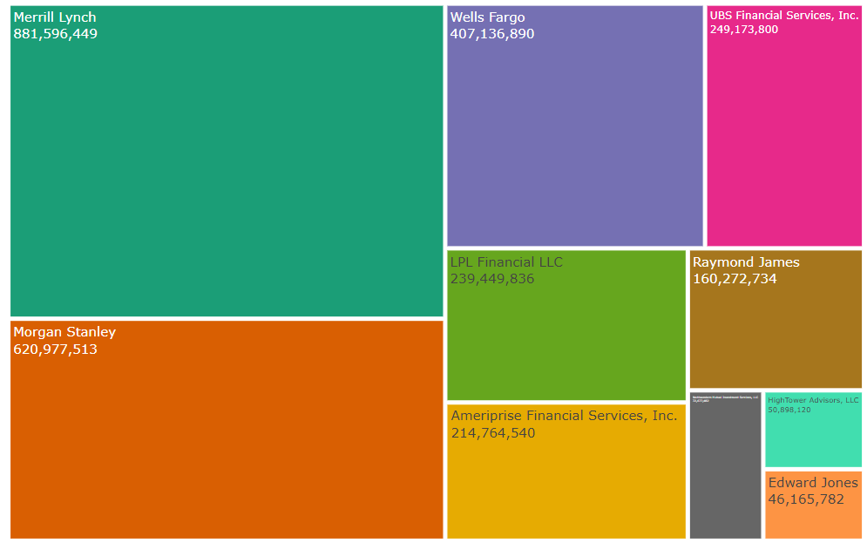

Major Firms AUM
MF
$523M
$882M
SMA
$300M
MF
$284M
$621M
SMA
$231M
Facts
Only UBS Financial Services, Inc. sales “Product Class – ALT” – $13.8Million.
Bernardo Wealth planning with only one branch generates $20Million
Values are in $
* 2018 sales data
Notes:
Top 4 companies generate almost ~75% of the company
The numbers represented are $AUM numbers . If top 2 companies are looked at, you will clearly see that the funds are allocated between MF and SMA. These funds hold 90% of the firms capital, again the AUM’s are long term deposits and they are not direct representation of sales performance for the year 2018.
The short-term trading funds (CEF, MF & ETF ) are not captured by this dataset, since the data only represent year end sales details.

Slide 8
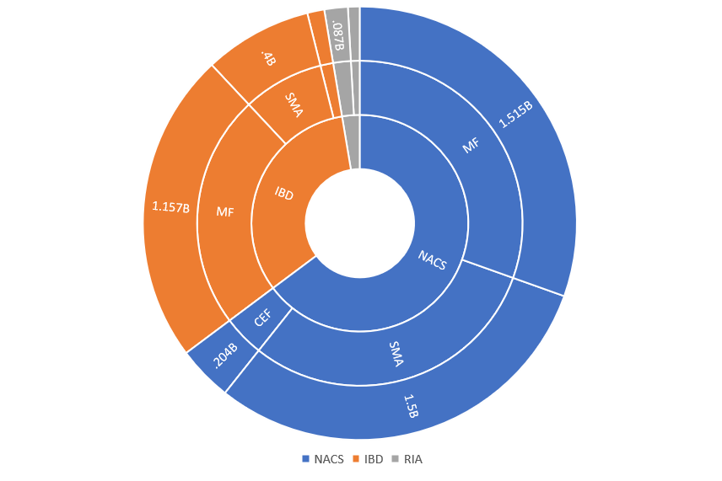
Sub Channel Performance
$3.325 Billion business through National Broker dealers (NACS)
$1.667 Billion business Independent dealers
97% business happens through NACS and IBD channels
2.6% of business through ‘(RIA) Fee based Advisors’
Rest of the channels (USBT, AFFL, Other, Global, DCIO) are less than 1%
Notes:
97% of the trading happens through the two sub channels IBD and NACS, in that if you closely look the AUM has majorly MF and SMA,

Slide 9
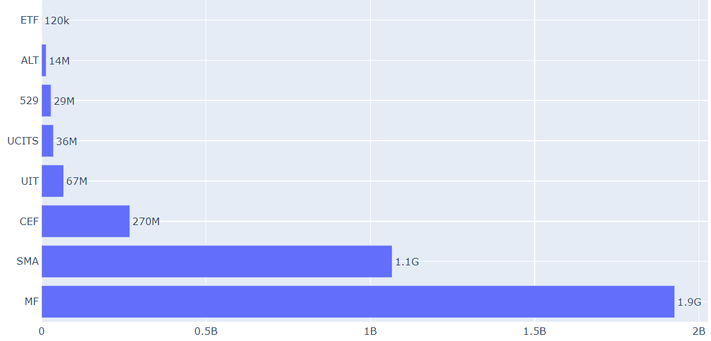
Most invested Product class
Only one firm, Morgen Stanley has $150k ETF fund at the end of 2018.
ETF’s are market driven hence buying / selling happens based on the stock market.
Product Class
Only one firm, UBS Financial sold $14M ALT fund.
Can this product class be phased out?
Amount in $
2018 sales data
Negative values are not converted to zero’s

Slide 10
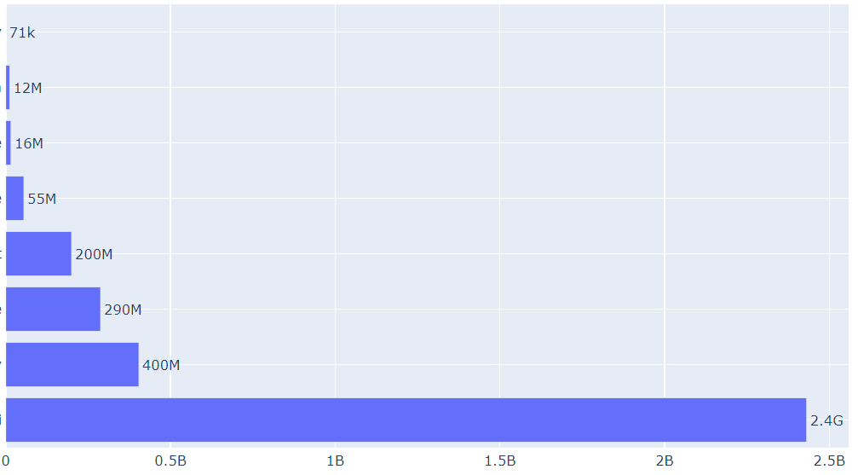
Asset Class
Money
Asset class Money has lowest revenue at the end of 2018 year, can this be out phased?
Physical Commodity
Real Estate
Asset Class
Multiple
Asset class fixed municipal bonds are long term in nature and hence they are carried over year after year.
Target
Fixed Taxable
Equity
Fixed Municipal
Amount in $
2018 sales data
Negative values are not converted to zero’s
Notes:
The bonds are more than year holding hence there are possibilities of spillover from year/ year. Hence AUM for fixed municipal bonds you see large spike even without any association with sales figures.
All the raw data is good so far how do we make use of it for the forecast or prediction of next year sales.
Two important categories that are to considered one
How revenues we Nuveen would be generating next year
How many new products could Nuveen sale this to rest of the target groups.
Revenue tells us future revenue.
New product offering tells us about new clients business (indirect)

Slide 11

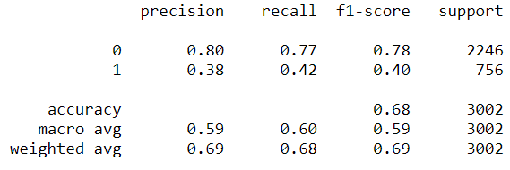
Baseline model
Sales data [next year] = sales data of [pervious year] remain same year over year.
New fund [next year] = new fund of [pervious year] remain same year over year.
Classification Baseline
Predicted Label
 | 0 | 1
0 | 1730 | 516
1 | 437 | 319
Actual label

Slide 12




Regression Analysis
Import
Import files merge 2018 & 2019
Split train/ test sets
Linear Regressor Model
Features | coef
constant | 0.567221
No of sales 12M 1 | 0.509898
No of Redemption 12M 1 | 0.761213
AUM | 0.074597
Total Sales (curr + 12M) | 0.668180
Train
Fill NaNs with zeros
Run feature selection
Identify features
Negatives to zeros
Transform data
Split X_train and y_train
Test
Fill NaNs with zeros
Negatives to zeros
Transform data
Split X_test and y_test
How good is the prediction?
Parameters | Values
Mean Absolute Error (MAE) | $130k
R2 | .62
Max Error | $32 Million
Regressor
Run regressor models
Select best regressor model
Find coefficients

Slide 13
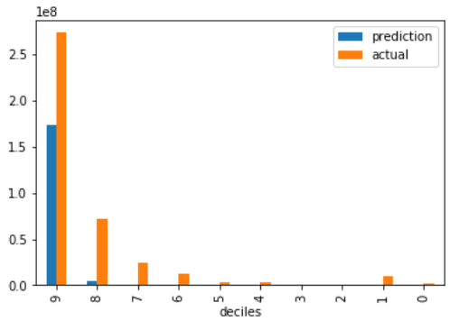
Regression Analysis
$$Sales_{2019}=0.567221+0.509898∗{\text{4395} \atop nos}\left\lceil \text{no} \text{of} \text{sales}\text{ 12}\text{m}\text{ 1}\right\rceil +\text{0.761213}∗{\text{12152} \atop nos}\left\lceil no of Redemption 12M 1\right\rceil +$$
$$0.074597∗{\$223M \atop \$}\left\lceil AUM\right\rceil +\text{0.668180}∗{\$57M \atop \$}\left\lceil total sales\right\rceil$$
*Units:- AUM & total_sales are in $, No of sales/redemption are in numbers
*Max prediction Error $32 Million (range up to $223Millon)
*R2 square values for both train/test are 65%/62%
*Values of upper left corner represents max value; bottom left corner represents units for given [variable]
Model predicts 45% of Actual sales 2019
Small test set sample size
Sparse data
Several large outliers
Sales 2019 in $
Population sample in deciles %
Notes:
Total sales for 2019 Actual = $402 Million, the model both decile 9 & 8 put together could capture only $183 Million dollar about 45% of actual sales. Which very low , hence the historical data collection methods to be relooked at and understand more deeply why the issues a raise.
Decile plot:
Clearly you see that the 50% of the data, is zeros. Remaining values are distributed exponentially, this is nice because it allows our strategies to be focused only top 10% of the population. The delta difference between two columns actual and predict columns gives info on ‘Regressor performance” if you closely observe the data only represents close to 45% of actual sales numbers.
Model is predicting based on small sample size of 2502 rows. Which is very low , in that predominately there are lot of outliers, the outliers skew the data and shift the median away from the mean.
Large amount outliers distort the predictions.
Sparse data, meaning the data rows has lot of zeros and they are equated to zeros of sales 2019.
When 2018 sales has zero sales, year 2019 shows large sales. This means, we are equating the zeros of 2018 data into the 2019 sales data, which could lead to high erroneous numbers of predictions.
When 2019 sales has zero sales, year 2018 shows large sales.

Slide 14
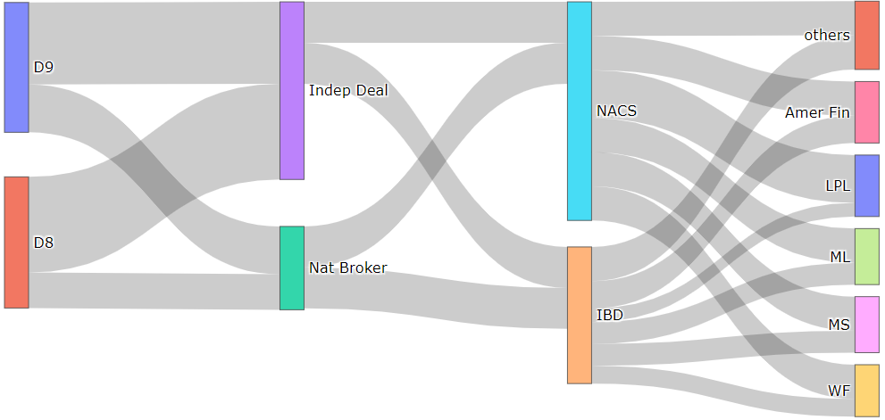
Money flow
Deciles
Channels
Sub Channels
Firms
$70 M
$21 M
$27 M
$24 M
$30 M
20% population sample size
$8 M
Lift table
Market Opportunity = $178M
Notes:
Total 2019 Actual sales size = $403 Million
How well the regressor captures these values in? What do we recover from the two decile,
Regressor predicts about 45% of total actual sales which about 183% million, in two decile 99% of predictions are covered that means 20% of population represents entire market size.
Hence our focus group mainly depends upon decile 9 & 8. The market strategies can be based of these two deciles.

Slide 15





Market Strategy
Strategy
10%
Cost of maintaining Social Media campaign is relatively low and has significant outreach to ‘Millennials’.
Significant competition in mutual fund business nearly 8000 funds as on 2019 (Statista Research Department)
Better the predictions, more the market share!
8%
6%
Sales budget (10% of revenue)
4%
2%
20%
40%
60%
80%
100%
20% population size
Top revenue firms
Notes:
In person meeting =
Meeting and Special Events =
Tele Marketing =
Social Media presence =
Explain “Y Axis” :- The 20% population from Decile plot is taken and plotted in an ascending order, all the firms with high sales numbers are on the zero and low values are on the right.
In that top 40% of them qualify for the in-person meeting, the number of 250 * .4 = 100 firms in-person meeting
Remaining 30% shall be allocated for meetings and special events where more than two three firms are invited or visited to discuss the market strategies.
Third categories are for telemarketing and forth is for the social media penetration.

Slide 16
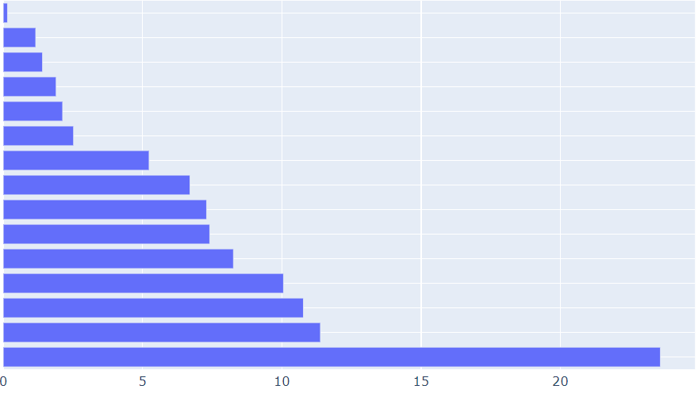
Classification Analysis
RandomForest Classifier Feature importance
Import
Import files merge 2018 & 2019
Firm info
AC Real Estate
PC 529
AC Target
New fund 2018
PC CEF
Subchannel
No funds sold
Train
Fill NaNs with zeros
Convert some datatype to categorical
Feature selection
Split X_train and y_train
Balance labels
AC Multiple
PC SMA
No of fund current
No of sales
No of Redemption
Total Sales
AC Fixed Income
AUM
Test
Fill NaNs with zeros
Split X_test and y_test
% Probability of adding new fund
If 2018 sales has money in ‘AUM’, has 24% probability of adding ‘new funds in 2019’.
Regressor
Run Classifier models
Select best classifier model
Find feature importance

Slide 17
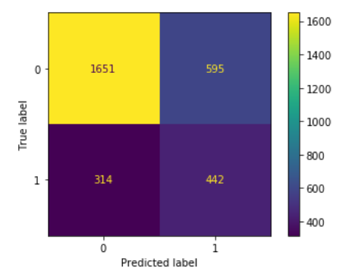
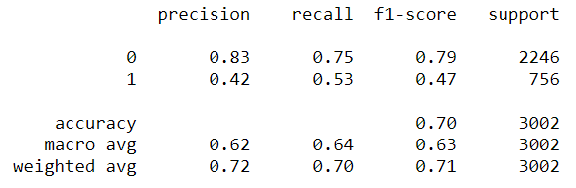
Classification Metrics
%11 increase in recall compared to Baseline
% 7 increase in f1-score compared to Baseline
% 4 increase in precision compared to Baseline
Class 1 = New fund added
Class 0 = No new fund

Slide 18
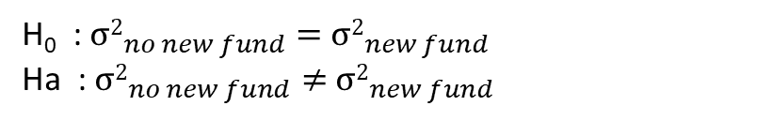
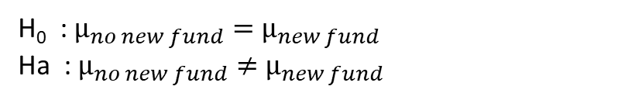
More new funds → More revenue?
Mean test
Variances test
H₀ : $μ_{no new fund}=$ $μ_{new fund}$
Ha : $μ_{no new fund}≠$ $μ_{new fund}$
H₀ : ${σ2}_{no new fund}=$ ${σ2}_{new fund}$
Ha : ${σ2}_{no new fund}≠$ ${σ2}_{new fund}$
No statistically significant revenue increase by adding new funds
Evidence from 2018 [past] data
90% generated by two product class ‘SMA’ & ‘MF’s
95% funds are invested into ‘Fixed Municipal Asset Class’

Slide 19
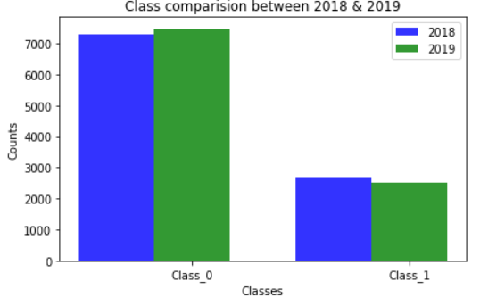
More new funds → new business?
Column | (Class 1) New Fund | (Class 0) No New fund
No of sales | 35.86 | 14.77
No of funds sold | 2.27 | 1.06
No of Asset class sold | 1.202 | 0.64
No of sales >10k | 4.1 | 1.85
No of funds sold >10k | .966 | .436
No of Asset class sold >10k | 0.6 | .304
Mean transactions = Number of transactions / Total number of columns of new fund or no new fund
Comparing means atleast it shows that there are more transactions with new funds
More Number of transactions → More customer traffic to firms → New business!

Slide 20
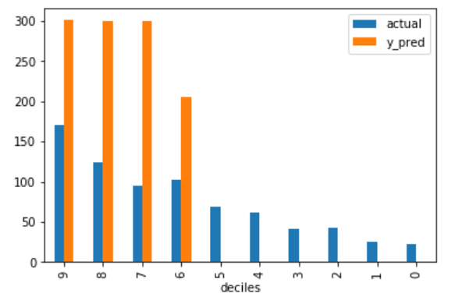
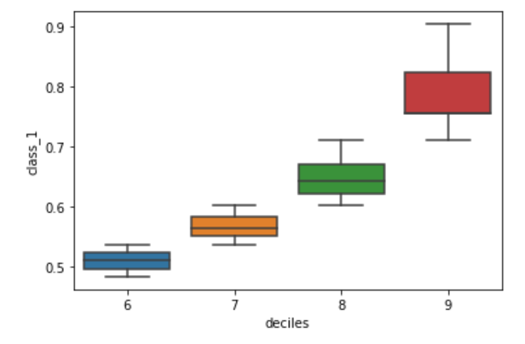
Market Strategy for New funds
Probability
Decile 9 has firms with 70% to 90% probability of adding new funds → ‘In person Meeting strategy’
Decile 8 has firms with 60% to 70% probability of adding new funds → ‘sort them with other marketing strategies’

Slide 21
Conclusions
LPL Financials LLC contributes significantly for revenue addition $27Million in 2019
LPL Financials LLC has 90 to 70% probability of adding new funds in 2019
Regression model predicts 62% higher than baseline.
Classification Model predicts 11% higher recall than baseline.
The model could be improved further by adding
More balanced data (class 1 data)
Timeseries data
More historical data
Lesser outliers
Less sparse data

Slide 22
Future work
Low income / medium Income zip code office locations are underrepresented by data
Suggestions:-
Map Adviser vs Zip code vs Median Income range, housing data, employment data etc.
Analysis revenue generation location wise.
Using NetworkX map shortest distance between two Advisers/ firms.
Using NetworkX map, ‘In person sales” strategy can be prepared.
Firm/ Adviser with single office location might be underrepresented
Use Bayesian Theorem and update ‘aprior’ dataset year over year to predict more accurately with options of selecting independent variables.

Slide 23
Acknowledgments
Carleton Smith , Data Scientist
Jacob Koehler, Course Leader
John W Paisley, Columbia University
Ansaf Salleb Aouissi , Columbia University
Support team, Emeritus
PGDMLAI teammates – Hari Krishna Kapparapu, Ratan Siram & Rodrigo Allegretti
References
Slackflow for code on balancing classifier labels
Kaggle
Github repositories
Sklearn, Pandas, Statsmodel, etc python libraries.

Slide 24
Appendix

Slide 25
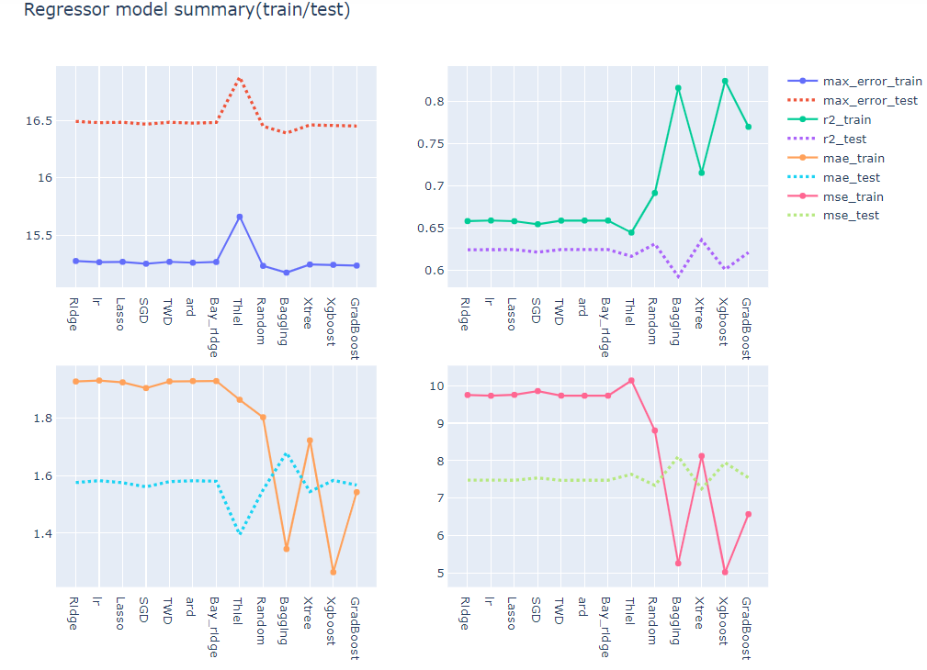
Regressor metrics
Max Error
R2
MAE
MSE
*Error graphs - Y axis values are in log scale
*R2 y axis in 0-1scale
MAE = Mean Absolute Error
MSE= Mean Squared Error

Slide 26
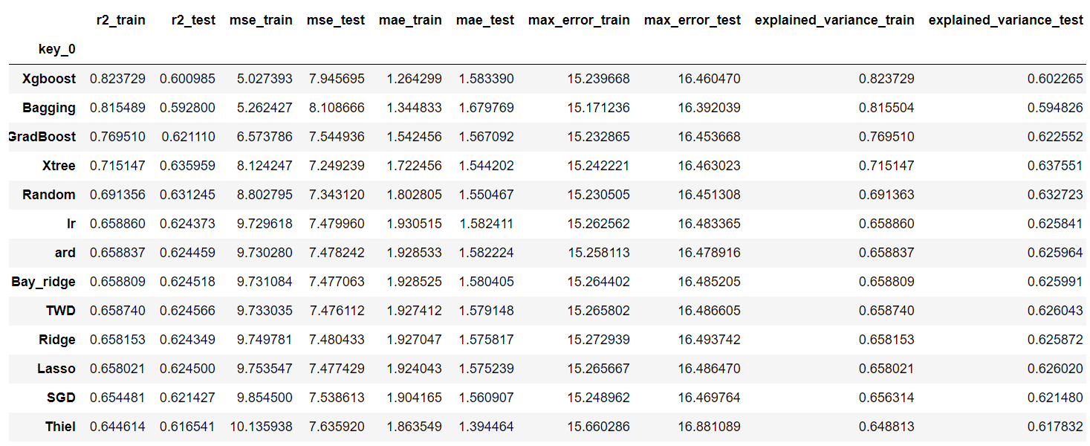
Regressor selection
*MSE= Mean Squared Error
*MAE = Mean Absolute Error
*Errors are in log scale
*R2 in 0-1scale

Slide 27
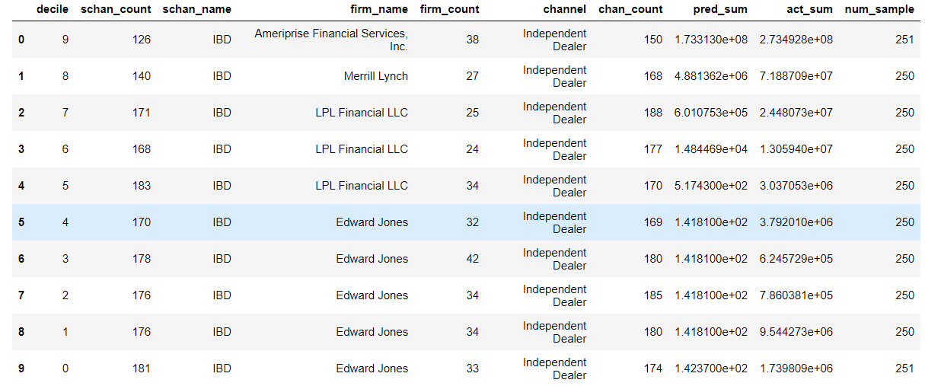
Lift Table for regression

Slide 28
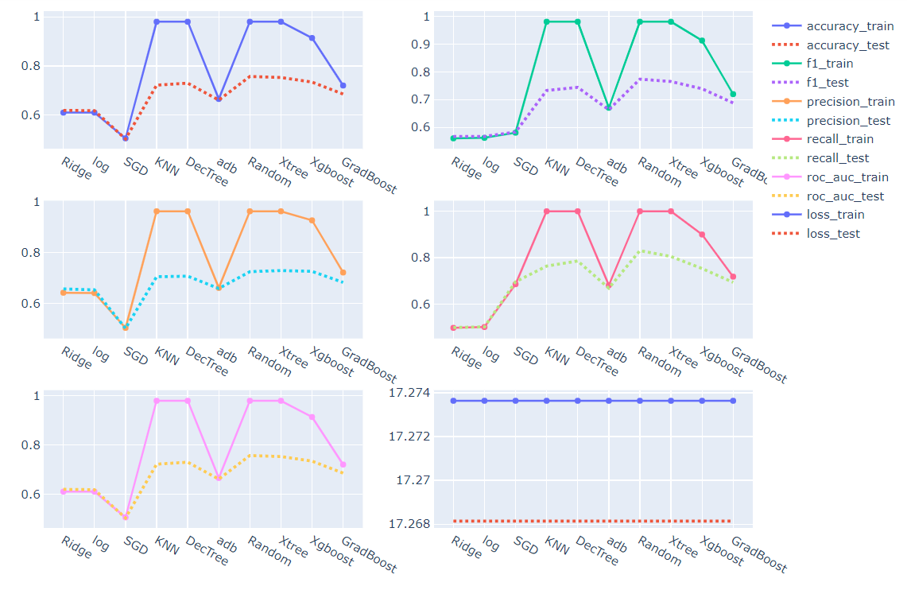
Classifier metrics

Slide 29
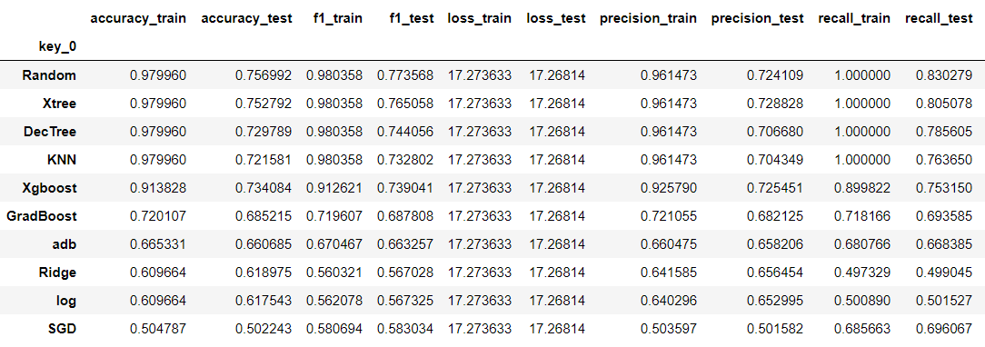
Classifier selection
RandomForestClassifier :- It is tree-based classifier using ensemble methodology.

Slide 30
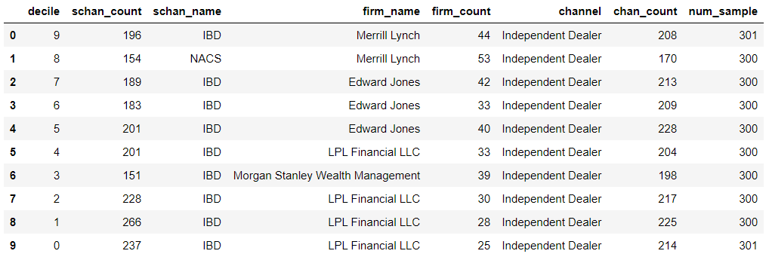
Lift table for classification
Decile 9 has firms with 70% to 90% probability of adding new funds
Decile 8 has firms with 60% to 70% probability of adding new funds

Slide 31
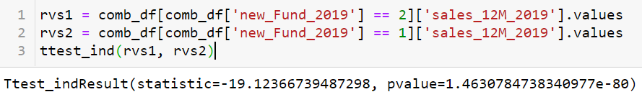
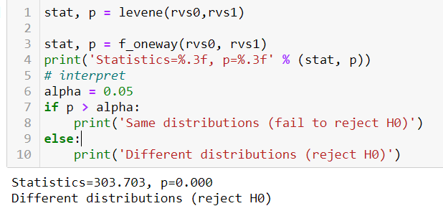
Means comparison
Different distributions reject H0
Variance comparison

Slide 32
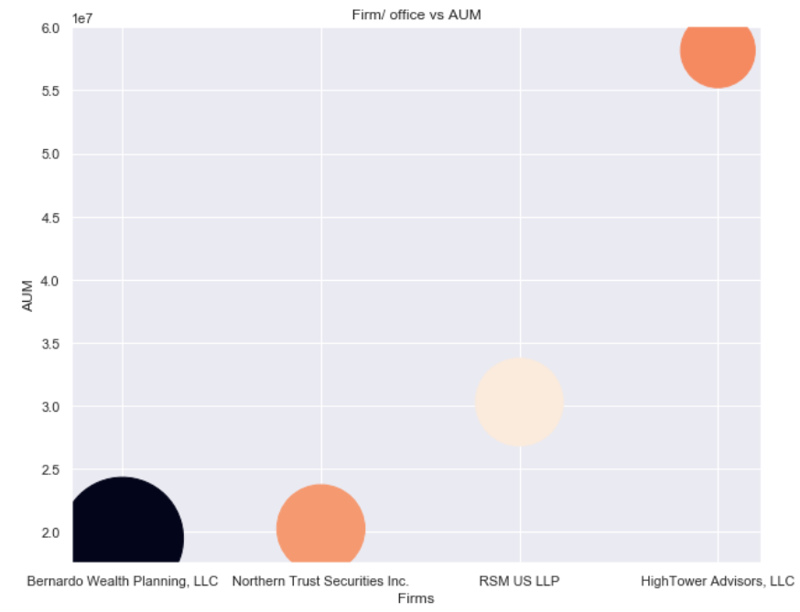
Major Firms
Most revenue generating firm/ office?
Bernardo Wealth Planning, LLC with single office generates $19.5Million AUM

Slide 33
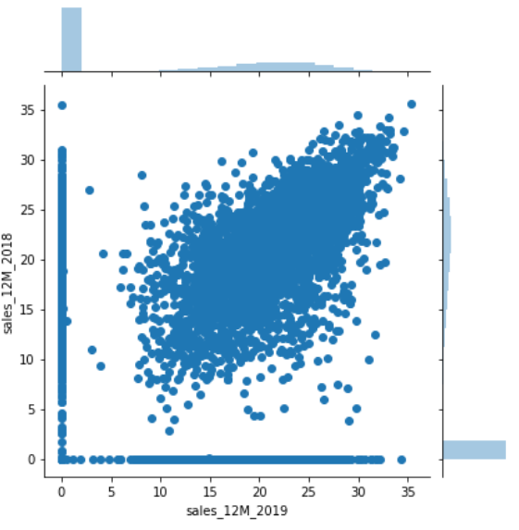
Group 3
Group 1
Group 3 → 2018 sales data when 2019 sales data are zero.
Group 2 → 2019 sales data when 2018 sales data are zero.
Group 1 → Log transformed data showing linear relationship between 2018 and 2019 sales
Group 2

Slide 34
Bias/ Assumptions
Bias
1. Adviser’s career start date (if Adviser has started in the 2018, he would wrongly be classified as underperformer for the whole year of 2019)
2. Adviser’s geo location and affinity to High income population has impact on performance.
3. Adviser’s / Firms with single or few office location could be potentially underrepresented.
4. Only year 2018 data provided; the conclusions drawn does not consider historical performance
Assumptions
2019 Sales are dependent on market performance, geopolitical stability, market speculation, government policies etc. Based on the dataset it is assumed that the market and other factors behave like 2018 .
The sale and redemption time details are not provided and hence AUM is assumed to be balance at the end of the 2018
Negative values in Product class and AUM are assumed to be zero for some analysis.

