Slide 1
Impact of Search Engine
24 Aug 2021

Slide 2
Agenda
Business Use case Input & output Technical Stack & Design flow
Edge cases covered References
Q & A

Slide 3
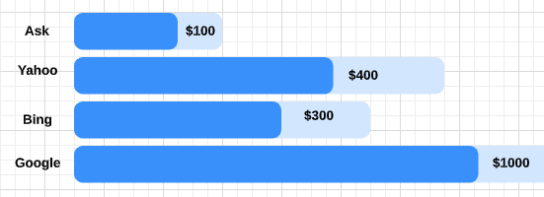
Business Use case
How much revenue is the client getting from external Search Engines, such as Google, Yahoo and MSN, and which keywords are performing the best based on revenue?

Slide 4
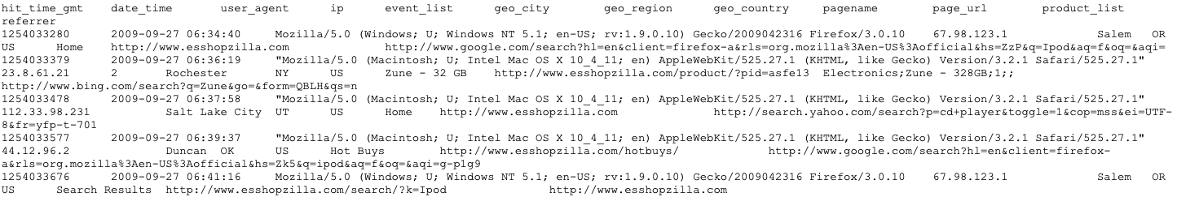

Input & Output
Input
Files will be landed hourly into S3 bucket
output
Output will be loaded to S3 in tab separated

Slide 5
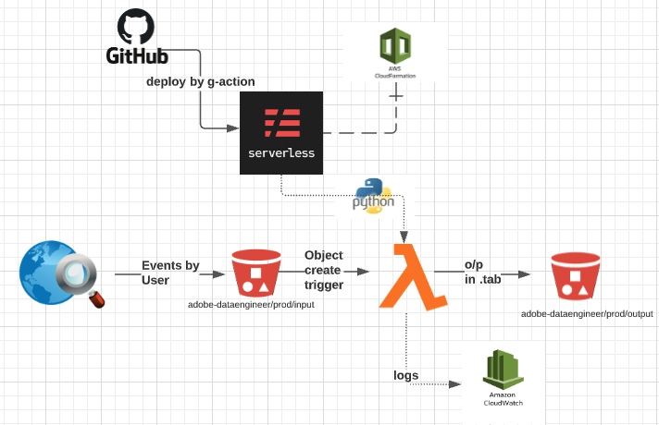
Technical Stack & Design flow
Technical Stack
AWS Tools – Lambda , S3 , CloudFormation , CloudWatch
Programing Language – Python
Repo – Github
Deploy Framework - Serverless
Design Flow

Slide 6
Edge cases covered
Revenue Calculated for below Edge cases
if User purchase one product or multiple products in a purchase event
If User have multiple buys in different purchase events in a session
If User have multiple buys in different purchase events in multiple session using different search keys

Slide 7
References
Github Repo
https://github.com/srinvias/ShoppingRevenueBySearchEngine
Serverless F/w
https://www.serverless.com/framework/docs/providers/aws/events/s3/

Slide 8
Q & A

