Slide 1
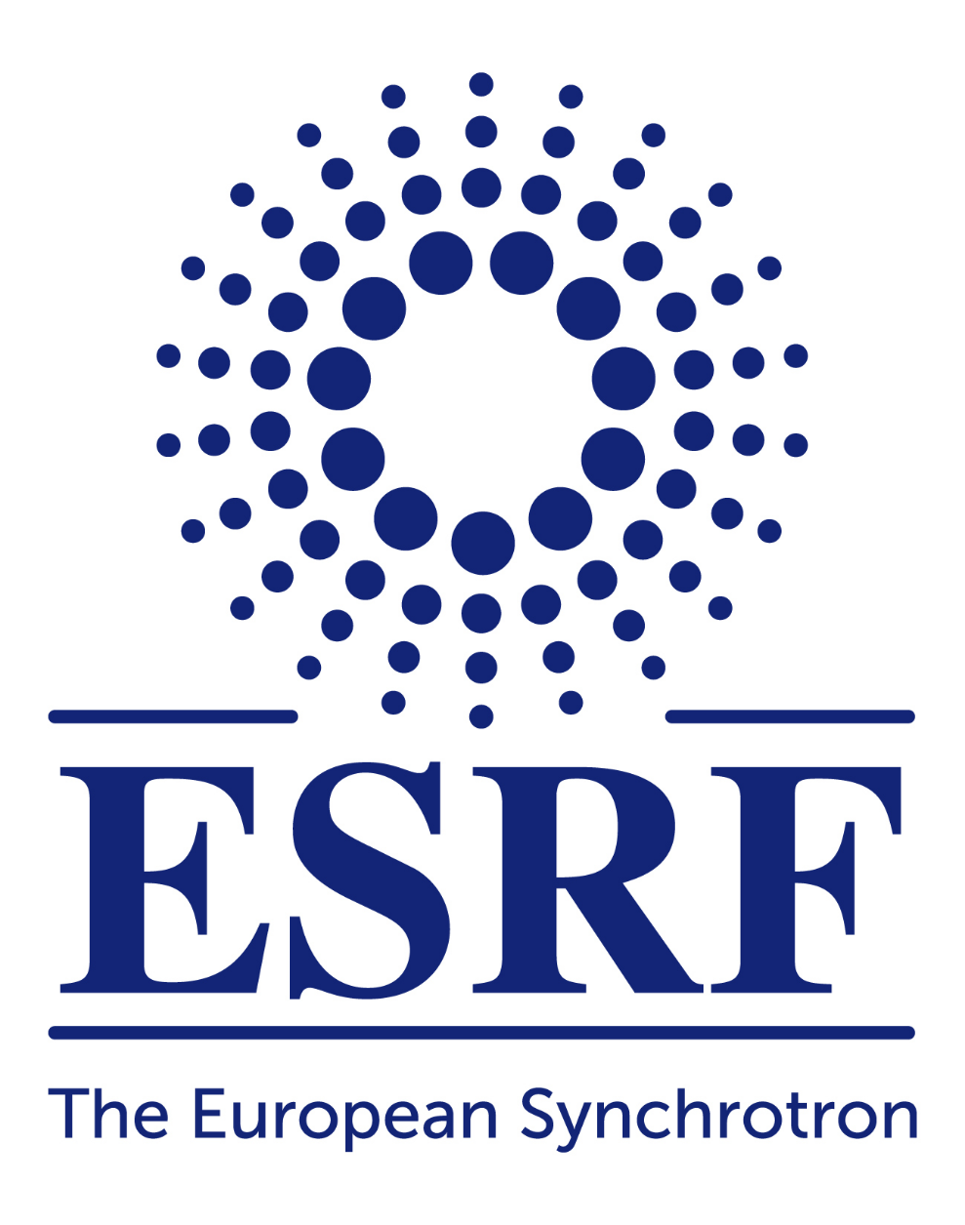

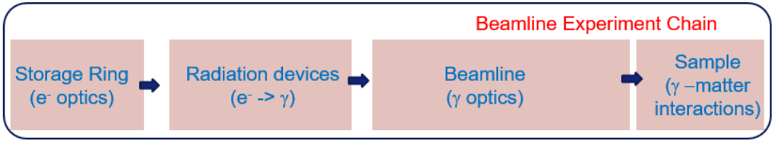
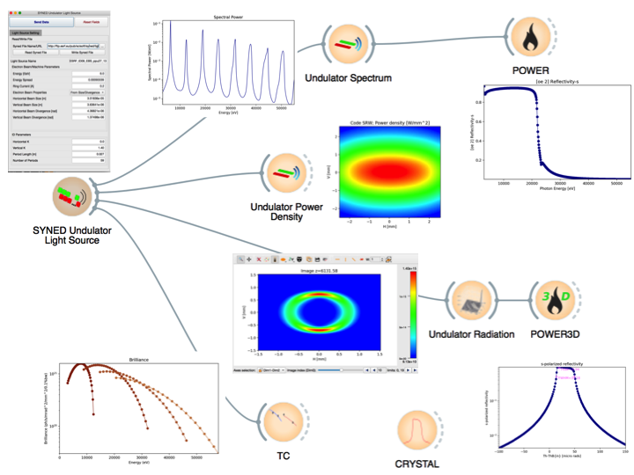
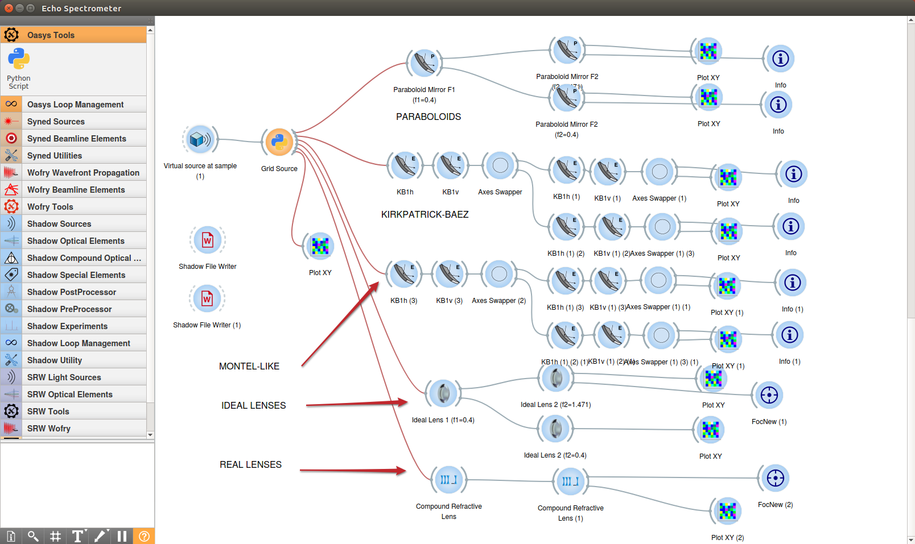
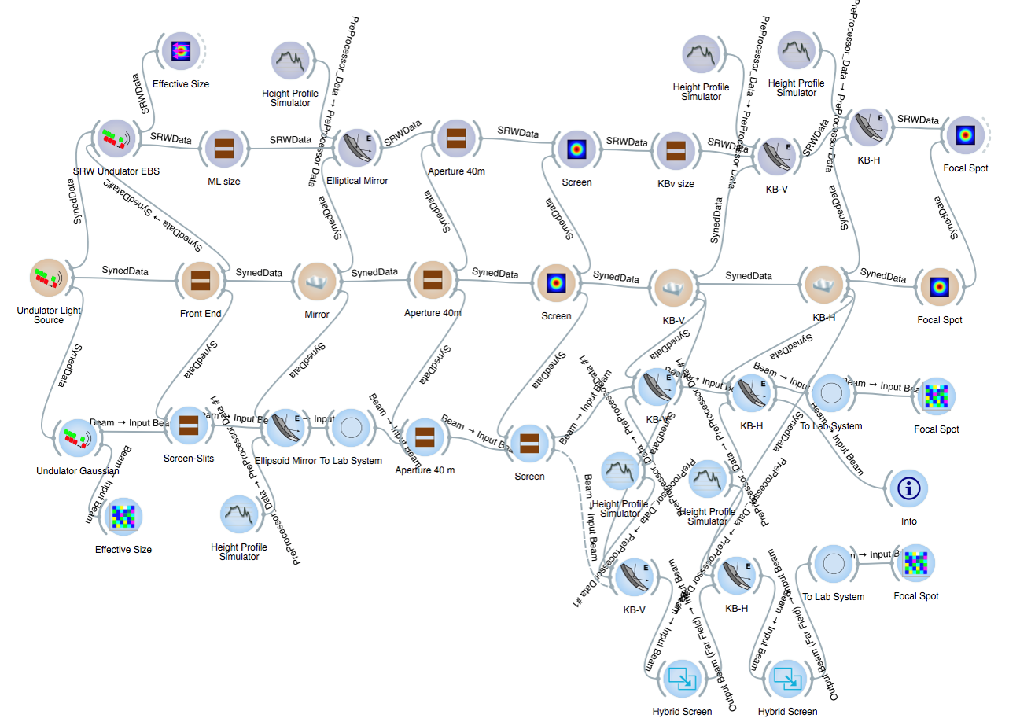


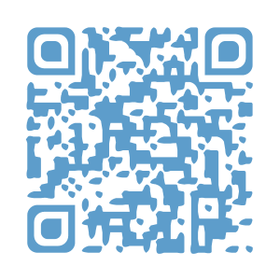
OASYS: a software suite for beamline simulations and synchrotron virtual experiments.
Manuel Sanchez del Rio (ESRF, France) and Luca Rebuffi (Elettra, Italy)
OASYS (OrAnge SYnchrotron Suite) is an open-source graphical environment for beamline simulation and optimization, for performing virtual synchrotron experiments in an efficient, elegant and precise way.
OASYS integrates in a synergetic way some of the most powerful open-source calculation engines available. It interfaces widely used simulation tools for X-ray Optics (e.g. SHADOW for ray tracing, and SRW for wave optics) that are complemented with new tools. OASYS provides a mechanism to communicate among the different packages by sending and receiving encapsulated data.
The workflow of a synchrotron virtual experiment
OASYS aims to simulating the complete chain of a synchrotron experiment. Thus, the virtual experiment can be decoupled in different steps
The Toolboxes: XOPPY, XRayServer, SYNED
OASYS contains different small programs to calculate the individual response of sources (spectral and angular characteristics), optical elements (mirror, crystals, etc.) and other tools.
OASYS defines a uniform and exchangeable description of the components of the virtual experiment. This is implemented by SYNED (SYNchrotron Elements Dictionary) a framework library that provides the glossary of light sources and optical components, together with a set of dedicated widgets.
OASYS elements: canvas, widgets, add-ons
OASYS environment for synchrotron radiation virtual experiments is presented as a graphical workspace (canvas) that can be populate with applications (widgets) that communicate among them and are picked up from menus. The applications (widgets) come from different simulation packages interfaced into OASYS and called add-ons.
Wave optics
WOFRY (WaveOptics Framework in pYthon), SRW [2], WISE [3], Partial coherence (under development): SRW (Monte Carlo multielectron), COMSYL (coherent mode decomposition) [5]
Interoperability
Wave optics simulation (SRW)
SYNED definition of beamline
Ray tracing simulation (SHADOW)
Branch using HYBRID
Key technologies
Open source https://github.com/oasys-kit/
Python-based
Visual environment: Orange [1] (http://orange.biolab.si)
Graphics: silx (http://www.silx.org)
Optical constants: xraylib (https://github.com/tschoonj/xraylib)
Ray tracing: shadow3 (https://github.com/oasys-kit/shadow3) and ShadowOui (https://github.com/oasys-kit/ShadowOui)
Wave optics: WOFRY, SRW [2] (https://github.com/ochubar/srw), WISE [3]
Remote calculator server: XRayServer (http://x-server.gmca.aps.anl.gov/)
Remote data server: DABAM [4]
Ray tracing
ShadowOui (frontend to shadow3 + Hybrid [6] + DABAM [4] etc.)
Availability
http://www.elettra.eu/oasys.html https://github.com/oasys-kit
References.
[1] Demsar, J., Curk, T. and Erjavec, A. Journal of Machine Learning Research 14, 2349 (2013) http://orange.biolab.si
[2] Chubar, O., Elleaume, P. Proceedings of the EPAC98 Conference, 22–26 June 1998, 1177 https://github.com/ochubar/srw
[3] L. Raimondi and D. Spiga, Astronomy and Astrophysics 573, p. A22 (2015)
[4] M Sanchez del Rio et al, Journal of Synchrotron Radiation 23 665-678 (2016)
[5] M. Glass, M. Sanchez del Rio EPL (Europhysics Letters) 119 3 (2017)
[6] X.Shi, R.Reininger, M.Sanchez del Rio, L.Assoufid Journal of Synchrotron Radiation 21 669-678 (2014)
Get poster:
https://cloud.esrf.fr/index.php/s/35ZRxjX3z4dkRmG

