Slide 2

EBSL1-ID18
Ray tracing and wave optics study of WBDM
Juan Reyes Herrera
Manuel Sanchez del Rio
AAPU/MEG
11/08/2021 (version 1)
18/11/2021 (version 2)

Slide 3
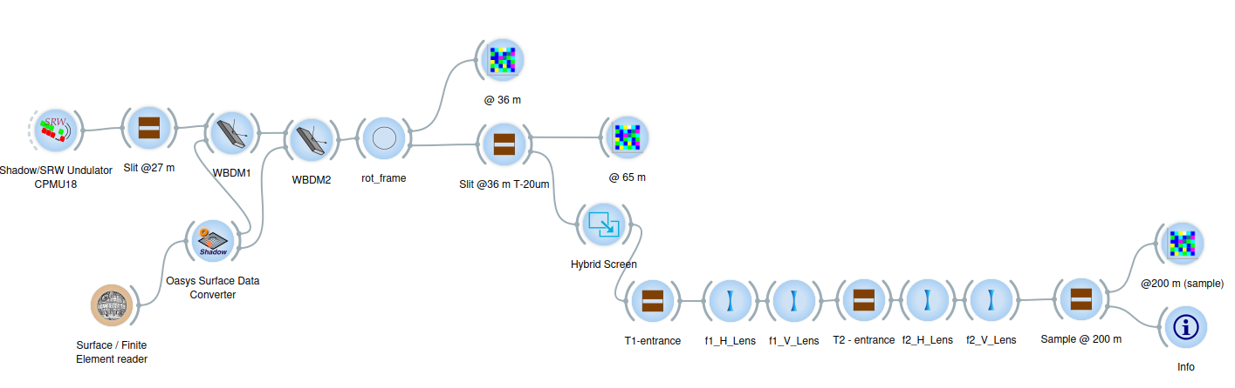
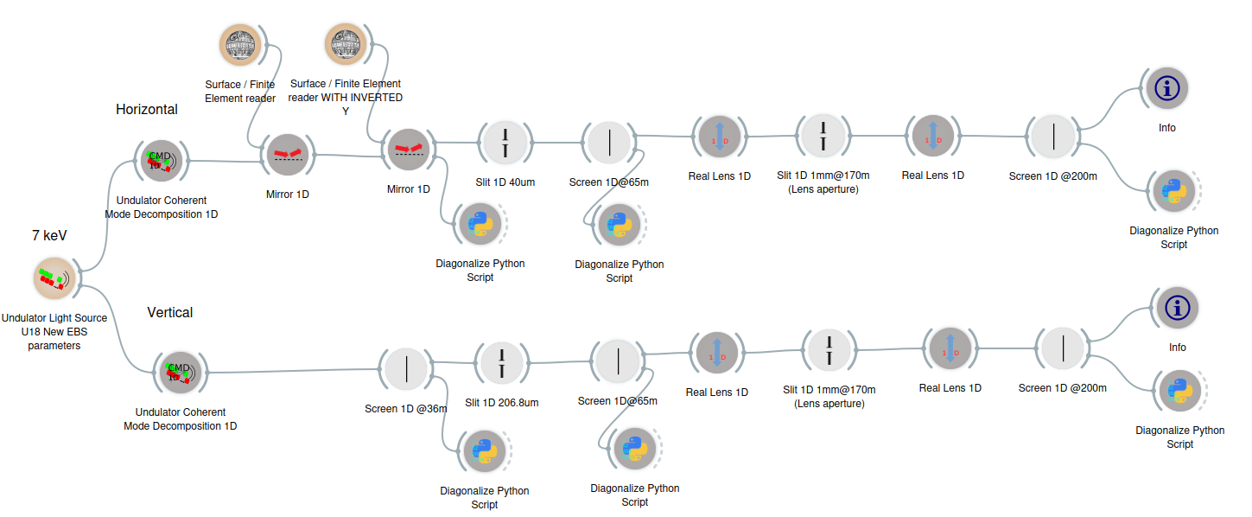
OASYS models using SHADOW (ray tracing) and WOFRY (wave optics)
Configurations: 7 keV, WBDM Si @ 3 mrad, coherence slit: 40 x 206.8 μm, f1 (h: 41.69 m, v: 49.73 m), f2 (h: 26.15 m, v:39.72 m)
Shadow (ray tracing)
https://raw.githubusercontent.com/srio/paper-transfocators-resources/main/workspaces/Hybrid-Shadow/EBS_ID18_shadow_WBDM.ows
Wofry (wave optics)
https://raw.githubusercontent.com/srio/paper-transfocators-resources/main/workspaces/EBS_ID18_wofry_WBDM.ows
Slope errors were considered for both WB mirrors in both SHADOW and WOFRY
SHADOW used hybrid mode for the slit only (to get reasonable vertical sizes))

Slide 4
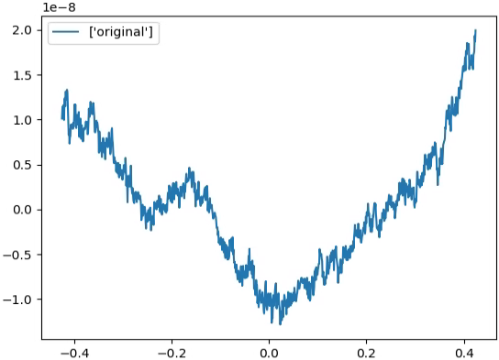
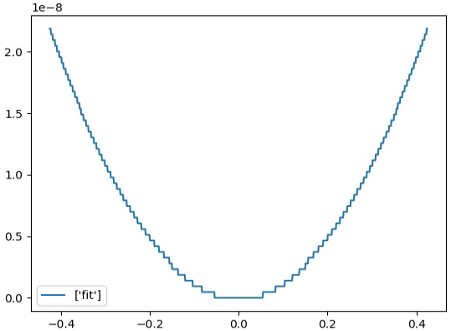
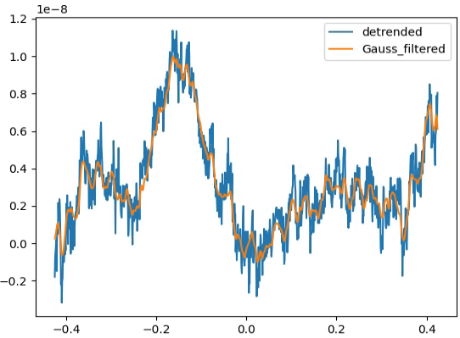
Profile errors of WBDM
Detrending and Gaussian smoothing
Original central profile*
Best fitting curve
profile [m]
length [m]
*From file provided by Raymond Barrett (ring256_TypbeB_F127001_frontside_ontissue_meas2__avg_2D.txt)

Slide 5
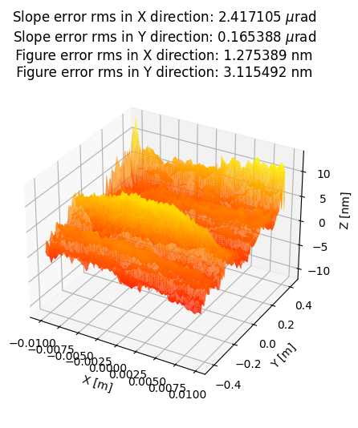
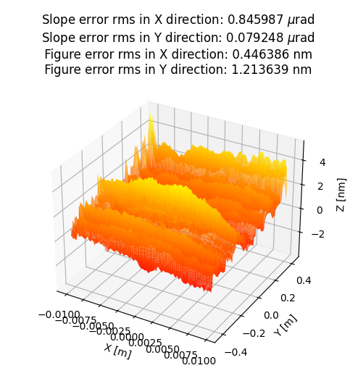
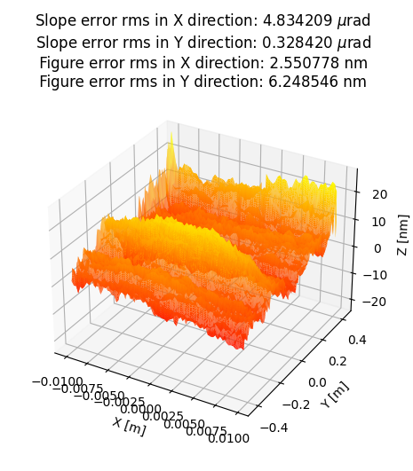
Profile errors of WBDM
By simply scaling the profiles, simulation were performed for 4 conditions:
Ideal surfaces
mod. surface: 165 nrad
mod. Surface to get about ½ slope error*
mod. Surface to get about 2x slope error
After applying the surface modification to the 2D surface:
* Because non linearity in Gaussian filtering, this is obtained multiplying height by 0.35

Slide 6
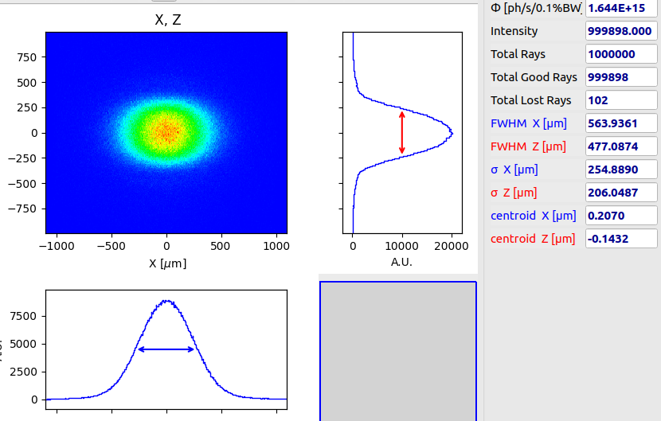
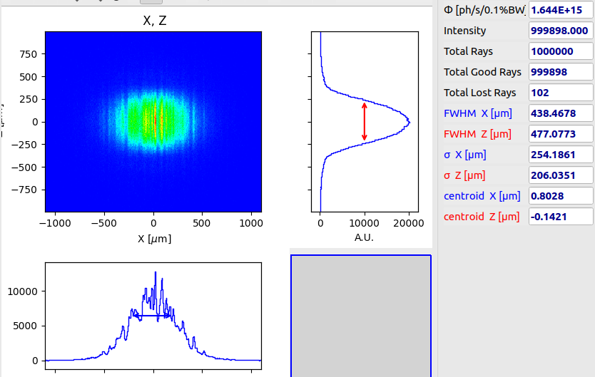
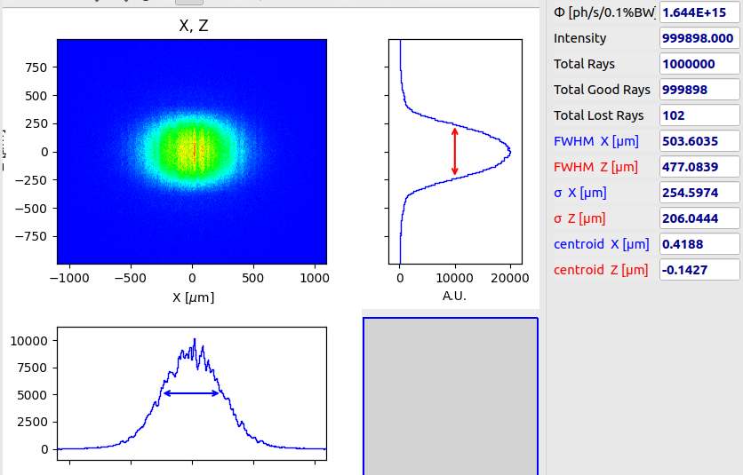

Beam profile – Coherence Slit (36 m) SHADOW
ideal
~165 nrad
z [μm]
z [μm]
~80 nrad
~330 nrad
z [μm]
z [μm]

Slide 7
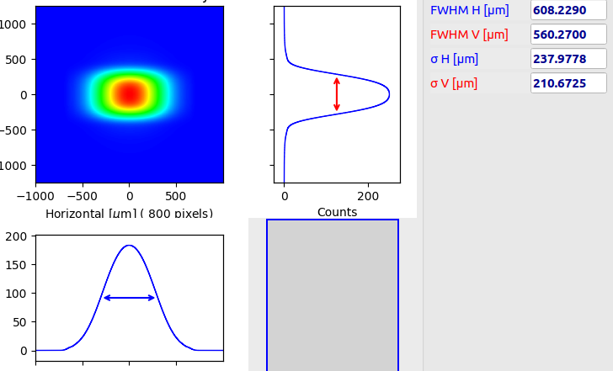
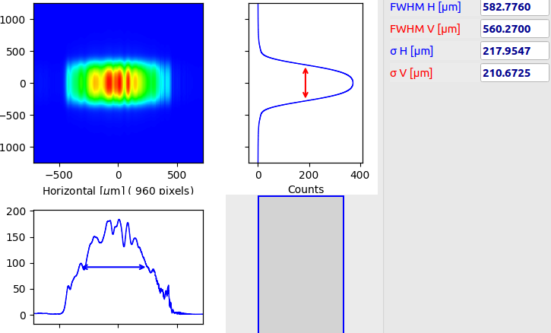
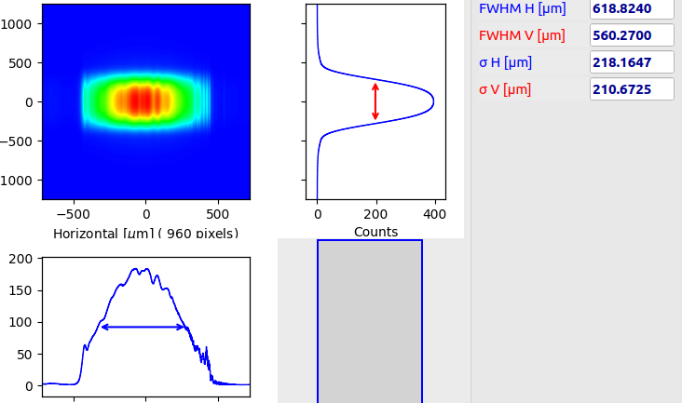
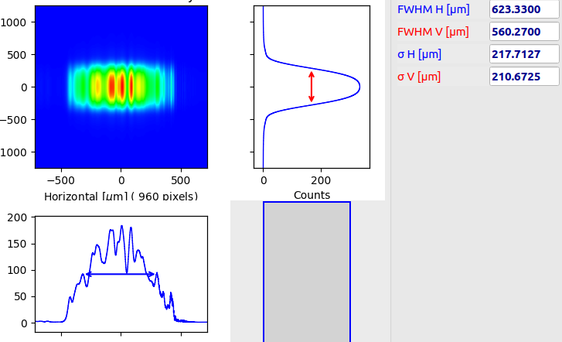
Beam profile – Coherence Slit (36 m) WOFRY
ideal
~165 nrad*
z [μm]
z [μm]
~80 nrad*
~330 nrad*
z [μm]
z [μm]
*The horizontal intensity has an abrupt cut of the tails: this is an artifact due to the propagation of the high modes, and should be improved

Slide 8
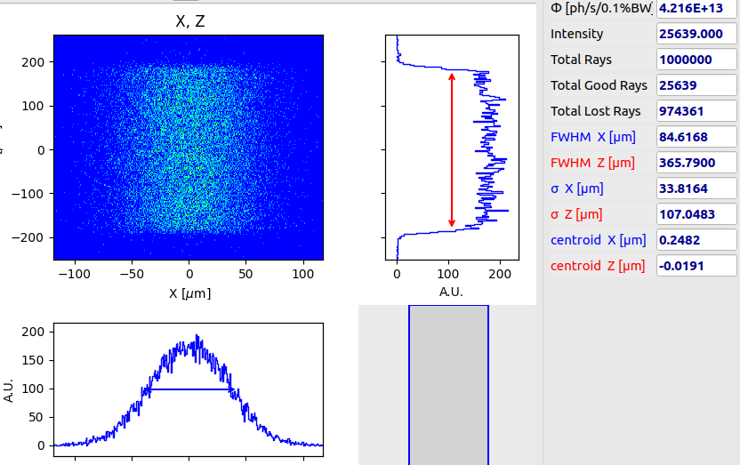
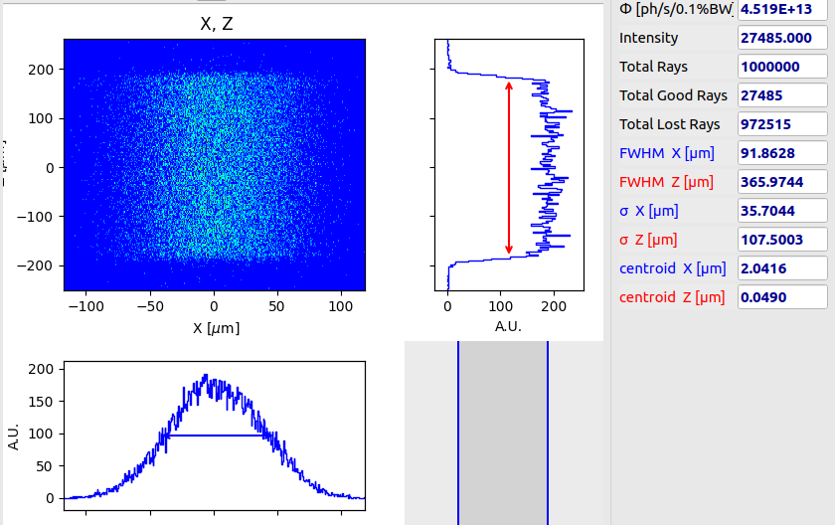
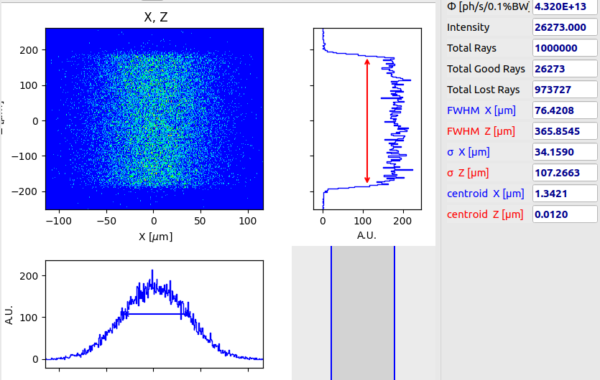

Beam profile – Transfocator 1 entrance (65 m) SHADOW
ideal
~165 nrad
z [μm]
z [μm]
~80 nrad
~330 nrad
z [μm]
z [μm]

Slide 9
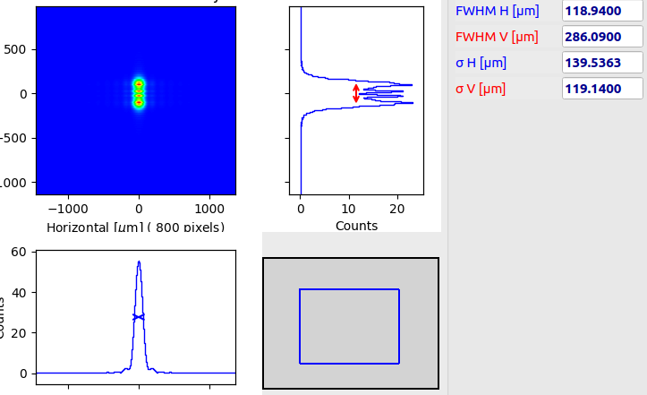
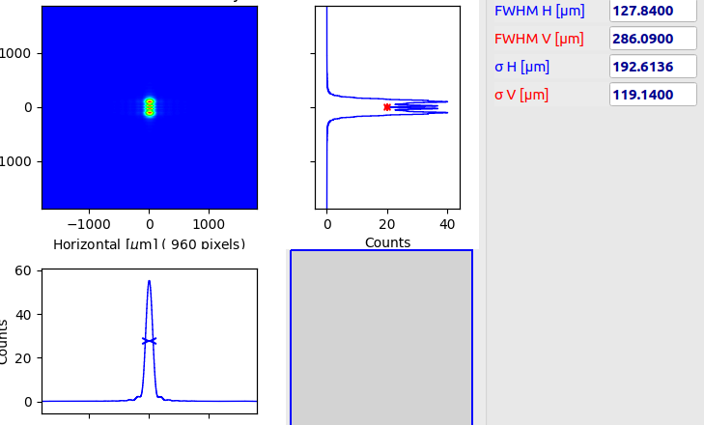
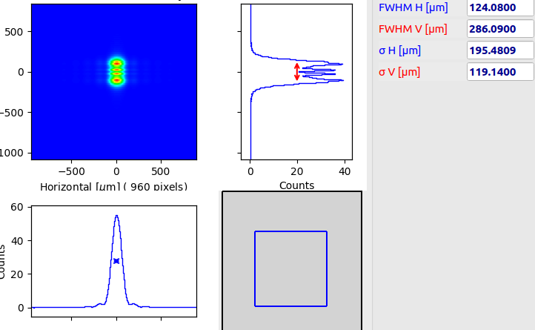
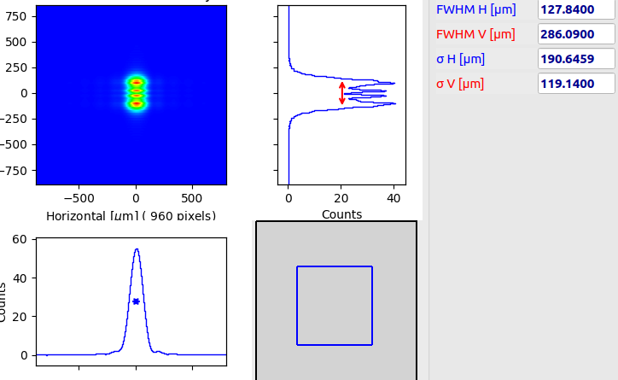
Beam profile – Transfocator 1 entrance (65 m) WOFRY
ideal
~165 nrad
z [μm]
z [μm]
~80 nrad
~330 nrad
z [μm]
z [μm]

Slide 10
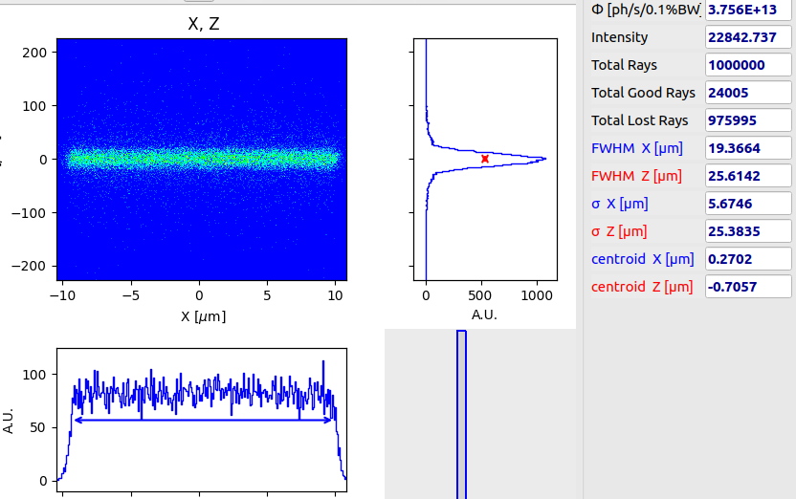
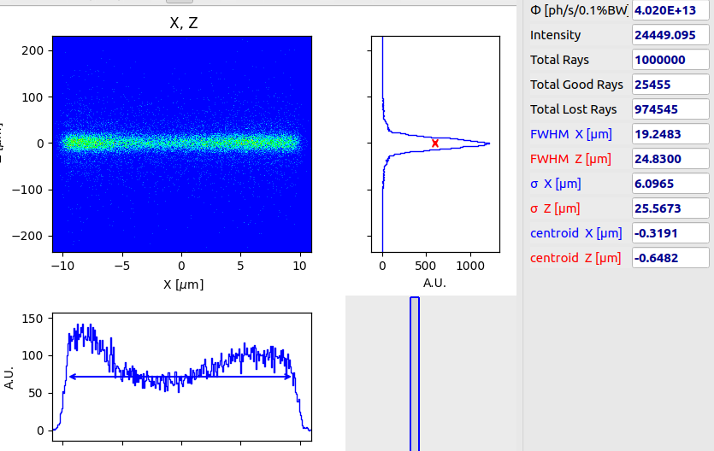
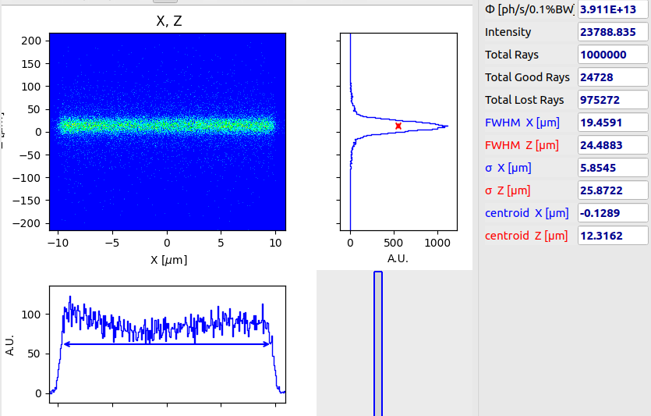
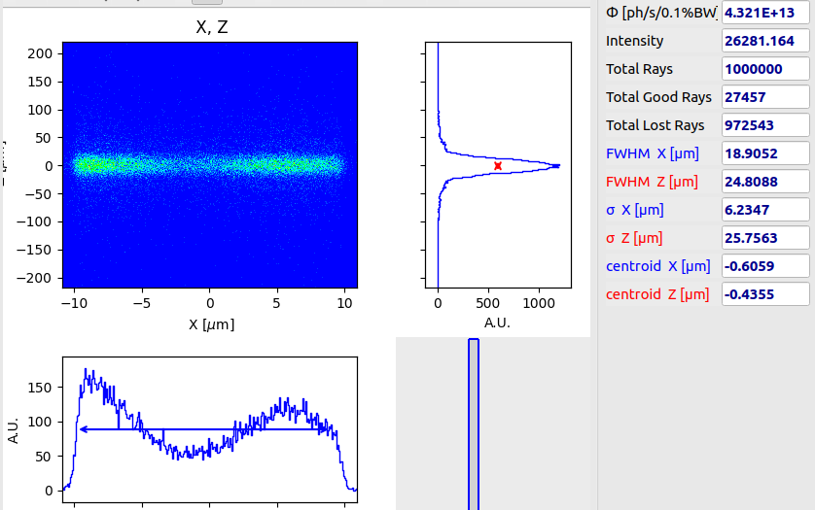
Beam profile – Sample position (200 m) SHADOW
ideal
~165 nrad
z [μm]
z [μm]
~80 nrad
~330 nrad
z [μm]
z [μm]

Slide 11
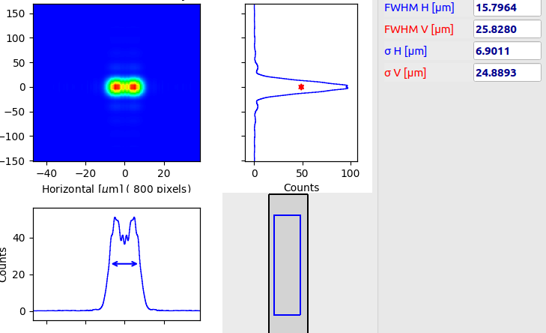
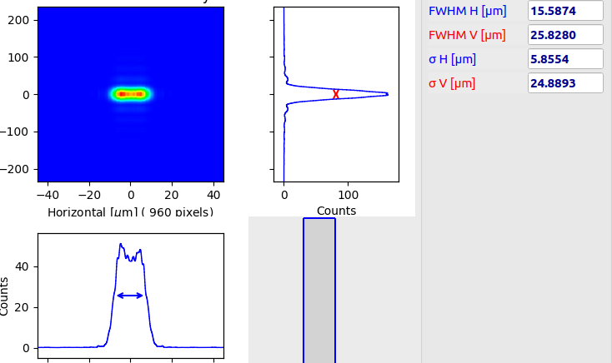
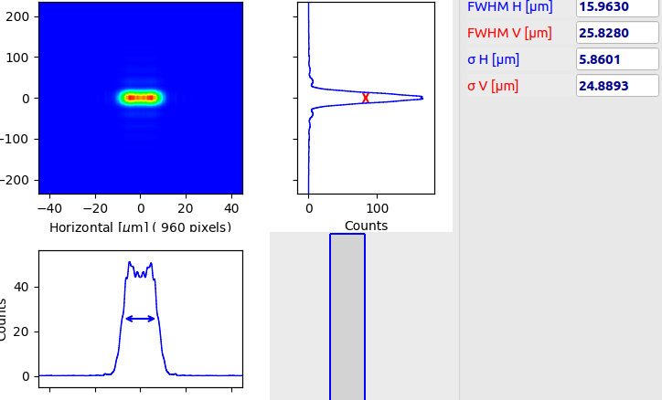
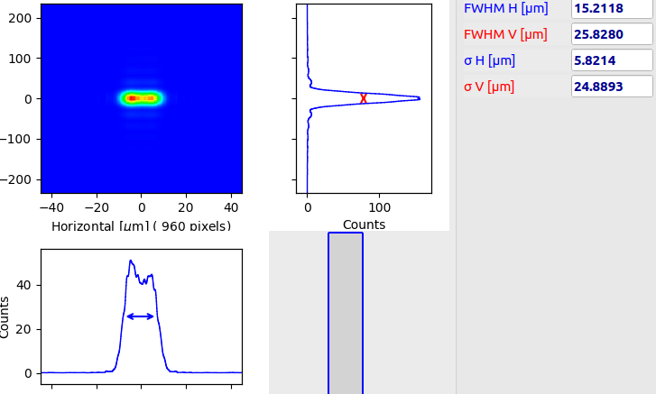
Beam profile – Sample position (200 m) WOFRY
ideal
~165 nrad
z [μm]
z [μm]
~80 nrad
~330 nrad
z [μm]
z [μm]

