Slide 1
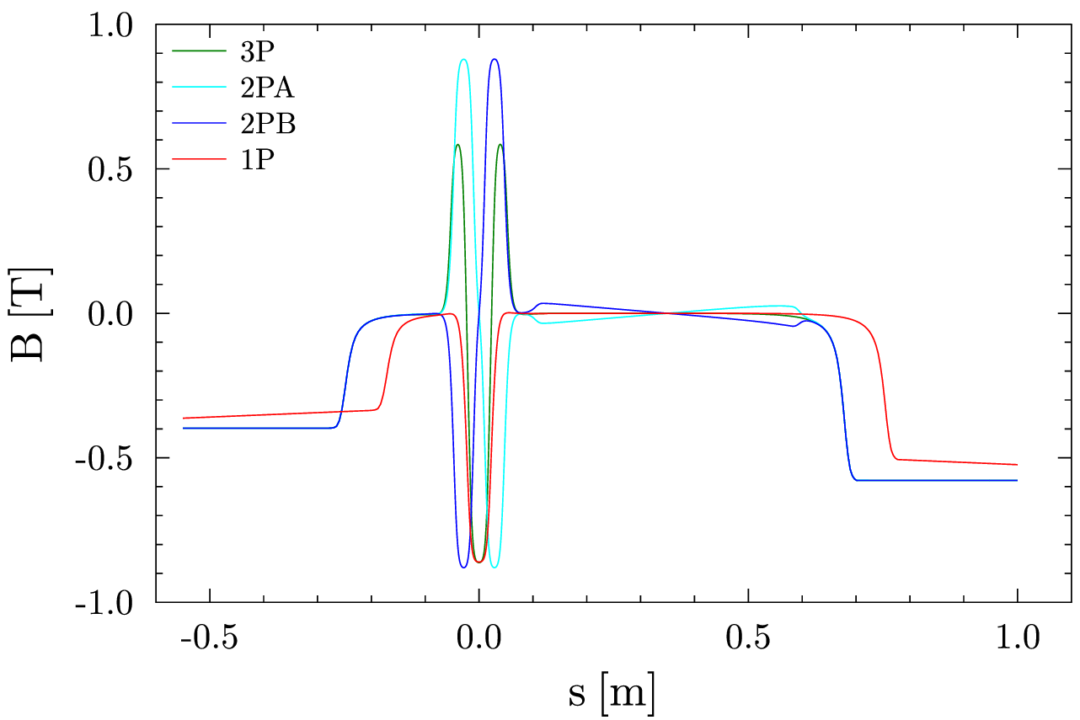
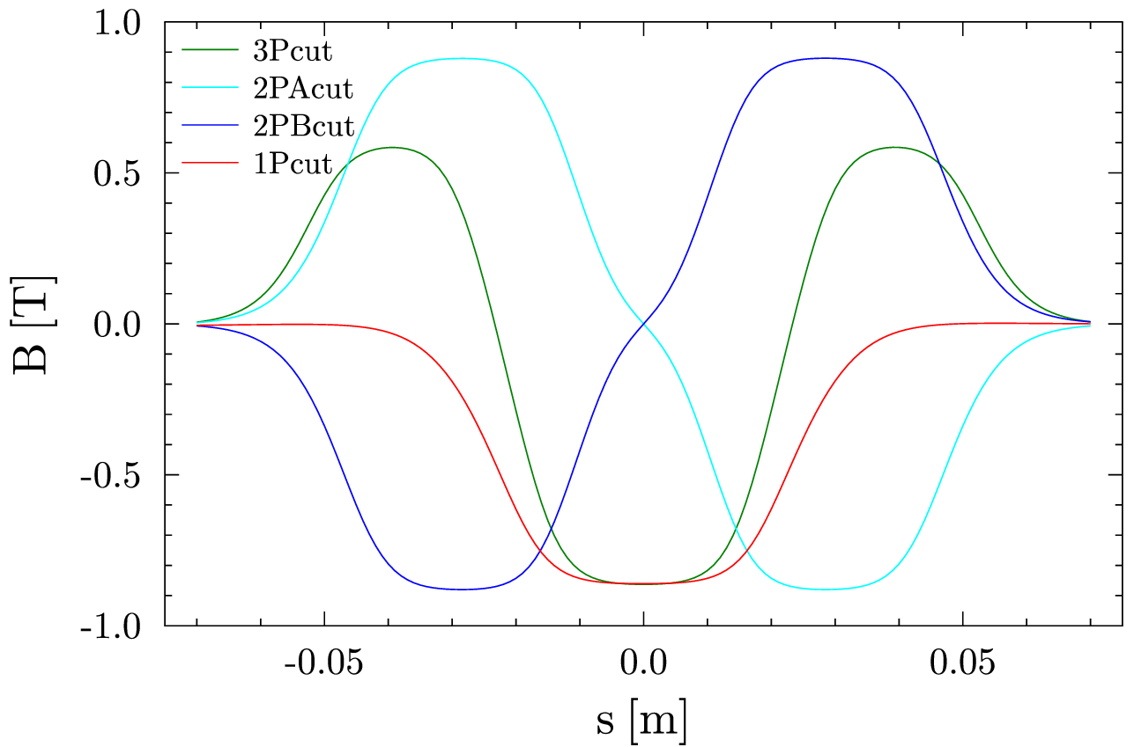

Slide 2
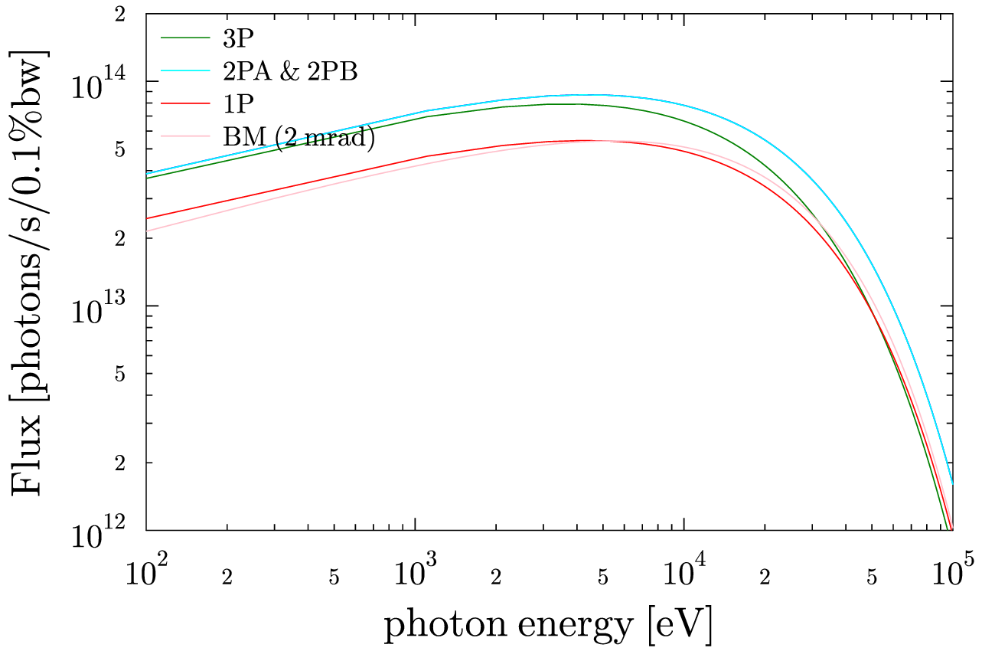

Slide 3
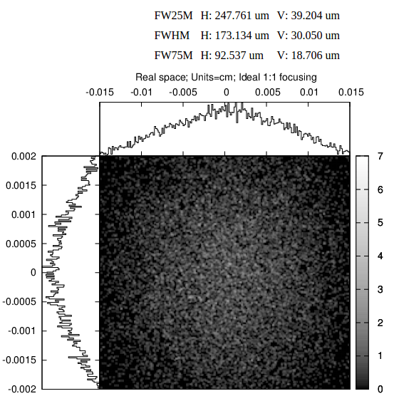
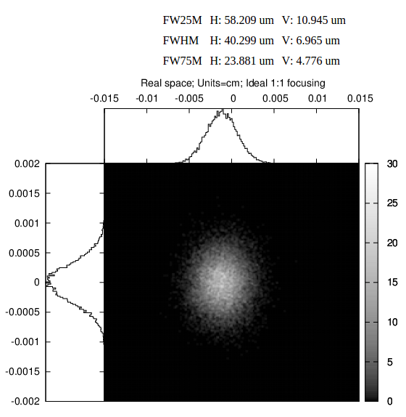
20 keV – 1:1 Ideal focusing BM 3P x20 Gain

Slide 4
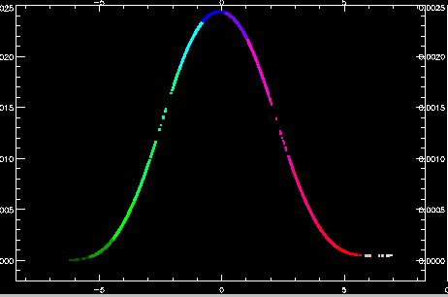
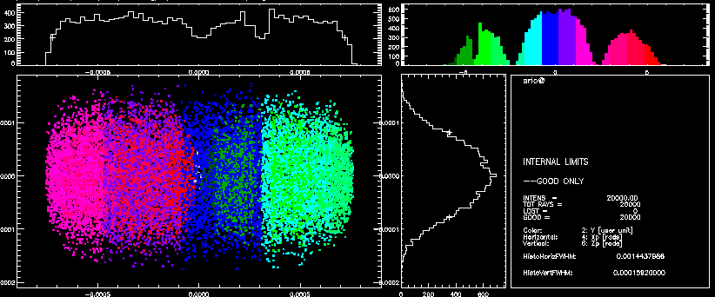
3Pcut – 10 keV – zero emitt

Slide 5
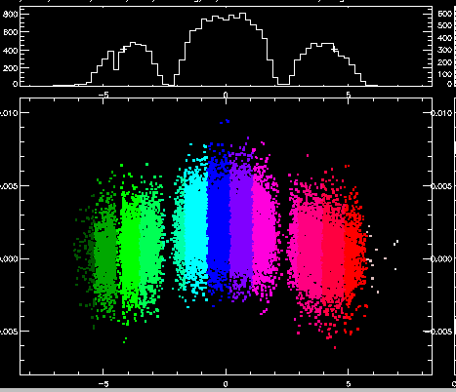
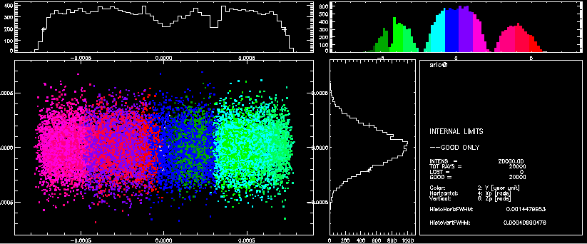
3Pcut – 10 keV – with emitt

Slide 6
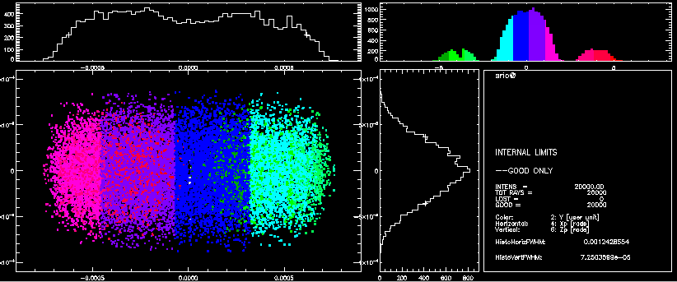
3Pcut – 50 keV – zero emitt

Slide 7
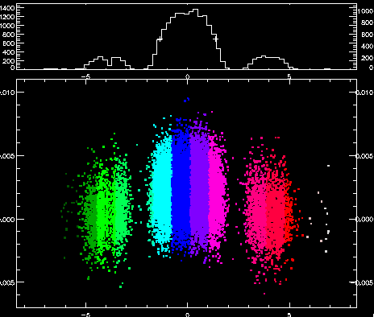
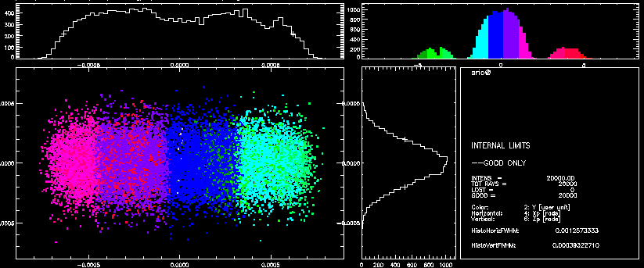
3Pcut – 50 keV – with emitt

Slide 8
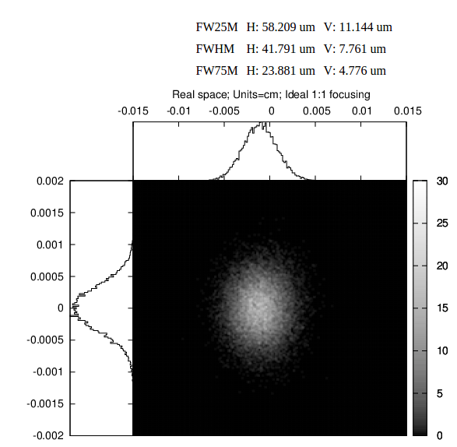
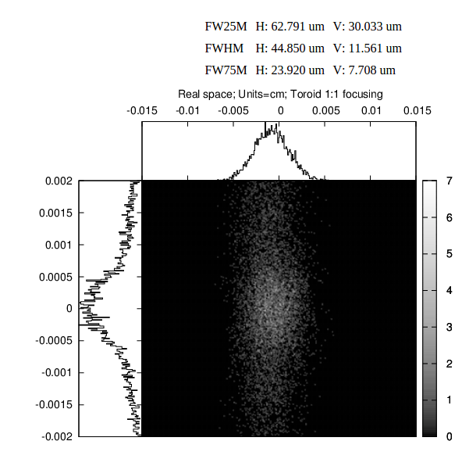
3Pcut – 10 keV 1:1 Ideal 1:1 Toroid

Slide 9
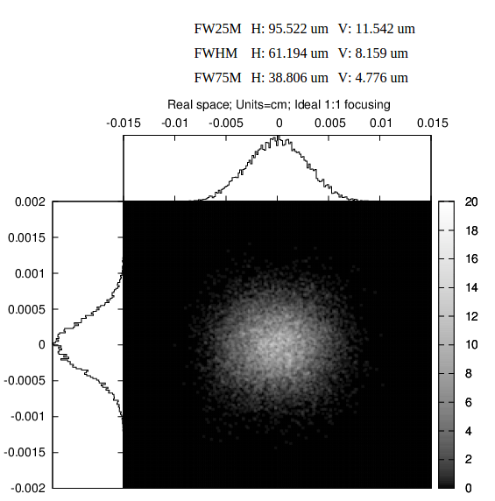
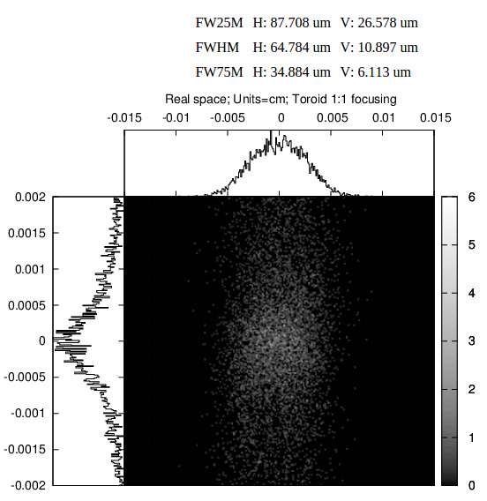
2Pcut – 10 keV 1:1 Ideal 1:1 Toroid

Slide 10
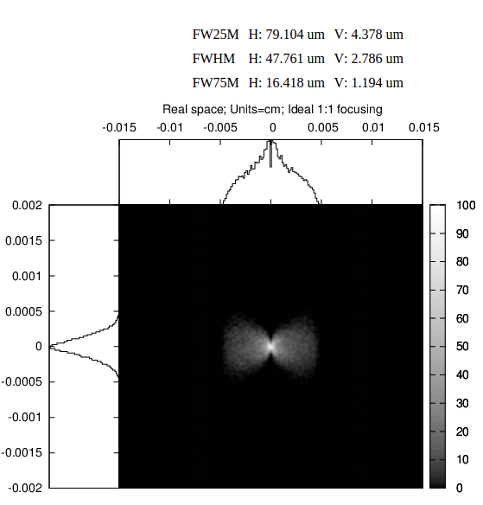
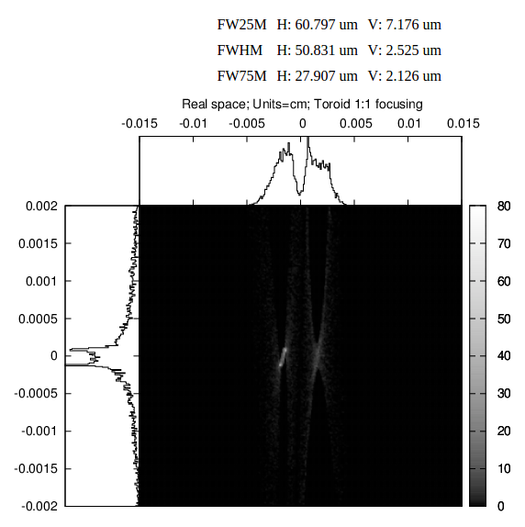
2Pcut – 20 keV – zero emitt 1:1 Ideal 1:1 Toroid

Slide 11

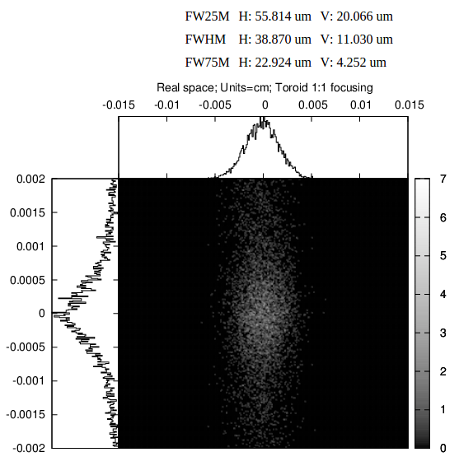
1Pcut – 10 keV 1:1 Ideal 1:1 Toroid

