Slide 1
Mapping Document

Slide 2
Hibernate Mapping
For Persistence Hibernate uses a mapping document, which
  Tells Hibernate how to store the information it find in the objects and
  is an XML File containing the mapping details
The format for the mapping document is
  <?xml version="1.0"?>
  <!DOCTYPE hibernate-mapping PUBLIC
  "-//Hibernate/Hibernate Mapping DTD 3.0//EN"
  "http://hibernate.sourceforge.net/hibernate-mapping-3.0.dtd">
  <hibernate-mapping>
  ………………….
  </hibernate-mapping>

Slide 3
Example mapping Document
<?xml version="1.0"?>
<!DOCTYPE hibernate-mapping PUBLIC "-//Hibernate/Hibernate Mapping DTD 3.0//EN" "http://hibernate.sourceforge.net/hibernate-mapping-3.0.dtd">
<hibernate-mapping package="eg">
<class name="Cat" table="cats" discriminator-value="C">
<id name="id">
<generator class="native"/>
</id>
<discriminator column="subclass" type="character"/>
<property name="weight"/>
<property name="birthdate" type="date" not-null="true" update="false"/>
<property name="color" type="eg.types.ColorUserType" not-null="true" update="false"/>
<property name="sex" not-null="true" update="false"/>
<property name="litterId" column="litterId" update="false"/>
<many-to-one name="mother" column="mother_id" update="false"/>
<set name="kittens" inverse="true" order-by="litter_id">
<key column="mother_id"/>
<one-to-many class="Cat"/>
</set>
<subclass name="DomesticCat" discriminator-value="D">
<property name="name" type="string"/>
</subclass>
</class>
<class name="Dog">
<!-- mapping for Dog could go here -->
</class>
</hibernate-mapping>

Slide 4
Important Elements of Mapping Document
<hibernate-mapping>
<class>
<property>
<id>
<generator>
<discriminator>
<subclass >
<joined-subclass >
<key >
<column> & <formula>
<import>
<many-to-one>
<one-to-one>

Slide 5
<hibernate-mapping>
<hibernate-mapping schema="schemaName" catalog="catalogName"
default-cascade="cascade_style" default-access="field|property|ClassName" default-lazy="true|false"
auto-import="true|false" package="package.name" />

Slide 6
<class>
<class name="ClassName"
table="tableName"
discriminator-value="discriminator_value"
mutable="true|false"
schema="owner"
catalog="catalog"
proxy="ProxyInterface"
dynamic-update="true|false"
dynamic-insert="true|false"
select-before-update="true|false"
polymorphism="implicit|explicit"
where="arbitrary sql where condition"
persister="PersisterClass"
batch-size="N"
optimistic-lock="none|version|dirty|all"
lazy="true|false"
entity-name="EntityName"
check="arbitrary sql check condition"
rowid="rowid"
subselect="SQL expression"
abstract="true|false"
entity-name="EntityName"
node="element-name" />

Slide 7
<id>
<id name="propertyName"
type="typename"
column="column_name"
unsavedvalue="null|any|none|undefined|id_value"
access="field|property|ClassName">
node="element-name|@attribute- name|element/@attribute|"
<generator class="generatorClass"/>
</id>
Note: type refers to a hibernate Type

Slide 8
Understanding Object Identity
Java object identity and equality
  Object identity,’ ‘==‘ is notion defined by the java virtual machine
  Two Object references are identical ( == ) if they point to the same memory location
  equals(): two objects are equal if they have the same value
With object/relational persistence,
  A persistence object is an in-memory representation of a particular row of a database table
  Therefore, along with Java identity and object equality we have database identity

Slide 9
Understanding Object Identity
For a persistent Object, we have three methods for identifying Objects:
  Object identity : Objects occupy the same memory location (==)
  Object equality : Objects have the same value
  Database identity : Objects are identical in a table if they represent the same row (share the same primary key)

Slide 10
<generator>
Class | Description | Types
increment | Creates unique id for column | long,short,int
Identity | DB-supported identity column | long,short,int
sequence | DB-supported sequence | long,short,int
hilo | The hi/lo algorithm generates identifiers that are unique only for a particular database. | long,short,int
seqhilo | Hi/lo using sequence | long,short,int
Uuid.hex | 128 bit UUID algorithm incorporating IP address | 32 digit hex string
Uuid.string | Same | 16 character ASCII string
Native | Varies | best of identity, Sequence or hilo based on database capabilities

Slide 11
<generator>
Class | Description | Types
assigned | Application assigned | Any supported type
guid | uses a database-generated GUID string on MS SQL Server and MySQL | String
Select | retrieves a primary key assigned by a database trigger by selecting the row by some unique key and retrieving the primary key value. | Any supported type
foreign | uses the identifier of another associated object. Usually used in conjunction with a <one-to-one> primary key association. | Any supported type

Slide 12
<discriminator>
required for polymorphic persistence using the table-per-class-hierarchy mapping
declares a discriminator column of the table
The discriminator column contains marker values that tell the persistence layer what subclass to instantiate for a particular row
<discriminator column="discriminator_column" type="discriminator_type"
force="true|false"
insert="true|false"
formula="arbitrary sql expression" />

Slide 13
<property>
The <property> element declares a persistent, JavaBean style property of the class
<property name="propertyName”
column="column_name"
type="typename"
update="true|false"
insert="true|false"
formula="arbitrary SQL expression" access="field|property|ClassName"
lazy="true|false"
unique="true|false"
not-null="true|false"
optimistic-lock="true|false"
node="element-name|@attribute-name|element/@attribute|." index="index_name" unique_key="unique_key_id" length="L" precision="P" precision="S" />

Slide 14
<many-to-one>
An ordinary association to another persistent class is declared using a <many-to-one> element
a foreign key in one table is referencing the primary key column(s) of the target table.
<many-to-one name="propertyName"
column="column_name"
class="ClassName"
cascade="cascade_style"
fetch="join|select"
update="true|false"
insert="true|false"

Slide 15
<many-to-one>
property-ref="propertyNameFromAssociatedClass"
access="field|property|ClassName"
unique="true|false"
not-null="true|false"
optimistic-lock="true|false"
lazy="true|proxy|false"
not-found="ignore|exception"
entity-name="EntityName"
formul="arbitrary SQL expression"
node="element-name|@attribute-
name|element/@attribute|."
embed-xml="true|false" index="index_name" unique_key="unique_key_id" foreign-key="foreign_key_name“
/>

Slide 16
<one –to-one>
<one-to-one name="propertyName"
class="ClassName"
cascade="cascade_style"
constrained="true|false"
fetch="join|select"
property-ref="propertyNameFromAssociatedClass"
access="field|property|ClassName"
formula="any SQL expression"
lazy="true|proxy|false"
entity-name="EntityName"
node="element-name|@attribute-name|element/@attribute|." embed-xml="true|false" foreign-key="foreign_key_name"
/>

Slide 17
Mapping Examples
Mapping a simple java class
Mapping Inheritence
Mapping collections

Slide 18
Mapping class Inheritance
The three different approaches to representing an inheritance hierarchy.
  Table-per-concrete-class: one table is created for each concrete class and data is stored in all the tables
  Table-per-class hierarchy: only one table is created containing the columns for all the possible attributes in the base class as well as the child classes. Hibernate tracks data using a discriminator column in the table
  Table-per-subclass : one table for the base class and one table for each subclass is created but subclass table contains the columns for the subclass specific attributes

Slide 19
Advanced Mapping
one-to-one
many-to-one
collection mapping
one-to-many
many-to-many

Slide 20
Simple Association (one-to-one)
Definition: In this relationship, one first-rank class holds a reference to a single instance of another first-rank class and they are related by a common PK.
Scenario:
The two first-rank classes, Emp and EmpPersonal which are related to each other as follows:
EmpPersonal Emp.getEmpPersonal() // returns corresponding
// EmpPersonal instance
Hibernate Mapping:
<class name=“Emp" table=“Emp"
...
<one-to-one name=“empPersonal" class=“EmpPersonal"/>
</class>
No extra columns are needed to support this relationship. Instead both Emp and EmpPersonal must share the same PK values to be part of a one-to-one assocation.
If you create suitable instances of Emp and EmpPersonal with a shared PK, then retrieving a Emp will automatically retrieve the corresponding EmpPersonal.
Emp
EmpPersonal
id
id

Slide 21
Simple Reference (many-to-one)
Definition: It is the same as the one-to-one situation except there is no requirement to have a shared PK. Instead a FK is used.
Scenario:
We have two first-rank classes, Emp and Dept which are related to each other as follows:
Dept Emp.getDept() // returns corresponding Dept instance
Hibernate Mapping:
In Hibernate, this could be mapped as follows:
<class name=“Emp" table=“Emp">
...
<many-to-one name=“dept" class=“Dept" column=“deptno"/>
</class>
Now we have created an extra column in Emp table which holds the FK to Dept. Emp and Dept can have completely different PKs and the relationship will still hold.
Bidirectionality:
This relationship can be declared both ways, with Bar having getFoo(), by simply adding a similar mapping and property to Bar. This will result in Bar's table getting an extra column foo_id.
Emp
Dept
id
deptno
deptno

Slide 22
Collection mapping
<map name="propertyName"
table="table_name"
schema="schema_name"
lazy="true|false"
inverse="true|false"
cascade="all|none|save-update|delete|all-delete-orphan"
sort="unsorted|natural|comparatorClass"
order-by="column_name asc|desc"
where="arbitrary sql where condition"
fetch="join|select|subselect"
batch-size="N"
access="field|property|ClassName"
optimistic-lock="true|false"
node="element-name|." embed-xml="true|false"
<key .... />
<map-key .... />
<element .... />
</map>

Slide 23
Basic Collection (one-to-many)
Definition: A one-to-many reference is basically a collection. Here a first-rank class, A, holds a reference to a collection of another first-rank class, B.
Scenario:
We have two first-rank classes, Foo and Bar which are related to each other as follows:
Set Dept.getEmps() // returns a collection of Emp instances
Hibernate Mapping:
In Hibernate, this could be mapped as follows:
<class name=“Dept" table=“Dept">
...
<set name=“emps" table=“Emp">
<key column=“deptno"/>
<one-to-many class=“Emp"/>
</set>
</class>
Bidirectionality:
This relationship can be declared both ways, with Emp having geDept(), by suitable code changes to Emp and the following schema change:
<class name=“Emp" table=“Emp">
...
<many-to-one name=“dept" class=“Dept" column=“deptno"/>
</class>
Now your Emps will know who their Dept is. NB: No extra columns are generated for the bidirectionality.
Emp
Dept
id
deptno
deptno

Slide 24
Collection (many-to-many)
Definition:
A many-to-many reference is basically a collection. First-rank class A holds a reference to a set of first-rank class B instances (as in the one-to-many case), but B might have multiple A's.
Scenario:
We have two first-rank classes, Magazine and Subscriber which are related to each other as follows:
Set Magazine.getSubscribers() // returns a collection of Subscriber instances
Hibernate Mapping:
In Hibernate, this could be mapped as follows:
<class name=“Magazine" table=“Magazines">
...
<set name=“subscribers" table=“Mag_Subs">
<key column=“issueNo"/>
<many-to-many column=“custId" class=“Subscriber"/>
</set>
</class>

Slide 25
Collection (many-to-many)
Magazine
issueNo
Mag_Sub
custId
issueNo
Subscriber
custId

Slide 26
Collection (many-to-many)
In this case we have an extra table, Mag_sub, which holds the relationship between instances.
Bidirectionality:
This relationship can be declared both ways, with Subscriber having getMagazines(), by suitable code changes to Bar and the following schema change:
<class name=“Subscriber" table=“Subscribers">
...
<set name=“magazines" table=“Mag_Sub">
<key column=“custId"/>
<many-to-many column=“issueNo" class=“Magazine"/>
</set>
</class>

Slide 27
Subclasses
Definition:
Subclasses are classes that extend another class in a standard OO inheritance relationship.
Scenario:
We have one class, Foo, and another class, Bar, which is a subclass of Foo.
public class Bar extends Foo // Bar is a subclass of Foo
Hibernate Mapping:
In Hibernate, this could be mapped as follows:
<class name="Foo" table="foo" discriminator-value="F">
...
<discriminator column="class"/>
...
<subclass name="subclass.Bar" discriminator-value="B">
<property name="name" column="name" type="string"/>
</subclass>
</class>

Slide 28
Subclasses
Foo
id
class
name
The class field holds a discriminator value. This value tells Hibernate which Java class to instantiate on loading. The subclass, Bar, has its properties stored in the Foo table.
Bidirectionality:
Inheritance relationships are only unidirectional in Java. A child can determine its parent class but the reverse has no meaning.

Slide 29
Working with persistent Objects
ORM advocates a design in which there are more persistent classes than tables
One row represents multiple objects
As database identity is implemented by primary key, some persistent object won’t have their identity
One of the objects represented in the row has its own identity and others depend on that

Slide 30
Entity and value types
Entity type
  has its own database identity (Primary key)
  an object reference to an entity is persisted in as a reference in the DB
  an entity has its own lifecycle, it may exist independently
Value type
  has no database identity
  It belongs to an Entity
  Its persistent state is

Slide 31
Querying the Database
Hibernate represents the underlying database using simple java Objects
Hibernate facilitates direct retrieval of persistent Objects from the database
Hibernate uses the following ways to retrieve Objects from the databases:
  Hibernate Query Language (HQL)
  Query by Criteria (QBC)
  Query by Example using Criteria API
  Native SQL Query

Slide 32
HQL – Hibernate Query Language
HQL is used for building queries to find or filter data from the database.
  Looks like SQL’s SELECT at first glance
Differences from SQL:
  It’s only used for searching, not updating.
  It understands inheritance polymorphism, and object-oriented ownership of associations.
  Most pieces (even the SELECT clause) are optional in at least some situations!

Slide 33
HQL Syntax
HQL Syntax and features are very similar to SQL
AN HQL Query may consist of
  Clauses
  Aggregate functions
  Subqueries

Slide 34
Before we proceed
We should know that..
Query and Criteria interfaces both define methods for controlling the execution of a query
Query provides methods for binding concrete values to query parameters
To execute a Query we need to obtain an instance of one of these interfaces using Session
  Query q = session.createQuery(“from users”);

Slide 35
Querying the Database
Hibernate represents the underlying database using simple java Objects
Hibernate facilitates direct retrieval of persistent Objects from the database
Hibernate uses the following ways to retrieve Objects from the databases:
  Hibernate Query Language (HQL)
  Query by Criteria (QBC)
  Query by Example using Criteria API
  Native SQL Query

Slide 36
HQL – Hibernate Query Language
HQL is used for building queries to find or filter data from the database.
  Looks like SQL’s SELECT at first glance
Differences from SQL:
  It’s only used for searching, not updating.
  It understands inheritance polymorphism, and object-oriented ownership of associations.
  Most pieces (even the SELECT clause) are optional in at least some situations!

Slide 37
HQL Syntax
HQL Syntax and features are very similar to SQL
AN HQL Query may consist of
  Clauses
  Aggregate functions
  Subqueries

Slide 38
Before we proceed We should know that..
Query and Criteria interfaces both define methods for controlling the execution of a query
Query provides methods for binding concrete values to query parameters
To execute a Query we need to obtain an instance of one of these interfaces using Session
  Query q = session.createQuery(“from users”);

Slide 39
HQL - Basics
Simplest possible HQL query:
  from Employee
    Returns all employees in the database
HQL implements the four ANSI join types, plus Oracle-style Cartesian joins.
Clauses:
  SELECT (optional)
  FROM (required, except with Session.filter)
  WHERE (optional)
  Other: ORDER BY, GROUP BY, HAVING, …

Slide 40
‘from’ Clause
Simplest form of an HQL Query
Specifies the Object whose instances are to be returned as the query result
Commonly used with SELECT
Syntax:
  From object [as object_alias]
  Object _alias simply means another name given to refer to an object for convenience
  example
  ‘from Users as u’
  Will return all the instances of Object Users

Slide 41
‘select’ Clause
Specifies Object and properties to be returned
Used in conjunction with the ‘from’ clause
Syntax:
  Select [object.]property
  e.g: select dept.mgr from comp.Dept as dept
  Will return all values of mgr in all instances of dept

Slide 42
‘where’ Clause
‘where’ clause narrows down the search of data
‘where’ clause is used to put a condition during query
  List servers = session.createQuery(“from Server as server where server.port = 0”);

Slide 43
Listing and Iterating Results
List() method executes the query and returns the results as a list:
  List result = session.createQuery(‘from User”).list();
Iterate() method also can be used to iterate throu the results:
  Iterator I = session.createQuery(“from User”).iterate();

Slide 44
Using Named Parameter
Hibernate supports Named Parameters
Using Named parameter the value of a parameter can be set dynamically
  Query q = session.createQuery(
  “from Group group where group.name=:groupname”);
  .setString(“groupname”,”alt.mygroup”);
  Iterator I = q.iterate();

Slide 45
Important!
When we pull objects from the database we get a “List” where entries are the actual Objects
We can use get() to Obtain an Iterator and Type caste the Objects to the required type
If HQL is used to pull more than one object then Hibernate returns a List Object containing an array of Objects

Slide 46
Example
The Query:
List stuff = session.createQuery(“select name,date,sum(records) from table …..);
Returns a List of Object arrays. To access each of the values we use code as follows:
Iterator i = stuff.iterator();
while(i.hasNext()) {
Object[] temp =(Object)i.next();
String name = (String)temp[0];
Date date = (Date)temp[1];
Integer sum =(Integer)temp[2];
}

Slide 47
Aggregate Functions
count(*): provides a total number of objects persisted in the database.
count(query): provides a total no. of objects based on the supplied query
count(distinct attribute): provides the count of objects having distinct attribute values
count(attribute): provides a count of all the objects in a specified class
avg(attribute):provides the average values for the foeld provided
sum(sttribute): provides the sum of all values supplied in the attribute
min(attribute): provides the minimum of all the supplied attributes
max(attribute): provides the maximum of all the supplied attributes

Slide 48
Subselect(subquery)
Multiple selection capability is often called “subselect”
The basic idea is to perform a SELECT on the database and then use the result of this SELECT as the input to final SELECT that provides the result
from Group as group where size(group.stories)>(select avg(storygroup.stories))from Group as storyfroup)

Slide 49
Fetching Strategies
Hibernate supports four types of fetching startegies:
  Immediate fetching: associated Object is fetched immediately using a sequential database read
  Lazy fetching: The associated objec or collection is fetched “lazily” when it is first accessed .
  Eager fetching: the associated object or collection is fetched togather with the owning object, using an SQL outer join and no further database access is required
  Batch fetching : this approach may be used to improve the performance of lazy fetching by retrieving a batch of objects or collections when a lazy association is accessed

Slide 50
HQL Joins
Hibernate supports the following joins
  Left Outer Join
  Right Outer Join
  Inner Join
  Full Join
  Fetch join

Slide 51
Left Outer Join
Select group.name, count(items)from Group as group Left outer join group.stories as items group by group.stories.name
Obtains the name of a group as well as a count of all stories in the group based on the story name
Note: left table becomes the source table and all of its rows are included in the result regardless of matching.

Slide 52
Fetch join
Used to fetch an association eagerly
This allows Hibernate to fully initialize an Object along with its association
from Group as group left join fetch group.stories

Slide 53
HQL JOINS

Slide 54
Joins
Person
ID | First_name | Last_name
1 | Roger | Whitney
2 | Leyland | Beck
3 | Carl | Eckberg
Email_address
ID | User_name | host | Person_id
1 | Beck | cs.sdsu.edu | 2
2 | whitney | cs.sdsu.edu | 1
3 | whitney | rohan.sdsu.edu | 1
4 | foo | rohan.sdsu.edu

Slide 55
Joins
The tables have a column in common as email_addresses.person_id refers to people.id
So we can create a new table by joining the two tables together on that column

Slide 56
Inner Join (or just Join)
Only uses entries linked in two tables
select
first_name, last_name, user_name, host
from
people, email_addresses
where
people.id = email_addresses.person_id;
First_name | Last_name | User_name | host
Leland | Beck | beck | cs.sdsu.edu
Roger | Whitney | whitney | cs.sdsu.edu
Roger | whitney | whitney | rohan.sdsu.edu

Slide 57
Inner Join (or just Join)
Only uses entries linked in two tables
select
first_name, last_name, user_name, host
from
people inner join email_addresses
on
(people.id = email_addresses.person_id);
First_name | Last_name | User_name | host
Leland | Beck | beck | cs.sdsu.edu
Roger | Whitney | whitney | cs.sdsu.edu
Roger | whitney | whitney | rohan.sdsu.edu

Slide 58
Outer Join and Left Outer Join
Outer Join
  Uses all entries from a table
Left Outer join
  Use all entries from the left table

Slide 59
Outer Join and Left Outer Join
Outer Join
  Uses all entries from a table
Left Outer join
  Use all entries from the left table

Slide 60
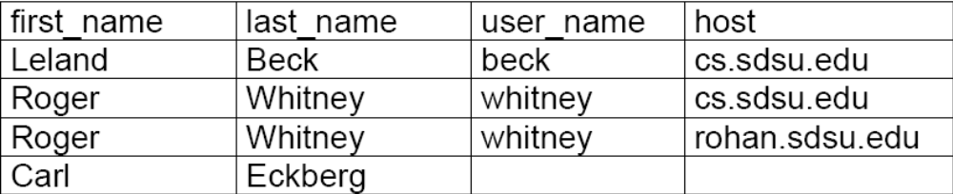
Outer Join
select
first_name, last_name, user_name, host
from
people left outer join email_addresses
on
(people.id = email_addresses.person_id);

Slide 61
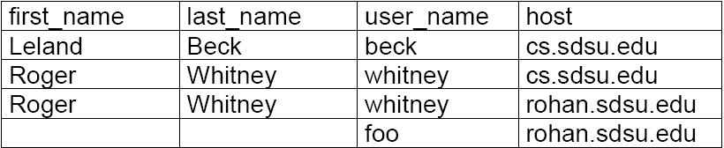
Right Outer Join
Use all entries from the right table
select
first_name, last_name, user_name, host
from
people right outer join email_addresses
on
(people.id = email_addresses.person_id);

Slide 62
A right outer join B & B left outer join A
The following two statements are equivalent
select
first_name, last_name, user_name, host
from
people right outer join email_addresses
on
(people.id = email_addresses.person_id);
  select
  first_name, last_name, user_name, host
  from
  email_addresses left outer join people
  on
  (people.id = email_addresses.person_id);

Slide 63
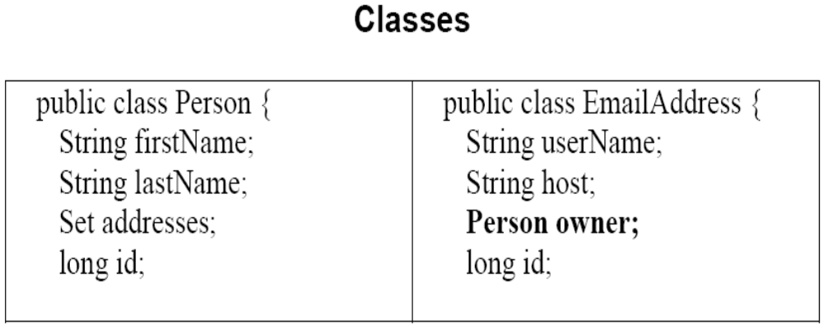
Many-to-One Bidirectional

Slide 64
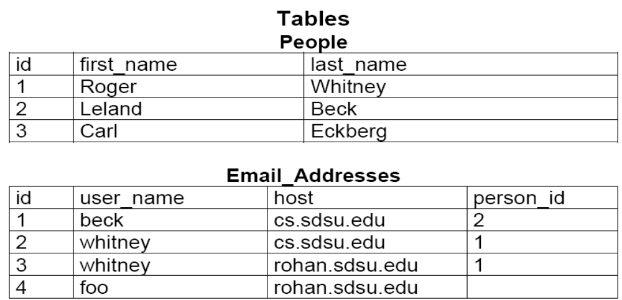

Slide 65
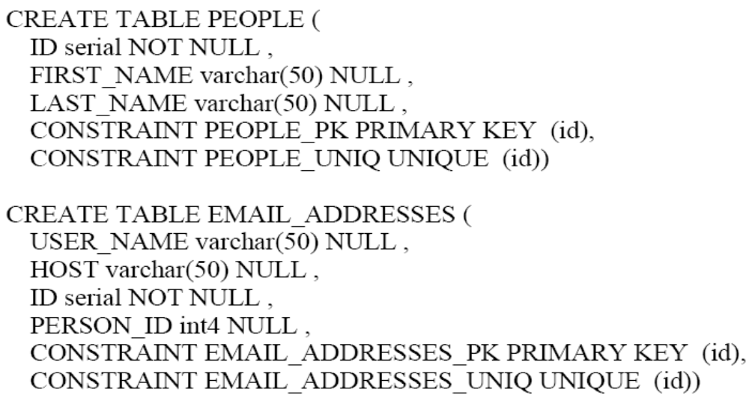

Slide 66
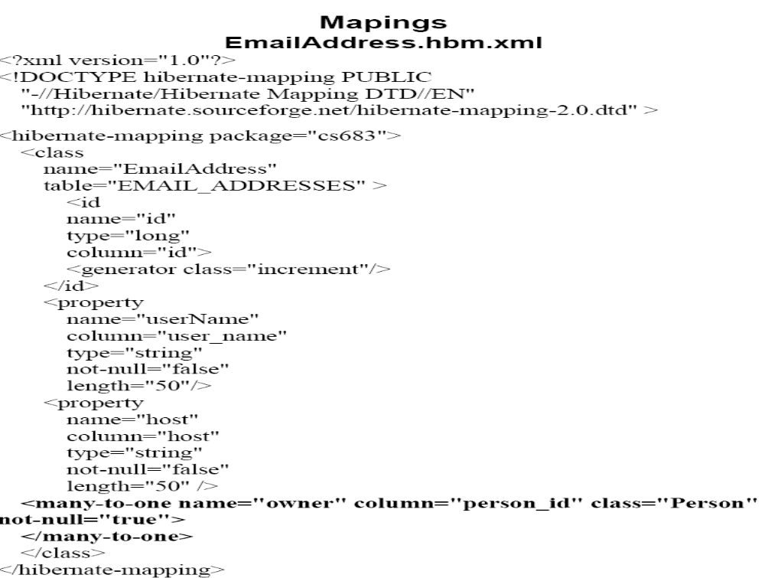

Slide 67
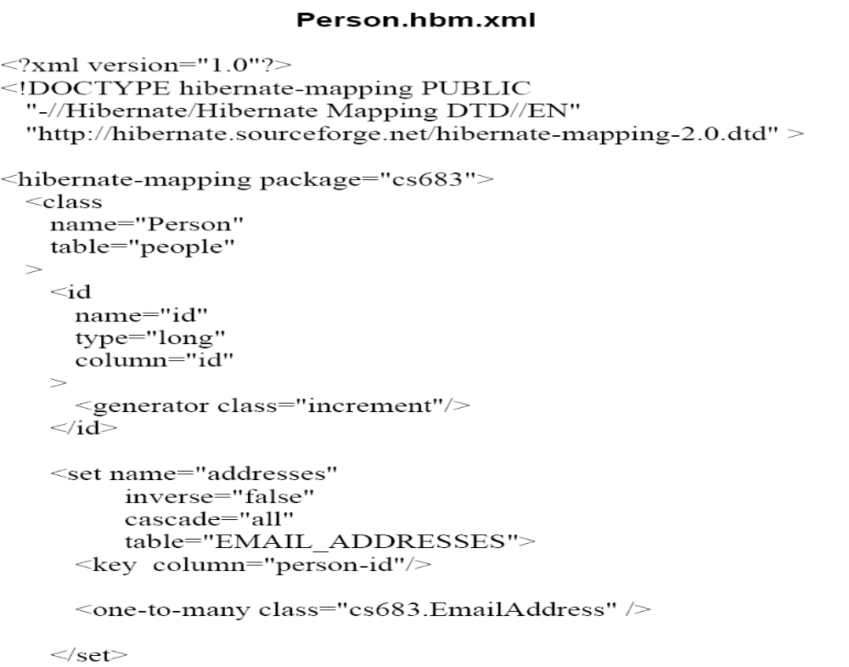

Slide 68
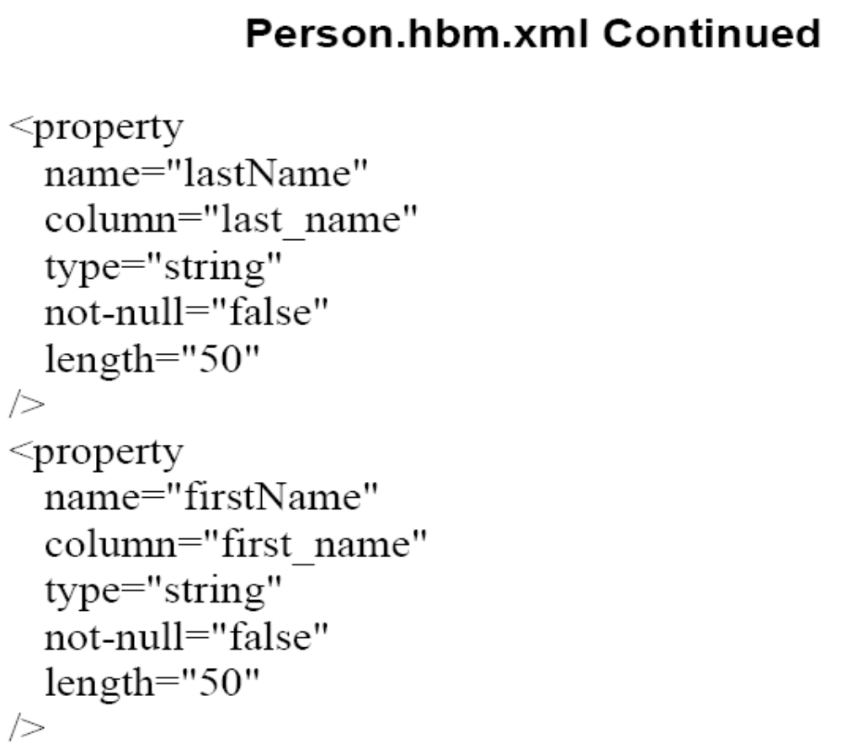

Slide 69
Read
static void sampleRead() throws MappingException, HibernateException,
Exception
{
String query = "select p from Person p join p.addresses address where
address.host like '%gmail%'"
Session session = getHibernateSession();
Query getGmailUser =
session.createQuery(query);
List result = getGmailUser.list();
System.out.println("Number of People: " + result.size());
Object first =result.get(0);
System.out.println( first);
session.close();
}

Slide 70
Select
select
address
from
Person p join p.addresses address
where
address host like ‘%gmail%’
select
p
from
Person p join p.addresses address
where
address host like ‘%gmail%’

Slide 71
Select without a Join
select p from Person p where p.lastName = 'Beck’

Slide 72
Joins in Hibernate
Hibernate supports
  Inner join
  Left outer join
  Right outer join

Slide 73
Inner join
Join defaults to inner
The following are equivalent
select
p
from
Person p join p.addresses address
//******************//
select
p
from
Person p inner join p.addresses address

Slide 74
Outer Joins
The left join will get Eckberg
select
p
from
Person p left join p.addresses address
where
address host like ‘%gmail%’ or p.lastName like ‘E%’
The right join will not get Eckberg
select
p
from
Person p right join p.addresses address
where
address host like ‘%gmail%’ or p.lastName like ‘E%’

Slide 75
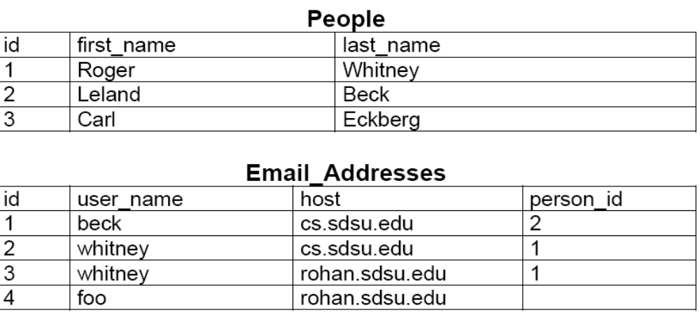

Slide 76
Selecting Multiple Objects
select p, address from Person p join p.addresses address
Session session = getHibernateSession();
Query getGmailUser = session
.createQuery("select p, address from Person p join p.addresses address");
List result = getGmailUser.list();
System.out.println("Number of People: " + result.size());
for (int k = 0; k < result.size(); k++)
{
Object[] resultArray = (Object[]) result.get(k);
Person personResult = (Person) resultArray[0];
EmailAddress addressResult = (EmailAddress) resultArray[1];
System.out.println("" + personResult + " " + addressResult);
}
session.close();

Slide 77
Update
Session session = getHibernateSession();
Transaction update = session.beginTransaction();
Query getGmailUser = session.createQuery(
"select p from Person p join p.addresses address where
address.host='gmail.com'") ;
List result = getGmailUser.list();
Person gmailUser = (Person) result.get(0);
gmailUser.setFirstName("Roger");
Iterator listEmails = gmailUser.getAddresses().iterator();
while (listEmails.hasNext())
{
EmailAddress anAddress =(EmailAddress) listEmails.next();
if (anAddress.getHost().equals("gmail.com"))
anAddress.setHost("gmail.google.com");
}
update.commit();
session.close();

Slide 78
Delete
Session session = getHibernateSession();
Transaction deleter = null;
try
{
deleter = session.beginTransaction();
Query getGmailUser = session.createQuery(
"select p from Person p join p.addresses address where
address.host like '%gmail%'");
Person result = (Person) getGmailUser.uniqueResult();
session.delete(result);
deleter.commit();
}
catch (Exception problem)
{
if (deleter != null) deleter.rollback();
throw problem;
}
finally
{
session.close();
}

Slide 79
Write, Update & Delete Cascading
<set
name="addresses"
inverse="false"
cascade="all"
table="EMAIL_ADDRESSES">
<key column="person_id"/>
<one-to-many class="cs683.EmailAddress" />
</set>

Slide 80
Values for Cascade
all – cascade write, update & delete
none – no cascading
save-update – cascade only update & save
delete – cascade only deletes

Slide 81
Query and Native SQL

Slide 82
Query By Criteria
session.createCriteria(Category.class)
.add( Expression.like("name", "Laptop%") );

Slide 83
Paging the result
Query query =
session.createQuery("from User u order by u.name asc");
query.setFirstResult(0);
query.setMaxResults(10);
****************************
Criteria crit = session.createCriteria(User.class);
crit.addOrder( Order.asc("name") );
crit.setFirstResult(40);
crit.setMaxResults(20);
List results = crit.list();

Slide 84
Paging the result
List results =
session.createQuery("from User u order by u.name asc")
.setFirstResult(0)
.setMaxResults(10)
.list();
******************************************
List results =
session.createCriteria(User.class)
.addOrder( Order.asc("name") )
.setFirstResult(40)
.setMaxResults(20)
.list();

Slide 85
Binding parameters
Using named parameters
String queryString =
"from Item item where item.description like :searchString";
List result = session.createQuery(queryString)
.setString("searchString", searchString)
.list();
*******
String queryString = "from Item item “ + "where item.description like :searchString “ + "and item.date > :minDate";
List result = session.createQuery(queryString)
.setString("searchString", searchString)
.setDate("minDate", minDate)
.list();

Slide 86
Using positional parameters
String queryString = "from Item item "
+ "where item.description like ? "
+ "and item.date > ?";
List result = session.createQuery(queryString)
.setString(0, searchString)
.setDate(1, minDate)
.list();

Slide 87
Binding arbitrary arguments
A particularly useful method is setEntity(), which lets you bind a persistent entity:
session.createQuery("from Item item where item.seller = :seller")
.setEntity("seller", seller)
.list();

Slide 88
Using named queries
Hibernate lets you externalize query strings to the mapping metadata, a technique that is called named queries.
This allows you to store all queries related to a particular persistent class (or a set of classes) encapsulated with the other metadata of that class in an XML mapping file
The name of the query is used to call it from the application.

Slide 89
The getNamedQuery() method obtains a Query instance for a named query:
session.getNamedQuery("findItemsByDescription")
.setString("description", description)
.list();
****************
<query name="findItemsByDescription"><![CDATA[
from Item item where item.description like :description
]]></query>

Slide 90
Named Queries
Named queries don’t have to be HQL strings
They might even be native SQL queries—and your Java code doesn’t need to know the difference
<sql-query name="findItemsByDescription"><![CDATA[
select {i.*} from ITEM {i} where DESCRIPTION like :description
]]>
<return alias="i" class="Item"/>
</sql-query>

