Slide 1

Exploratory Data Analysis
G2M insight for Cab Investment Firm
06/21/2023

Slide 2

Agenda
Introduction
Objective
Approach
EDA[Exploratory Data Analysis]
Hypothesis
Recommendations

Slide 3
Introduction G2M cab firm case study
XYZ is a private firm based in the United States. With the significant growth witnessed in the cab industry over the past few years and the presence of numerous key players in the market, XYZ is considering an investment in the cab industry. However, before making a final decision, XYZ has decided to conduct a thorough market analysis to gain a comprehensive understanding of the industry.
Objective: The primary objective of XYZ's market analysis is to gather relevant information and insights to support their investment decision in the cab industry. By conducting a comprehensive analysis.
Approach:
The analysis has been divided into four parts:
Data Understanding
Forecasting profit and number of rides for each cab type
Finding the most profitable Cab Company
Recommendations for investment

Slide 4
EDA – Exploratory Data Analysis
Data Description: we have 4 individual dataset files
Cab_Data.csv – this file includes details of transactions for 2 cab companies
Customer_ID.csv – this is a mapping table that contains a unique identifier that links the customer’s demographic details
Transaction_ID.csv – this is a mapping table that contains transaction-to-customer mapping and payment mode
City.csv – this file contains the list of US cities, their population and the number of cab users
I have merged all 4 datasets into 1 dataset(merge_final) to perform further analysis. merge_final file has 359392 rows and 16 columns(float64(3), int64(5), object(8)).
There are no missing values in the data

Slide 5
EDA – Exploratory Data Analysis
Data Cleaning and Preprocessing
We have split the data into train, validation, and test sets in a 40:40:20 ratio to identify the outliers, we had a boxplot for the columns KM Travelled, Price Charged, Cost of Trip, and Income.
Univariate analysis
Outliers are present in the Price_Charged feature but due to the unavailability of trip duration details, we are not treating this as an outlier.
Key findings and insights
Profit of rides is calculated keeping other factors constant and only Price Charged and Cost of Trip features are used to calculate profit

Slide 6
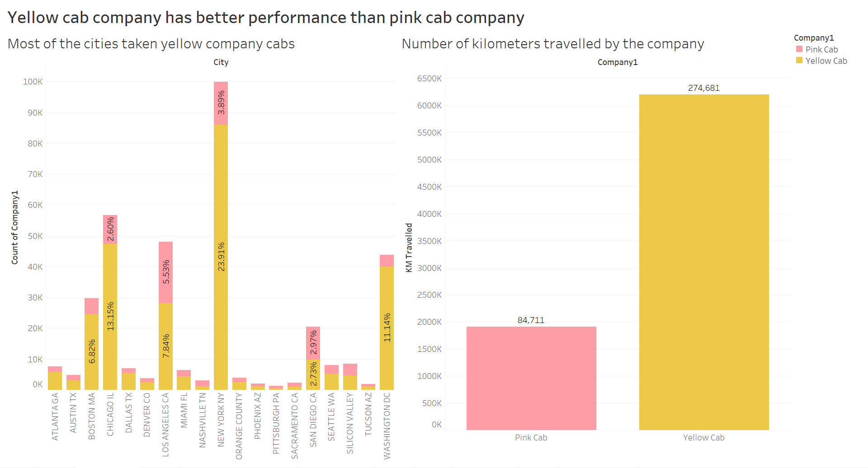
Yellow cab company has better performance than pink cab company

Slide 7
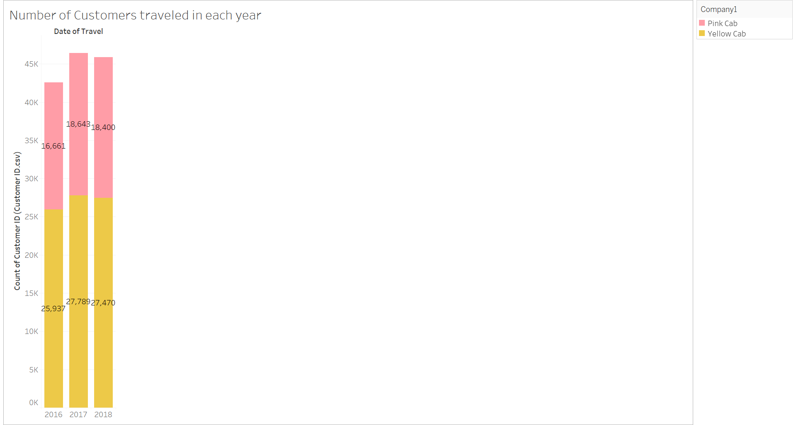
Number of Customers traveled in 2016, 2017 and 2018

Slide 8
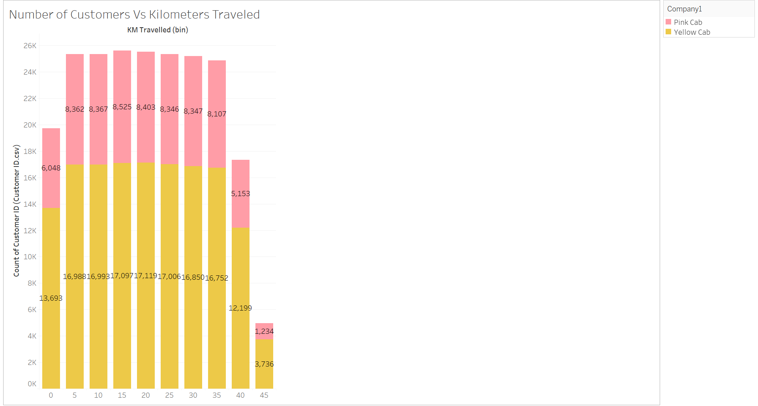
Number of Customers Vs Kilometers Traveled

Slide 9
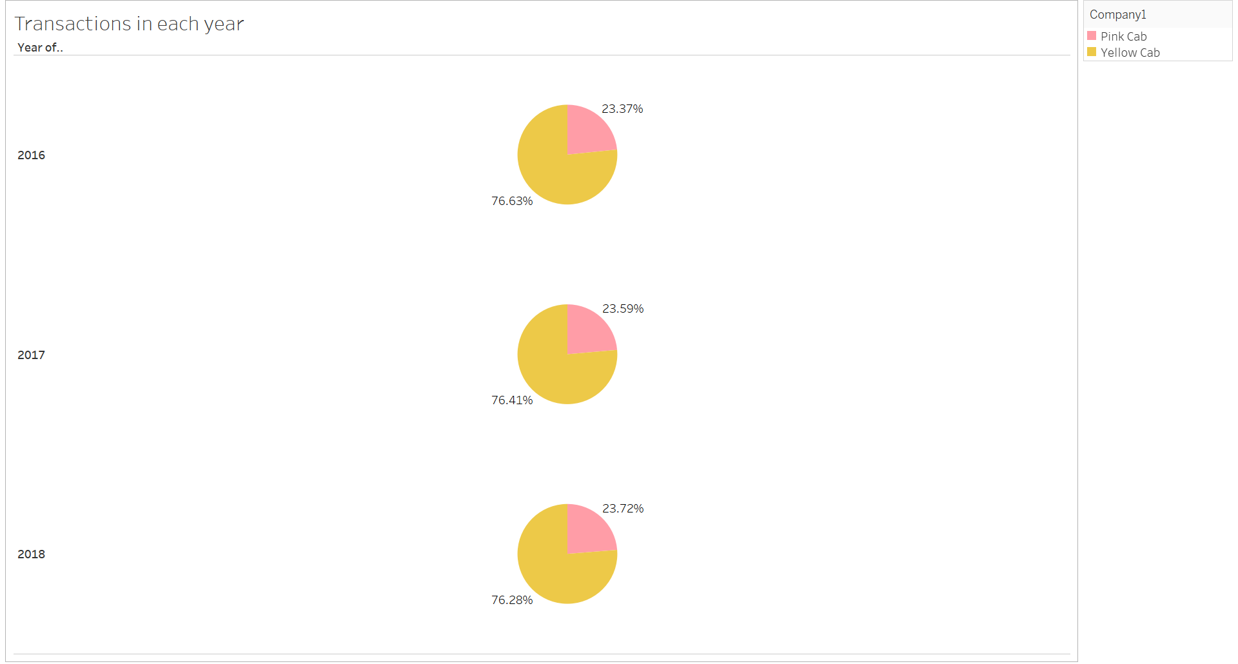
Yellow Cab Transactions Vs Pink Cab Transactions

Slide 10
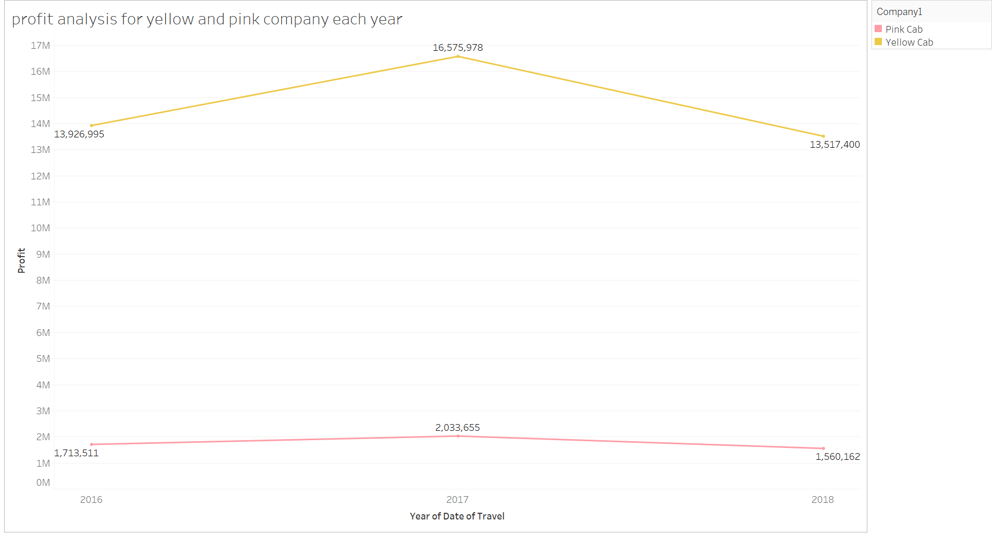
Profit Analysis for Yellow and Pink Cab Companies in the year 2016, 2017 and 2018

Slide 11
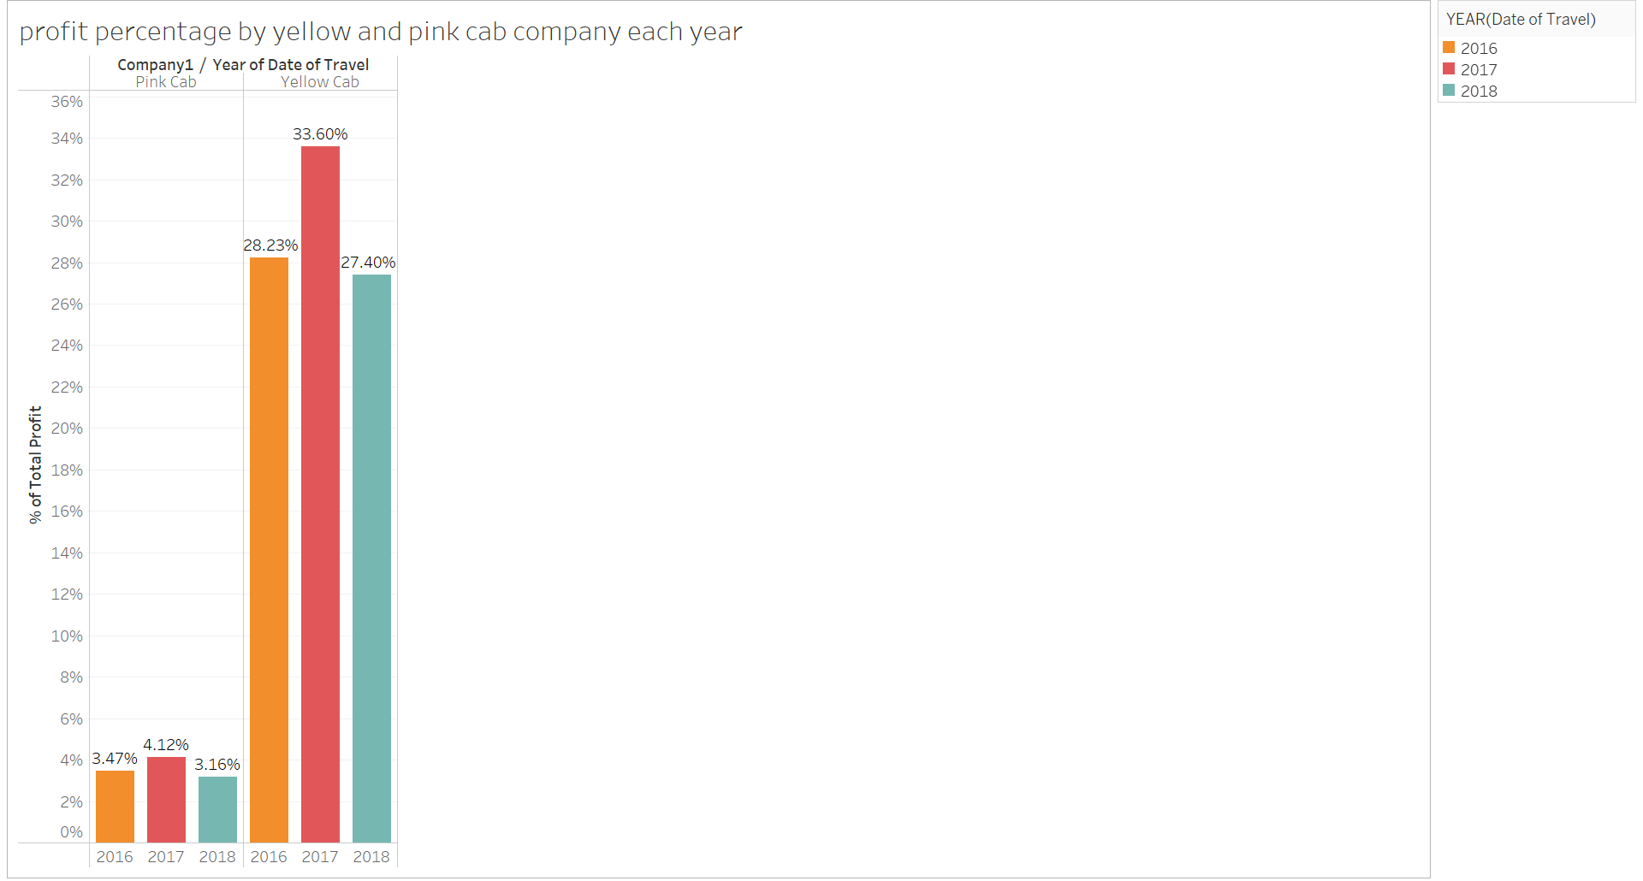
Profit Percentage by Yellow and Pink Cab Company in the year 2016, 2017 and 2018

Slide 12
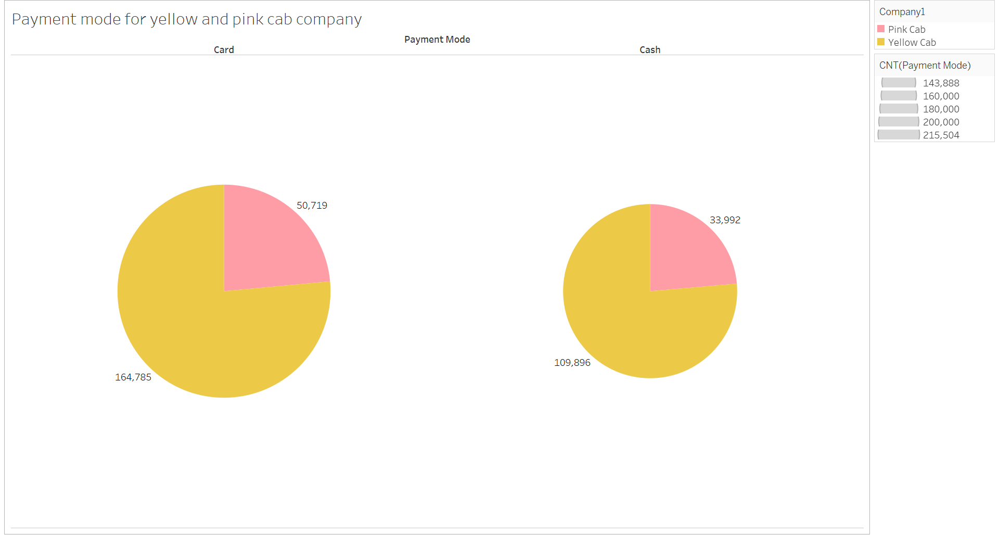
Payment mode for Yellow and Pink Cab company

Slide 13
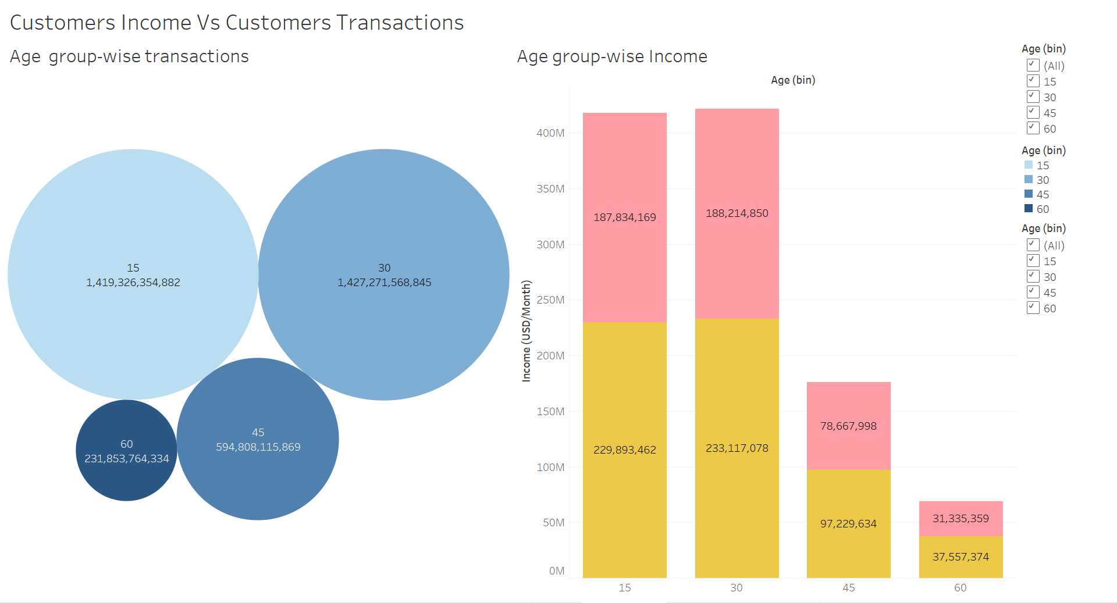
Customers Income Vs Customers Transactions

Slide 14
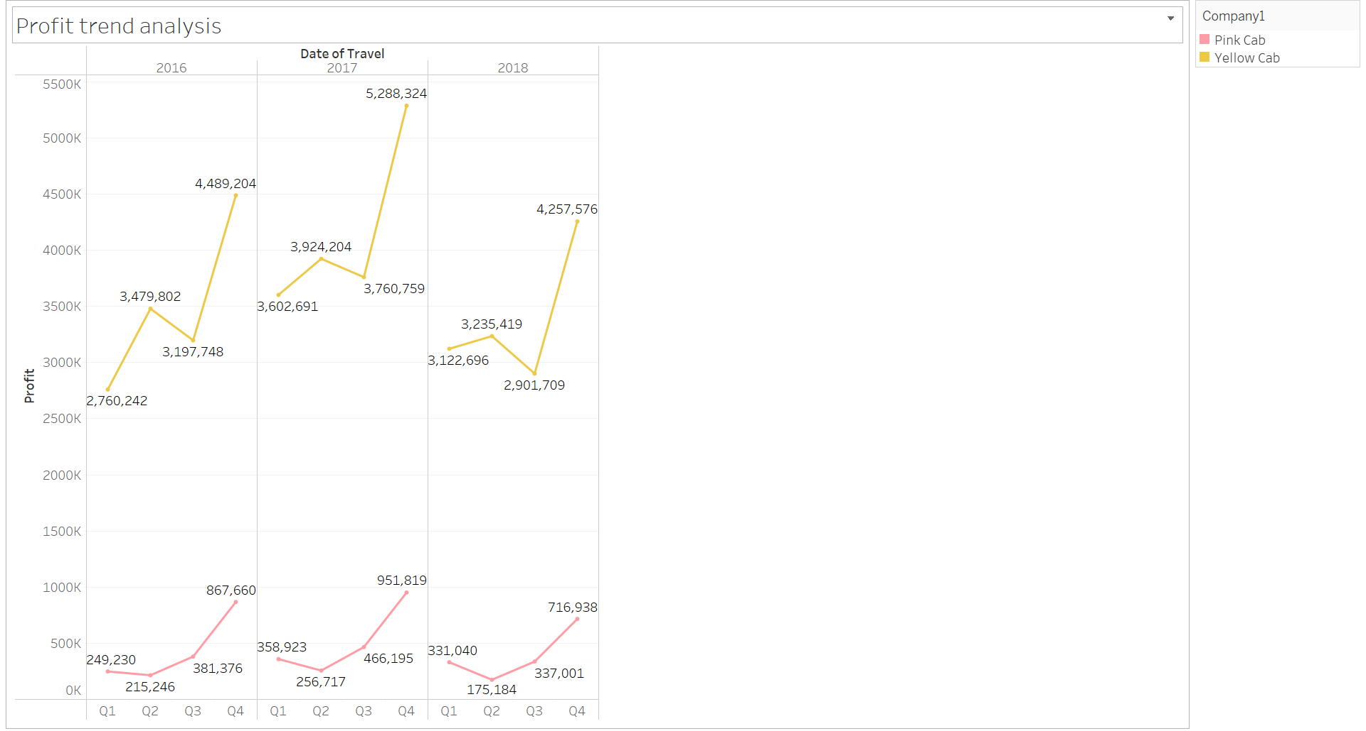
Profit Trend Analysis quarter wise

Slide 15
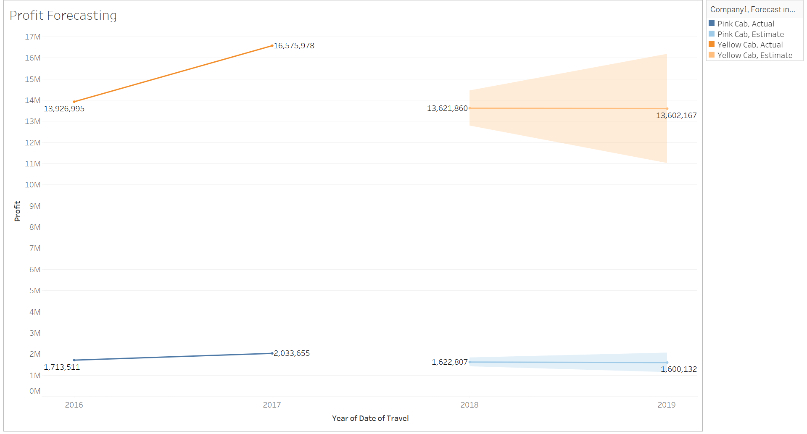
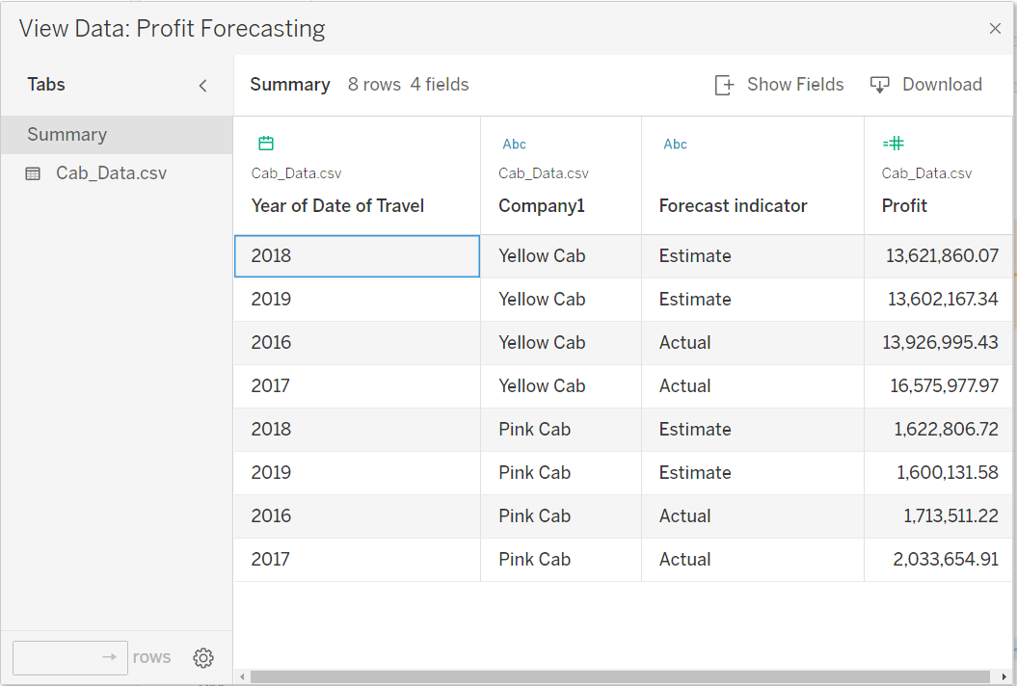
Forecasting Profit for the year 2019

Slide 16
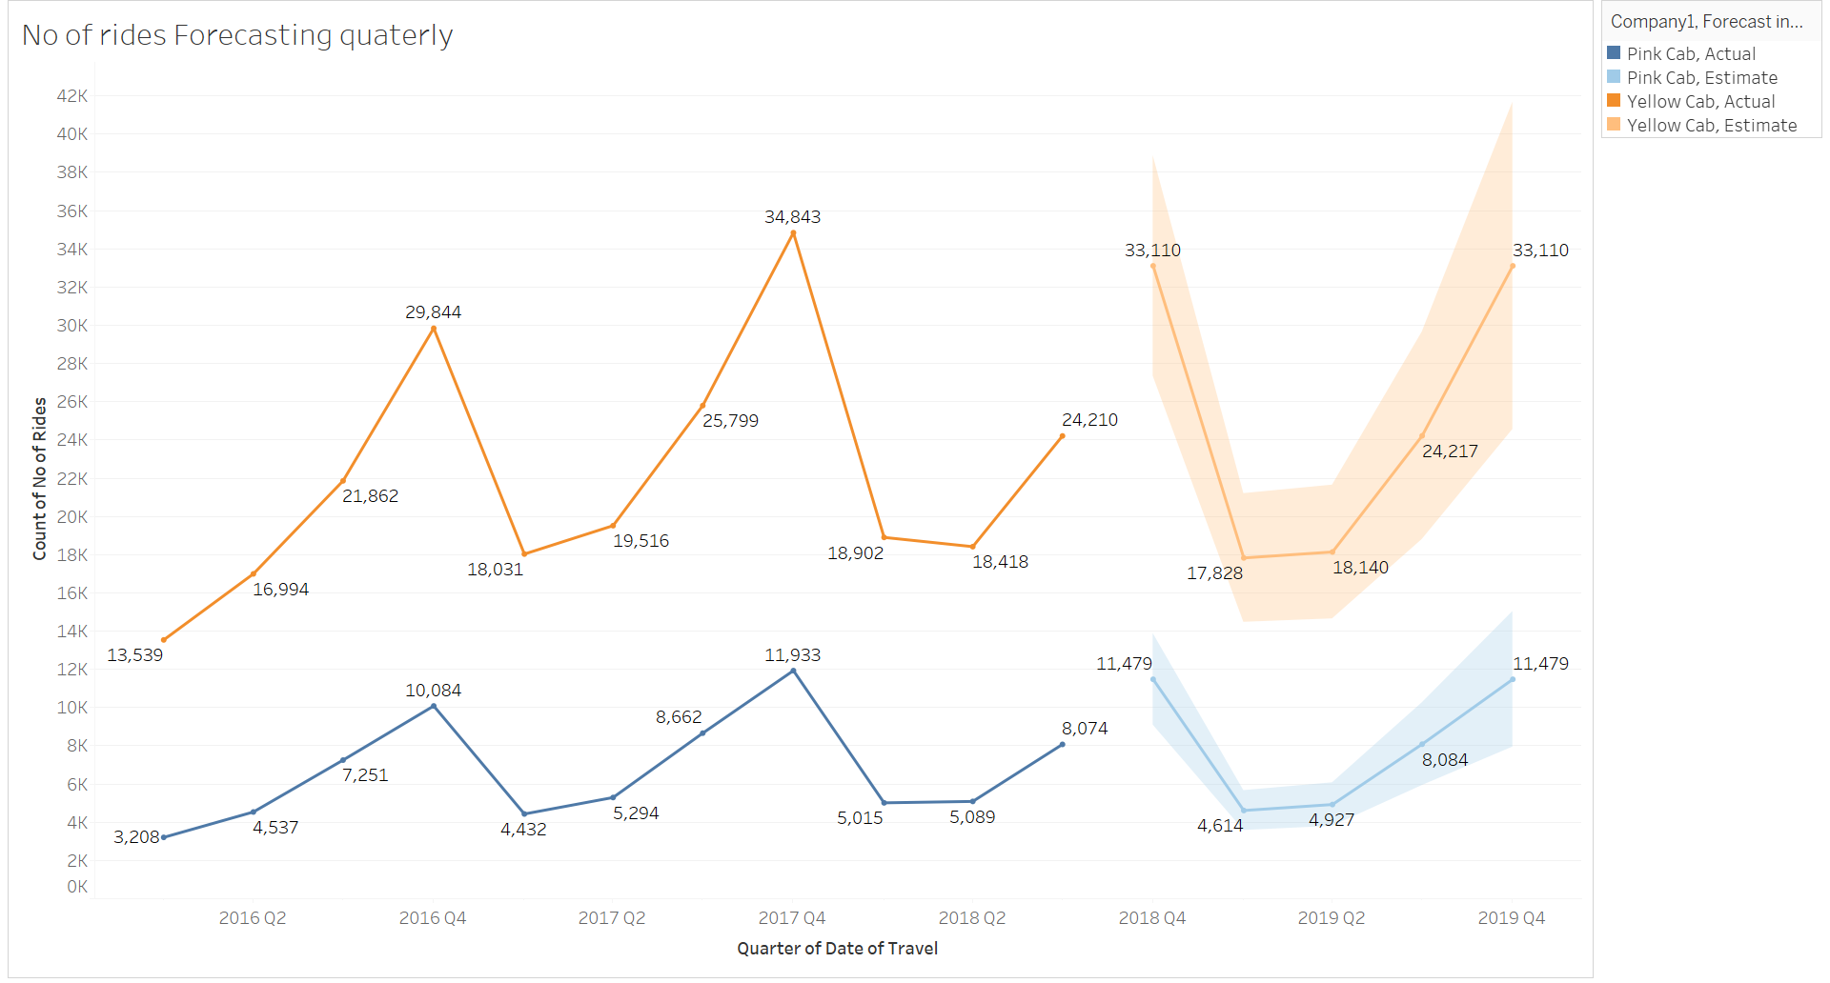
Estimating the Number of Rides for the Yellow and Pink Cab Companies for the year 2019

Slide 17
Hypothesis
1. Customers used more yellow cabs when compared to pink cabs based on the percentage and the year-wise insights.
- Hence, the hypothesis is True.
2. Yellow cab’s average profit per KM is almost three times the average profit per KM of the Pink cab.
- Hence, the hypothesis is True.
3. Analyzing age, gender, and income variables, the Yellow cab is performing better than the Pink cab.
- Hence, the hypothesis is True.
4. By analyzing payment mode and users, card and cash payments in the Yellow cab are 3 times than the cash/card payments in the Pink cab.
- Hence, the hypothesis is True.
5. Yellow cab is used more often compared to pink cabs in highly populated cities.
- Hence, the hypothesis is True.
6. The forecast for yellow cab seems more profitable than pink cab based on the data analysis of profit and no. of rides.
- Hence, the hypothesis is True.

Slide 18
Recommendation
After forecasting the profit for the year 2019, Yellow Cab company has faced a loss of 0.145% and the Pink Cab company has a 1.397% loss.
By looking at the profit and the loss analysis, yellow Cab Company is better than the Pink cab company to Invest.
By Estimating the number of rides in the year 2019 from quarter 1 to quarter 4, Yellow Cab company has a 46.15 profit percentage in the number of rides and the Pink Cab company has a 59.08 profit percentage in the number of rides.
By seeing these profit percentages, we cannot exactly estimate which company to invest in.
But there are a greater number of rides in the Yellow Cab company than in the Pink Cab Company.
By analyzing the data, we can say that the Yellow Cab company has better performance than the Pink Cab company.

Slide 19
Thank You

