Slide 1


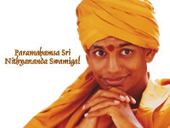
Meditative Healing
Introduction
&
Services Provided
(Free of Cost)

Slide 2
Outline
Meditative Healing Techniques
  What is it?
  What is the fundamental basis?
Where is it being used?
Who are we & what are our techniques?
Sri Swami Nithyananda’s spiritual journey
Frequently Asked Questions (FAQ’s)

Slide 3
Mind Body Techniques – What is it?
“Healing is restoring Physical and Mental Health. There are seven Energy centres in our body called the seven chakras. They manage our physical, mental and emotional activities. Due to our emotions or some other reason, if any one of them gets disturbed, disease prevails. Different diseases are associated with the different chakras. If you can activate or energise the chakras by a meditation technique, then you can free yourself from dis-ease.”
Sri Nithyananda Swami

Slide 4
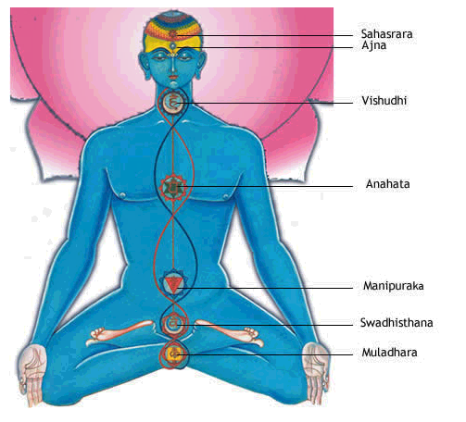
The Science of Chakras or Energy Centers
Sahasrara -
  Name of Gland: Pineal Gland
  Goals: wisdom, knowledge, consciousness
  Emotions: Spiritual addiction - skepticism
Ajna -
  Name of Gland: Pituitary Gland
  Goals: accurate interpretation, imagination
  Emotions: hallucinations - poor memory, denial
Visuddhi -
  Name of Gland: Thyroid Gland
  Goals: creativity, resonance
  Emotions: excessive talking – poor rhythm
Anahata -
  Name of Gland: Thymus Gland
  Goals: balance, compassion
  Emotions: possessive, jealous – shy, bitter
Manipuraka -
  Name of Gland: The Pancreas
  Goals: vitality, self-esteem, spontaneity
  Emotions: dominating, aggressive – weak will
Swadhistana -
  Name of Gland: Gonads
  Goals: pleasure, healthy sexuality
  Emotions: sex addiction – frigidity, impotence
Muladhara -
  Name of Gland: Adrenal Glands
  Goals: stability, prosperity
  Emotions: obesity, materialism - fear, restless

Slide 5
Mind Body Techniques –
Where is it being used?

Slide 6
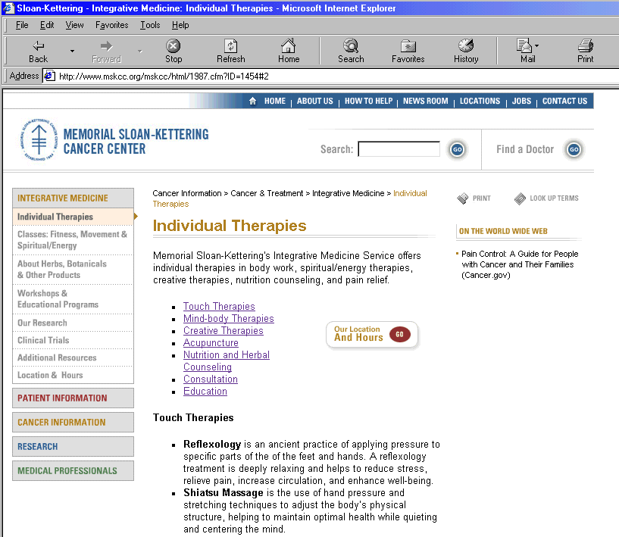

Slide 7
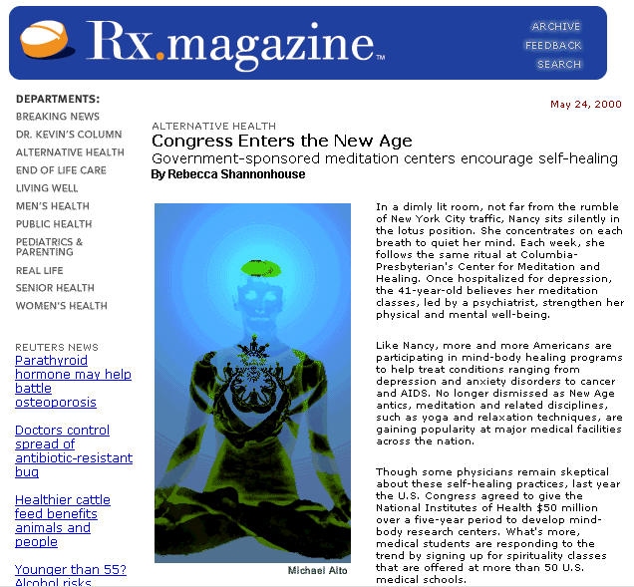

Slide 8
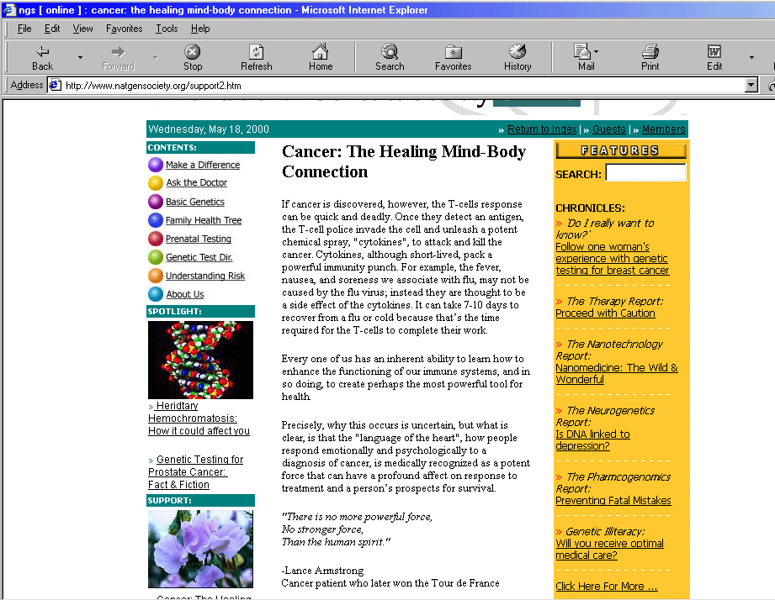

Slide 9
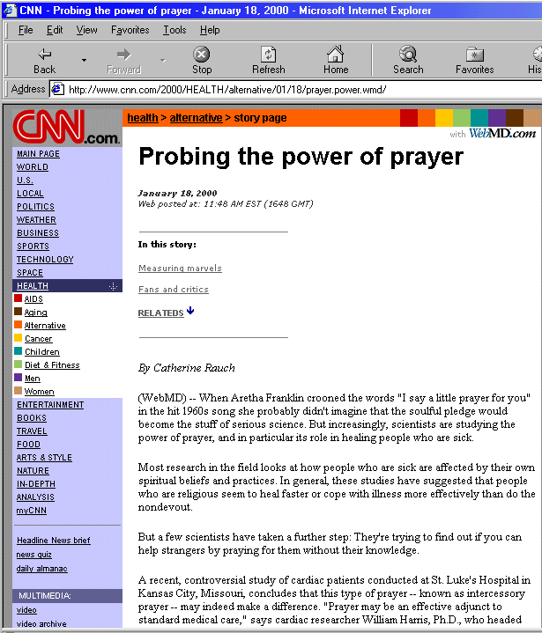

Slide 10
Who are we?
Healers trained in the science of meditative healing (or Ananda Healing) by Sri Nithyananda Swami
  Proven Techniques
  Thousands of people cured through meditative healing
Who is Sri Nithyananda Swami?

Slide 11
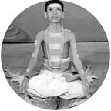
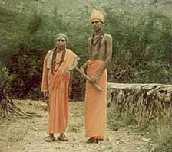
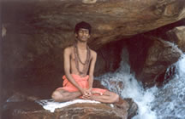
Sri Nithyananda Swami’s Spiritual Journey
Rajasekaran’s restless young
soul was ever seeking the
Eternal. At the age of 12,
he had his first spiritual
experience
1978
1990
1995 - 1999
At the age of seventeen Rajasekaran decided to
leave his home forever in pursuit of his goal.
He stayed in many mutts, studied the Vedas
and other scriptures, wandered over the vast
expanse of India, visiting many holy shrines and
meditating for long hours on snow, near rivers,
on hilltops, and in ashrams. Over 30,000 km of
Yatra he covered, of which more than 2000 km
on foot. With no proper clothing or food, or place
to sleep, the search continued.
Paramahamsa Sri Nithyananda
Swami was born on January 1,
1978, at Thiruvannamalai,
Tamil Nadu, a spiritual nerve centre
and the home of the Enlightened
Master Sri Ramana Maharishi.
Swamiji was named Rajasekaran.
Astrologers predicted a sanyasin’s
life for him – a Rãja Sanayasi.

Slide 12
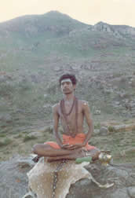
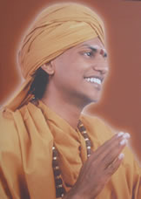
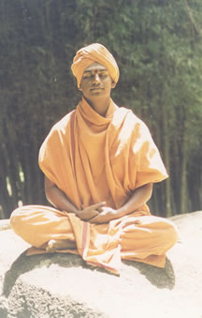
From Spiritual Journey to Enlightenment
Unexpectedly, at a time when he was
feeling frustrated, he felt as one
Enlightened - experiencing the Live Energy
Connection with the Universe. Rajasekaran
became Nithyananda. This happened on
January 1, 2000
1999
2000
2000-Present
At Kasi he had an experience of
death itself. It was a profound
Experience and he came back to
normalcy after a couple of hours.
The fear of death left him forever.
For the next nine months he lay motionless and
speechless most of the time with hardly any food
intake or proper clothing in a place in Tamil Nadu.
He lost his body-consciousness. At the end of it,
he slowly asserted his new Being and traveled to
Salem and Erode in South India, educating and
healing people. He discovered his healing touch
when he was asked to bless a man suffering from
lung cancer. The man was completely cured. He
finally settled at his ashram – Dhyanapeetam –
at Bidadi on the outskirts of Bangalore.

Slide 13
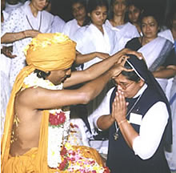
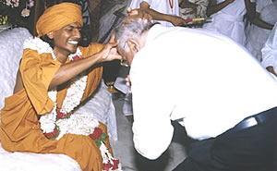
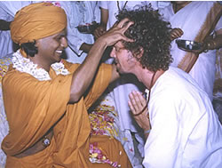
Dhyanapeetam - The Meditation Multiversity
After the Bhoomi Pooja and grand inauguration
on January 1, 2003, work started on the land
under the guidance of Swamiji. The Ashram is
located in Nithyanandapuri at Bidadi, on the
outskirts of Bangalore. It is on an expanse of
20 acres of land that was gifted to Swamiji.
1000s throng the Ananda Sabha to get the
Healing Touch and Blessings of the Master
or atleast to get a mere glimpse of him.
The atmosphere is serene and it is enough
for one to be simply in the Energy Field of
Swamiji to feel rejuvenated. At the Ashram,
Swamiji receives people with great love.
He himself gives the healing touch to one
and all alike at the Ananda Mandapam.
New healers are initiated at the Ashram by
Swamiji himself at periodical intervals at
solemn functions.

Slide 14
What is Ananda Healing?
An ancient, proven technique of self healing
Ananda Healers activate or energize the chakras by meditation techniques
Thousands of people have been cured through meditative healing
Ananda Healing compliments current/conventional medicine
ALL SERVICES PROVIDED FREE OF CHARGE

Slide 15
Frequently Asked Questions FAQ’s
Is Ananda Healing associated with any religion?
  No. This ancient method is based on the science of chakras and can be used by any one of any denomination (Christians, Muslims, Jews, Buddhists, Hindus, etc)
What is Dhyanapeetam?
  It is name given to the worldwide movement started by Sri Nithyanada Swami
  In Sanskrit “Dhyana” stands for meditation and “Peetam” stands for seat or center; In short, Dhyanapeetam is meditation multiversity
Why are we providing this service?
  This is a community service to provide a healing prayer to the sick
  Our teacher Swami Nithyananda Swami has recently visited Oklahoma City and taught several members of the community this ancient, proven techniques
  He is actively spreading this message of healing through meditation throughout the world
Do I need to continue with current medications and treatments?
  Yes, this technique is complimentary to existing medicines and treatments
  We recommend you continue all current medications and treatments
Is there any cost?
  No. This service is absolutely FREE
How can I request services?
  Please contact any of the healers listed in the attachment

Slide 16
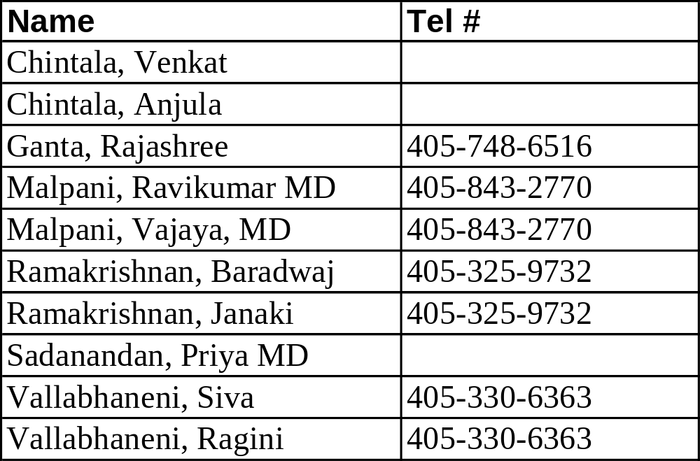
Oklahoma City Contacts:
For more information please also visit www.dhyanapeetam.com

Slide 17
Meditative Healing

