Slide 1
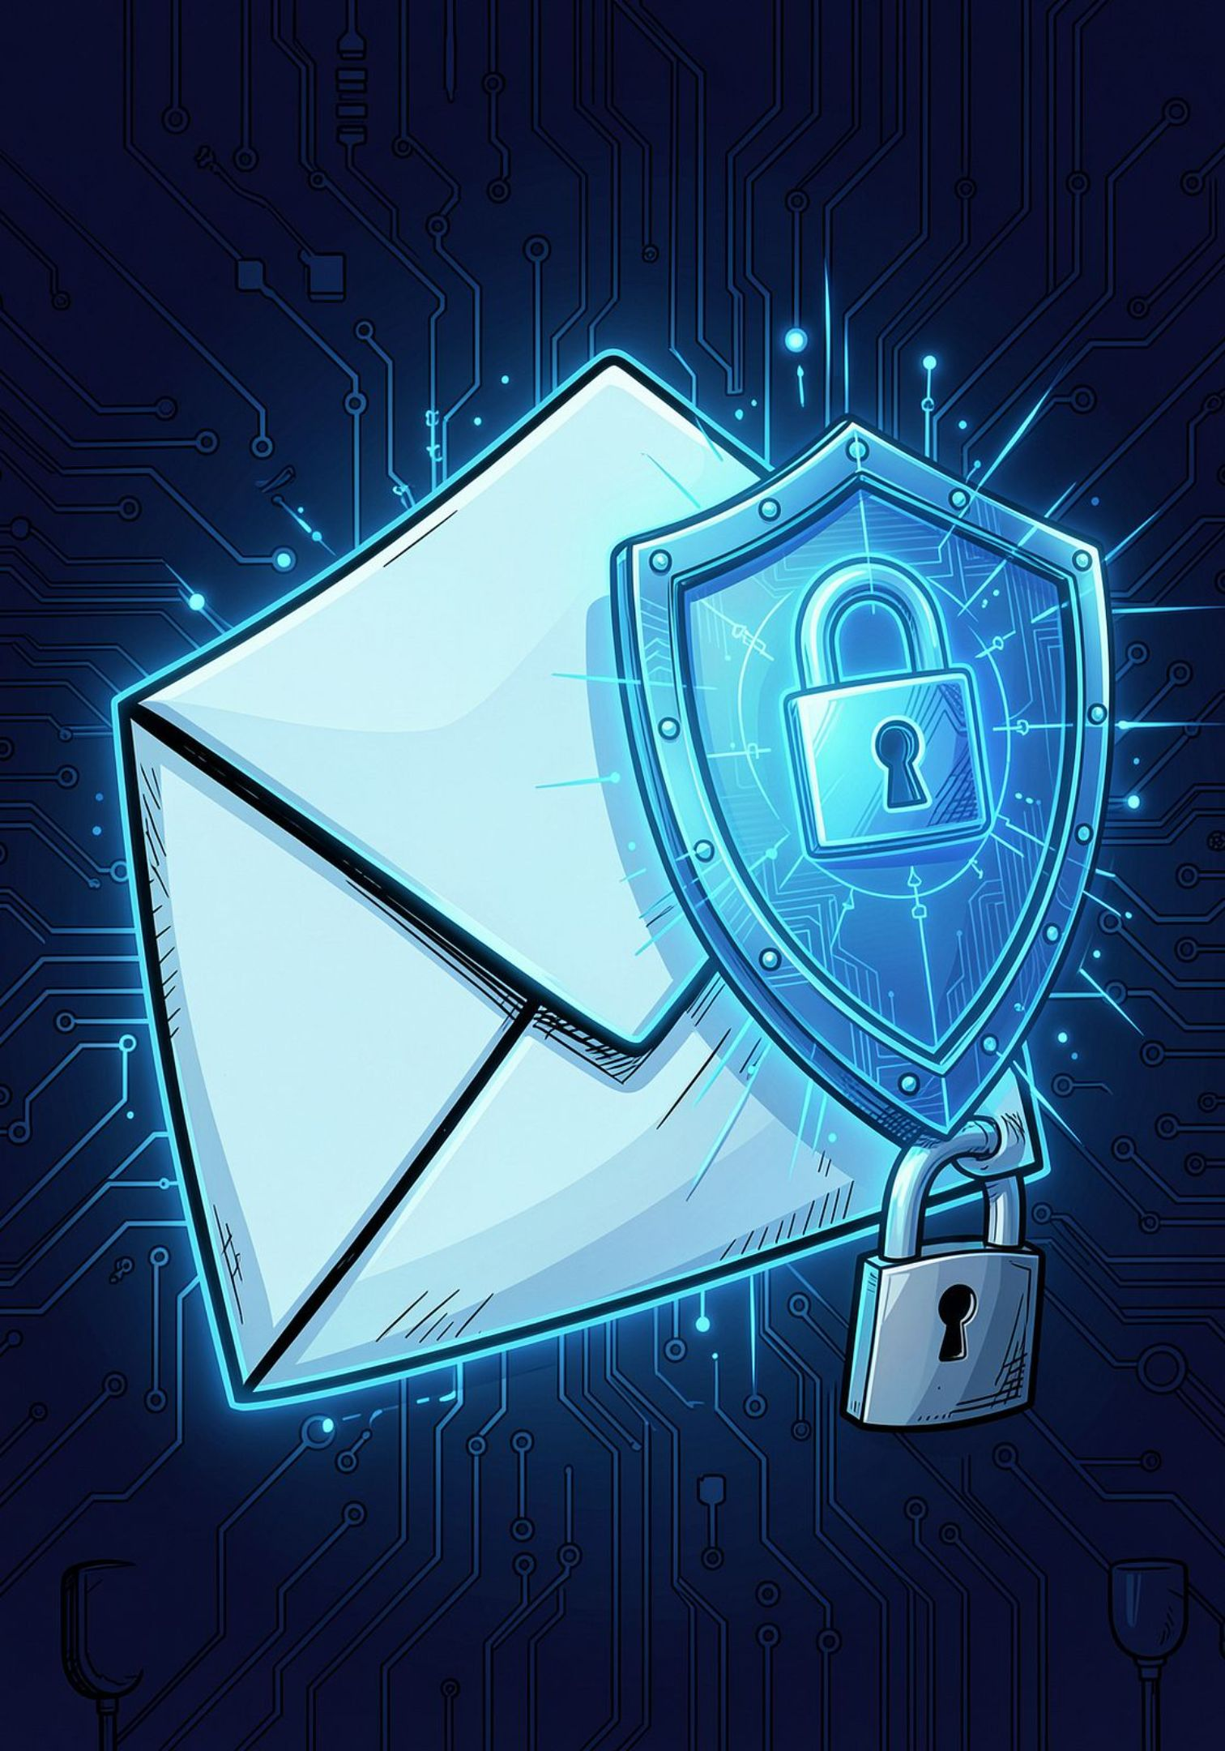
Phishing Awareness Training
Recognize • Prevent • Respond
CodeAlpha Cybersecurity Internship
Task 2: Phishing Awareness Training
Domain: Cybersecurity

Slide 2
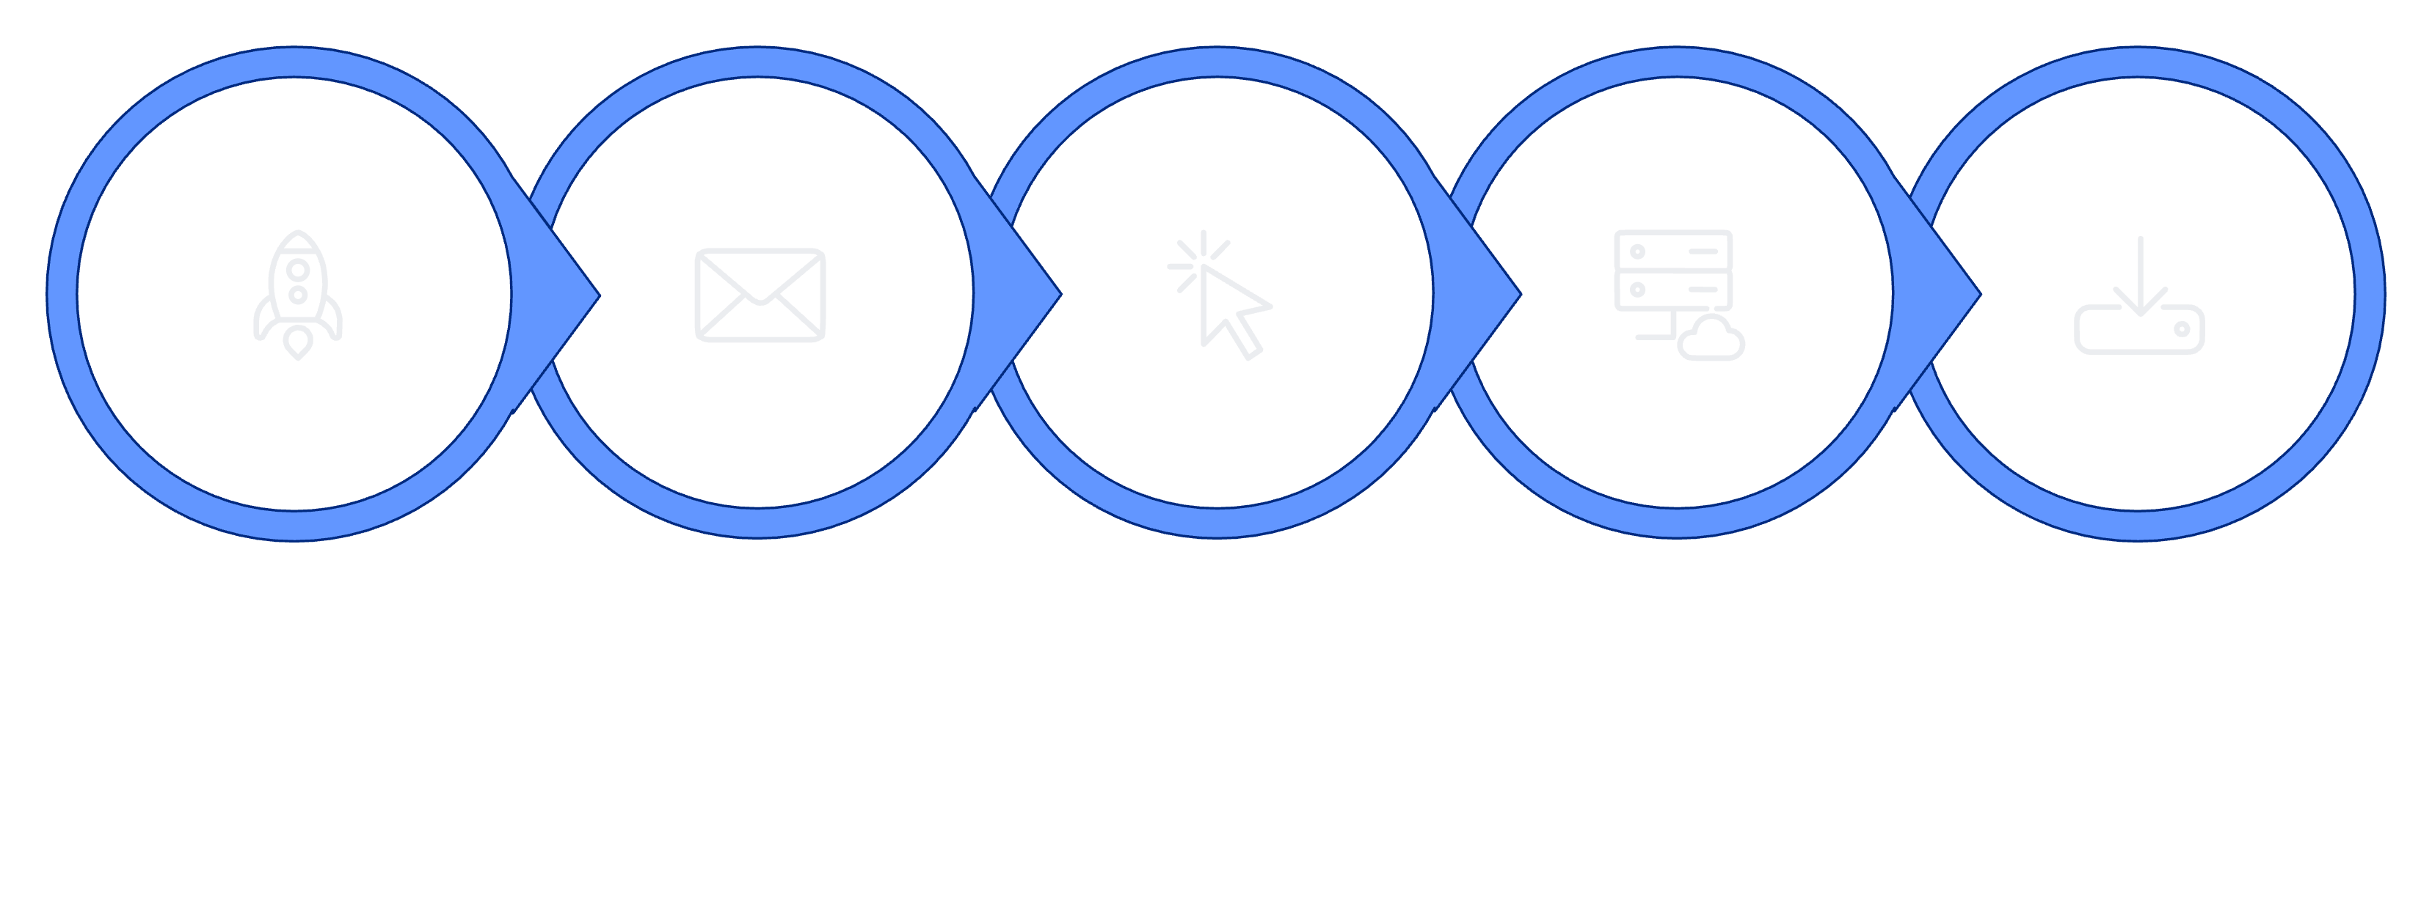
What Is Phishing?
Definition
Common Phishing Channels
Phishing is a type of cyberattack in which attackers use deceptive messages or websites to trick people into revealing sensitive information or performing unsafe actions.
Attackers often impersonate trusted people, companies, banks, services, or organizations.
Email
SMS and messaging applications
Phone calls
Social media
Fake websites
Common Targets
Usernames and passwords
Banking and payment information
Personal information
Authentication codes
Organizational credentials
Attack Flow
Craft Message
Send Message
Click Link
Steal Data
Exfiltration

Slide 3






Common Types of Phishing
Email Phishing
Spear Phishing
General fraudulent emails sent to many potential victims.
Highly targeted phishing directed at a specific person or organization.
Smishing
Vishing
Phishing performed through SMS or text messages.
Phishing performed through voice calls or phone conversations.
Clone Phishing
Website Phishing
A legitimate message is copied and modified to contain malicious content.
A fake website is created to imitate a legitimate website and collect information.

Slide 4

How to Recognize a Phishing Email
Red Flags Checklist
Sender
Links
Check the complete sender email address.
Be cautious of unfamiliar or slightly altered domains.
Hover over links before clicking.
Check the actual destination.
Be cautious of shortened or suspicious URLs.
Message
Attachments
Urgent or threatening language.
Unexpected requests for sensitive information.
Spelling or grammar mistakes.
Unusual requests for payments or account verification.
Be careful with unexpected attachments.
Do not open suspicious files simply because the message appears to come from someone familiar.
Example Email — Red Flags Highlighted
From: | support@paypa1.com ← Misspelled domain
Subject: | URGENT: Your account will be suspended in 24 hours! ← Urgent/threatening language
Body: | Dear Customer,Your account has been compromised. Click here to verify your password immediately.hxxp://paypa1-secure-login.com/verify ← Suspicious URL— PayPal Security Team
Pause before you click.

Slide 5
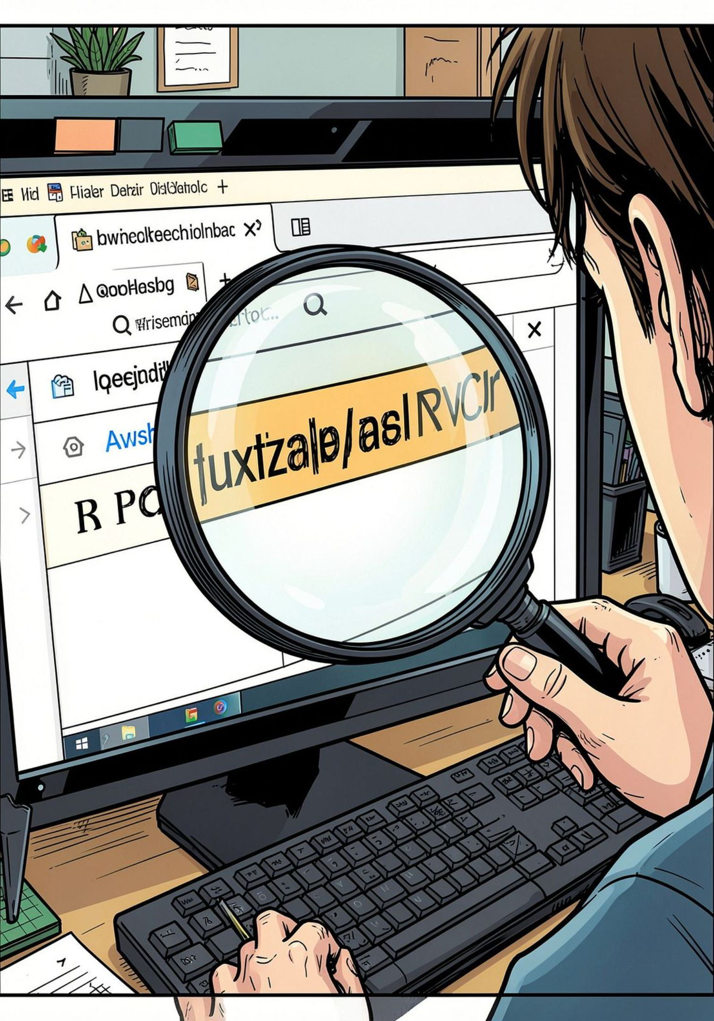

How to Identify a Fake Website
Warning Signs
Domain Comparison
Suspicious or misspelled domain name
Unusual characters or misleading subdomains
Unexpected login or payment request
Poor grammar or inconsistent branding
Missing or suspicious contact information
Unusual urgency or security warnings
Website address does not match the organization being claimed
Legitimate-Looking Domain:
https://example.com
Suspicious Domain:
https://example.security-login.com
The actual domain in the second example is "security-login.com", not "example.com".
Important: HTTPS indicates an encrypted connection, but HTTPS alone does not prove that a website is legitimate.

Slide 6








Social Engineering: How Attackers Manipulate People
Social engineering involves manipulating human behavior to encourage a victim to reveal information or perform an action.
Urgency
Fear
Authority
"Act immediately or your account will be locked."
"Your account has been compromised."
"I am calling from your bank/security department."
Curiosity
Reward
Trust
"Look at this confidential document."
"You have won a prize. Claim it now."
"I'm your manager. Please complete this request."
Scarcity
"This offer expires in 10 minutes."
Key Message: Attackers often try to make victims act quickly before they have time to verify the request.

Slide 7

Real-World Example: Facebook, Instagram & WhatsApp Phishing Campaign
What Happened?
Red Flags
How Users Can Protect Themselves
In December 2021, Meta reported taking legal action against a phishing operation.
The attackers created more than 39,000 fake websites impersonating the login pages of Facebook, Messenger, Instagram, and WhatsApp.
Victims were directed to these fake pages and prompted to enter their usernames and passwords.
The attackers collected credentials entered by victims.
Fake login page designed to look like a trusted service
Deceptive or misleading website address
Request to enter login credentials
Impersonation of a trusted brand
Do not log in through unexpected links.
Check the complete website domain before entering credentials.
Access services through the official application or website.
Use multi-factor authentication (MFA).
Report suspicious phishing messages or websites.
Key Lesson: "A website can look exactly like a legitimate login page and still be a phishing site. Always verify the domain before entering credentials."
Source: Meta Newsroom — "Taking Legal Action Against Phishing Attacks" December 20, 2021 — https://about.fb.com/news/2021/12/taking-legal-action-against-phishing-attacks/

Slide 8




Best Practices: Stop • Check • Verify
STOP
CHECK
Don't click links immediately.
Don't open unexpected attachments.
Don't respond while under pressure.
Never share passwords or authentication codes through unsolicited messages.
Check the sender's address.
Check the URL/domain.
Look for unusual requests.
Examine the message for urgency or manipulation.
VERIFY
SAFE ACTION
Contact the organization through an official channel.
Independently verify unusual payment or account requests.
Access important services using their official website or application.
Use strong, unique passwords.
Enable multi-factor authentication.
Keep operating systems and applications updated.
Use security software where appropriate.
Report suspicious messages.

Slide 9
Interactive Quiz: Can You Spot the Phish?
Question 1
Question 2
Question 3
You receive an email saying: "URGENT! Your bank account will be suspended today. Click here to verify your password."
What should you do?
A message claims to be from a company but the link points to: https://company.security-login.com
What should you check first?
Someone pretending to be your manager says: "I need this payment completed within 10 minutes. Don't call me because I'm in a meeting."
Which social-engineering tactics are being used?
A. Website color
B. Domain name
C. Number of images
D. Font size
A. Click immediately
B. Reply with your password
C. Access the bank through its official website/app
D. Forward the email to friends
A. Authority
B. Urgency
C. Secrecy
D. All of the above
Correct answer: B
Correct answer: C
Correct answer: D

Slide 10
What to Do & Key Takeaways
If You Clicked a Phishing Link
Key Takeaways
Stop interacting with the suspicious page.
If you entered credentials, change the affected password from a trusted device.
Enable or reset multi-factor authentication where appropriate.
Report the phishing message.
Inform your organization's security/IT team if it involves a work account.
Monitor the affected account for suspicious activity.
🔍 Check the sender
🔗 Verify links and domains
🚨 Don't trust urgency
🔐 Never share passwords or authentication codes
🛡️ Use MFA
✅ Verify unusual requests
🚩 Report suspicious messages
Think Before You Click.
Thank You
CodeAlpha Cybersecurity Internship — Task 2

