Slide 1
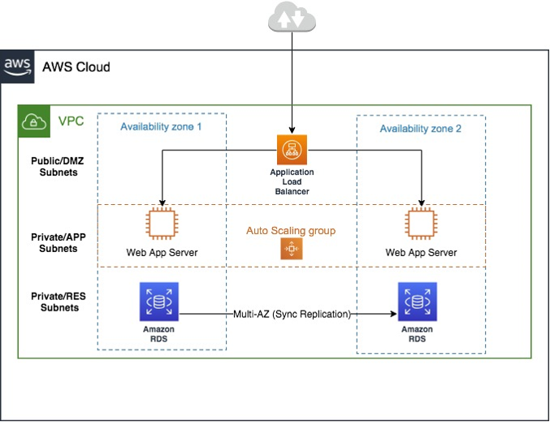

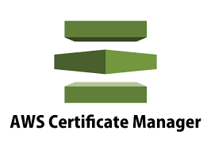

CloudTrail

Slide 2
Infra deployment plan
First I would write a Terraform script to prepare the Iaas Code to build the Infrastructure. (Terraform code will be written as modules).
I would set up a branching strategy for code merging for the app teams.
Then I would setup the CICD pipeline for auto deployment.

