Slide 1


P.S.V COLLEGE OF ENGINEERING & TECHNOLOGY
(Approved by AICTE, New Delhi and Affiliated to Anna University, Chennai)
Accredited by the NAAC with ‘A’ Grade
(Inclusion Under Section 2(f) &12(B) of the UGC Act,1956)
(An ISO 9001:2015 Certified Institution)
Bangalore – Chennai Highway, (NH-46),
Mittapalli, Balinayanapalli Post, Krishnagiri-635108.
DEPARTMENT OF COMPUTER SCIENCE AND ENGINEERING
TITLE
A Machine Learning based Security Model for Cloud Services
Using SVM and J48 Algorithm
Presented by:
HOD: Mr. CHANDRA SHEKAR
GUIDED BY: Mrs.R.Monisha
SriPradesh M (611820104306)
Akash V (611820104002)
Gopi M (611820104303)

Slide 2
A Machine Learning based Security Model for Cloud Services
TITLE
Using SVM and J48 Algorithm

Slide 3
ABSTRACT
Cloud computing is a computing paradigm that provides OnDemand, scalable, measured and secure services to the end users over the internet.
This review investigates the efficiency of machine learning applications, particularly utilizing Support Vector Machines (SVM) and the J48 algorithm, in enhancing cloud security.
Conducting a comprehensive literature search, we identify and analyze studies focusing on threat detection and mitigation in cloud environments.
Comparative analyses reveal the strengths and weaknesses of SVM and J48, considering performance metrics. The most applied metric is true positive rate and least used is training time. Lastly, from 20 datasets found.

Slide 4
PROBLEM STATEMENT
Software security is a critical aspect of software quality, but it is also a complex and challenging topic. Software development organizations often treat security as an afterthought, which leads to security vulnerabilities in their software.
These vulnerabilities can be exploited by attackers to steal data, disrupt operations, or even cause physical damage.
One of the main problems with software security is that it is difficult to integrate into all phases of the software development life cycle (SDLC). This is because security is often seen as a separate concern from functionality and performance.

Slide 5
OBJECTIVES
Identify and address prevalent security concerns in cloud computing, with a particular focus on DDoS attacks and data privacy.
Develop and implement machine learning models, both in hybrid and standalone forms, to detect and mitigate security threats.
Prioritize key metrics in the evaluation framework, emphasizing the true positive rate while considering practical aspects such as training time.
Incorporate insights from multiple datasets to enhance the system's effectiveness and generalizability.

Slide 6
LITERATURE SURVEY 1
AUTHOR NAME | TITLE | EXPLANATION
FABIO DE ROSA | ONTOLOGY-BASED AUTOMATED THREAT MODELING FOR ICT INFRASTRUCTURES | Proposed in this paper Threat modelling is a critical process in cybersecurity that empowers defhas enders to systematically identify and analyse potential threats to a target system. However, the current state of threat modelling often involves manual efforts and lacks formalized approaches, posing challenges to consistency and effectiveness. Additionally, teams engaged in threat modelling may possess varying levels of security expertise, leading to diverse interpretations of the system under analysis.

Slide 7
LITERATURE SURVEY 2
AUTHOR NAME | TITLE | EXPLANATION
MOHAMED NOORDIN YUSUFF MARICAN | CYBER SECURITY MATURITY ASSESSMENT FRAMEWORK FOR TECHNOLOGY STARTUPS | Proposed this paper The increasing significance of cybersecurity across diverse industries, coupled with the rising frequency of cyber-attacks, has compelled firms of all sizes to prioritize robust security measures. Among these, technology start-ups stand out as particularly vulnerable due to inherent challenges such as limited human capital and financial resources.

Slide 8
LITERATURE SURVEY 3
AUTHOR NAME | TITLE | EXPLANATION
Qiang | ALARGE-SCALE EMPIRICAL STUDY ON PROJECT DEPENDENCY OF SECURITY VULNERABILITIES | Proposed this paper The widespread practice of reusing libraries in software development has undeniably enhanced development efficiency and software quality. However, the security implications arising from vulnerabilities in reused libraries, particularly those propagated through project dependencies, have not been thoroughly investigated.

Slide 9
SYSTEM REQUIREMENTS
HARDWARE REQUIREMENTS
CPU type : Intel core i5 processor
Clock speed : 3.0 GHz
RAM size : 8 GB
Hard disk capacity : 40 GB
Keyboard type : Internet Keyboard
CD -drive type : 52xmax
SOFTWARE REQUIREMENTS
Operating System : Windows 10
Front End : JAVA

Slide 10
EXISTING SYSTEM
Security is one of the most critical aspects of software quality. Software security refers to the process of creating and developing software that assures the integrity, confidentiality, and availability of its code, data, and services.
Software development organizations treat security as an afterthought issue, and as a result, they continue to face security threats. Incorporating security at any level of the Software Development Life Cycle (SDLC) has become an urgent requirement.
Several methodologies, strategies, and models have been proposed and developed to address software security, but only a few of them give reliable evidence for creating secure software applications.

Slide 11

DRAWBACKS
Security measures can be complex to manage and maintain, especially as software systems evolve over time.
If security measures are not implemented correctly, they can give users a false sense of security, which can make them more vulnerable to attacks.
Security measures can sometimes conflict with other features of software systems, which can lead to compatibility issues.

Slide 12
PROPOSED SYSTEM
The proposed system is a cloud-based intrusion detection framework leveraging machine learning algorithms to handle the complexities of the NSL KDD dataset.
The system begins with the preprocessing module, which converts numeric attributes to nominal ones and optimizes feature selection using techniques such as Information Gain, Intrinsic Information, and Gain Ratio.
These steps ensure that the input data is uniform, relevant, and conducive to effective analysis by the subsequent machine learning module. At the heart of the system lies the Average One Dependency Estimator (AODE) classifier, renowned for its ability to discern intricate patterns and dependencies within high-dimensional datasets like NSL KDD.
aspects such as training time.

Slide 13
ADVANTAGES
The integration of machine learning in cloud security provides advanced capabilities for real-time threat detection and mitigation, bolstering overall cybersecurity measures.
ML algorithms enable the system to adapt and evolve in response to evolving cyber threats, ensuring a proactive and resilient defence against diverse attack vectors.
By automating the analysis of security events and patterns, machine learning accelerates incident response times, minimizing potential damages and reducing the impact of security breaches.

Slide 14
MODULES
NSL KDD DATASET
This module involves utilizing the NSL KDD dataset, a refined version of the original KDD'99 dataset specifically designed to eliminate redundant records and thus provide a more realistic and challenging benchmark for evaluating intrusion detection systems.
It encompasses a variety of simulated attacks and normal connections, enabling the training and testing of machine learning models to accurately identify malicious activities within network traffic.
NUMERIC TO NOMINAL CONVERSION
The Numeric to Nominal Conversion module is a pre-processing step critical for algorithms that perform better or require input data in categorical form.
This module converts numeric attributes to nominal (categorical) ones, facilitating more effective processing by certain machine learning models, ensuring data uniformity and improving model accuracy.

Slide 15
MODULES
FEATURE SELECTION
This module is dedicated to optimizing the selection of features (attributes) used to train the machine learning models. Feature selection is vital for enhancing model performance by eliminating irrelevant or redundant data, thus reducing complexity and improving execution efficiency.
Information Gain measures the change in entropy after the segmentation of a dataset based on an attribute. It helps in identifying features that provide the most useful information for classification.
Intrinsic Information evaluates the inherent information of a feature, focusing on the feature's own entropy and potential for classification, independent of its effect on the outcome.
Gain Ratio extends the concept of information gain by normalizing its value, balancing the bias towards multi-valued attributes by considering the intrinsic information of the split.

Slide 16
MODULES
MACHINE LEARNING
Average One Dependency Estimator (AODE) Classifier:
The Machine Learning module is at the core of the intrusion detection system, with the AODE classifier playing a pivotal role.
The AODE classifier is a sophisticated machine learning algorithm known for its ability to handle high-dimensional data and complex relationships between attributes effectively, significantly enhancing detection accuracy by capturing and utilizing the dependencies among features.
EVALUATION
The Evaluation module involves rigorously testing the system to assess its performance in accurately detecting intrusions. This includes evaluating the system's accuracy, efficiency, and reliability in identifying various types of malicious activities depicted in the NSL KDD dataset.

Slide 17
BLOCK DIAGRAM
NSL KDD Dataset
Numeric to Nominal Conversion
Feature Selection
Information Gain
Intrinsic Information
Gain Ratio
Machine Learning
Average One Dependency Estimator (AODE)
Evaluation

Slide 18
CONCLUSION
In conclusion, the proposed cloud-based intrusion detection system, equipped with advanced machine learning algorithms and tailored for the NSL KDD dataset, presents a formidable defense against modern cyber threats in cloud environments.
Through rigorous evaluation, its efficacy, efficiency, and reliability are validated, ensuring its readiness to combat emerging threats while minimizing false positives and negatives.
This comprehensive solution underscores the importance of leveraging cutting-edge technologies to bolster cybersecurity measures, safeguarding sensitive data and systems within cloud infrastructures against a myriad of evolving threats.
aspects such as training time.

Slide 19
FUTURE SCOPE
Future work in this domain could focus on enhancing the scalability and adaptability of the intrusion detection system to meet the evolving demands of cloud environments.
This includes exploring techniques for dynamic model updating and retraining to incorporate new threat intelligence and adapt to changing attack patterns.
Additionally, research efforts could be directed towards developing hybrid models that leverage the strengths of different machine learning algorithms to improve overall detection accuracy and resilience against sophisticated attacks.
aspects such as training time.

Slide 20
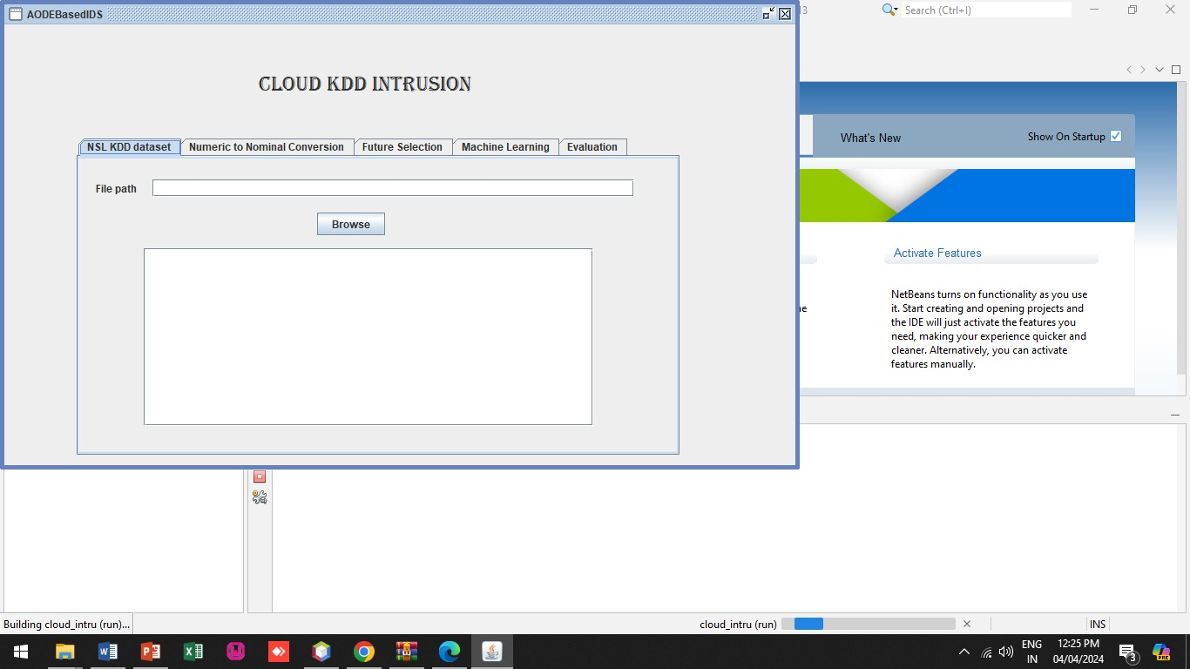
SCREEN SHOT 1
aspects such as training time.
Cloud KDD Intrusion Deduction

Slide 21
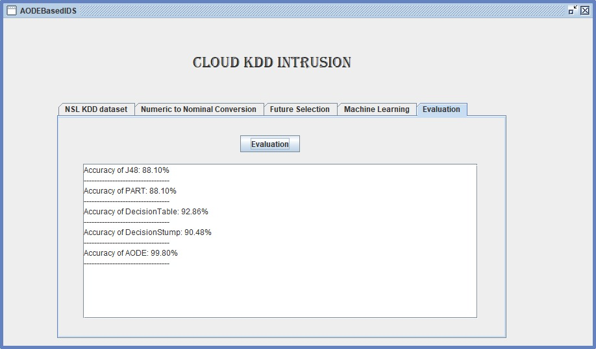
SCREEN SHOT 2
aspects such as training time.
Evaluation process

Slide 22
REFERENCES
Mishra, s. ThreMA: Ontology-Based Automated Threat Modeling for ICT Infrastructures. Electronics 2023, 12, 3524.
Dorri, a.; kanhere, s.s.; jurdak, r.; gauravaram, p. Lsb: Cyber Security Maturity Assessment Framework for Technology Startups: A Systematic Literature Review. J. Parallel distrib. Comput. 2019, 134, 180–197.
Mistry, i.; tanwar, s.; tyagi, s.; kumar, n. PD Graph: A Large-Scale Empirical Study on Project Dependency of Security Vulnerabilities. Mech. Syst. Signal process. 2020, 135, 106382
Felcia, h.j.; sabeen, s. Security Assurance Model of Software Development for Global Software Development Vendors Webology 2022, 19, 3741–3763
Maamar, z.; faci, n.; ugljanin, e.; baker, t.; burégio, v. Analysis of Systems Security Engineering Design Principles for the Development of Secure and Resilient Systems 2021, 14, 100400.
aspects such as training time.

Slide 23




THANK YOU

