Slide 1

ORDER PROCESSING SYSTEM
Submitted by:
ARSH PARNAMI - SPOC
APOORVA S DESHPANDE
BIBHANSHU JHA
DIVYA KURMI
SHRUTHI MEHTA
SRIPRIYA
DHANYA SAJAN

Slide 2
CONTENTS
ABSTRACT
INTRODUCTION
IMPLEMENTATION
OBJECTIVE
MODULES & DESCRIPTION
DIAGRAMS
SNAPSHOTS
CONCLUSION
FUTURE SCOPE

Slide 3
ABSTRACT
This project is aimed at developing an order processing system that is useful for customers to browse multi range of products of different company. It is a useful application as it provides customers efficient service . Customer will be able to view product and can order them and can get the invoice after the order is accepted by the company.
The company will have employees who will login and can add products .They can also track the orders of the customer and accept the requested orders. As soon as the company accepts the order requests, invoice will be generated for the customers which both the customers as well as company can view. The project thus aims at providing an efficient and user-friendly interface for the customers to order the products and also to process and manage the products efficiently.

Slide 4
INTRODUCTION
In today's fast-paced and highly competitive business landscape, the ability to efficiently manage customer orders is a mission-critical component of success. In a world where customers are at the heart of our business, ensuring their satisfaction is paramount.
An Order Processing System is a critical component of a company's business operations, primarily focused on managing and fulfilling customer orders efficiently and accurately.
The system will consist of efficient and user friendly interface for the Customers to check the products ,order the products and get the invoice for the order. The system also consists of interface for the employee of the company to track the orders of the customers.

Slide 5



IMPLEMENTATION
FRONTEND:
HTML,CSS,JAVASCRIPT
DATABASE:
JDBC,SQL
PROGRAMMING LANGUAGE: JAVA

Slide 6
OBJECTIVE
The objective of our Order Processing System project is to develop a robust and user-friendly web-based application that simplifies the process of ordering the products .The customers will be able to browse the products ,order them and get the invoice for the products whose orders are accepted by the company.
Additionally, the customers will be able to import or export the products in the form of XML/JSON file .
The Employee of the company will be able to login to the system where they have a separate interface to track the orders of the customers and accept the order requests of the customers.
Once the order is accepted the customer will get the invoice for their orders.

Slide 7
MODULES & DESCRIPTION
CUSTOMER MODULE:
Purpose: The customer module manages customer-related functionalities and data. It deals with user authentication and profile.
Key functionalities:
Customer authentication: Allows customers to log in securely.
Customer profile: Manages personal information of customer.
Product ordering: Allows to order the products.
Export/Import products: Allows the customers to export or import the products details to their system.
Invoice generation: Allows customer to get the invoice as soon as the order gets accepted.
Permission and roles: Defines user roles (customer and employee) and their respective permissions within the system.
Use case:
When a customer logs in, the module ensures they have appropriate permissions and displays the content accordingly.

Slide 8
EMPLOYEE MODULE:
Purpose: The employee module manages the product of the company and also manages the order related information.
Key functionalities:
Employee authentication: Allows employees to log in securely.
Adding Product : Allows the employees to add the products.
Tracking of orders: Allows the employees to track the orders of the customers and accept the order requests
Invoice generation: As the order request is accepted ,invoice for the order will be generated.
Use case:
When the employee logs in, the module ensures they have appropriate permissions and displays the content accordingly.

Slide 9
PRODUCT MODULE:
Purpose: The product module has the product details .
Key functionalities:
Adding Product : Allows the employees to add the products.
Order the product: Customers will be able to order the product.
Use case:
When the products are imported or exported by the customer as XML/JSON file, it will be validated and the status will be displayed as completed, failed or partial. The screen will also show the number of products imported and also those that are not imported.

Slide 10
COMPANY MODULE:
Purpose: The company module has the company details .
Key functionalities:
Adding Product : Allows the employees of company to add the products.
Track the order: Employees from the company will be able to track the orders
Use case:
When the order request sent by the customer , the approval should be done by the company employee. As soon as the approval of order request is done,

Slide 11
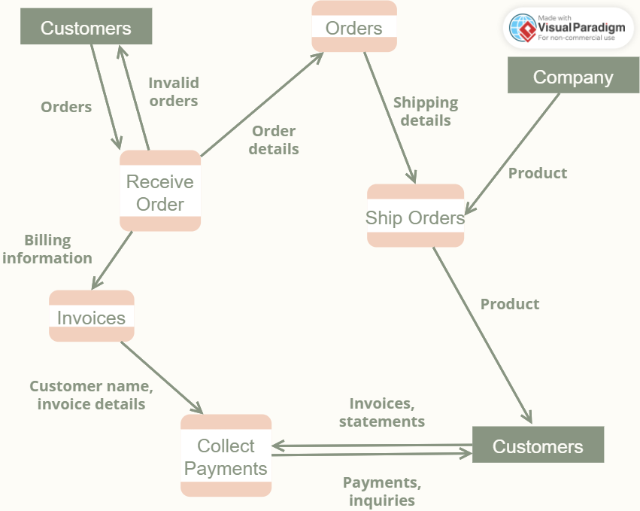
DIAGRAMS
DATA FLOW DIAGRAM:

Slide 12
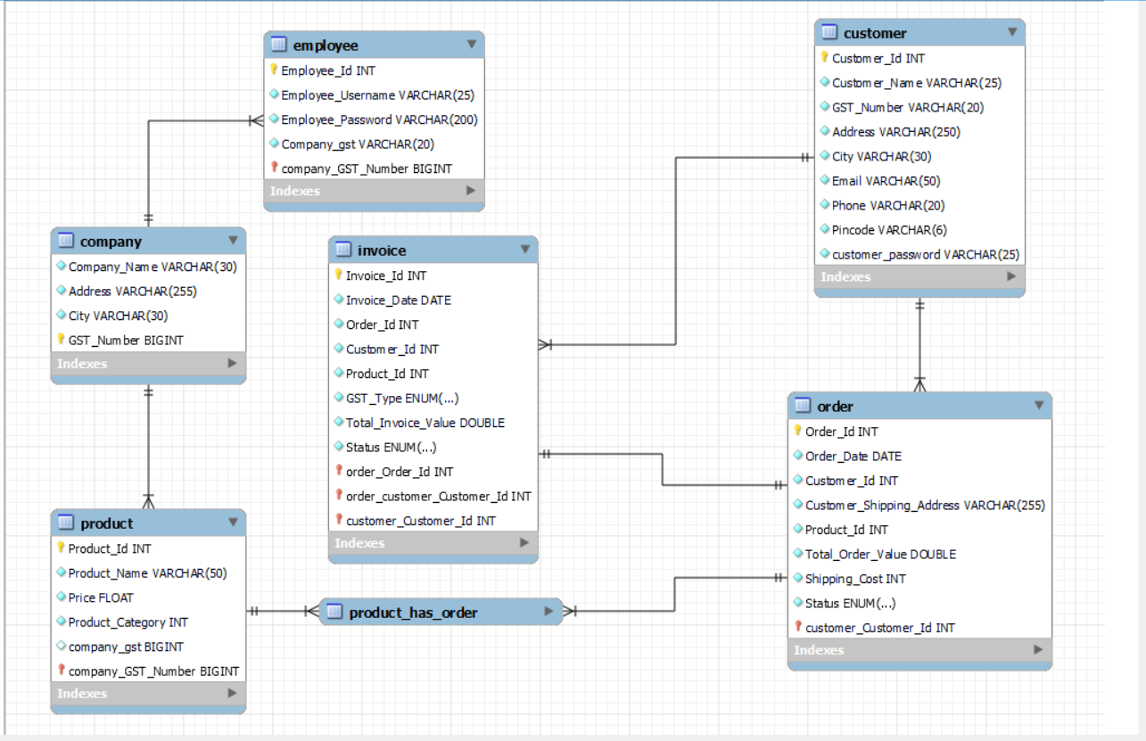
ER DIAGRAM

Slide 13
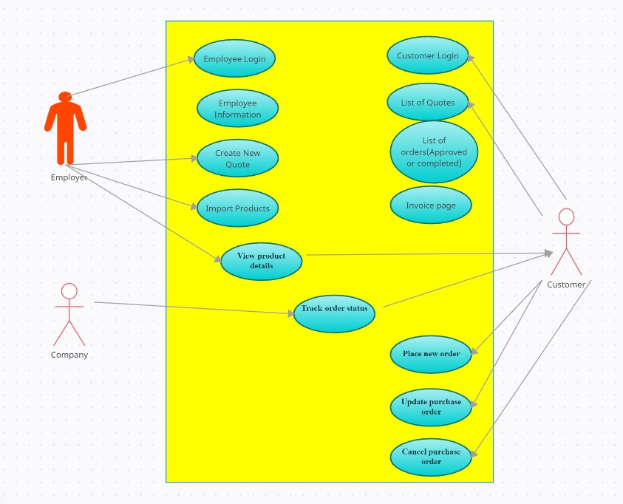
USECASE DIAGRAM

Slide 14
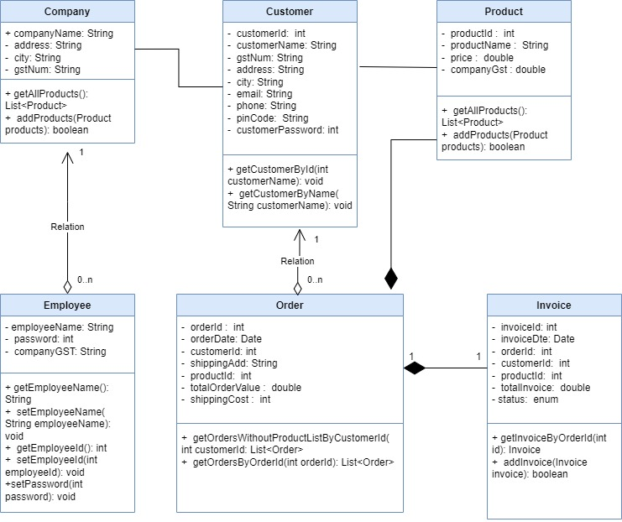
CLASS DIAGRAM

Slide 15
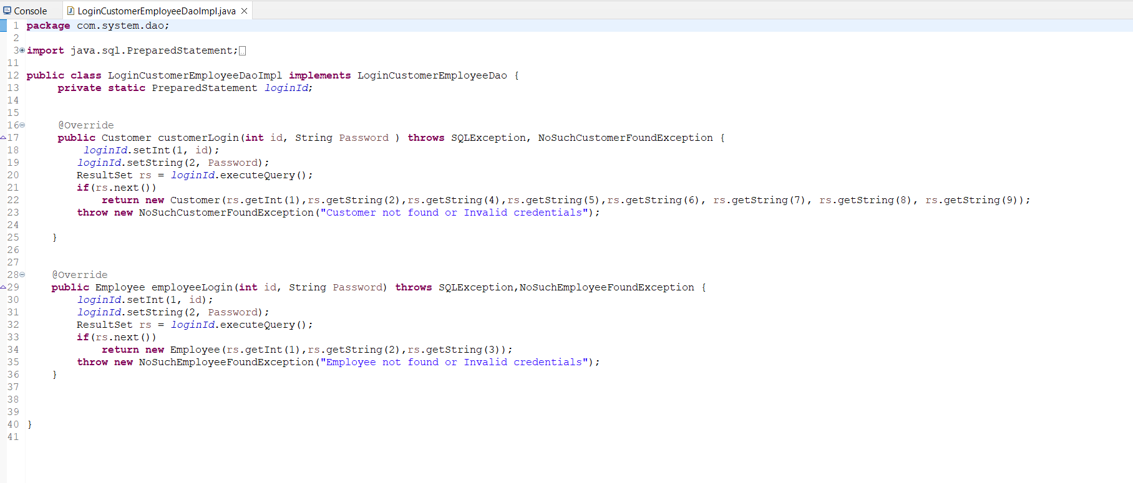
SNAPSHOTS

Slide 16
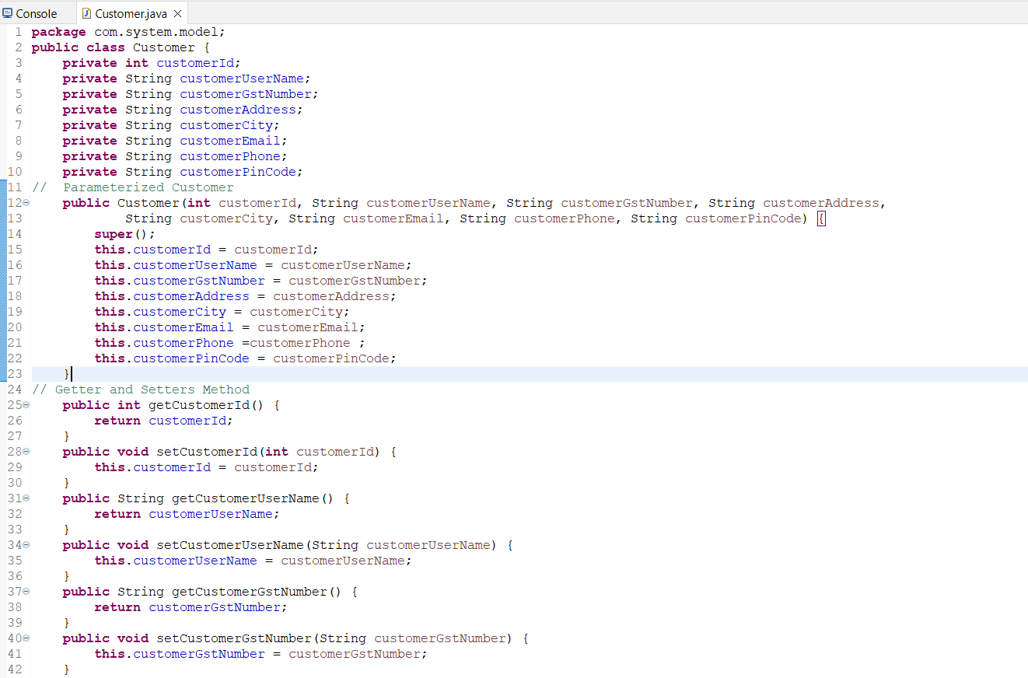

Slide 17
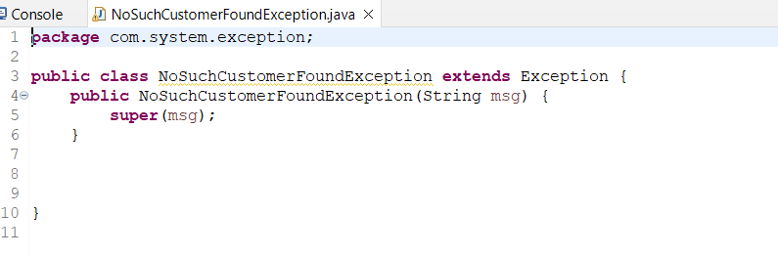

Slide 18
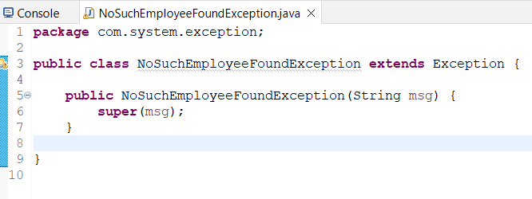

Slide 19
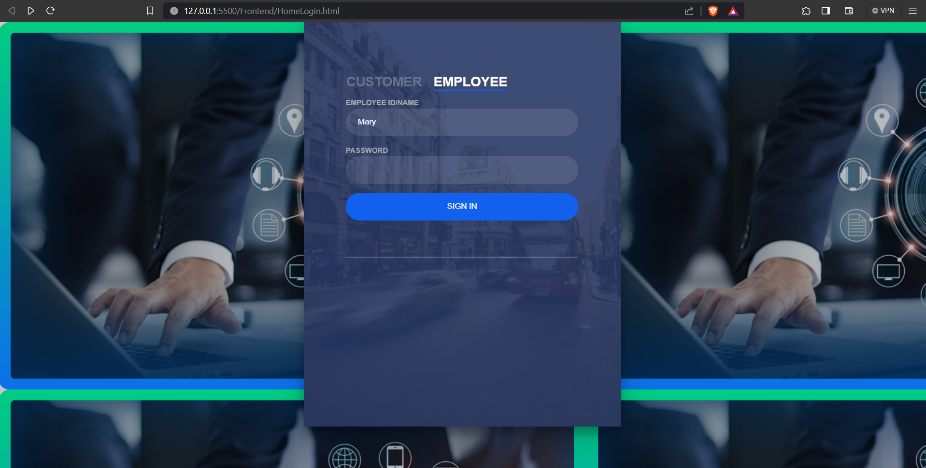
Snapshots of Frontend

Slide 20
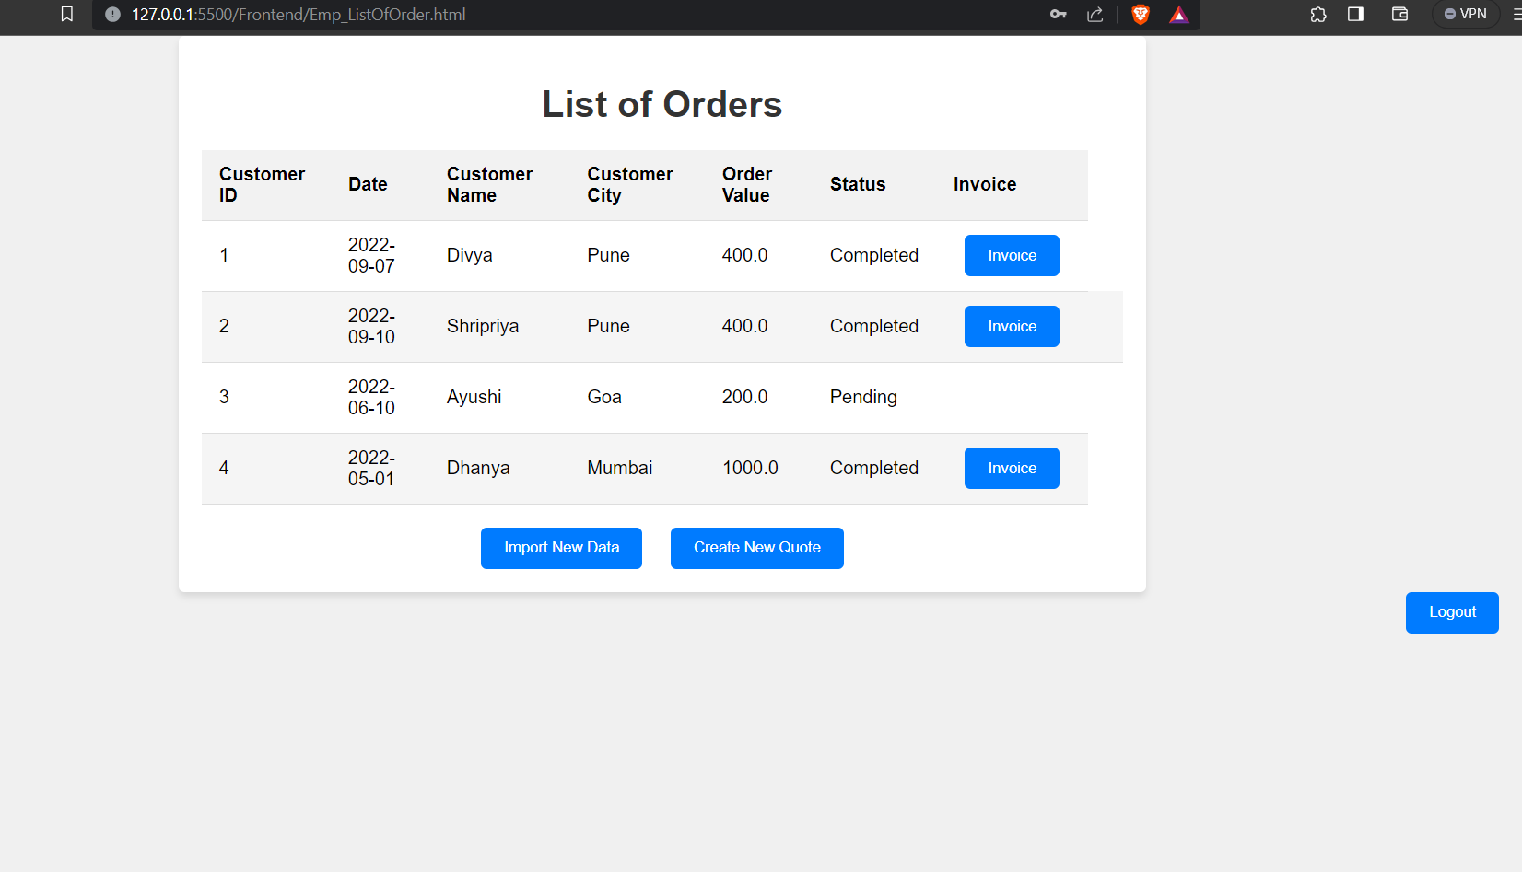
Employee

Slide 21
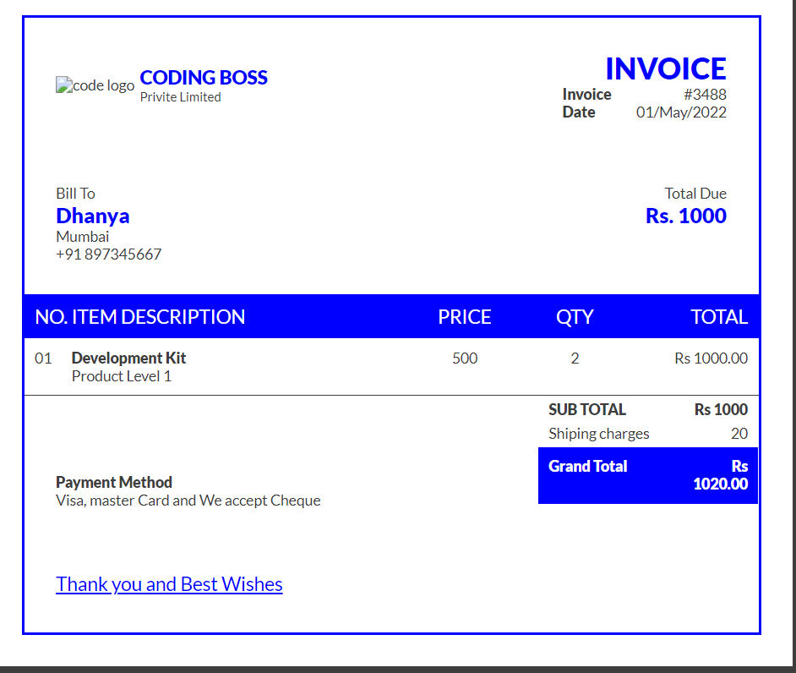

Slide 22
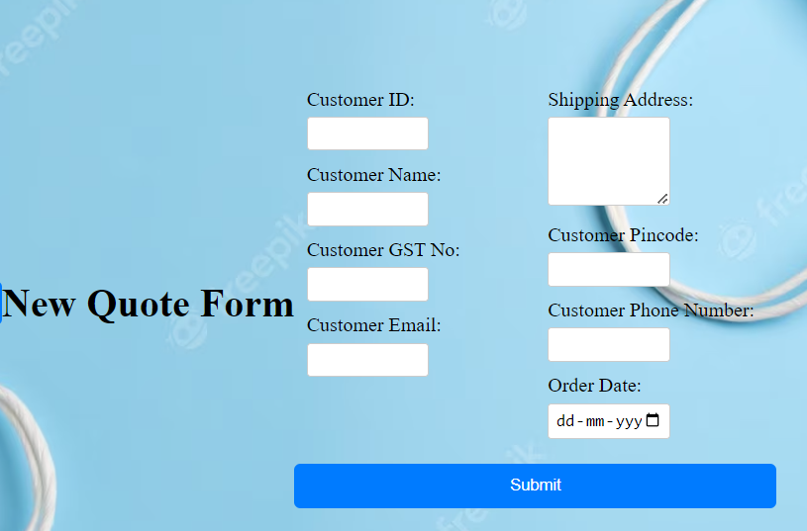

Slide 23
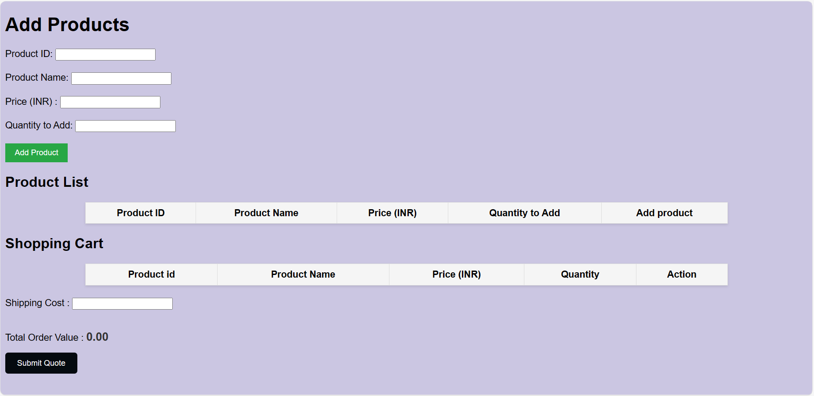
Customer

Slide 24
CONCLUSION
In conclusion, our Order Processing System has successfully addressed the critical need for efficiency and accuracy in managing customer orders. Through the strategic utilization of a robust Database Management System, we have streamlined order creation, tracking, product management resulting in significantly improved operational efficiency.
Real-time order tracking and automated invoice generation will enhance customer satisfaction, while the normalization of our database schema has ensured data integrity and accuracy.

Slide 25
FUTURE SCOPE
Advanced Analytics: Implement advanced data analytics and reporting features to gain deeper insights into order trends, customer behavior, and inventory management.
Mobile Application: Develop a mobile application to allow customers to place orders and track their status conveniently. Additionally, consider providing a mobile app for field sales representatives to input orders while on-site.
Customer Self-Service Portal: Expand the customer self-service capabilities, allowing customers to modify orders, request returns, and manage their profiles independently.
Customer Feedback and Surveys: Incorporate mechanisms for collecting customer feedback and conducting surveys to gauge satisfaction and gather insights for continuous improvement.
Mobile Notification Services: Develop mobile notification services that provide customers with real-time updates on their orders through SMS, email, or push notifications via a mobile app.

Slide 26

THANK YOU!

