Slide 1
Export of GTP-U Information in IPFIX draft-ietf-opsawg-ipfix-gtpu-03
Enabling insights in GTP forwarding plane by adding GTP-U dimensions
daniel.voyer@bell.ca
sriragop@cisco.com
thomas.graf@swisscom.com
vyasraj@juniper.net
17 Mar 2025

Slide 2
GTP-U @ IPFIX Draft Status since last review @ IETF121
Highlights since IETF121
Liaison statement issued with 3GPP and requested 3GPP TSG SA WG5 and 3GPP TSG CT WG4 to review this draft.
Addressed comments from Mohamed on updating the IE description, Use case section (Sec-4) by giving additional references to slicing related info.
Updated IE description will be updated with IANA also (should I mentioned this statement??)
There is a possibility of additional IEs to be added as part of addressing the ongoing comments. Ex: gtpuheadersection, gtputotalheaderlength
Review and addressing further comments from Mohamed’s on version 03 – In progress

Slide 3
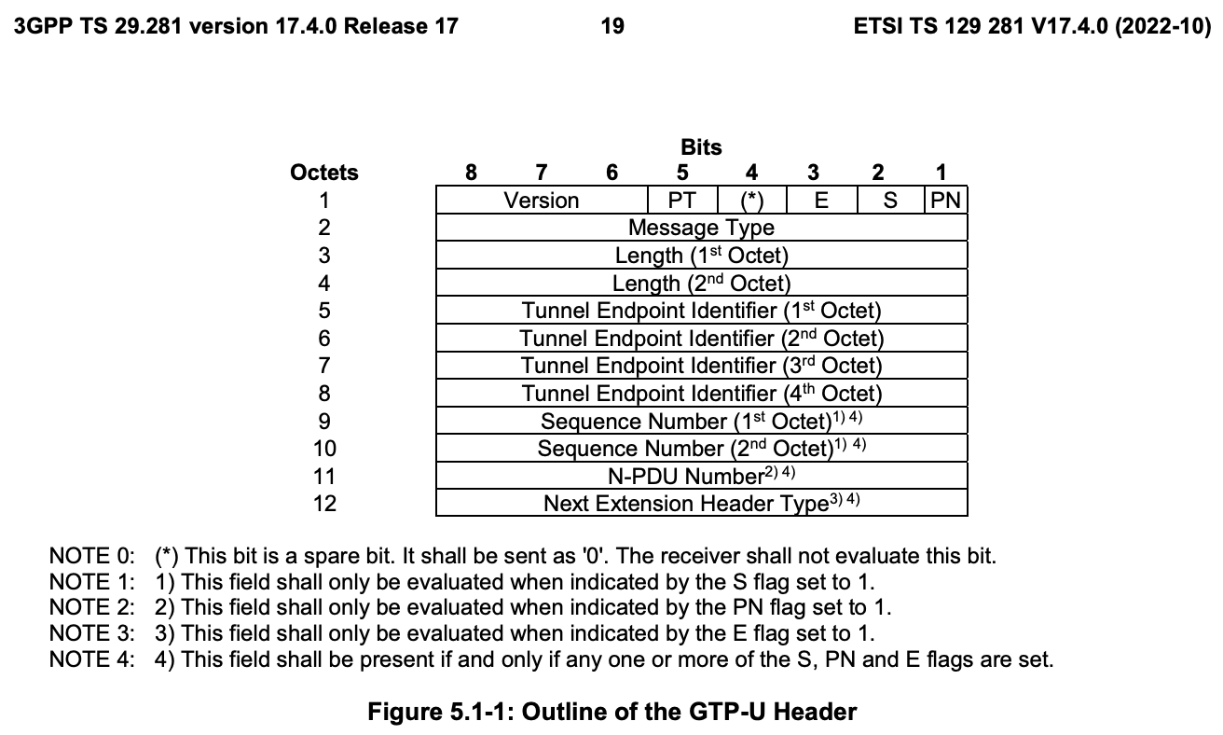
GTP-U @ IPFIX IPFIX entities in context of the GTP-U (1)
gtpuFlags IE-505
8-bit flags field defined in the GTP-U which indicates the version of GTP-U protocol, protocol type and presence of extension header, sequence number and N-PDU number in the GTP-U header.
gtpuMsgType IE-506
8-bit message type field defined in the GTP-U which
indicates the type of GTP-U message.
gtpuTEid IE-507
32-bit tunnel endpoint identifier field defined in GTP-U which unambiguously identifies a tunnel endpoint in the receiving GTP-U protocol entity for a given UDP/IP endpoint..
gtpuSequenceNum IE-508
16-bit sequence number field defined in the GTP-U. This field is interpreted based on the corresponding flag value from gtpuFlags

Slide 4
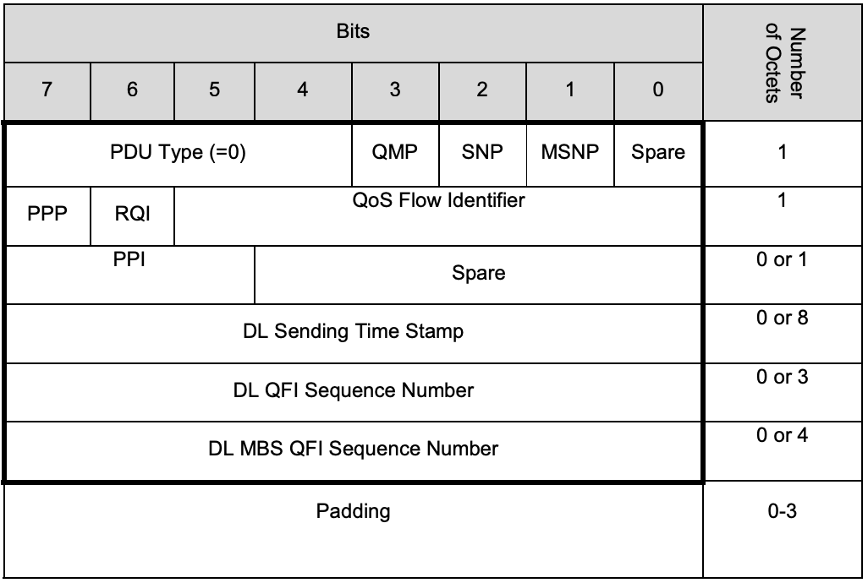
GTP-U @ IPFIX IPFIX entities in context of the GTP-U (2)
gtpuQFI IE-509
8-bit QoS flow identifier field defined in PDU Session Container extension header of GTP-U. This is defined in section 5.5.3 of PDU session spec [TS.38415]. This is used to determine the QoS flow and QoS profile which are associated with the received packet.
gtpuPduType IE-510
8-bit PDU type field defined in PDU Session Container extension header of GTP-U. This is defined in section 5.5.3 of PDU session spec [TS.38415]. This field indicates the structure of the PDU session UP frame..

Slide 5
GTP-U @ IPFIX Next Steps
I would seek inputs from the WG if there is any interest on below comments.
Is it worth to also report the extension header chain?
We could think of two options to report the GTP-U extension header chain
Export complete GTP-U header, for example gtpuHeaderPacketSection
Export only the extension headers, for example gtpuExtHeaderPacketSection
As the header length is variable, is it worth to also export the length as a separate IE

