Slide 1
Export of GTP-U Information in IPFIX draft-ietf-opsawg-ipfix-gtpu-00
Enabling insights in GTP forwarding plane by adding GTP-U dimensions
daniel.voyer@bell.ca
sriragop@cisco.com
thomas.graf@swisscom.com
benoit.claise@huawei.com
vyasraj@juniper.net
23 Oct 2024

Slide 2
GTP-U @ IPFIX Draft Status since last review @ IETF119
Highlights since IETF119
Draft is adopted by OPSAWG
Many thanks Paul Aitken for the IPFIX doctor review.
IANA assigned IE numbers for GTP fields are available; IE 505-510.
Added a new section named ‘Operational Considerations’
Shared with DMM WG
Review and adding Mohamed’s comments

Slide 3
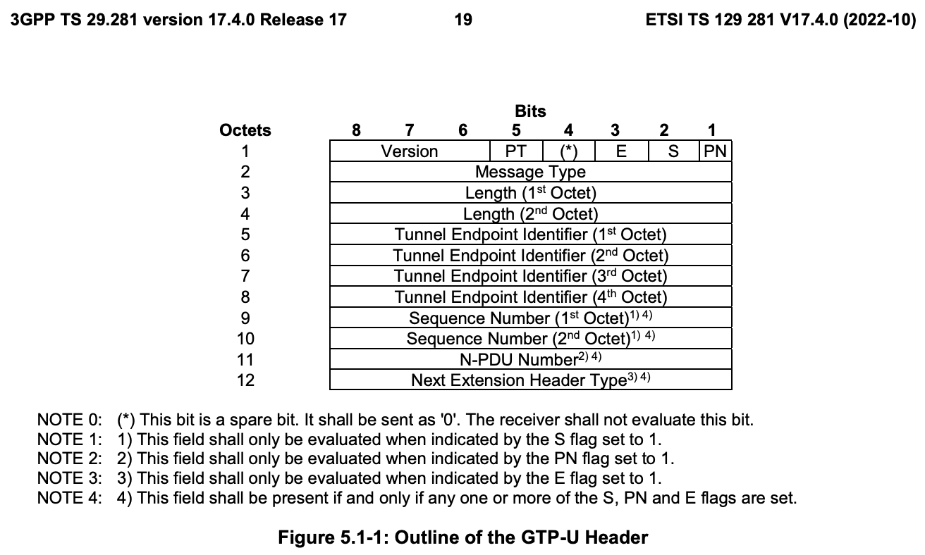
GTP-U @ IPFIX IPFIX entities in context of the GTP-U (1)
gtpuFlags IE-505
8-bit flags field defined in the GTP-U which indicates the version of GTP-U protocol, protocol type and presence of extension header, sequence number and N-PDU number in the GTP-U header.
gtpuMsgType IE-506
8-bit message type field defined in the GTP-U which
indicates the type of GTP-U message.
gtpuTEid IE-507
32-bit tunnel endpoint identifier field defined in GTP-U which unambiguously identifies a tunnel endpoint in the receiving GTP-U protocol entity for a given UDP/IP endpoint..
gtpuSequenceNum IE-508
16-bit sequence number field defined in the GTP-U. This field is interpreted based on the corresponding flag value from gtpuFlags

Slide 4
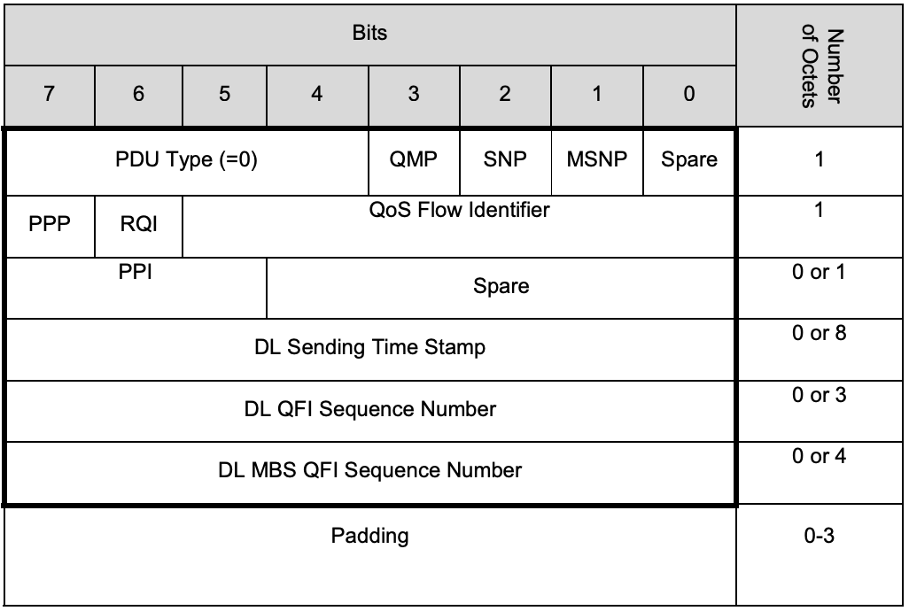
GTP-U @ IPFIX IPFIX entities in context of the GTP-U (2)
gtpuQFI IE-509
8-bit QoS flow identifier field defined in PDU Session Container extension header of GTP-U. This is defined in section 5.5.3 of PDU session spec [TS.38415]. This is used to determine the QoS flow and QoS profile which are associated with the received packet.
gtpuPduType IE-510
8-bit PDU type field defined in PDU Session Container extension header of GTP-U. This is defined in section 5.5.3 of PDU session spec [TS.38415]. This field indicates the structure of the PDU session UP frame..

Slide 5
GTP-U @ IPFIX Next Steps
Request for comments and feedback
Thank you

