Slide 1

DOMAIN NAME : MACHINE LEARNING
TITLE : HAND GESTURE RECOGINIZATION
GUIDE NAME : MR.R.ROSHAN JOSHUA.,M.E.
TEAM MEMBERS:
THEJEAL SRI K(811721243055)
SUJAINITHA G(811721243055)
DHIVYA A D(811721243014)
SATHVIKA A(811721243049)

Slide 2
ABSTRACT:
Gesture recognition is an emerging topic in today’s technologies. The main focus of this is to recognize the human gestures using mathematical algorithms for human computer interaction. Gesture recognition is one of the essential techniques to build user-friendly interfaces. Usually gestures can be originated from any bodily motion or state, but commonly originate from the face or hand. Gesture recognition enables users to interact with the devices without physically touching them. In this project we are going to use convolution neural network(CNN) along with a classification technique (Ensemble Learning) in order to recognize gestures.

Slide 3
INTRODUCTION:
Machine learning (ML) is pivotal in gesture recognition by extracting features from sensor data, training models to classify gestures, and enabling real-time applications like sign language interpretation and device control.
ML's adaptability, multi-modal integration, and applications in human-computer interaction make it essential for natural and accessible interaction with technology.
CNNs are crucial for image recognition because they excel at learning hierarchical features from raw image data, making them adept at identifying patterns and objects.
Their parameter sharing reduces overfitting and computational demands.

Slide 4
Gesture recognition is an area of research and development in computer science and language technology concerned with the recognition and interpretation of human gestures.
Gestures can originate from any bodily motion or state, but commonly originate from the face or hand.
Sign language is a visual and gestural means of communication used by Deaf and hard-of-hearing individuals.
Some well-known sign languages include American Sign Language (ASL), British Sign Language (BSL), and Auslan (Australian Sign Language).
In our project we have planned to train the model using TSL tamil sign language.

Slide 5
LITERATURE SURVEY :
PAPER TITLE : An Intelligent Heuristic Manta-Ray Foraging Optimization and Adaptive Extreme Learning Machine for Hand Gesture Image Recognition.
AUTHOR NAME : Seetharam Khetavath, Navalpur Chinnappan Sendhilkumar, Pandurangan Mukunthan, Selvaganesan Jana, Lakshmanan.
YEAR PUBLISHED : 2023
TECHNIQUE AND METHOD USED : Hand gesture image segmentation, Multifaceted Feature Extraction Model (MFE), Heuristic Manta-ray Foraging Optimization, Adaptive Extreme Learning Machine (AELM).
ADVANTAGES : MFE captures diverse hand gesture features effectively.
DISADVANTAGES : Heuristic optimization like Manta-ray Foraging may find suboptimal solutions.

Slide 6
PAPER TITLE :A Static Hand Gesture Recognition Model based on the Improved Centroid Watershed Algorithm and a Dual-Channel CNN.
AUTHOR NAME : Xude Dong, Yuanping Xu, Zhijie Xu,Jian Huang,Jun Lu,Chaolong Zhang, Li Lu.
YEAR PUBLISHED : 2018
TECHNIQUE AND METHOD USED : Centroid watershed algorithm , CNN.
ADVANTAGES : Effective image segmentation based on region properties.
DISADVANTAGES : Demands significant computational resources and extensive training data.

Slide 7
PAPER TITLE : Hand Gesture Recognition based on Convolution Neural Network (CNN) and Support Vector Machine (SVM).
AUTHOR NAME : Muhammad Afiq Abdull Razak, Farah Yasmin Abdul Rahman,Roslina Mohamad, Shahrani Shahbuddin,Yuslinda Wati Mohamad Yusof,Saiful lzwan Suliman.
YEAR PUBLISHED : 2023
TECHNIQUE AND METHOD USED : Convolution Neural Network (CNN) and Support Vector Machine (SVM).
ADVANTAGES : Enhanced accuracy and feature learning capabilities in image classification tasks.
DISADVANTAGES : Increased computational complexity and training time due to the combination of two powerful algorithms.

Slide 8
PAPER TITLE : Hand gestures recognition using dynamic Bayesian networks.
AUTHOR NAME : Somayeh Shiravandi, Mohammad Rahmati,Fariborz Mahmoudi
YEAR PUBLISHED : 2013
TECHNIQUE AND METHOD USED : Dynamic Bayesian networks.
ADVANTAGES : Effective modeling of temporal dependencies in sequential data.
DISADVANTAGES : Computational complexity and data requirements can be high.

Slide 9
PAPER TITLE : Hand Sign Recognition System Based on EIT Imaging and Robust CNN Classification.
AUTHOR NAME : Bilel Ben Atitallah, Zheng Hu,Dhouha Bouchaala, Mohammed Abrar Hussain, Amir Ismail,Nabil Derbel,Olfa Kanoun.
YEAR PUBLISHED : 2021
TECHNIQUE AND METHOD USED : EIT imaging , Robust CNN classification.
ADVANTAGES : Real-time, non-invasive monitoring of tissue conductivity changes for medical applications.
DISADVANTAGES : Increased resource requirements in terms of data and computation for improved robustness in CNN classification.

Slide 10
EXSISTING SYSTEM :
A hand gesture recognition system was developed to capture the hand gestures being performed by the user and to control a computer system based on the incoming information.
This architecture has been developed which aims to design a vision-based hand gesture recognition system with a high correct detection rate along with a high-performance criterion, which can work in a real time HCI system without having any of the mentioned strict limitations.
The design is composed of a human computer interaction system which uses hand gestures as input for communication.

Slide 11
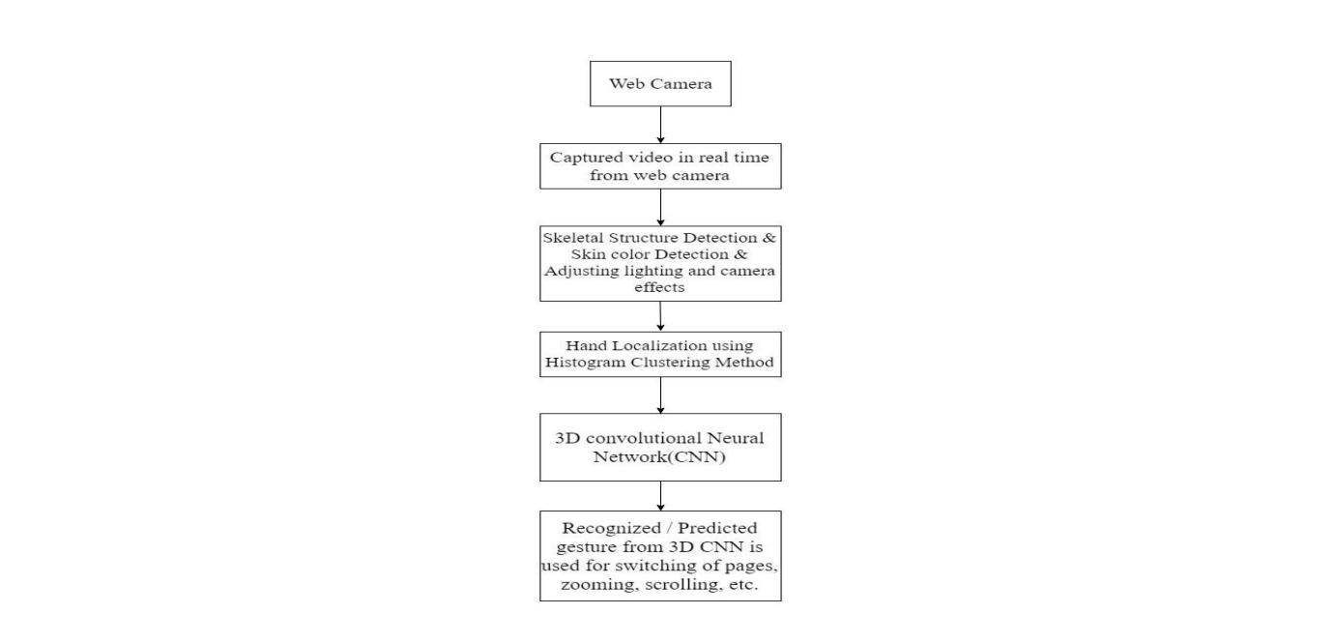
DESIGN OF EXSISTING HCI SYSTEM

Slide 12
PROPOSED SYSTEM :
In our project we have an idea of combining Convolutional Neural Networks (CNNs) with Ensemble learning for certain tasks, including hand gesture recognition.
CNN for Feature Extraction: Convolutional Neural Networks are used to automatically extract relevant and hierarchical features from input data, commonly applied in computer vision tasks.
Feature vector representation: A compact numerical representation of data, containing essential information for analysis or processing.
Classification: A machine learning ensemble method that uses multiple classifiers to classify data, providing robust and accurate predictions.
Testing and Inference: The process of evaluating hypotheses or making predictions based on observed data to draw meaningful conclusions or decisions in statistics and machine learning.

Slide 13
BENIFITS OF COMBINING CNN WITH ENSEMBLE LEARNING:
Ensemble learning are known for their ability to handle high-dimensional data and capture complex decision boundaries.
Combining CNNs with Ensemble learningcan provide robustness to noise and overfitting, which can sometimes be a concern in deep learning models.
Overall Combining CNNs with Ensemble learning can boost accuracy, reduce overfitting, enhance interpretability, improve robustness, and provide efficient training, making it versatile for various tasks.

Slide 14
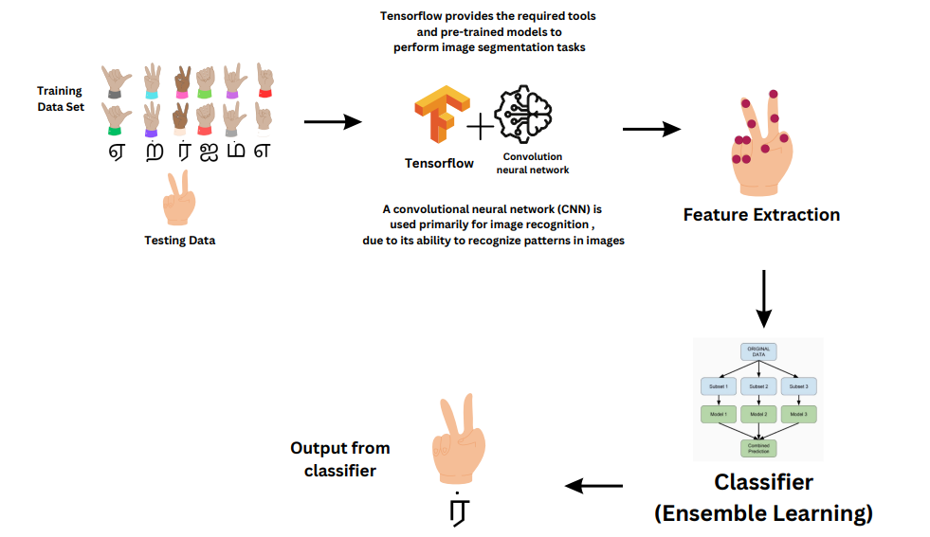
ARCHITECTURE DIAGRAM:

