Slide 1
Student portfolio
STUDENT NAME : L.M.sriraksha
REGISTER NO : 24131211802522079
NAANMUDHALVAN ID : asanm121anm12124214080.
DEPARTMENT :B.SC Computer science-II year,B section.
COLLEGE : Immaculate college for women/Annamalai University.

Slide 2
Project title
Student portfolio developed with
HTML,CSS and JavaScript

Slide 3
Agenda
Problem statement
Project overview
End users
Tools and technologies
Portfolio design and layout
Feature and functionality
Results and screenshot
Conclusion
GitHub link

Slide 4
Problem statement
Student needs a portfolio showcase skills and achievements effectively.
Generic template do not highlight individual creativity.
A personalized portfolio enchances career growth, network and personal branding.

Slide 5
Project overview
Goal : create a responsive, visually appealing portfolio.
Single - page website using HTML, CSS and JavaScript.
Showcases education, skills, projects and contact details.
Increases online visibility and credibility.

Slide 6
End user
Student – to showcase skills and creativity.
Faculty – to assess progress and provide references.
Recruiters – to evaluate suitability for jobs.
Clients – to view past work before projects.

Slide 7
Tools and technologies
HTML5 – structure of the portfolio.
CSS3 – styling, layout, responsiveness.
JavaScript– Interactivity, animation.
GitHub– version control and hosting.
Google fonts – Modern typography.

Slide 8
Portfolio design and layout
Clean and consistent layout with modern typography.
Grid-based design for balanced structure.
Professional green/white theme.
High-quality visuals/ screenshots.
Sticky header navigation and smooth scrolling.

Slide 9
Feature and functionality
Responsive design for all devices .
Interactive navigation bar with smooth scrolling.
Dedicated section for About, Education, Skills, Projects, contact.
JavaScript – enable animation.
Social media/ GitHub integration.

Slide 10
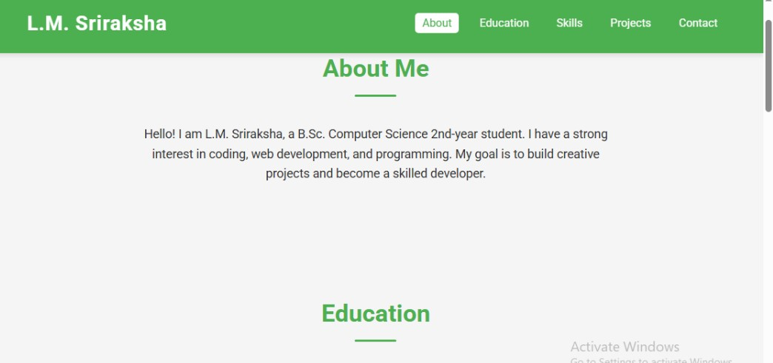
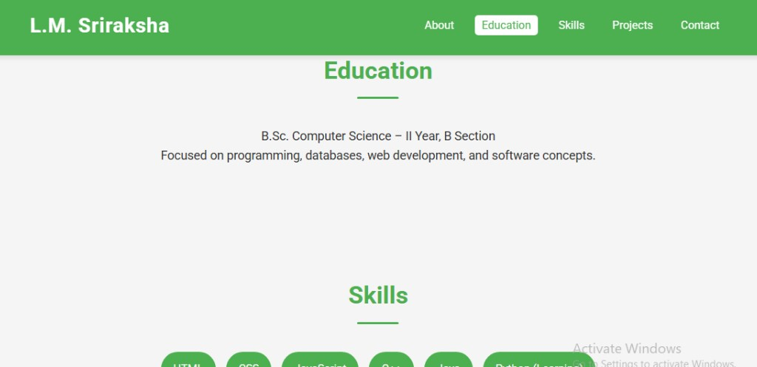
Result and screenshot

Slide 11
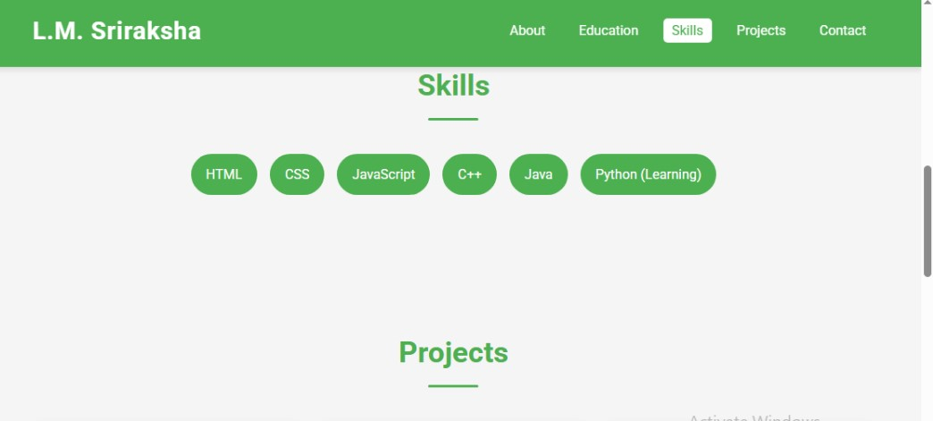
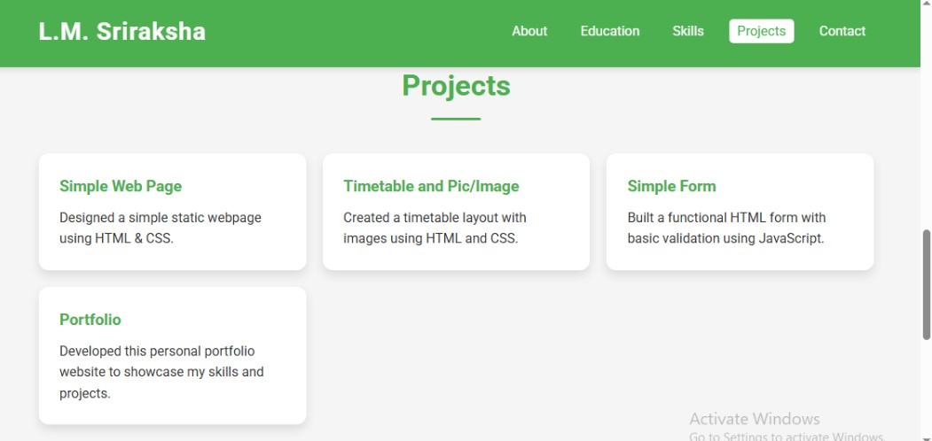
Result and screenshot

Slide 12
Conclusion
Developed a modern , engaging, responsive portfolio website.
Demonstrates creativity, technical skills, and attention to detail.
Useful for academic, professional, and freelancing opportunities.
Enhances personal branding and career growth.

Slide 13
GitHub
Respository URL : https://GitHub.com/<your-username>/portfolio

