Slide 1

VASAVI COLLEGE OF ENGINEERING(A)
DEPARTMENT OF COMPUTER SCIENCE AND ENGINEERING
presents
24-hour hackathon
INNOVASIA

Slide 2

TEAM DETAILS
Team Name: GREEN ARMY
Team Leader Name: Namratha Jaggavarapu
College Name: Vasavi College of Engineering
Team Member 1 Name: Akshitha Pottumuthu
Team Member 2 Name: Vamsi Krishna Desineedi

Slide 3
AgriTech
APPROACH
Problem Statement: Innovative Ideology to INCREASE PRODUCTIVITY and CROP MANAGEMENT.
Our requirements for the solution are: 1. Seed Quality
2. Fertility Of Land
3. Landscape
To know about SEED QUALITY we take two inputs - CROP TO BE GROWN and the CERTIFICATION TAG COLOR on SEED PACKET.
The inputs for FERTILITY OF LAND can be acquired from the FERTILITY TEST RESULT.(if the test is conducted recently (or) Can BOOK A FERTILITY TEST)
We take the SURVEY NUMBER as the input to have information of AREA OF CULTIVATION and the LOCATION.
With all the inputs fetched, the following are the resultant outcomes:
Right time for cultivation
Fertilizers(with Quantity) to be used
Estimation of profits
Additional benefit like Weather Alerts through recorded phone calls(when IoT Sensors are installed in fields)
For DETAILED IDEA: Click here

Slide 4
WHAT MAKES YOUR SOLUTION UNIQUE?
Our Model is unique from other as it includes many features like:
1. User friendly
2. Multiple Beneficiaries using minimum number of inputs :
Right time for cultivation
Fertilizers along with quantity to be used
Analysis of Profits
3. Additional Benefits like Weather Alerts(through Recorded Phone Calls).
4. Available in Multiple Languages like English , Telugu and Hindi.
“Farming looks mighty easy when your plow is a pencil and you’re a thousand miles from the corn field”

Slide 5
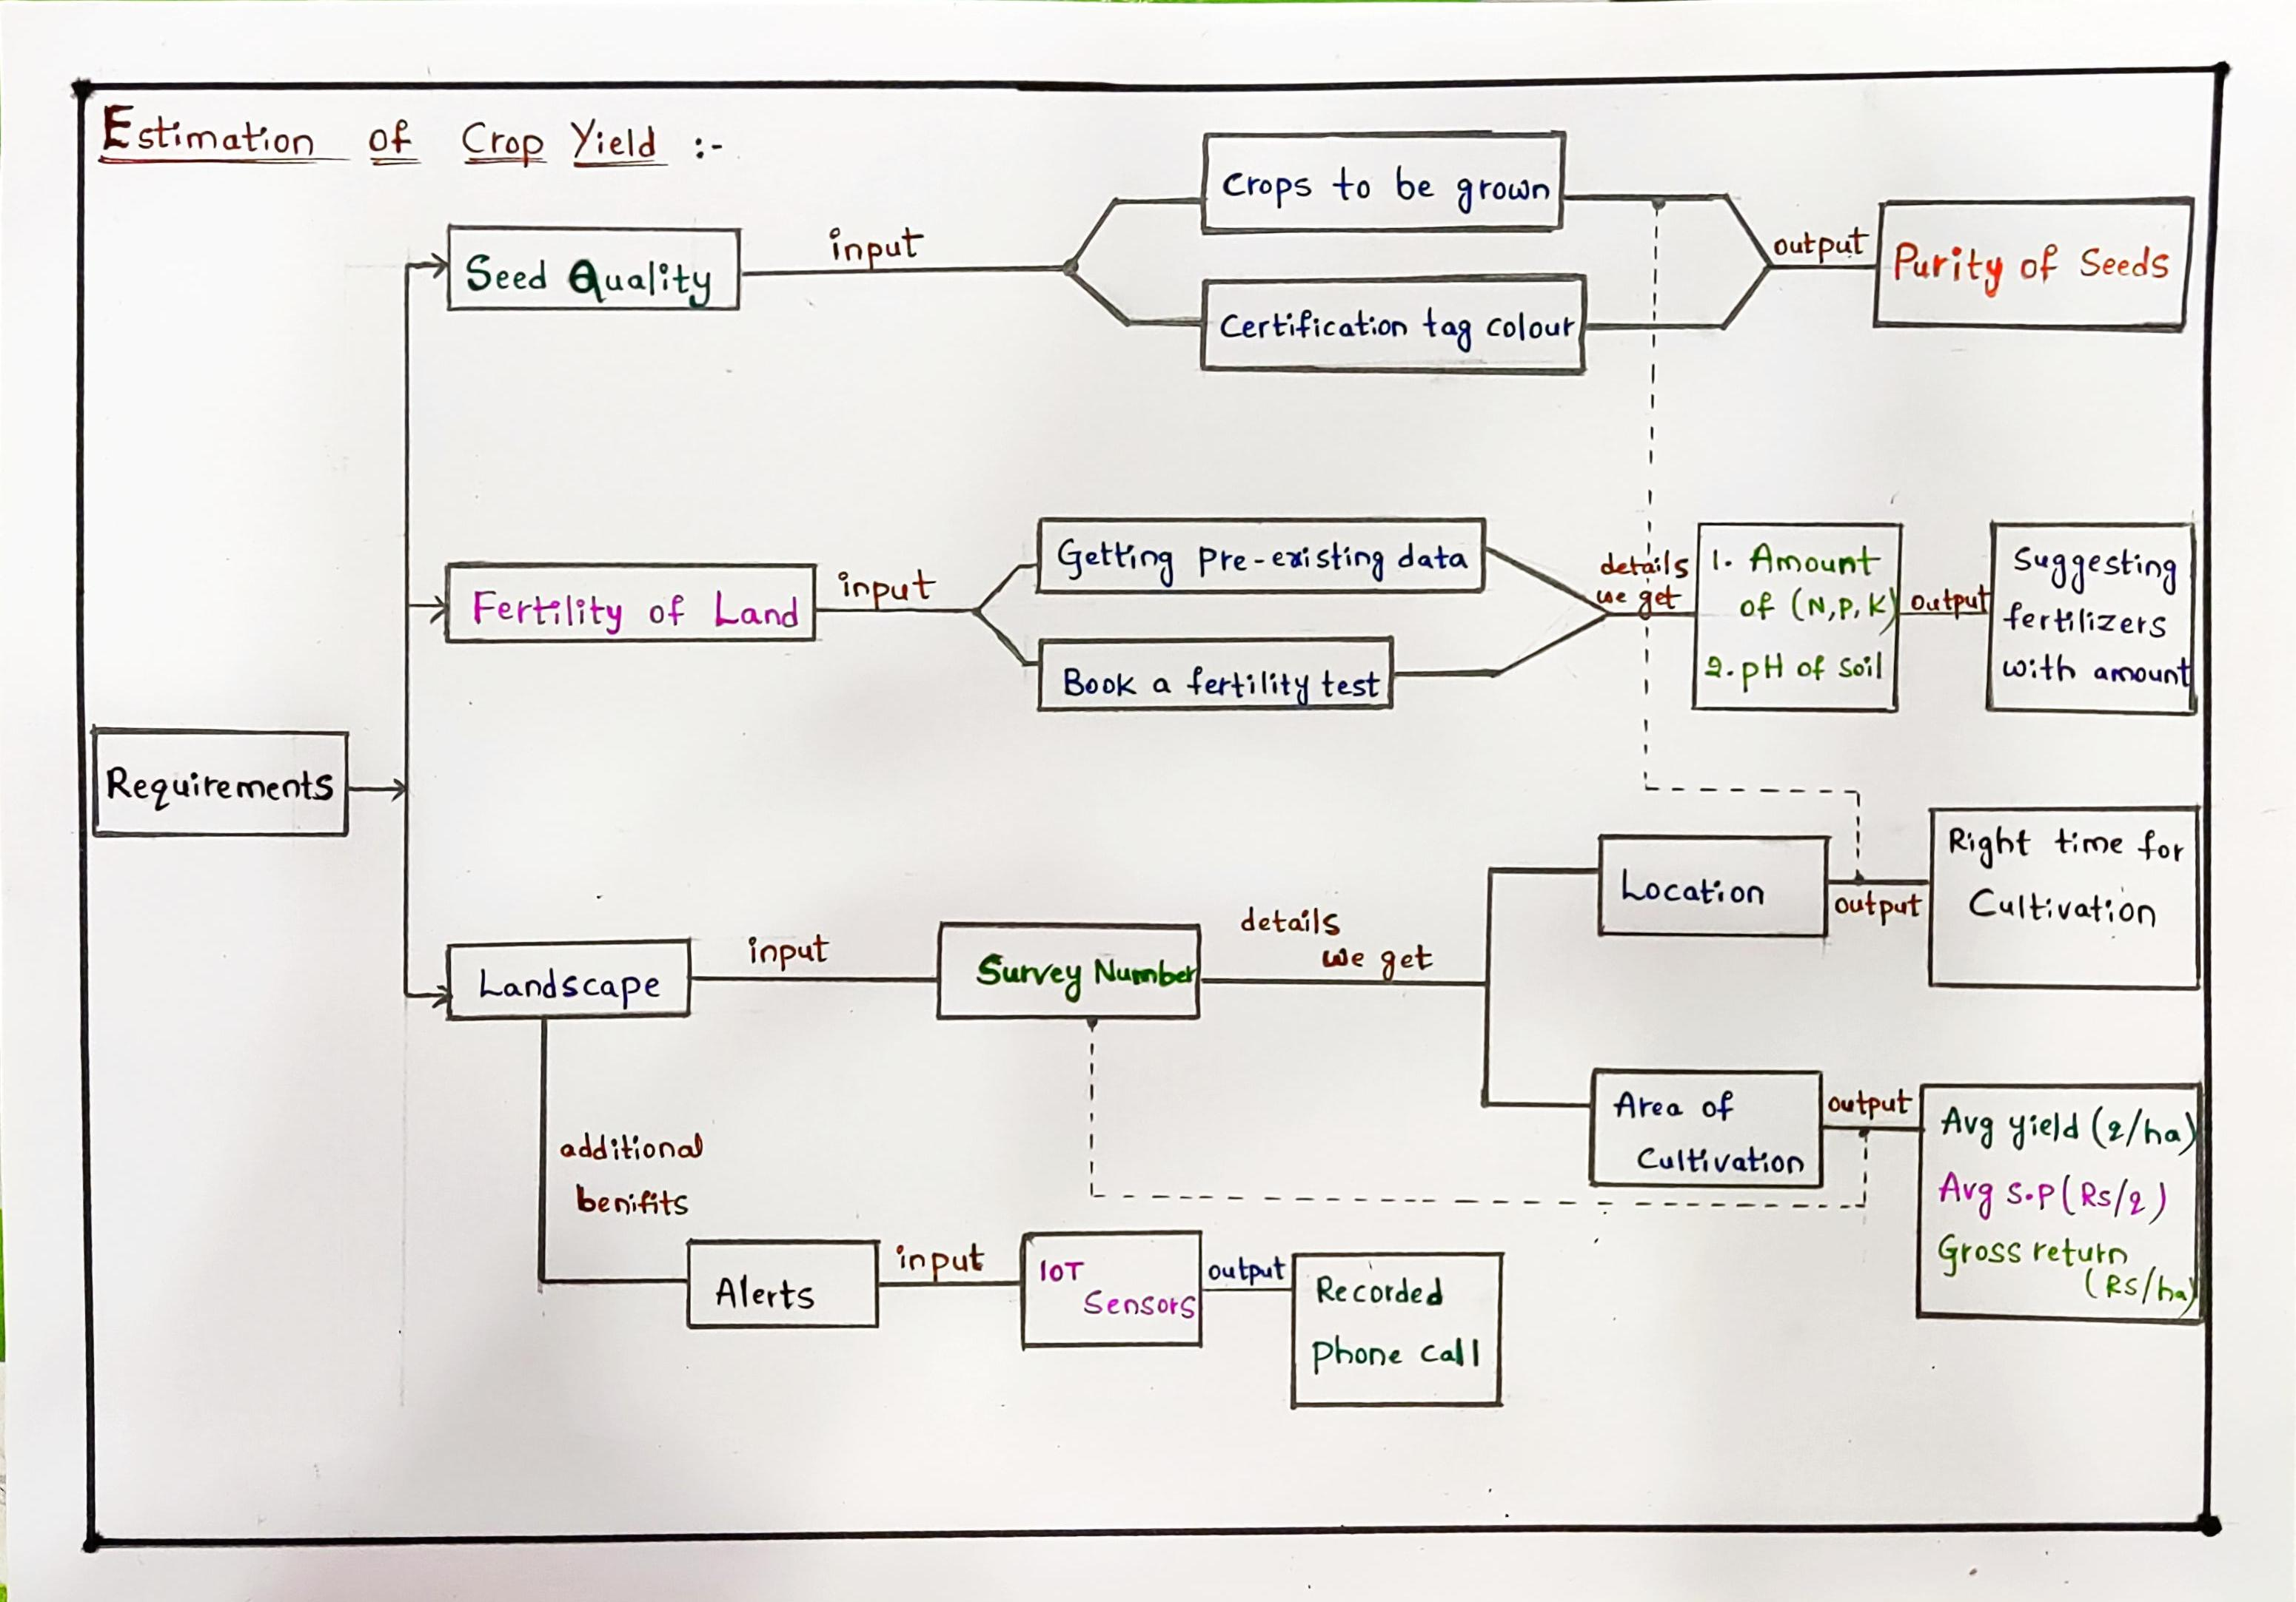
TECHNOLOGY USED / Solution architecture
The Technologies included in the solution are:
HTML
CSS
Java Script(JS)
Firebase
IoT (Node MCU and DHT11 Sensor)
Python

