Slide 1








$$f_{2}$$
$$f_{1}$$
$$f_{3}$$
Body Frame
$$\{B\}$$
$$d$$
$$f_{4}$$
$$d$$
$$\{I\}$$
Inertial Frame

Slide 2
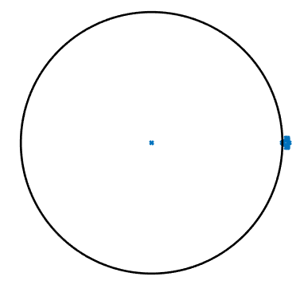
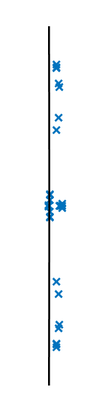

Slide 3
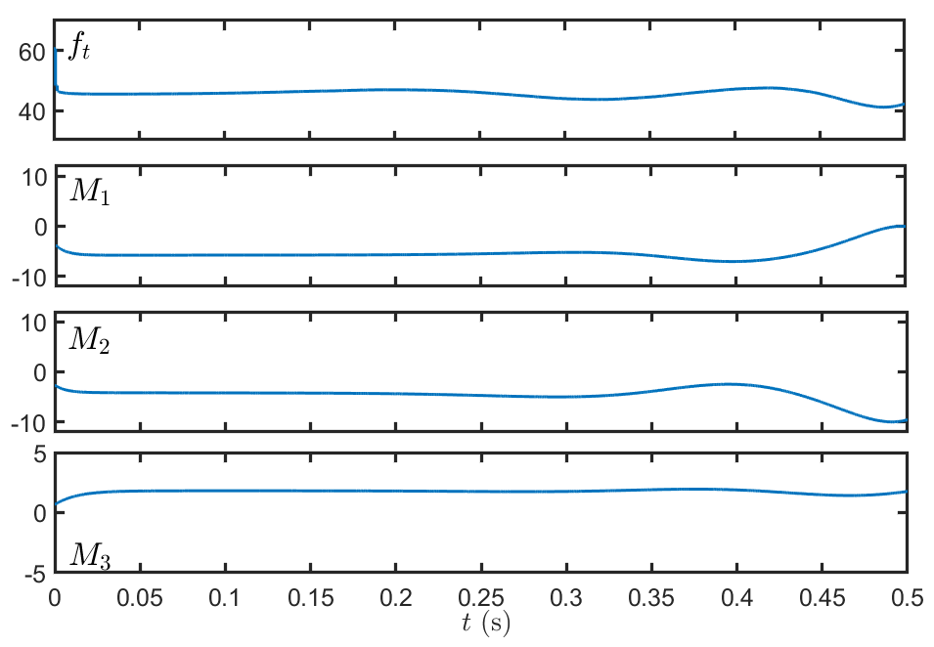

Slide 5
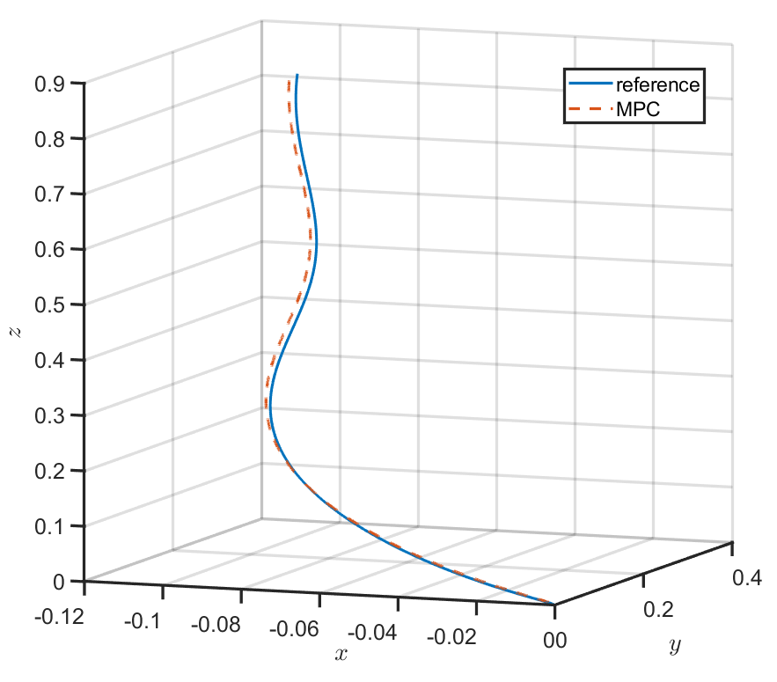

end
start

Slide 6
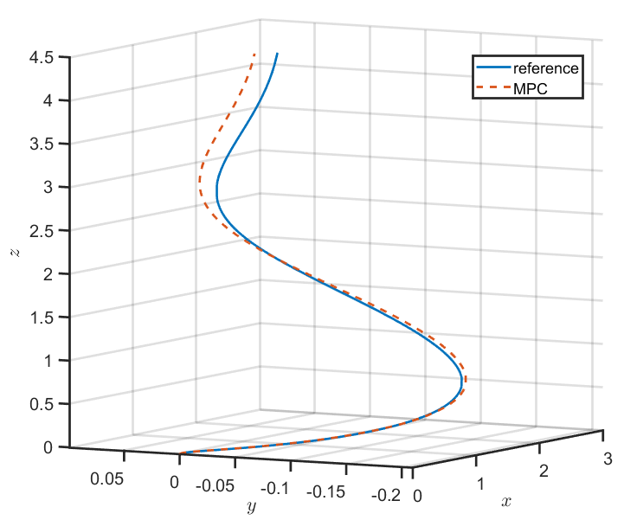
end
start

