Slide 1
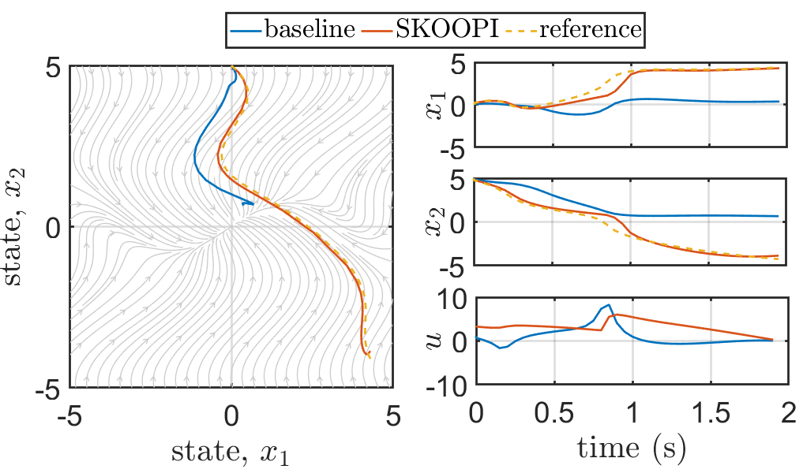
Using g(x) such that it cancels out the nonlinear terms Using analytical eigen functions t_end = 2; scale = 1.2; (for analytical eigfn
Q = diag([1e-3 1e-6]);
R = 1e-3*eye(n_ctrl);
QN = 1e-6*Q;
(a)
start
(b)
(c)
end
(d)

Slide 2
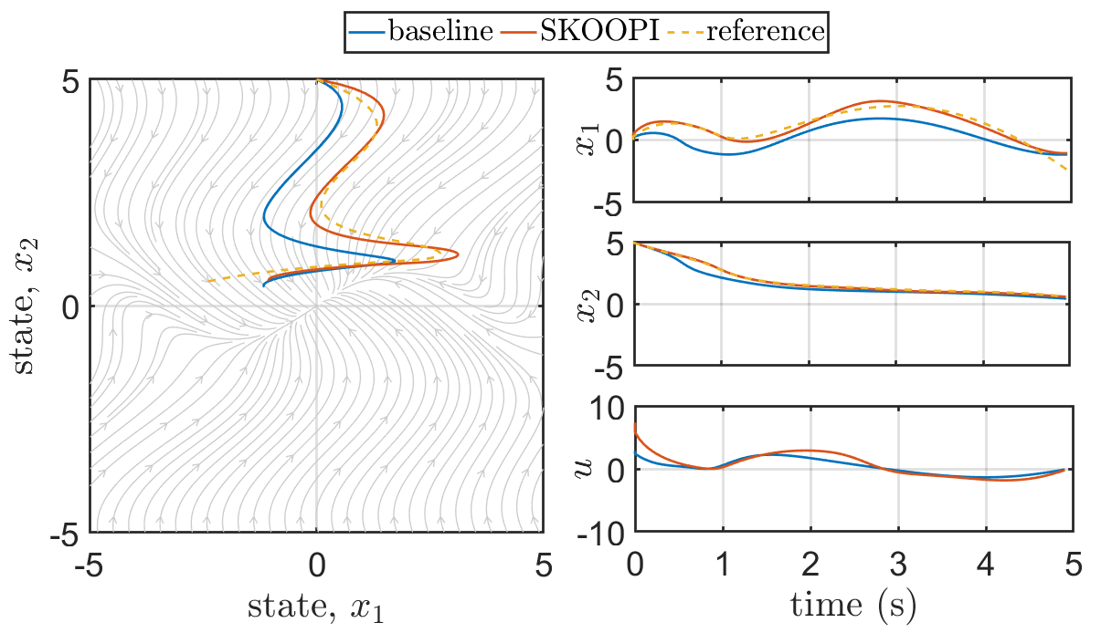
Using g(x) = 1 + cos(x) Using eigen functions estimated from path integrals t_end = 5;
PI scale = 2;
Integration time = 5s
Q = diag([1e-3 1e-6]);
R = 1e-3*eye(n_ctrl);
QN = 1e-6*Q;

