Slide 1
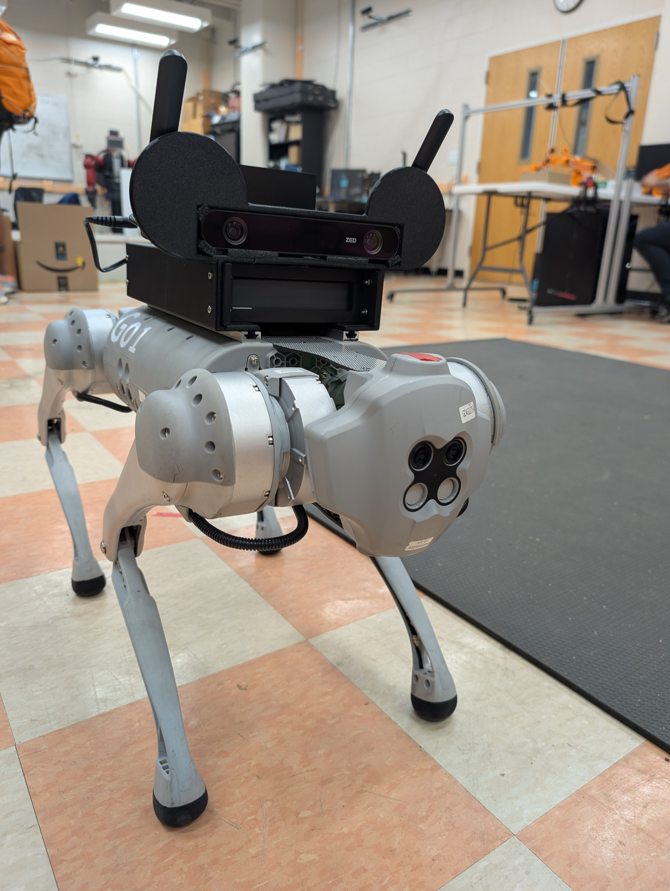
Wi-Fi Antennas
ZED 2i camera
Battery pack
Battery pack
3D printed housing

Slide 2
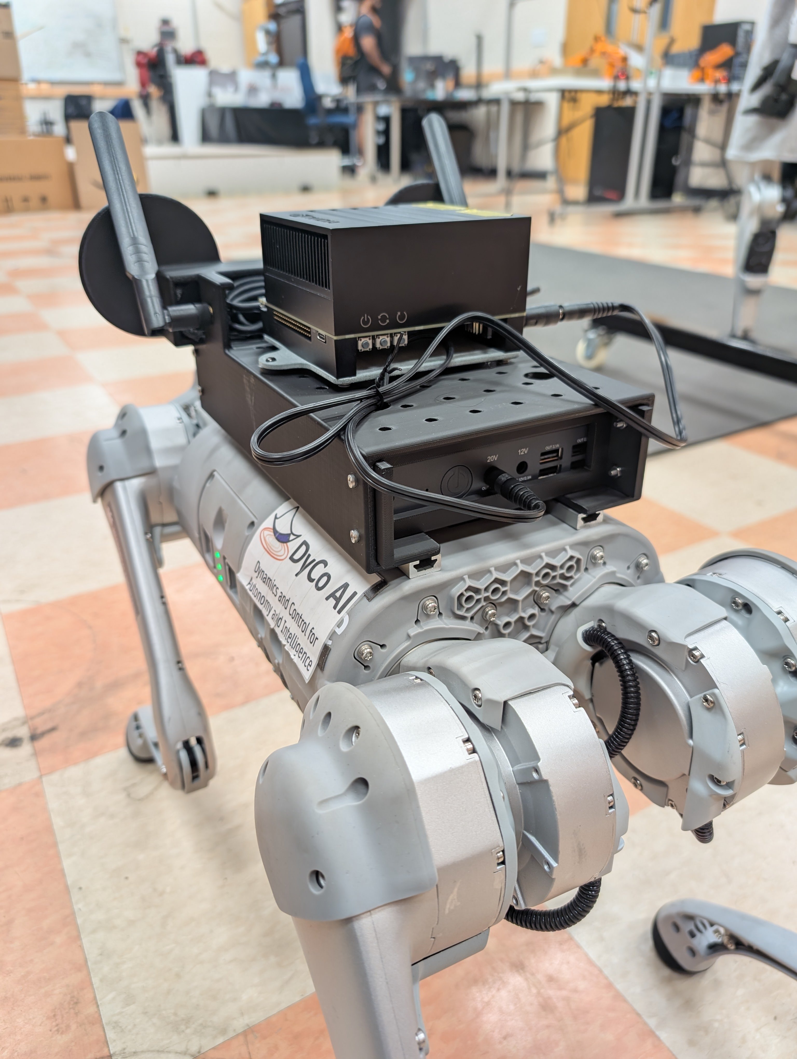
Jetson AGX
Battery pack

Slide 3
ZED camera
USB-C
Jetson AGX
Wi-Fi
Host Laptop
ZED SDK + ROS Noetic
Density planner + ROS master
Object Tracking
INPUT: Goal Pose
/detections
10 Hz
Camera pose
Density based motion planner
/camera_pose
10 Hz
10 Hz
Wi-Fi
safe vel cmds
Battery pack
Unitree SDK
100 Hz
/high_cmd
OUTPUT: Robot Locomotion
Jetson NX (onboard)

