Slide 1
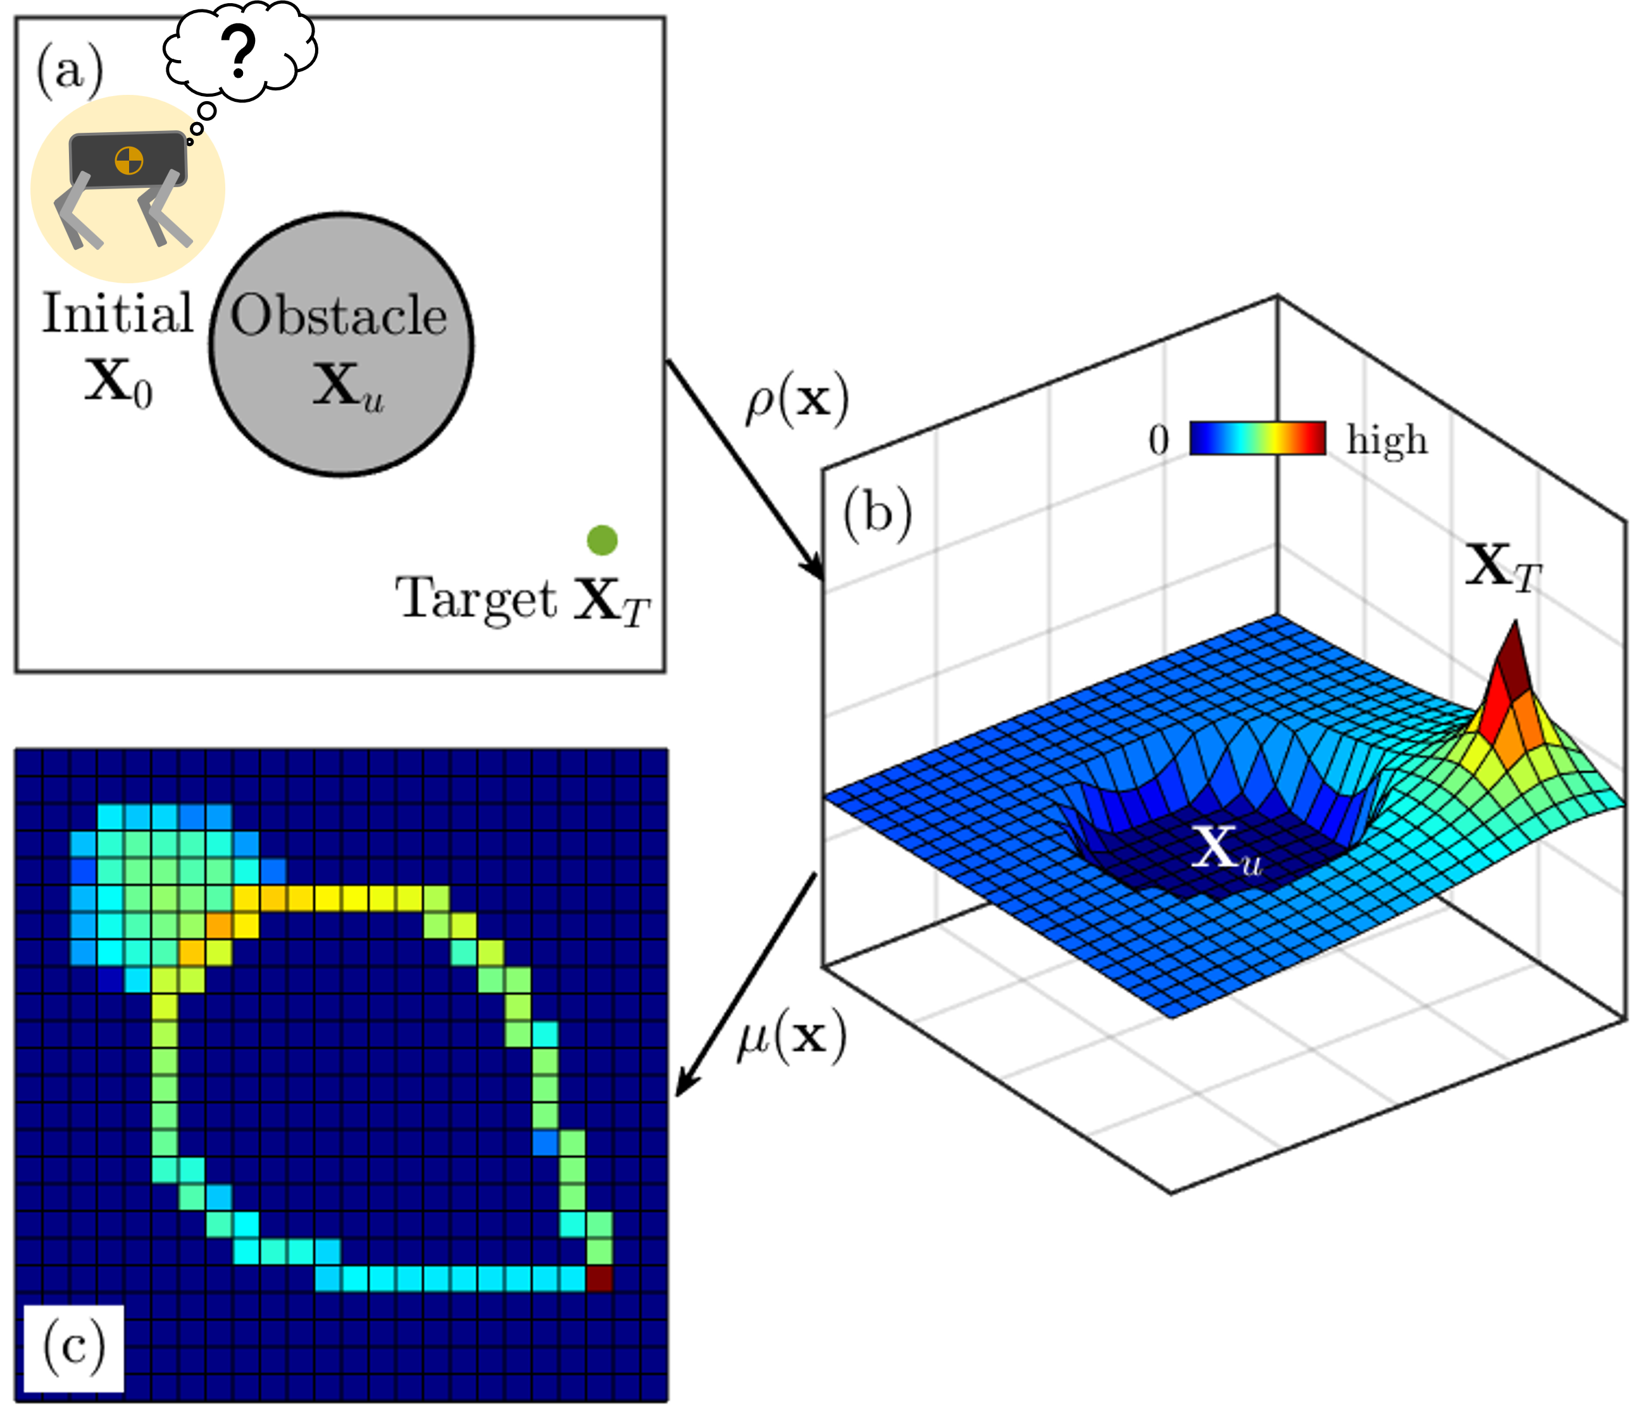

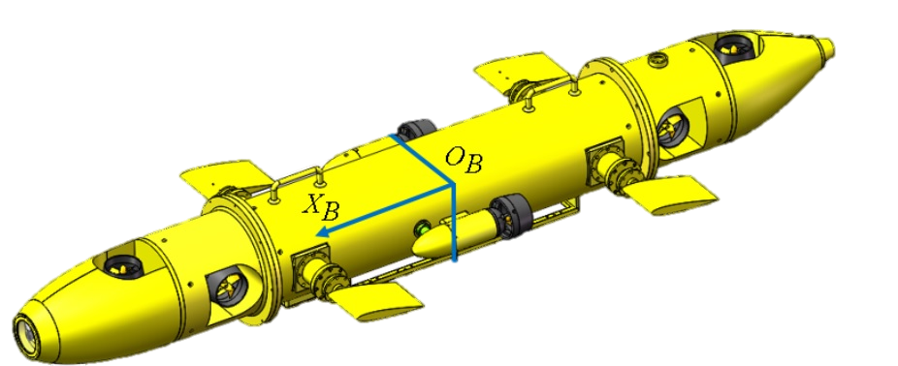
(a)
AUV
(b)
Occupancy
Density Space

Slide 2
