Slide 1
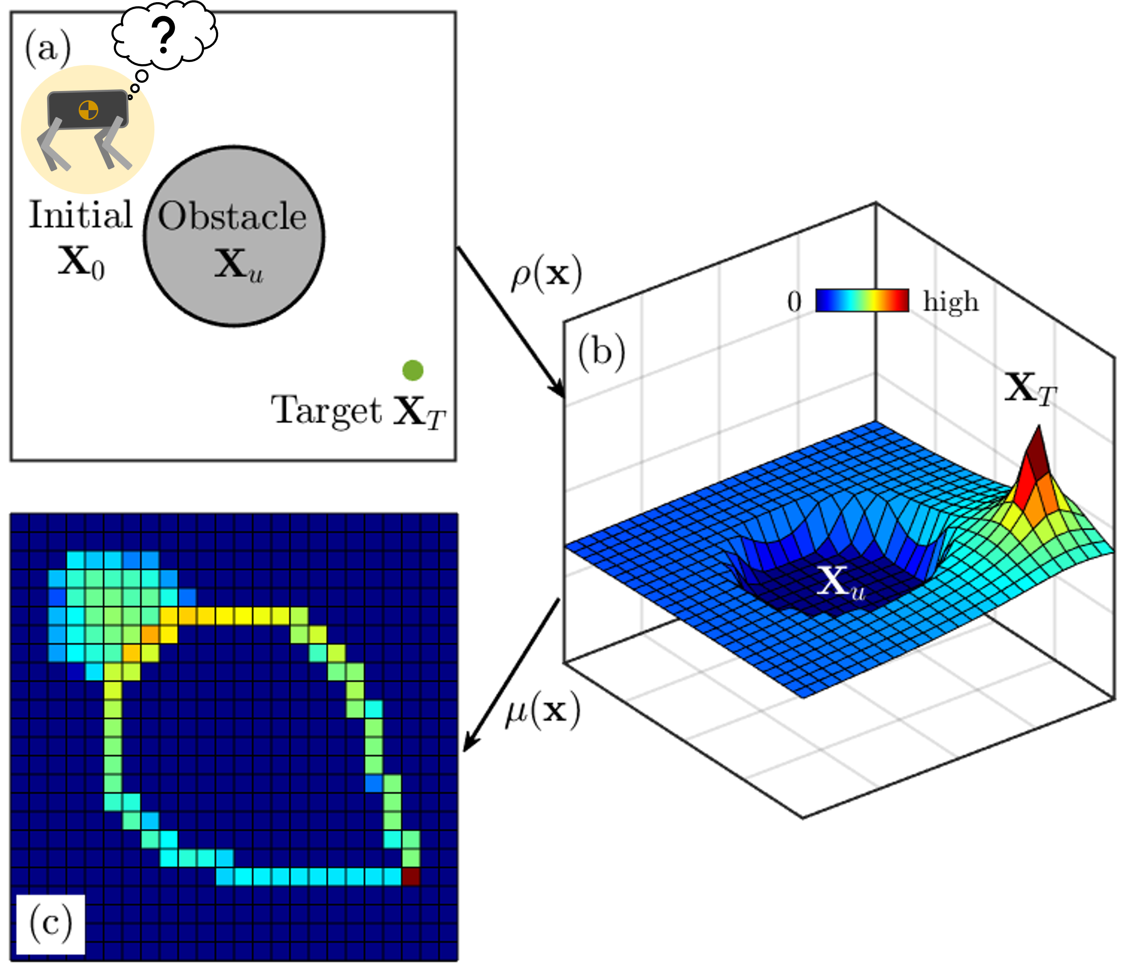

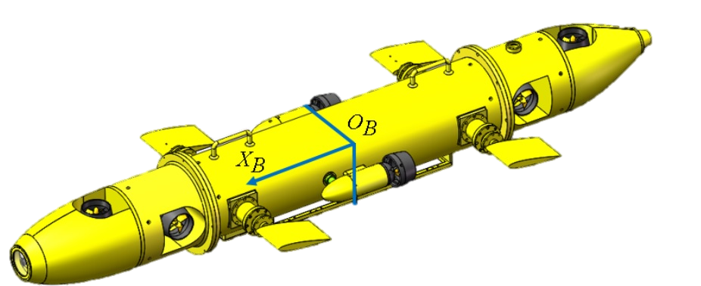
(a)
(b)
Occupancy
Density Space

Slide 2
