Slide 1
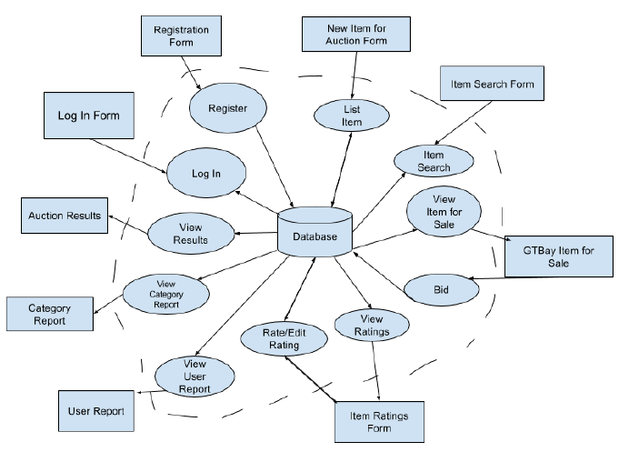
Phase 1 IFD| CS6400 – Spring 2018 | Team 055
Revised: 2/4/2018

