Slide 1
A Secure, Scalable Hybrid Examination Framework
React
Node
responsive frontend
Express API layer
For Seamless Digital and Offline Assessments
M.Tech Conference Presentation
Computer Science and Engineering
MySQL
ML
secure persistence
answer analysis
Presented by
Nimmalapudi Sri Satya Ramya | 243B1D5811
Guide: M. V Ramana, Ph.D. | VSM College of Engineering
ExamPulse | Hybrid Digital + Offline Assessment Framework
01

Slide 2
CONTENTS
The presentation follows the project report index.
01
Abstract
07
Sample Code
02
Introduction
08
Testing
03
Literature Survey
09
Screenshots
04
System Requirement & Analysis
10
Conclusion and Future Scope
05
System Design
11
References and Bibliography
06
Implementations
ExamPulse | Hybrid Digital + Offline Assessment Framework
02

Slide 3
ABSTRACT
ExamPulse unifies secure online exams with offline worksheet workflows.
Hybrid
Role-based
Automated
Scalable
online tests + downloadable worksheets
super admin, admin, teacher, student, parent
evaluation, analytics, instant result reports
React, Express, MySQL, JWT, PDF/XLSX flows
!
Problem
>
Solution
+
Outcome
Traditional exam processes are hard to scale, difficult to monitor, and depend heavily on physical classrooms.
A web platform manages exam setup, question banks, schedules, submissions, reports, and offline preparation.
The system reduces manual effort while keeping assessment delivery flexible, secure, and institution-ready.
ExamPulse | Hybrid Digital + Offline Assessment Framework
03

Slide 4
INTRODUCTION
The framework keeps assessment continuity across online and offline scenarios.
ExamPulse operating loop
1
Authenticate
2
Create
3
Attempt
4
Evaluate
5
Report
JWT login and role access
Question bank, exams, schedules
Online exam or PDF worksheet
Objective + subjective scoring
Results, analytics, exports
Designed for institutions that need exam delivery beyond a single classroom or device.
Supports students, teachers, administrators, super administrators, and parents.
Balances operational control with student-facing usability and fast result access.
*
Core promise
A single framework can manage setup, access, assessment, offline practice, analysis, and reporting without splitting the workflow across tools.
ExamPulse | Hybrid Digital + Offline Assessment Framework
04

Slide 5
LITERATURE SURVEY
Existing systems solve parts of exam delivery, but hybrid continuity remains the gap.
Approach
Strength
Limitation / Gap
Traditional classroom exams
High trust and familiarity
Manual scheduling, paper handling, delayed results
Generic online test portals
Remote access and auto-evaluation
Limited offline worksheet support and institution-specific control
LMS quiz modules
Integrated with course content
Often weaker in role governance, reports, and admin approval flows
ExamPulse direction
Hybrid exam + worksheet + analytics workflow
Built for institutional control and scalable modules
ExamPulse | Hybrid Digital + Offline Assessment Framework
05

Slide 6
SYSTEM REQUIREMENT & ANALYSIS
The requirements center on secure access, modular control, and exam reliability.
F
Functional requirements
N
Non-functional requirements
V
Feasibility
Authentication, question banks, exam scheduling, online attempts, PDF worksheets, results, reports, parent-teacher requests.
Performance under concurrent users, browser compatibility, maintainability, scalability, data security.
Uses readily available web technologies with a modular API and database-backed persistence model.
Hardware
Standard user devices, server host, stable network
Software
React.js, Node.js, Express.js, MySQL, JWT, PDF/XLSX tooling
Security
Login validation, role-based routes, protected exam/result operations
Scale
Module separation enables future course, user, and exam growth
ExamPulse | Hybrid Digital + Offline Assessment Framework
06

Slide 7
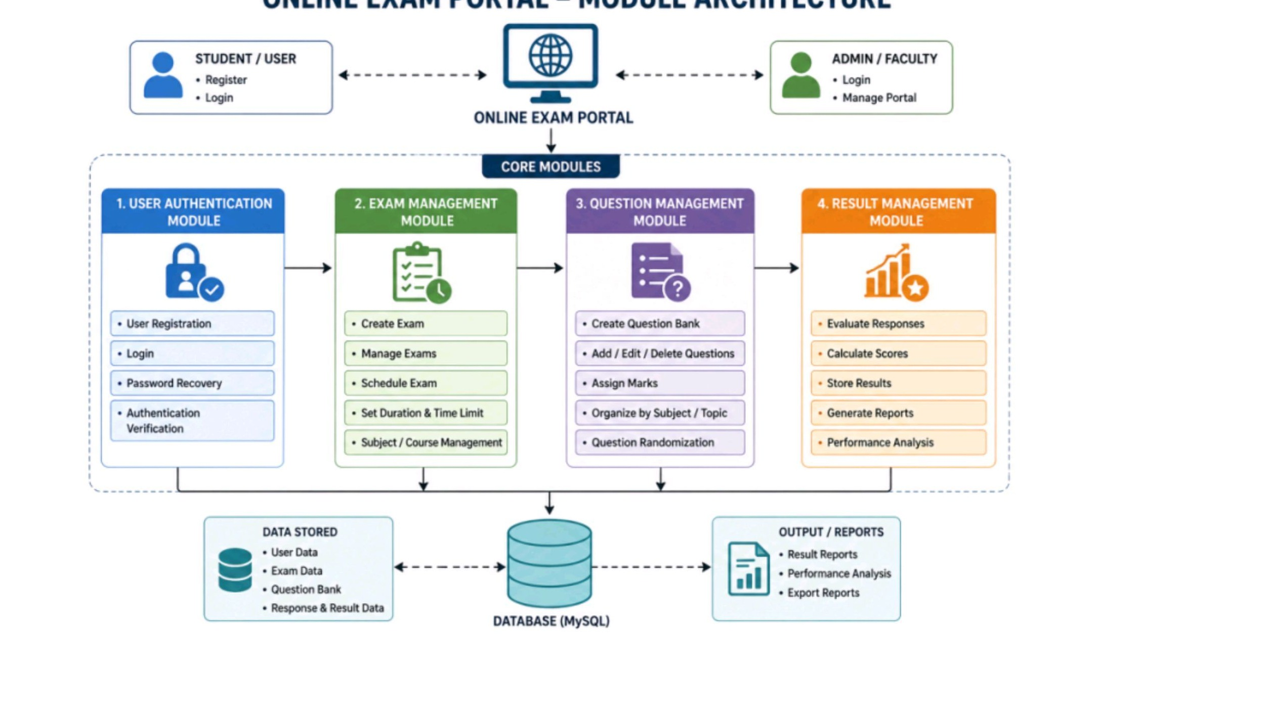
SYSTEM DESIGN
A three-tier design separates presentation, business logic, and persistent data.
1
Presentation layer
React + MUI delivers dashboards, exam pages, forms, and role-specific navigation.
2
Application layer
Express routes handle auth, setup, users, exams, worksheets, analytics, and ML scoring.
3
Data layer
MySQL stores users, exams, questions, submissions, results, access, and reports.
ExamPulse | Hybrid Digital + Offline Assessment Framework
07

Slide 8
IMPLEMENTATIONS
Implementation is organized around role-specific modules and reusable backend routes.
Super Admin
setup, approvals, packages, activation, reports
Admin / Teacher
questions, exams, users, worksheets, question paper generation
Student
practice, scheduled exams, profile, submissions, results
Parent
relationship details, meeting requests, review flows
Frontend
Backend
Analytics / ML
React 18, MUI dashboard components, Axios API integration.
Express 5 routes with MySQL, JWT, multer, PDFKit, XLSX.
Similarity, coverage, length adequacy and scoring helpers.
ExamPulse | Hybrid Digital + Offline Assessment Framework
08

Slide 9
SAMPLE CODE
The backend composes focused API routes into one examination service.
app.use('/api/auth', require('./routes/authRoutes'));
app.use('/api/student/myexam', studentMyexamRouter);
app.use('/api/analytics', require('./routes/analyticsRoutes'));
app.use('/api/ml', require('./routes/mlRoutes'));
app.use('/api/admin/manageexams', require('./routes/admin/manageexams'));
app.use('/api/teacher/generatequestionpaper',
require('./routes/teacher/generatequestionpaper'));
A
Route-level separation
Each role or feature area owns its own route module, making the platform easier to extend and debug.
B
ML scoring service
Subjective answer quality is estimated through text similarity, key term coverage, and length adequacy.
C
Offline support
Teachers can generate downloadable worksheets and question papers for offline exams.
ExamPulse | Hybrid Digital + Offline Assessment Framework
09

Slide 10
TESTING
Testing validates login, exam flow, role permissions, reporting, and worksheet generation.
1
Unit testing
2
Integration testing
3
Functional testing
Route handlers, helpers, validation logic
Frontend requests to backend APIs and MySQL operations
Login, exam creation, question add/edit, submission, result view
4
Security testing
5
Usability testing
Unauthorized access, role checks, protected routes
Dashboard navigation, exam attempt flow, result readability
Expected test outcome: stable role-based access, correct exam lifecycle, accurate result generation, and reliable downloadable offline papers.
ExamPulse | Hybrid Digital + Offline Assessment Framework
10

Slide 11
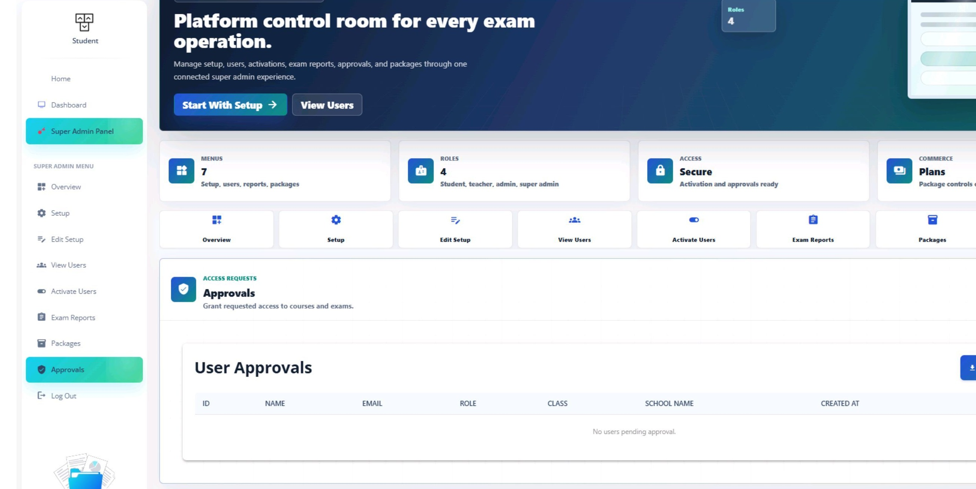
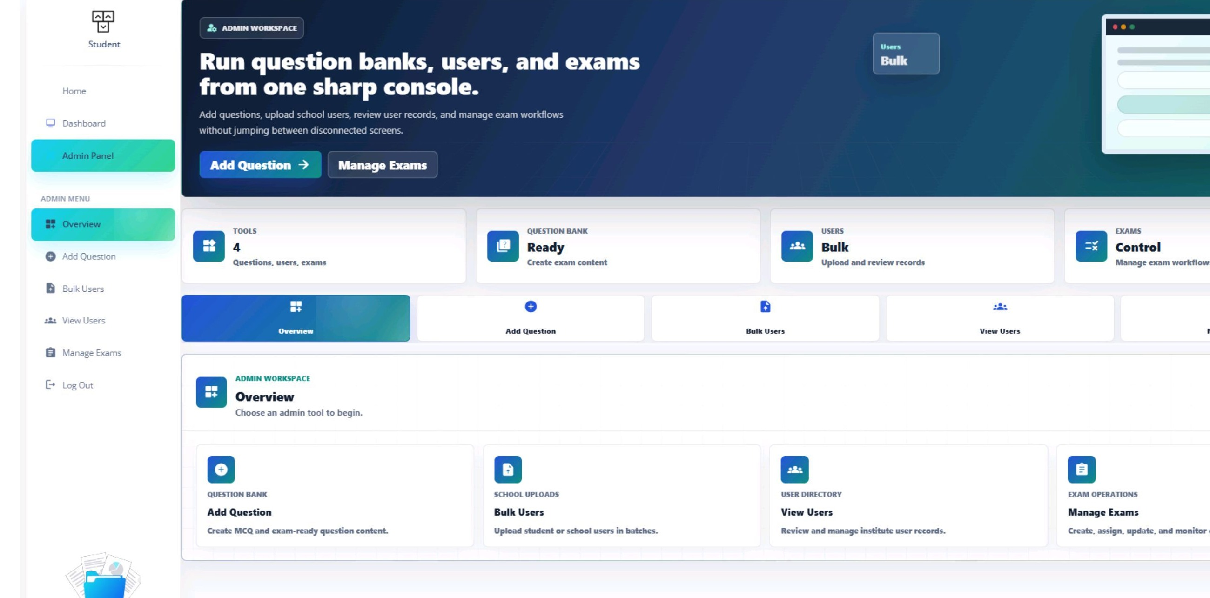
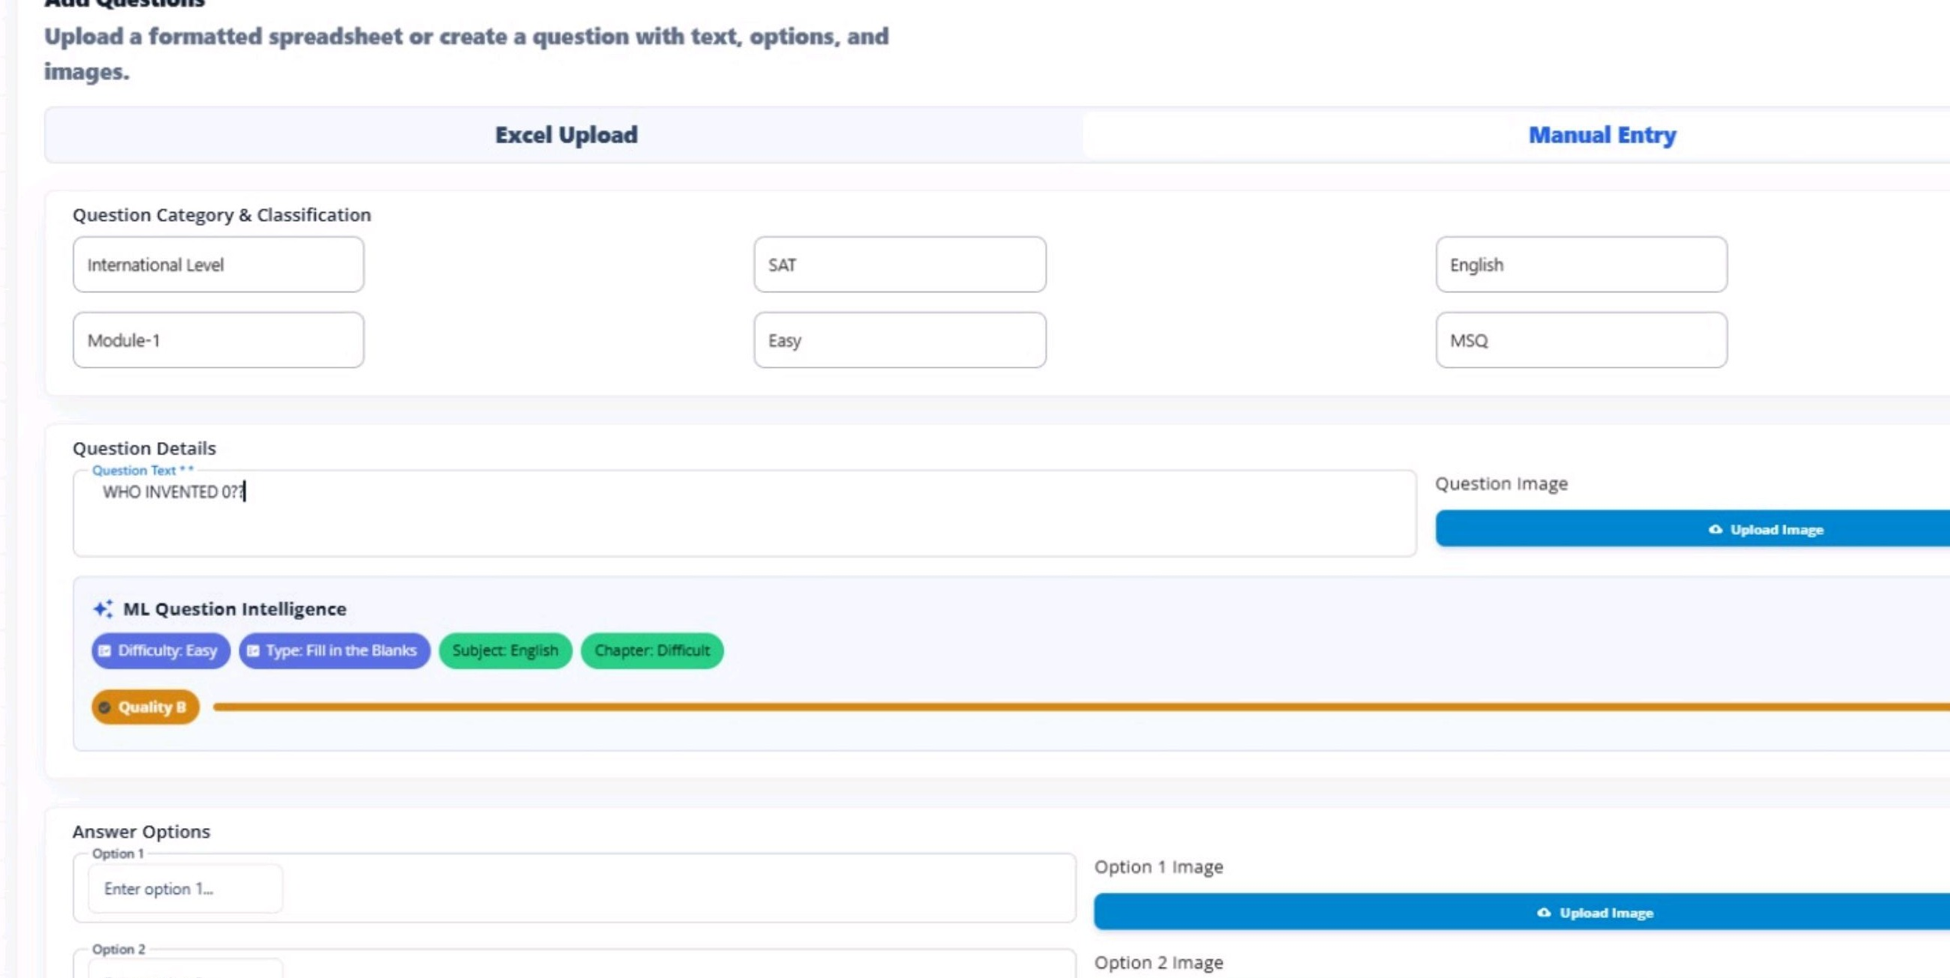
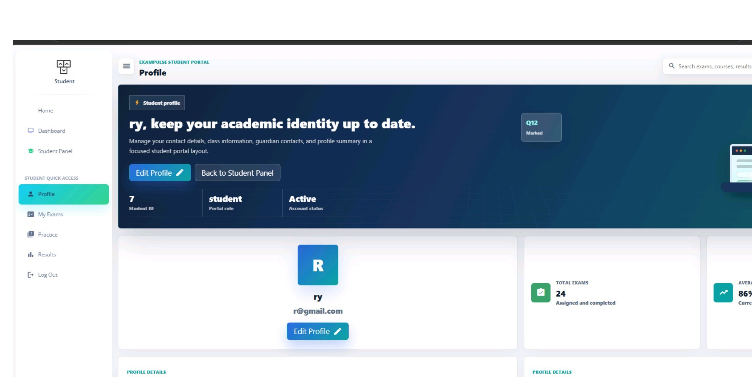
SCREENSHOTS
The implemented UI supports both administrative control and student-facing workflows.
Super Admin approvals
Admin panel overview
ExamPulse | Hybrid Digital + Offline Assessment Framework
11

Slide 12
CONCLUSION AND FUTURE SCOPE
The framework delivers a usable foundation for secure, hybrid institutional assessment.
AI proctoring
Face/behavior monitoring and malpractice alerts
✓
Conclusion
ExamPulse brings exam setup, access control, online attempts, offline worksheets, evaluation, and reports into a single workflow.
Adaptive tests
Difficulty adjusted using student performance
+
Project value
Mobile app
Dedicated Android/iOS interface for students and parents
The platform reduces manual exam effort while improving continuity, speed of result access, and administrative visibility.
Cloud scale
Containerized deployment, backups, and monitoring
ExamPulse | Hybrid Digital + Offline Assessment Framework
12

Slide 13
REFERENCES AND BIBLIOGRAPHY
The work builds on standard web engineering, database, and assessment-management practices.
Project report: A Secure, Scalable Hybrid Examination Framework For Seamless Digital and Offline Assessments.
React.js and Material UI documentation for the frontend dashboard implementation.
Express.js, Node.js, JWT, MySQL, PDFKit, and XLSX documentation for backend services and exports.
Software engineering references for requirements analysis, UML design, testing methodology, and maintainable modular architecture.
Secure
Scalable
authentication
modular API
Hybrid
Assessment-ready
online + offline
reports + analytics
Thank you
Questions and discussion
ExamPulse | Hybrid Digital + Offline Assessment Framework
13

