Slide 1
Northwind Kites: Q3 2026 results
A fictional company, for demonstration only

Slide 2
Q3 highlights
Revenue reached $48M, up 12% from Q2
Opened a second factory in Tulsa
Customer return rate fell to 1.8%
Notes:
The Tulsa factory starts full production in February 2027.

Slide 3
Quarterly revenue and cost

Slide 4
Q3 results by segment
Segment | Revenue ($M) | Gross margin | Units sold
Stunt kites | 21.0 | 44% | 140,000
Beach kites | 18.5 | 37% | 310,000
Accessories | 8.5 | 52% | 95,000

Slide 5
Order system architecture
Web store
Order API
Payments
Warehouse queue
Tulsa factory

Slide 6
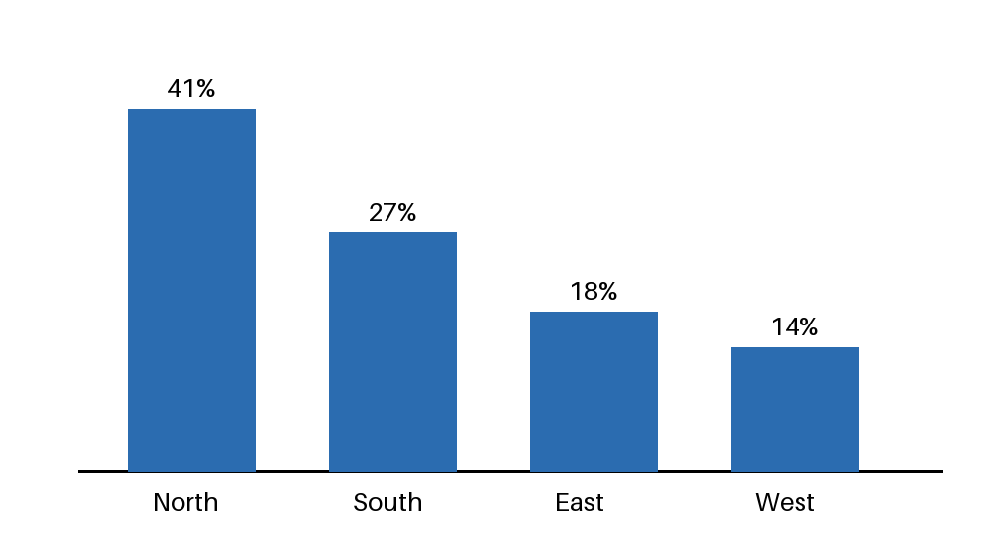
Where customers are

Slide 7
Risks and outlook
Ripstop nylon prices rose 9% this year
Q4 revenue guidance is $52M to $55M
Spring demand depends on weather

