Slide 1
Introduction to Version Control
Scott Campit
Chandrasekaran Lab
10 September 2019

Slide 2
Outline
How I use version control software on a daily
Team management and productivity
Expanding / keeping multiple versions of software
Sharing and distributing live code
What is version control?
What is Git?
What is GitHub?
Useful GitHub features
Summary and resources

Slide 3
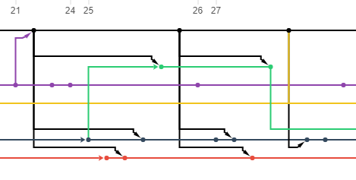



How I use VC | 1. Team management and productivity
July 2019
Maintain different versions of code for each person
Allow us (as a group) to merge, share, and review each other's code
Has productivity tools for teams (ie SCRUM boards, To-Do lists, etc)

Slide 4
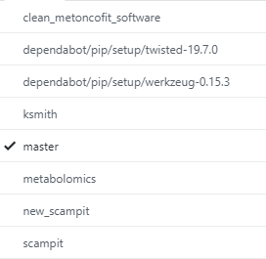
How I use VC | 2. Expanding software features safely
Version 1.1 - improvements
File A
File B'
File C"
We can keep different versions of software in a single database, rather than have multiple folders of the same code in our local machine.
Branches
Version 1.0 - in production
File A
File B
File C
Version 1.X - experimental
File A
File B
File C
File D

Slide 5
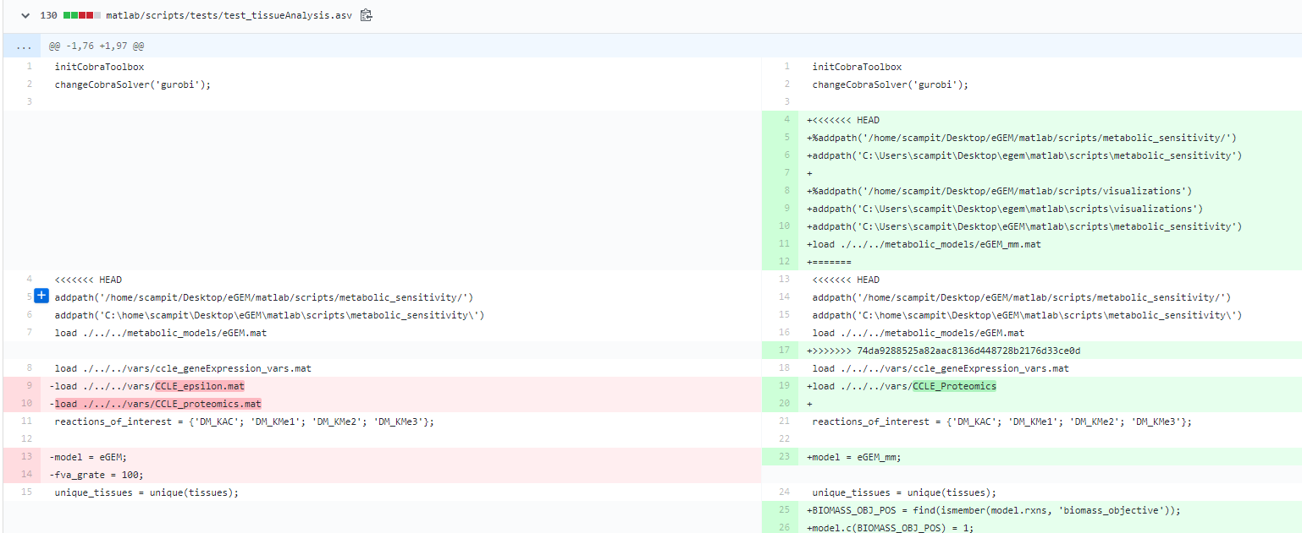
How I use VC | 3. Sharing and distributing "live" code
Old code
New code

Slide 6

What is version control?
Version control systems are software that allows teams to manage changes in code over time.
Benefits of VC:
Keep a complete history of every file
Independent containers (branches) for different projects and a way to merge these branches
Tons of open source tools to help develop better code
Final production code
New features branch
Initial commit
User 1
Fix bugs
Change variable names
https://www.atlassian.com/git/tutorials/what-is-version-control

Slide 7
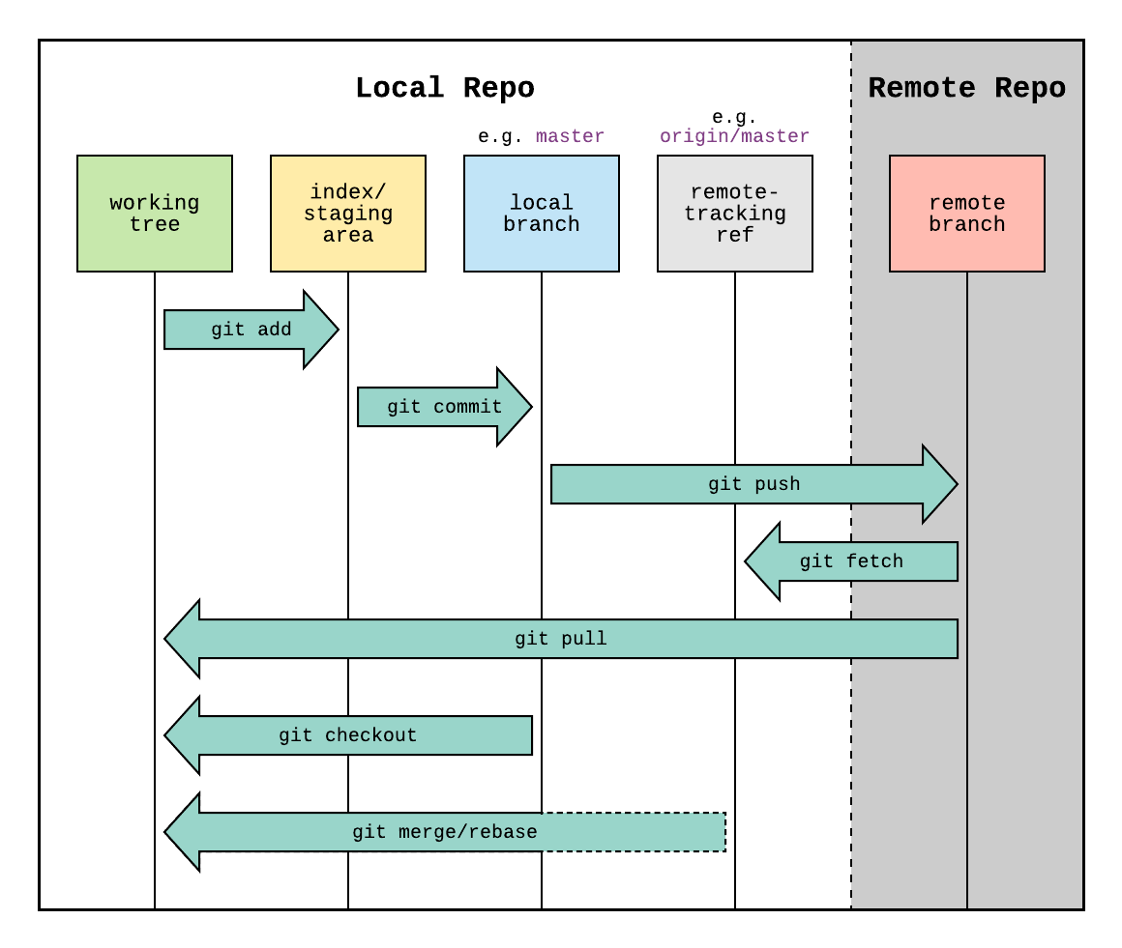
What is Git?
Git is the specific version control software most people use today.
The general workflow is as follows:
1. git init: Have a local folder (repo) point to a remote location.
2. git add: Add new local files to a "staging" area.
3. git commit: Associate these additions with a unique identifier.
This is how we can create multiple versions of software for a single user.
4. git push: Finally, make changes in a remote location (ie GitHub's servers).
https://www.reddit.com/r/git/comments/99ul9f/git_workflow_diagram_showcasing_the_role_of/

Slide 8
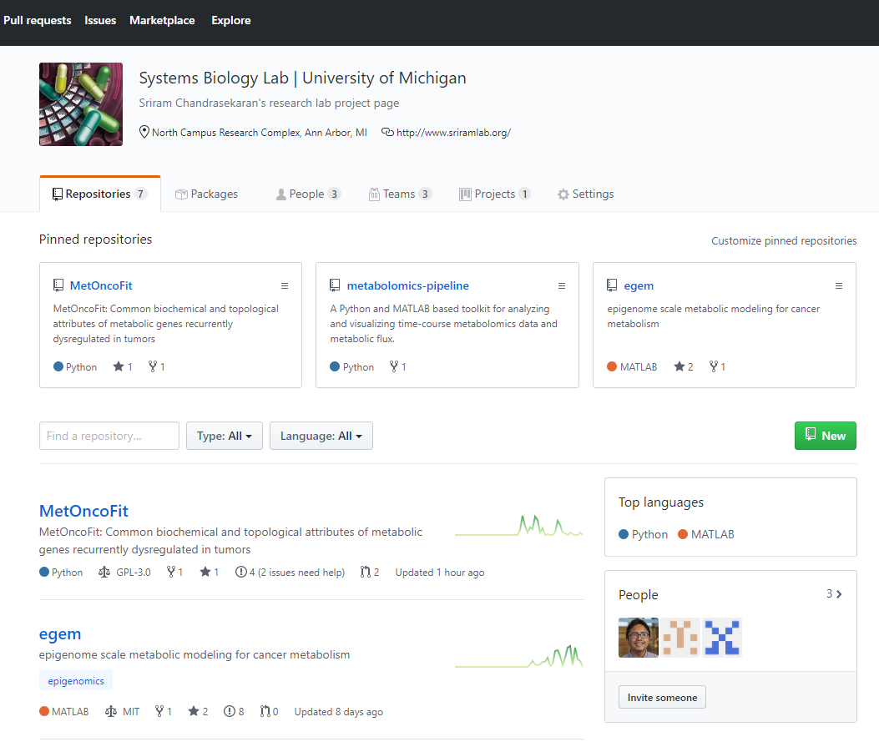
What is GitHub?
GitHub is the Facebook for software developers.
Some features include:
1. Publishing your project as a repo
Lab project site:
https://github.com/sriram-lab

Slide 9
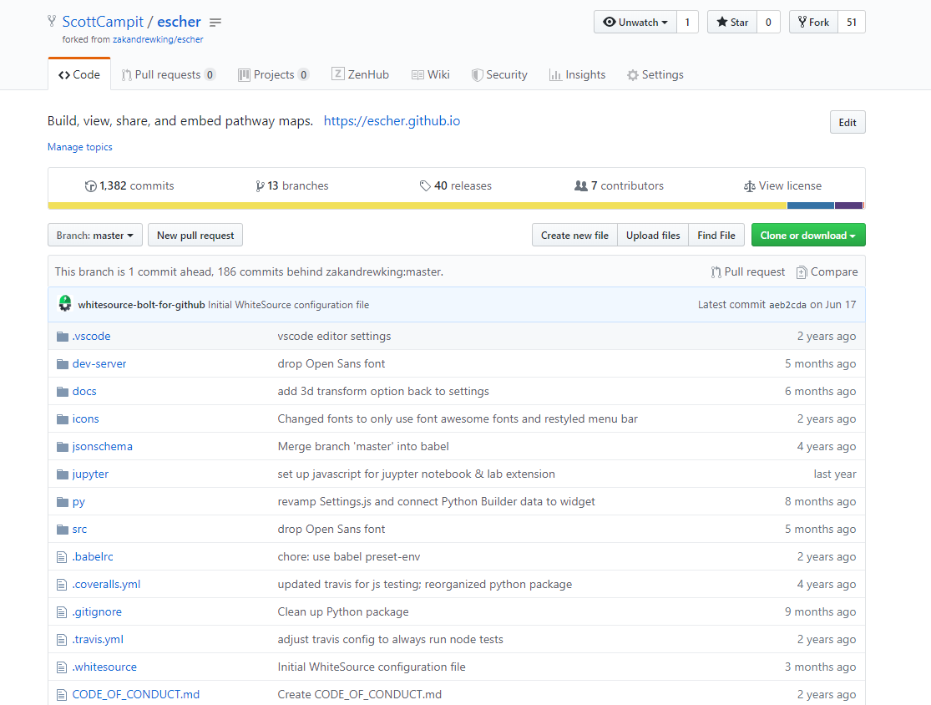
What is GitHub?
GitHub is the Facebook for software developers.
Some features include:
1. Publishing your project as a repo
Lab project site:
https://github.com/sriram-lab
2. Copy or fork other people's project's and customize it

Slide 10
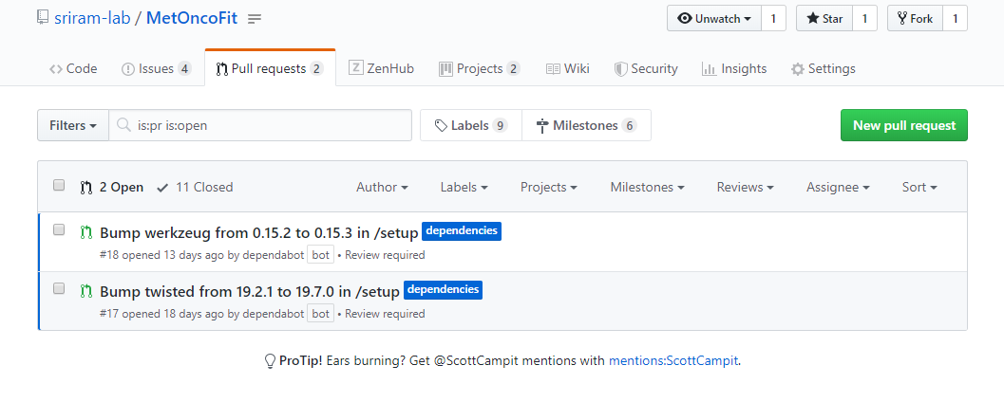
What is GitHub?
GitHub is the Facebook for software developers.
Some features include:
1. Publishing your project as a repo
Lab project site:
https://github.com/sriram-lab
2. Copy or fork other people's project's and customize it
3. Share your code with the original project by issuing pull requests

Slide 11
Useful features on GitHub
SCRUM tables
To-do lists (Issues)
Making WikiPages
Additional software

Slide 12
Resources and getting started on Git/GitHub
I wrote a tutorial that covers the basics:
https://github.com/sriram-lab/github-tutorials
Free course on Udacity:
https://www.udacity.com/course/version-control-with-git--ud123
The official Git documentation:
https://git-scm.com/
The official GitHub documentation:
https://guides.github.com/

