Slide 1
Introduction to Version Control
10 September 2019

Slide 2


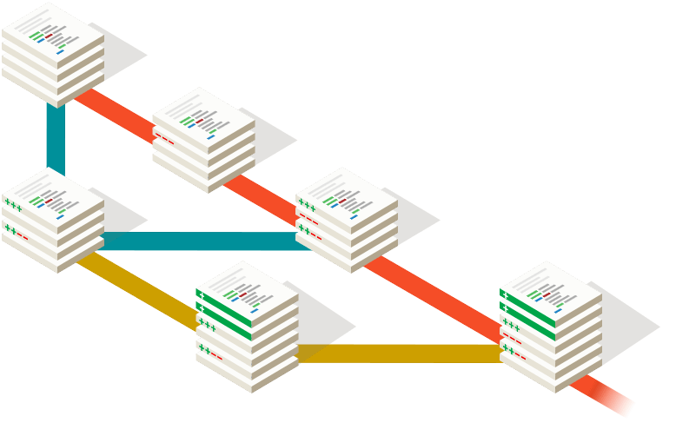
Outline
What is version control?
What is Git?
What is GitHub?
How I use Git and GitHub on a daily
Useful GitHub features
Summary and resources

Slide 3

What is version control?
New features branch
Version control systems are software that allows teams to manage changes in code over time.
Benefits of VC:
Keep a complete history of every file / can recover different file versions easily
Independent containers (branches) for different projects and a way to sync / merge these branches for collaborations
Tons of open source tools to help develop better code, automate tasks, etc.
Version 1
Initial commit
Fix bugs
Optimized things
Time
https://www.atlassian.com/git/tutorials/what-is-version-control

Slide 4
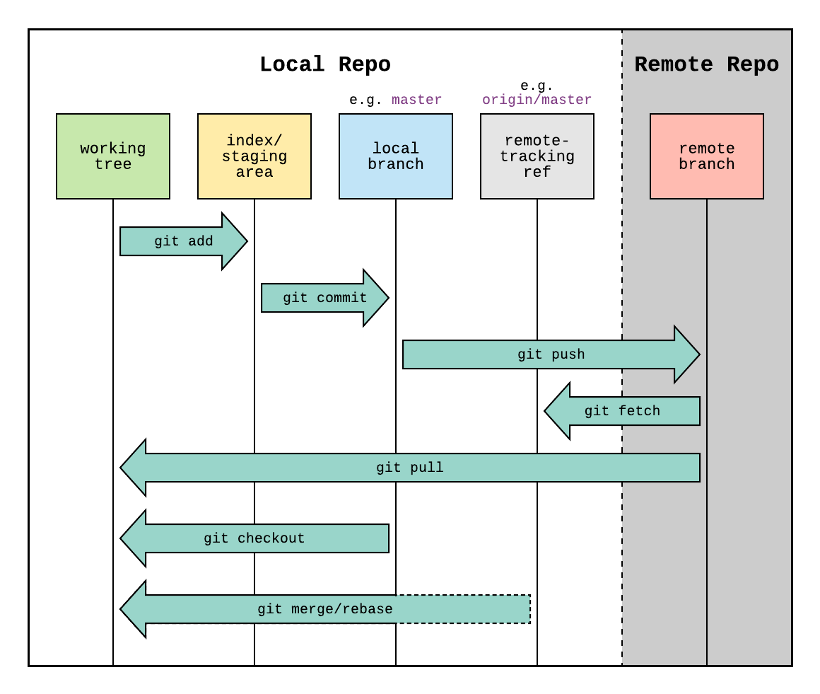
What is Git?
Git is the specific version control software most people use today.
1. git init: Have a local folder (repo) point to a remote location.
2. git add: Add new local files to a "staging" area.
3. git commit: Associate these additions with a unique identifier.
4. git push: Finally, make changes in a remote location (ie GitHub's servers).
https://www.reddit.com/r/git/comments/99ul9f/git_workflow_diagram_showcasing_the_role_of/

Slide 5
What is Git?
5. git fetch: Find remote branches and track them locally.
6. git pull: Bring changes from the remote to your local directory
7. git checkout: If you have multiple branches with different content, this allows you to switch between branches.
8. git merge/rebase: If there are differences between the local and remote code, you need to eventually resolve those differences.
https://www.reddit.com/r/git/comments/99ul9f/git_workflow_diagram_showcasing_the_role_of/

Slide 6
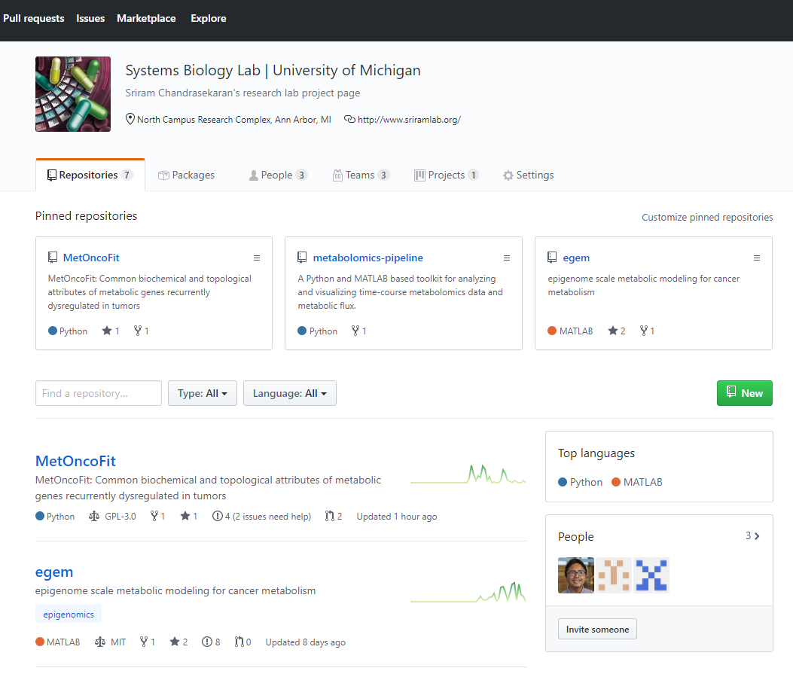
What is GitHub?
GitHub is like the Facebook/LinkedIn for software developers
1. Publishing your work as a repo
Lab project site: https://github.com/sriram-lab

Slide 7
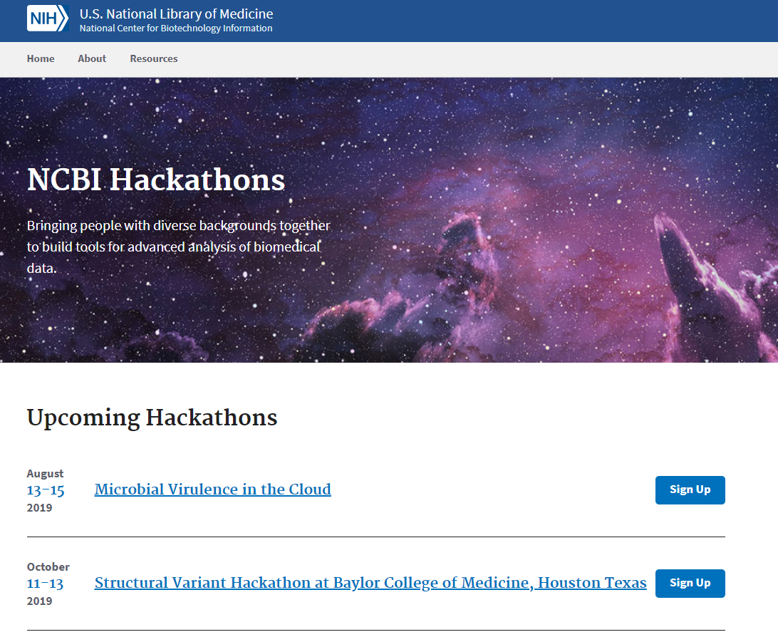
What is GitHub?
GitHub is like the Facebook/LinkedIn for software developers
1. Publishing your work as a repo
Lab project site: https://github.com/sriram-lab
2. Fork and contribute to other projects (and get recognized for it)
https://ncbi-hackathons.github.io/

Slide 8
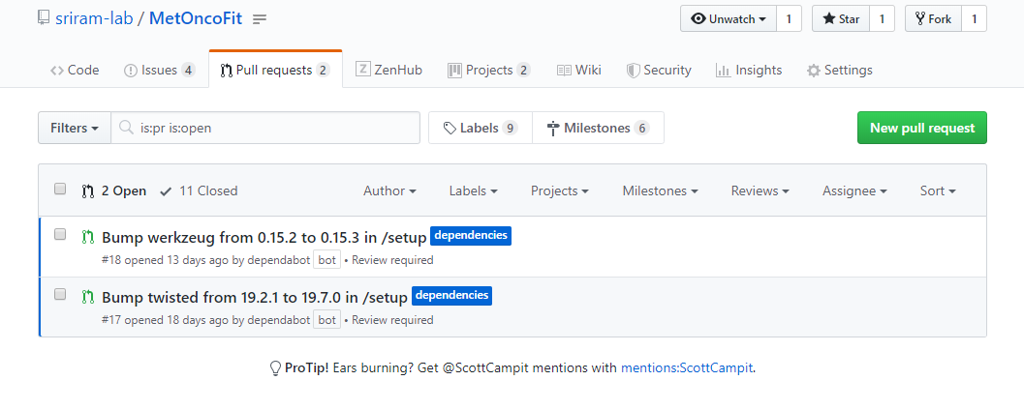
What is GitHub?
GitHub is like the Facebook/LinkedIn for software developers
Publishing your work as a repo
Lab project site: https://github.com/sriram-lab
2. Fork and contribute to other projects (and get recognized for it)
3. Continually fix issues, add feature requests, and make live improvements with your code

Slide 9




Applying Git | Developing code with others
July 2019
Benefits:
Maintain different versions of code for each person
Easier way to merge, share, and review each other's code
With GitHub:
Has productivity/ project management tools for teams (ie SCRUM boards, To-Do lists, etc)
Easy way to document code with Markdown

Slide 10
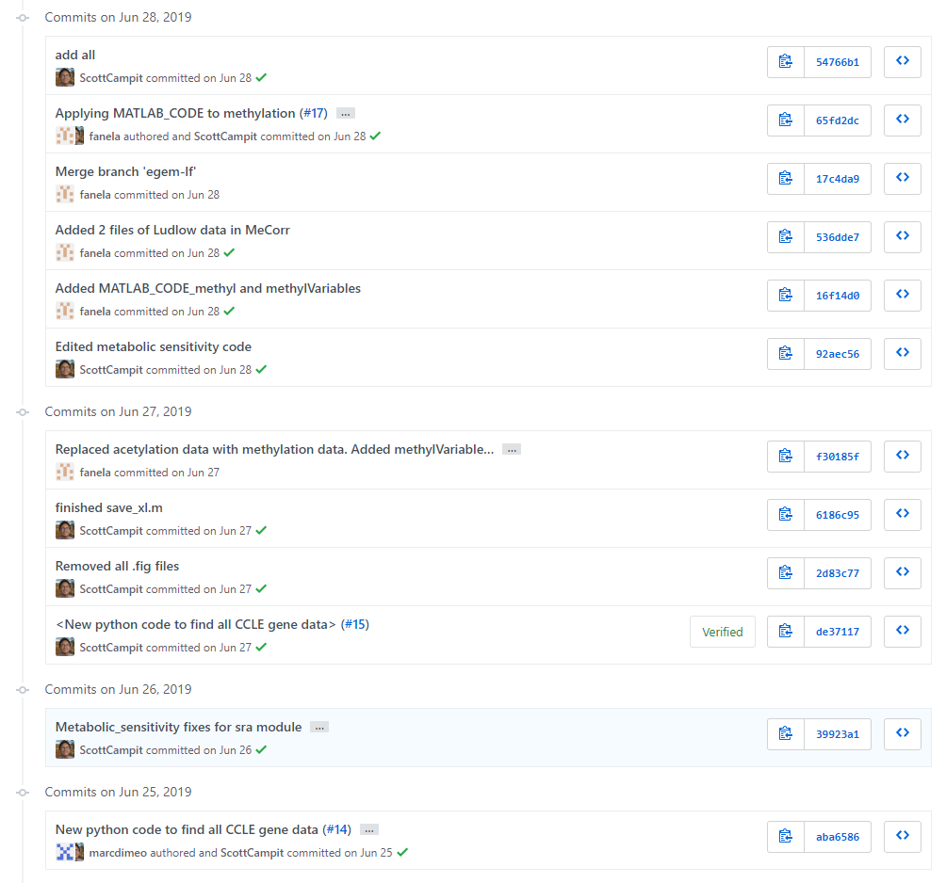
Applying Git| Permanently store your code in a safe place
Benefits of keeping your code in a VSC:
Keep a shared history of all of the changes to your code and easily move back/forward to different versions
Container-izing code
Options for large files (> 1GB)
Fail-safe in the case of hardware malfunctions

Slide 11
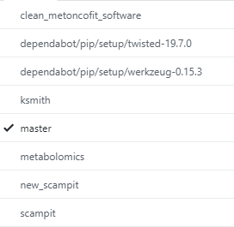
Applying Git| Permanently store your code in a safe place
Version 1.1 - improvements
Branches
File A
File B'
File C"
Benefits of keeping your code in a VSC:
Keep a shared history of all of the changes to your code and easily move back/forward to different versions
Container-izing code
Options for large files (> 1GB)
Fail-safe in the case of hardware malfunctions
Version 1.0 - in production
File A
File B
File C
Version 1.X - experimental
File A
File B
File C
File D

Slide 12
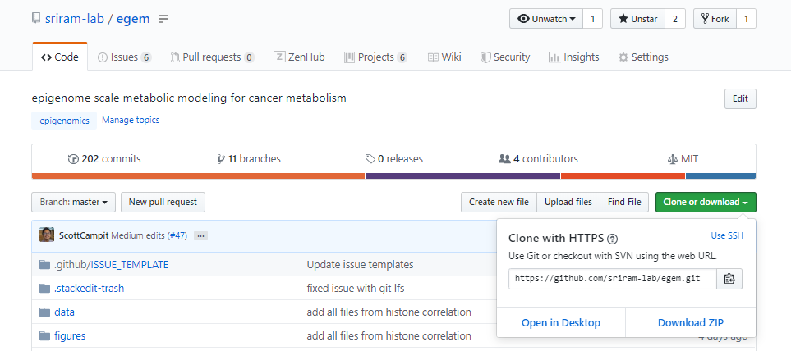
Applying Git| Sharing code
1. Easy to share and update software via URL

Slide 13
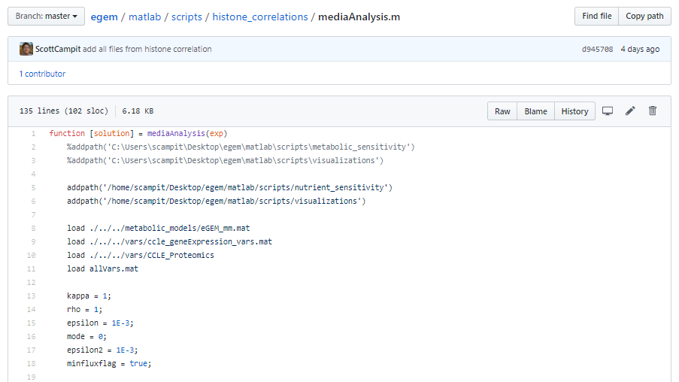
Applying Git| Sharing code
2. Code transparency and reproducibility

Slide 14
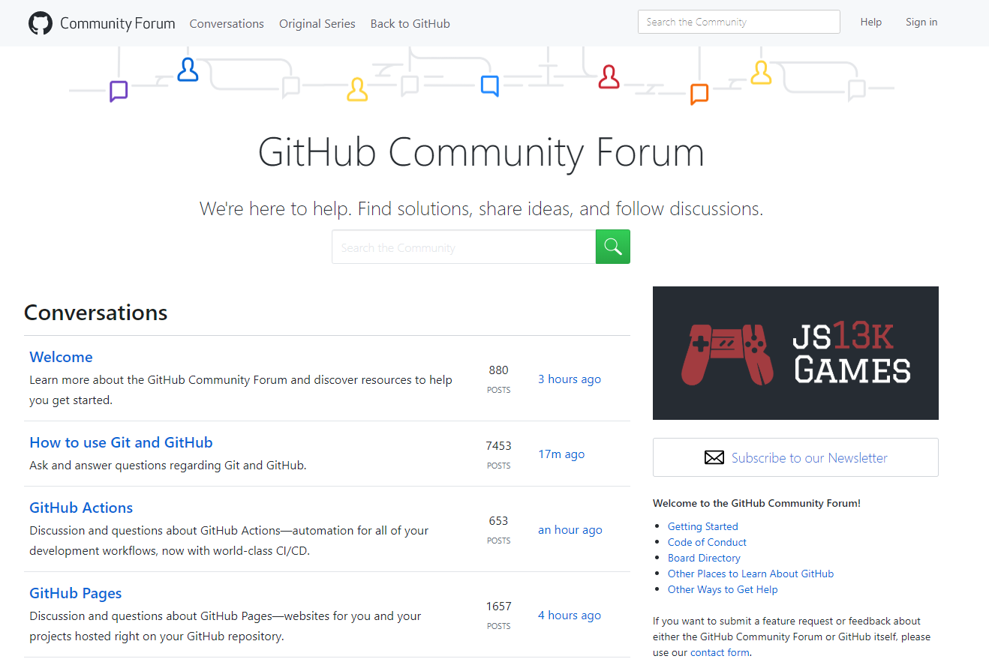
Applying Git| Sharing code
3. Large community

Slide 15
Useful features on GitHub
SCRUM tables
To-do lists (Issues)
Making WikiPages
Additional software

Slide 16
Resources and getting started on Git/GitHub
I wrote a tutorial that covers the basics:
https://github.com/sriram-lab/github-tutorials
Free course on Udacity:
https://www.udacity.com/course/version-control-with-git--ud123
The official Git documentation:
https://git-scm.com/
The official GitHub documentation:
https://guides.github.com/

