Slide 1
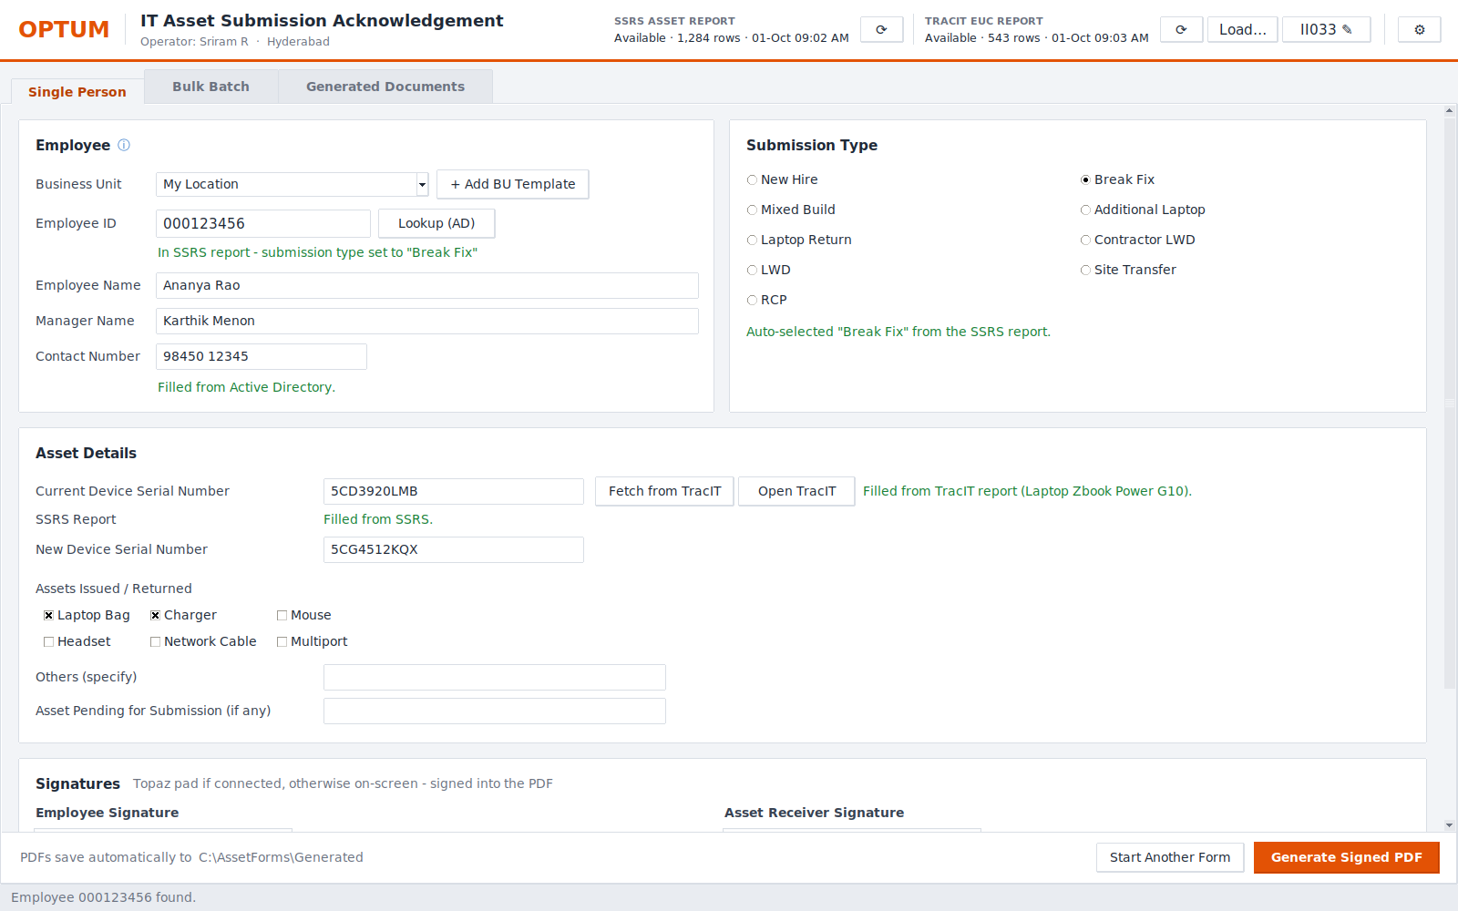
TEAM UPDATE · 01 OCTOBER 2026
IT Asset Submission Acknowledgement App
From five tools and manual typing to one screen and a signed PDF
Real app screen · sample data
Presented by Sriram R
Notes:
Good morning everyone, and thank you for the time.
Today I want to show you something I've been building for our team: the IT Asset Submission Acknowledgement app.
Every time we issue, swap or collect a laptop, we fill in an acknowledgement form and get it signed. It's a small task, but we do it many times a day, and on new-joiner and exit days we do it in bulk.
In the next ten minutes I'll show you what the process looks like today, what the app does, a quick look at the screens, where we stand, and what support I need to roll it out to the team.
(Everything you'll see on screen is real app screens - the names and IDs are sample data.)

Slide 2





Today, one form means five tools
Every issue, swap or return is done by hand, person by person
Look up name & manager
AD report in the browser
What this costs us
Find the new laptop
Retyping IDs and serial numbers invites typos
Bulk days (new joiners, exits) take hours
File names and folders differ by person
Depends on Acrobat + the Topaz plug-in on every PC
No single record of what was generated
SSRS asset report
Find the current laptop serial
Search TracIT
Type it all into the Word form
Then sign with Acrobat + Topaz plug-in
Save, name, file & email the PDF
Folder and file name chosen by hand
IT Asset Submission Acknowledgement · 2
Notes:
Let me start with how we do this today.
For one person, we open the AD report to get the employee's name and manager. For a new hire or break-fix we check the SSRS report for the new laptop. For an exit or break-fix we search TracIT for the current laptop's serial number.
Then we type all of that into the Business Unit's Word form, sign it with Acrobat and the Topaz plug-in, save it, pick a file name and folder, and for exits we write an email.
That's five different tools for one form. It works, but it's slow, especially on bulk days. Every time we retype an ID or a serial number there's a chance of a typo. Everyone saves files a little differently. And there's no single place to see what was generated.

Slide 3
The app: type the Employee ID, everything else fills itself
1
Name & manager
from Active Directory, automatically
2
Submission type & new laptop
from the SSRS report
3
Current laptop serial
from the TracIT report
4
Sign & generate
Topaz pad or on-screen, then one click for the signed PDF
IT Asset Submission Acknowledgement · 3
Notes:
This is the app. One screen for a single person.
You scan or type the Employee ID, and within about a second the app fills in the name and manager straight from Active Directory - the same data as the AD report, but no browser, no copy-paste.
At the same time it checks the SSRS report. If the person is there, it picks the submission type for us - here it chose Break Fix - and fills the new laptop serial.
For the current laptop, it reads the TracIT EUC report for our location and fills the serial number. You can see the green messages telling you where each value came from.
Then the employee signs on the Topaz pad, the receiver signs, and one click generates the signed PDF. If any source doesn't have the person, the app just tells you, and you type that field by hand - nothing breaks.

Slide 4




How it works
One Employee ID in - a signed, filed, logged PDF out
Active Directory
Saved automatically
name, manager, email
Type / Date / Operator folders
SSRS asset report
Outlook draft
Employee ID
type, new laptop
BU Word template → PDF → 2 digital signatures
for LWD returns (never auto-sent)
TracIT EUC report
Audit log
current laptop serial
who, when, employee, type
IT Asset Submission Acknowledgement · 4
Notes:
Here's what happens behind the scenes - in plain terms.
The only input is the Employee ID. From that, the app asks three sources:
- Active Directory gives the name, manager and email. It uses our own Windows login, so there's no password stored anywhere.
- The SSRS asset report, which the app downloads once a day, tells us if this is a new hire, break-fix and so on, and the new laptop serial.
- The TracIT EUC report for our location gives the laptop the person currently has.
The app then fills the Business Unit's own Word template, so the form looks exactly like today's, converts it to PDF and applies two real digital signatures - employee and asset receiver.
Finally it saves the file into a standard folder structure with a standard file name, opens an Outlook draft for exits - it never sends anything by itself - and writes a line to the audit log.

Slide 5
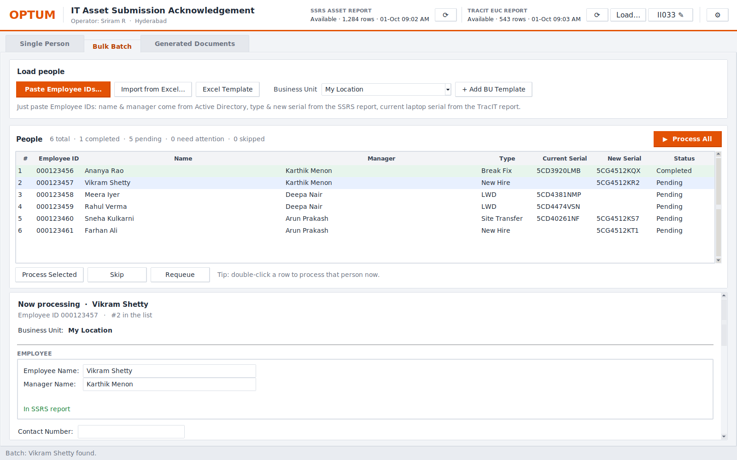
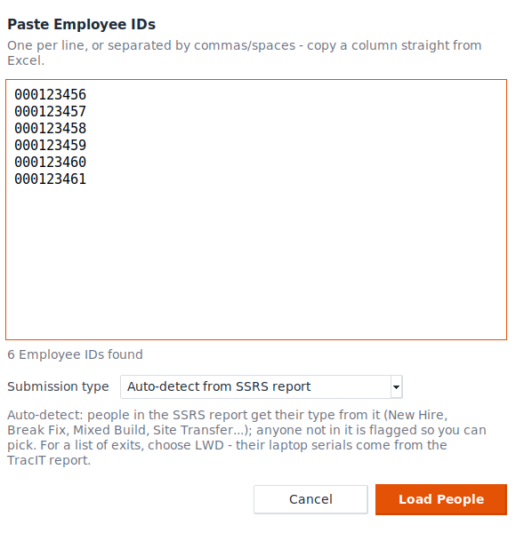
Bulk days: paste a list of IDs, the app does the rest
Paste Employee IDs straight from Excel or an email
Names & managers fill in automatically in the background
Type and serials come from SSRS and TracIT
Work through the list, or let it auto-advance
Only stops where a person is needed: signatures
IT Asset Submission Acknowledgement · 5
Notes:
Now the part I think will help us most: bulk days.
Instead of preparing a spreadsheet, you just copy the list of Employee IDs - from Excel, from an email, from anywhere - and paste it. The small window on the left is that paste box.
The app loads everyone into a list. While you start on the first person, it looks up everyone's name and manager in the background. Types and serial numbers come from the SSRS and TracIT reports, so the list on the right fills itself in - you can see type, current serial, new serial and status for each person.
For a list of exits you just choose LWD once, and every laptop serial comes from TracIT.
Then you work down the list - or click Process All and it moves to the next person automatically. It only stops where we genuinely need a human: the signatures.

Slide 6
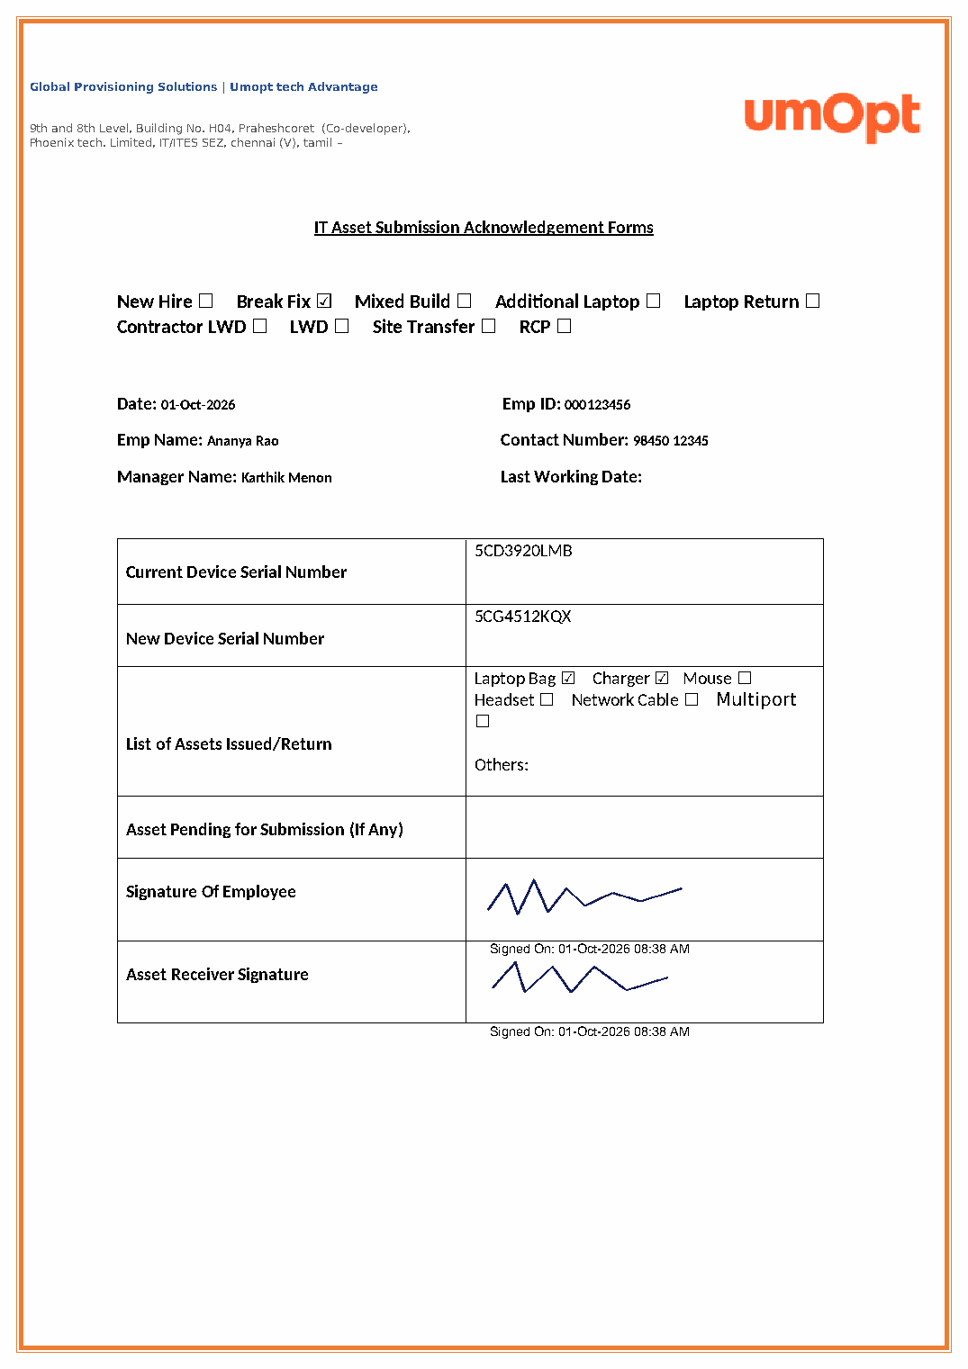



The result: a signed PDF on the same BU form
Real digital signatures
Employee and asset receiver - tamper-evident, checkable in Adobe's Signature panel
Signed-on date & time
Printed under each signature automatically
Filed the same way every time
Type \ Date \ Operator \ EmpID_Type_time.pdf
No Acrobat needed to create it
The app signs the PDF itself; Topaz pad or on-screen signing
IT Asset Submission Acknowledgement · 6
Notes:
This is what comes out - the same Business Unit form we use today, filled in, with both signatures.
Four things to point out.
First, these are real digital signatures, not just pictures pasted in. If anyone changes the PDF afterwards, Adobe will show the signature as broken. You can open the Signature panel in Adobe and see who signed and when.
Second, the date and time of signing are printed under each signature automatically.
Third, every file is saved the same way - by submission type, then date, then operator, with the Employee ID and type in the file name - so anyone can find any form.
And fourth, we no longer need Acrobat to create these. The app signs the PDF itself, with the Topaz pad when it's connected, or on screen when it isn't.

Slide 7
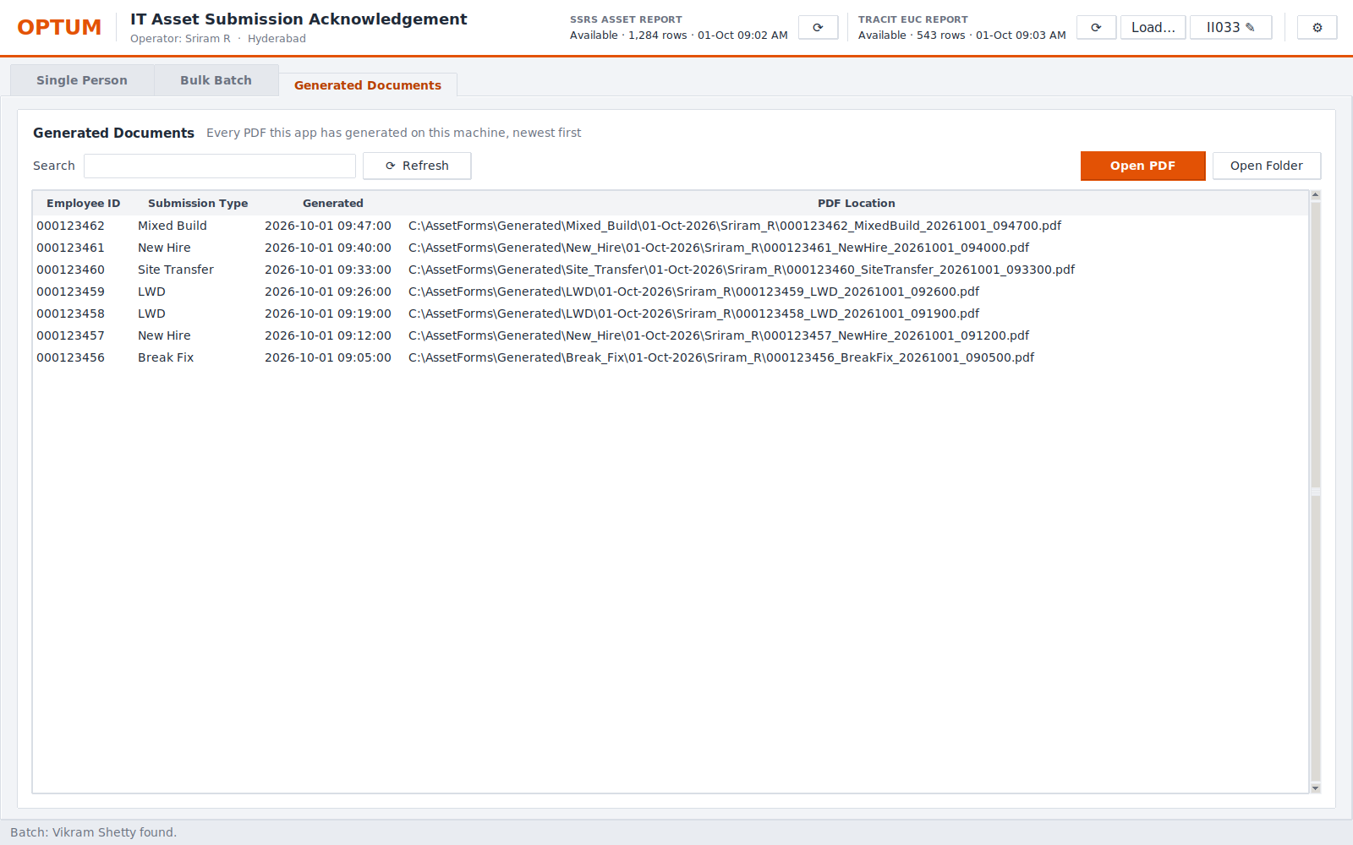

Every form is logged and easy to find
Audit log
Time, operator, Employee ID, type, data source, file location - one line per form
Search & open
Find by ID or type, open the PDF or its folder in one click
Details inside the PDF
Employee, type and operator stored in the PDF's properties
IT Asset Submission Acknowledgement · 7
Notes:
Every time a PDF is generated - or fails - the app writes one line to an audit log: when, who, which employee, which type, where the data came from, and where the file was saved.
The Generated Documents tab shows that history. You can search by Employee ID or type, and open the PDF or its folder in one click. So if someone asks "do we have the signed form for this person?", we can answer in seconds.
The same details are also stored inside the PDF's own properties.

Slide 8




Built to be safe and simple to support
Your own Windows login
Data stays inside
Tamper-evident PDFs
AD and SSRS use the signed-in user. No passwords stored or typed in the app.
Runs on the PC, talks only to our internal systems. Nothing goes to the cloud.
Each form carries two digital signatures that break if the file is edited.
Full audit trail
Never blocks the work
Nothing sent automatically
Every generation is logged with operator, time and file location.
If a source is down, the app says so and the field is typed by hand.
Emails open as drafts for us to review and send ourselves.
IT Asset Submission Acknowledgement · 8
Notes:
A word on safety, because I know that matters.
The app uses our own Windows login to read Active Directory and the SSRS report - there are no passwords stored in it. Everything runs on our PC and talks only to our internal systems; nothing is sent to the cloud.
The PDFs carry digital signatures, so any edit after signing is visible. Every form is logged.
And it's designed never to block us: if Active Directory, SSRS or TracIT can't be reached, the app tells you and you type that field by hand. Emails are only ever drafts - we review and send them ourselves.
One point for transparency: the signing certificate is created by the app itself, so Adobe shows the signature as valid but from a certificate it doesn't yet know. IT can make it fully trusted by installing that certificate - that's one of my asks at the end.

Slide 9
What changes for the team
5 → 1
0
1 paste
100%
tools per form
retyped IDs & serials
to load a whole batch
of forms logged
AD, SSRS, TracIT, Word and Acrobat become one screen
when the person is in AD, SSRS and TracIT
names, types and serials fill themselves in
same folders, same file names, one history
Next step: measure it. During the pilot we'll time forms before and after, and count corrections, so we can report real time saved.
IT Asset Submission Acknowledgement · 9
Notes:
So what does this change for us?
Five tools become one screen. When a person is in AD, SSRS and TracIT, we don't retype a single ID or serial number - which removes the most common source of mistakes. On bulk days, one paste loads the whole batch. And every form is filed the same way and logged.
I've deliberately not put a minutes-saved number on this slide, because I'd rather measure it than guess. During the pilot we'll time a few forms the old way and the new way, and count corrections, and I'll come back with real numbers.

Slide 10


Where we are
Done
In progress
Next
Single person & bulk processing
Active Directory auto lookup
SSRS: type + new laptop
TracIT report: current laptop
Topaz pad & on-screen signing
Signed PDF, filing, audit log
Outlook drafts for exits
New, cleaner screens
TracIT report downloads itself daily (today: one click on 'Load…' with the exported report)
Final checks on touchpad scrolling
2-week pilot with the team
ServiceNow live new-hire data
Trusted signing certificate (IT)
One-click install for everyone
IT Asset Submission Acknowledgement · 10
Notes:
Here's where we are.
Done: the single-person and bulk screens, the automatic Active Directory lookup, the SSRS and TracIT data, Topaz and on-screen signing, the signed and filed PDF with audit log, Outlook drafts for exits, and the new screens you've just seen. I'm using it now.
In progress: I'm making the TracIT report download itself every morning. Until that's finished, it's one extra click - export the EUC report from TracIT and use 'Load' in the app. That's what I'm doing today.
Next: a two-week pilot with the team, live new-hire data from ServiceNow, a trusted signing certificate from IT, and a simple install so everyone can use it.

Slide 11


What I need to roll it out
2–3 pilot volunteers for two weeks
1
Use it on real issues and returns, share what's missing
IT security review & trusted certificate
2
So Adobe shows our signatures as fully trusted for everyone
A contact in the TracIT team
3
To confirm we can pull the EUC report automatically each day
ServiceNow new-hire table details
4
So same-day new hires fill in automatically too
IT Asset Submission Acknowledgement · 11
Notes:
To take this from my desk to the whole team, I need four things.
One: two or three volunteers to use it for two weeks on real issues and returns, and tell me what's missing.
Two: support for an IT security review, and for IT to install the app's signing certificate as trusted, so Adobe shows our signatures as fully trusted for everyone.
Three: a contact in the TracIT team, so we can confirm the right way to pull the EUC report automatically every day.
And four: the ServiceNow table details for new-hire requests, so people who joined the same day fill in automatically too.
(Pause - look to the director.) If we can agree on the pilot today, I can start next week.

Slide 12
Thank you
Questions, and a 2-minute live demo
Sriram R
Notes:
Thank you - happy to take questions, and I can show it live for two minutes.
Demo: 1) Single Person: type an Employee ID - name and manager appear. 2) Point at the green "In SSRS report" / "Filled from TracIT report" messages. 3) Sign Now twice, Generate Signed PDF, open it. 4) Bulk: Paste Employee IDs, Load People, watch names fill in.
Likely questions:
- Secure? Uses our Windows login, no stored passwords, internal systems only.
- AD or TracIT down? It says so; you type that field by hand.
- Needs Acrobat? Not to create or sign. Any PDF viewer opens them.
- Rollout? Two-week pilot, then a simple install for the team.

