Slide 1
Measuring Effects of layoffs on corporate reputation using sentiment analysis
-Sriram Adhithyaa
22BCE5203

Slide 2
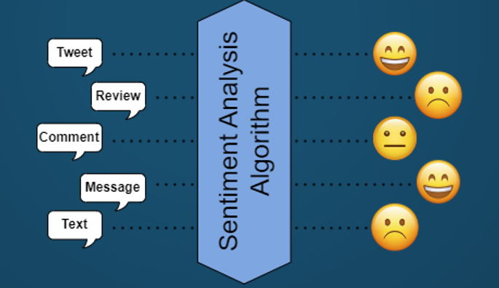
Introduction
Sentiment analysis -
Sentiment analysis, also known as opinion mining, is the process of using natural language processing and machine learning techniques to extract and identify the sentiment or emotion behind a piece of text.

Slide 3
Introduction continued..
Corporate Reputation-
Corporate reputation refers to the perception and image that an organization has among its stakeholders, including customers, investors, employees, suppliers, and the general public.
Importance of Corporate Reputation –
It can influence consumer behavior
It can affect investor decisions
Is vital for attracting and retaining talented employees
It can affect relationships with suppliers and partners
Layoff – A layoff or downsizing is the temporary suspension or permanent termination of employment of an employee for business reasons, such as personnel management or downsizing an organization

Slide 4
Diagram Representation:

Slide 5
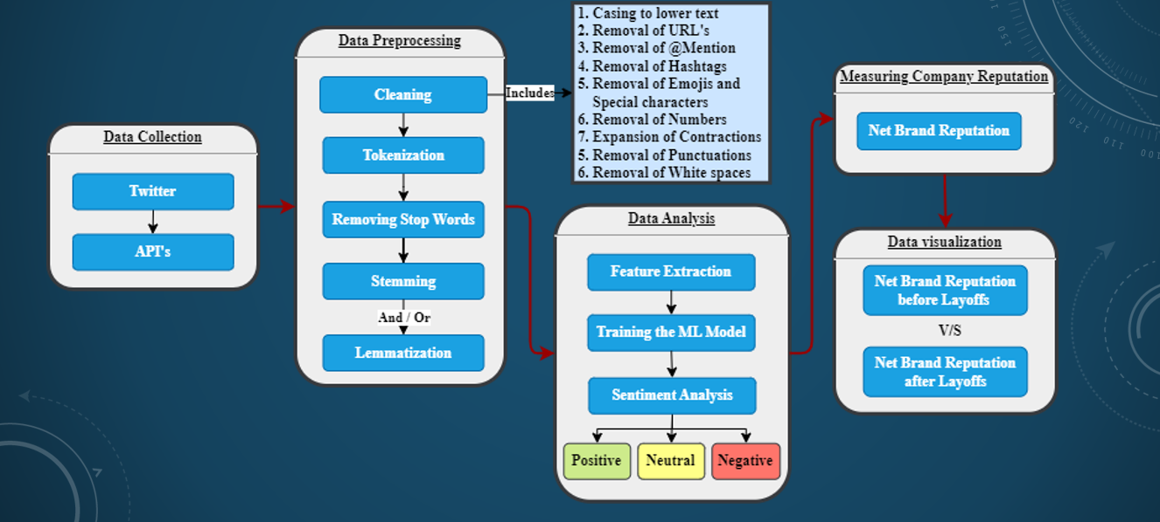

Slide 6
Data Mining
Steps
Install and Import Snscrape
Fetch tweets in Pandas dataframe
Store the data in CSV files

Slide 7
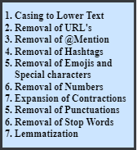
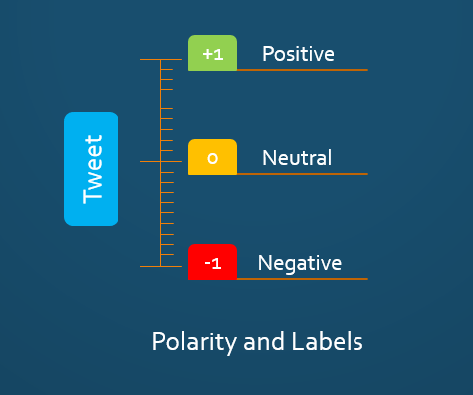
Data Preprocessing
Steps ->
Data Cleaning on training data
Polarity calculation of training data
Labeling sentiments of training data

Slide 8
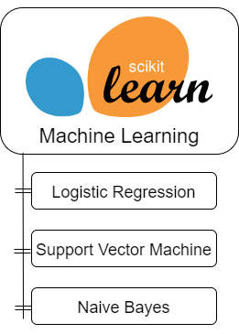
Model Training
Steps
Data splitting
Vectorization
Training the models
Testing the models

Slide 9


Data Prediction & Corporate reputation
Steps
Data cleaning
Vectorization
Prediction
Calculating Corporate Reputation

Slide 10
Dataset
Dataset Is collected from Twitter using Snscrape
Tweets are stored in Pandas in DataFrame and saved as CSV Files
Four Datasets are collected and used:
1) Training data : 10,000 Tweets about Facebook
2)Before Layoff data:10,000 tweets about Facebook before the layoffs
3)Layoff Specific Data : 10,000 tweets explicitly about layoffs
4)After Layoff Data:12,000 tweets post-layoff

Slide 11
Datasets file name and Entries:
1) After_Layoff.csv – 10,000 Entries
2)After_Layoff_General2.csv – 12000 Entries
3)Before_Layoff.csv – 10000 Entries
4)Fb_Training.csv – 10 5772 Entries
5)vect.csv – 66470 Entries

Slide 12
Metrics And Model Performance
Sentimental Classification: Positive , Negative and Neutral labels
ML models used: Support Vector Machine, Logistic regression, Naïve Bayes
Visual Analysis: Count Plots and Pie charts show an Increase or decrease in positive sentiment or neutral sentiment or negative sentiment

