Slide 1
Date: 05/09/2024
Customer Churn Analysis and Prediction
(June 2022 and July 2022)
by Sriram Murali

Slide 2
Overview
Goals:
Use the Customer Sample Dataset to:
Present an analysis why customers have left ScottishPower
The presentation is divided into two categories.
Exploratory Data Analysis
Machine Learning Modeling

Slide 3
Outline of the Analysis Report
Data Preprocessing
Exploratory Data Analysis
Churn Rate and Churn Trend
Seasonal Fluctuations
Churn rate by Tenure Months
Customer Segmentation (Demographic Analysis)
Customer Segmentation (Behavioural Analysis)
Customer Segmentation (Risk and Financial Analysis)
Feature Importance (Short Term Customers)
Feature Importance (Long Term Customers)
Modeling
Conclusion

Slide 4
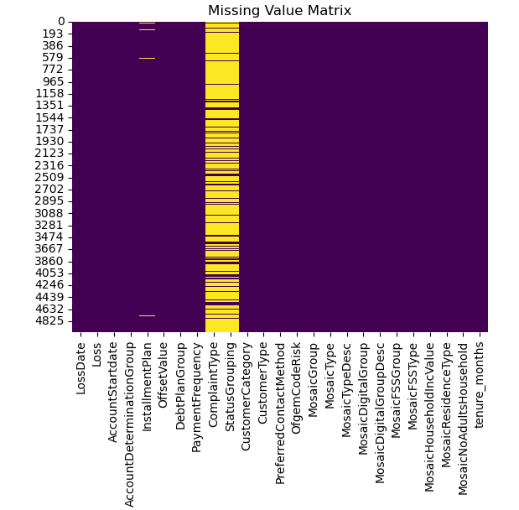
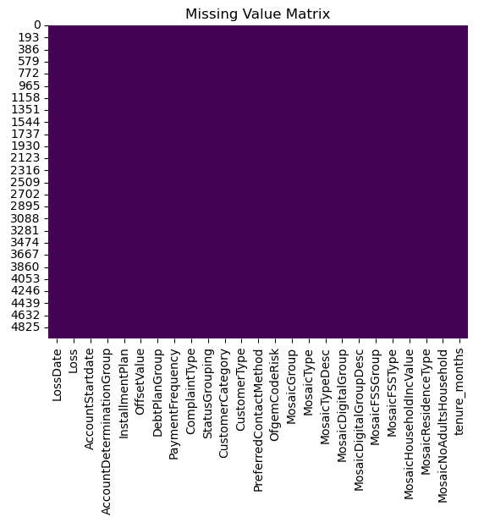
Data Processing
Objective: Prepare the data for analysis by removing and modifying data
Categorical
Missing Values
Found appropriate level of detail.
Label Encoding was used to deal with the categorical variables.
There was a few columns that had the missing values.
InstallmentPlan – 54 missing values
ComplaintType – 4021 missing values
StatusGrouping – 4021 missing values
Simple Imputer with Mode imputation is used to handle the missing values

Slide 5
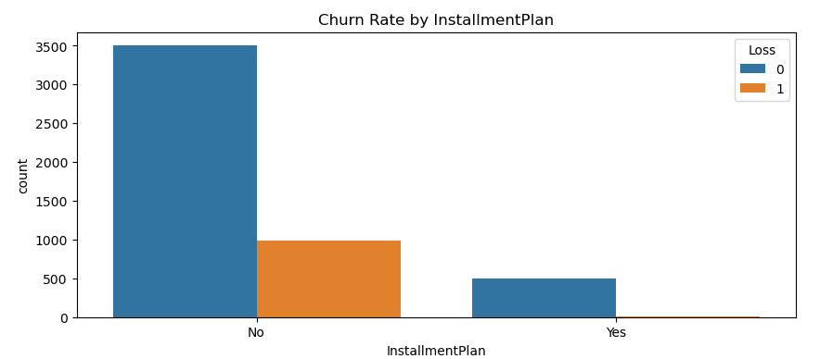
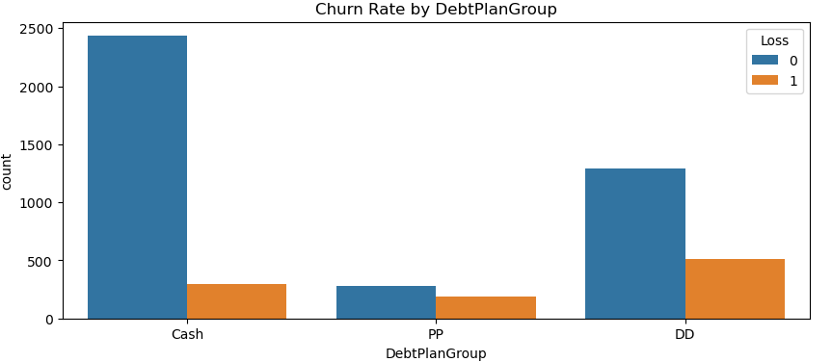
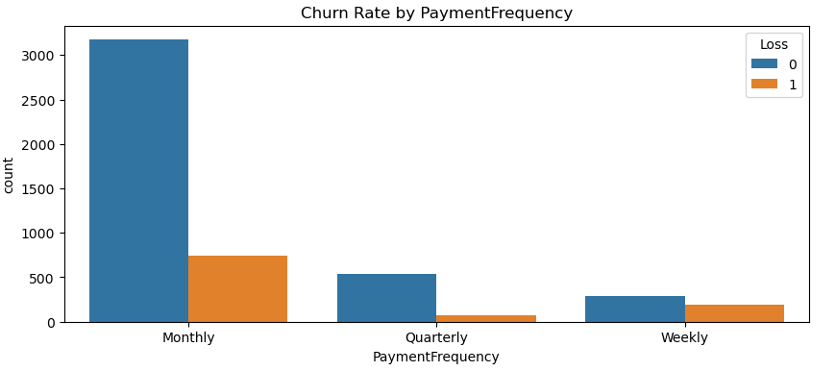
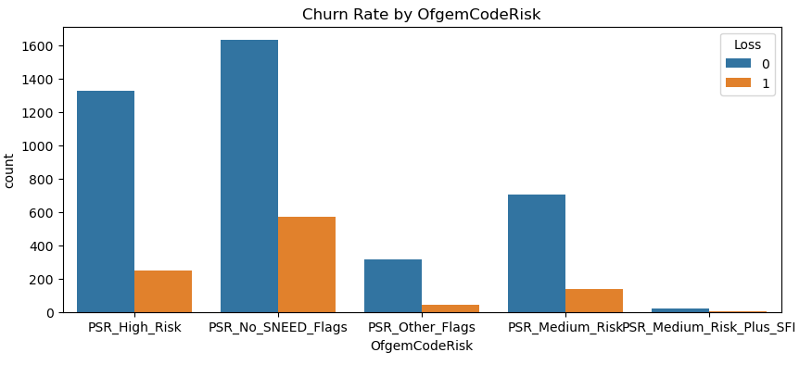
Exploratory Data Analysis
Some count plots are made to visualise the data.

Slide 6
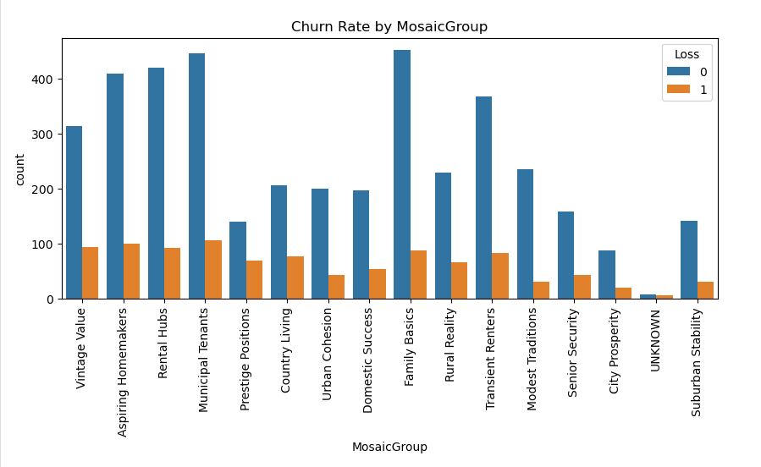
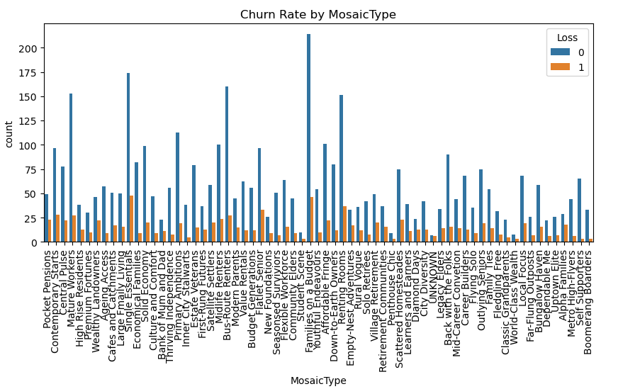
Exploratory Data Analysis
Some more count plots are made to visualise the data for the variables with more categories.
From the first plot, some of the groups like Municipal tenants, Rental Hubs, Aspiring Homemakers are tend to churn more compared to the rest of the groups.
From the second plot, types like, Single Essentials, Families on a Budget, Renting Rooms, Flatlet senior etc. are tend to churn more when compared to the rest of the types.

Slide 7
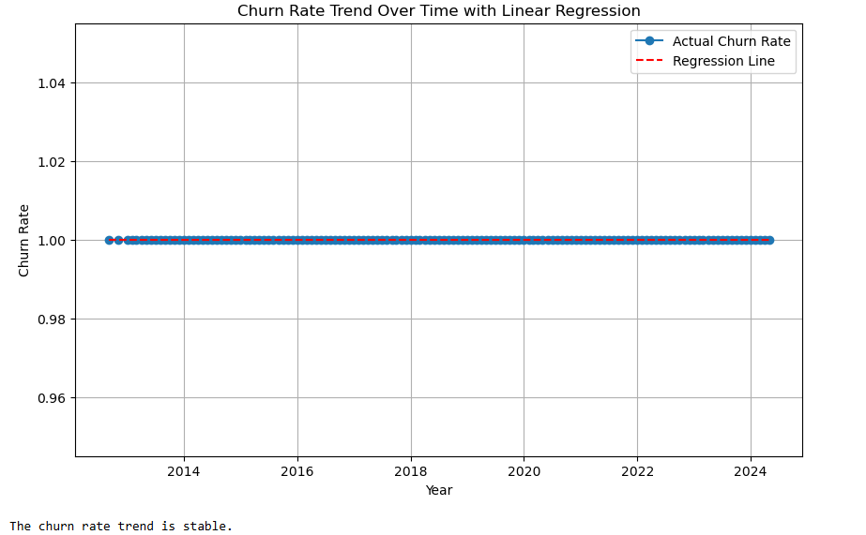
Churn Rate and Churn Rate Trend
Using the churned customers and the total number of customers Churn rate was found to be 20%
The calculation used was
Churn Rate = (Churned Customers / Total Customers) * 100
The Churn rate over time remains stable, indicating consistent customer retention. This suggests that our efforts in maintaining customer satisfaction and loyalty are effectively preventing significant fluctuations in customer attrition. A stable churn rate also provides predictability for future revenue streams, allowing us to focus on growth and acquisition strategies with confidence, knowing that our existing customer base remains steady.

Slide 8
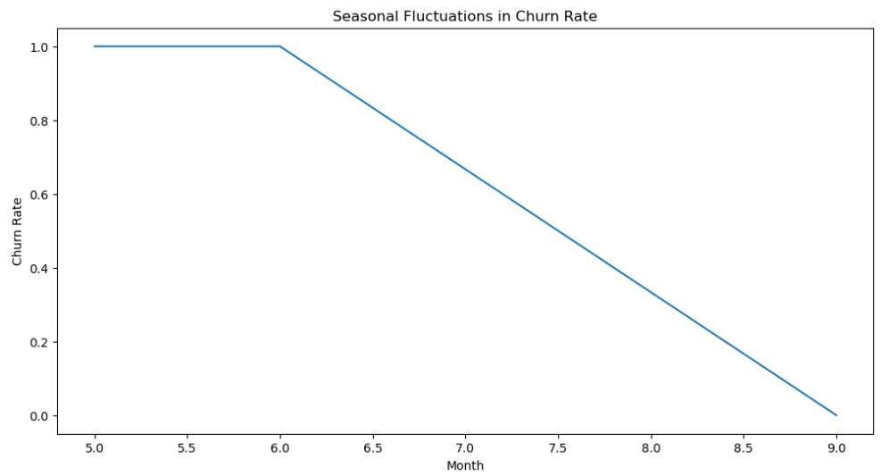
Seasonal Fluctuations
Seasonal Fluctuations refers to the regular, predictable changes in data that occur at specific intervals within a year.
The churn rate exhibits stable seasonal fluctuations during months 5 and 6, reflecting predictable customer behaviour patterns in these periods. However, a notable positive trend emerges as the churn rate begins to decrease consistently after month 6. This decline suggests that recent initiatives, such as targeted retention campaigns or product enhancements, are effectively reducing customer attrition, positioning us for stronger long-term retention and customer loyalty.

Slide 9
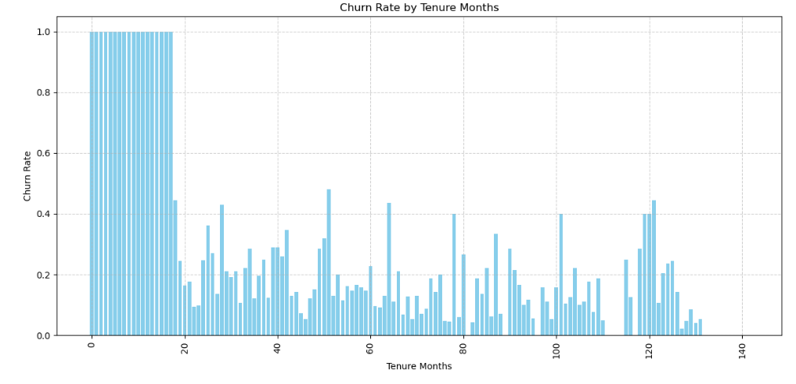
Churn Rate by Tenure Months
Tenure months is a metric that represents the total duration (in months) that a customer has been with a company or using a service.
Tenure Month = (End date – Start date) / 30.44 (which is the avg. no. of days in a month)
Tenure Months help identify critical periods during which customers are most likely to churn.
Analysis of customer tenure reveals a significant insight. Customers with a tenure of less than 20 months are far more likely to churn. This pattern suggests that the initial period of customer engagement is crucial, If customers do not feel committed or satisfied within the first 20 months, they are highly likely to leave. This highlights the importance of focusing on early retention strategies, such as onboarding experiences, personalised communication, and targeted offers, to reduce the churn during this critical period and foster long term loyalty.

Slide 10
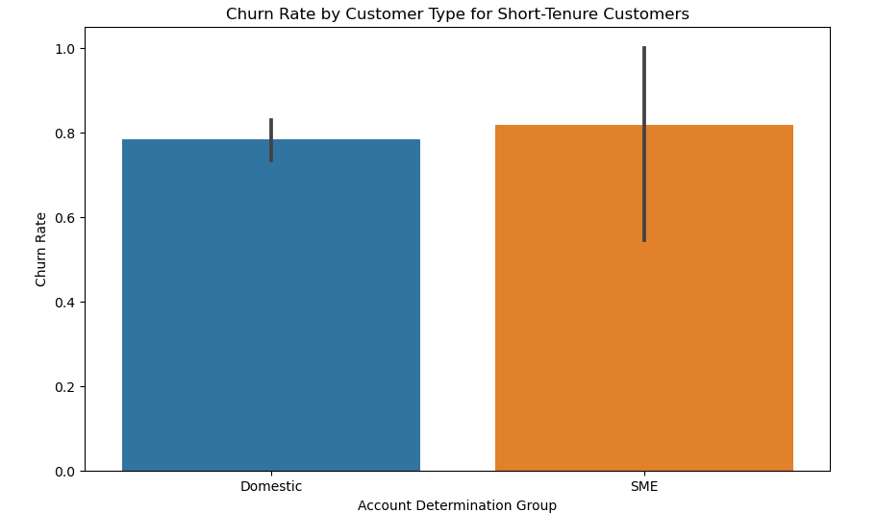
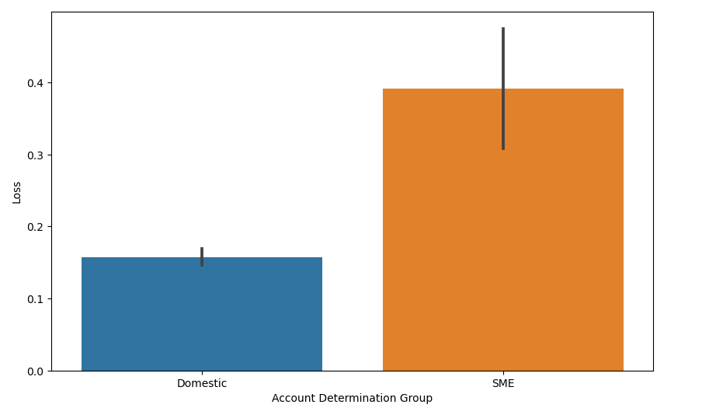
Customer Segmentation (Demographic Analysis)
Based on the tenure months, I have segmented the customer into two categories. They are Short tenure customers and Long tenure customers.
Short-Tenure: Both domestic and SME segments exhibit high churn rates approximately 0.8. This suggests that newer customers, regardless of their account type, are significantly more likely to discontinue services.
Long-Tenure: Churn rates are considerably lower, indicating better retention over time. Domestic accounts show a particularly low churn rate under 0.2, signaling strong loyalty. SME, while also showing improved retention compared to short tenure customers, still have slightly a higher churn rate of about 0.4.
This highlights the critical importance of early engagement, especially with SME customers to enhance retention rates.

Slide 11
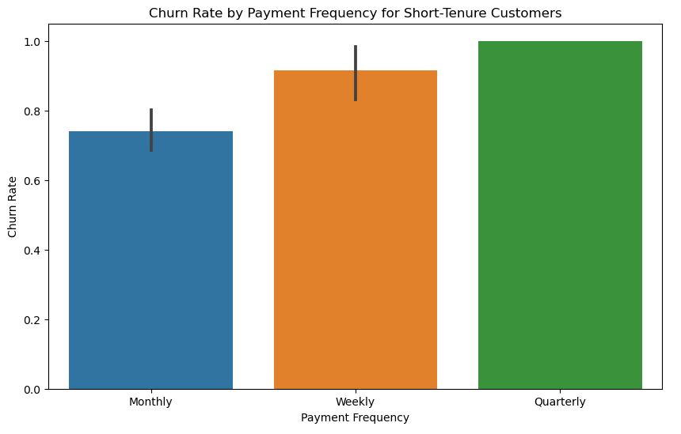
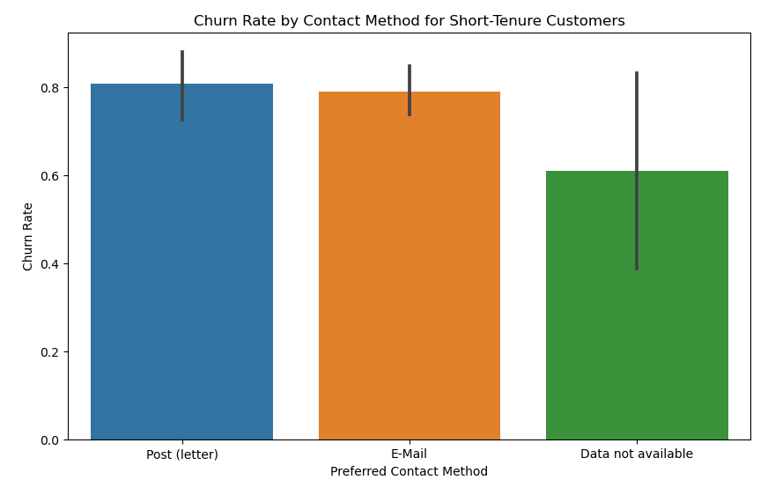
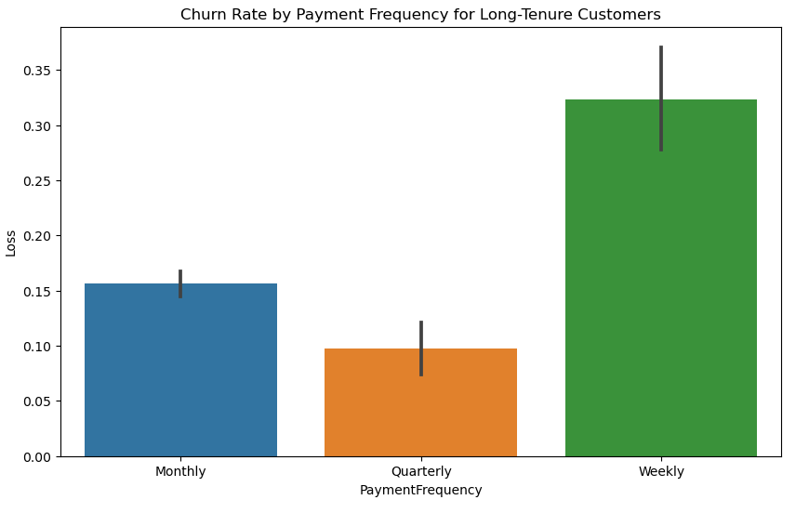
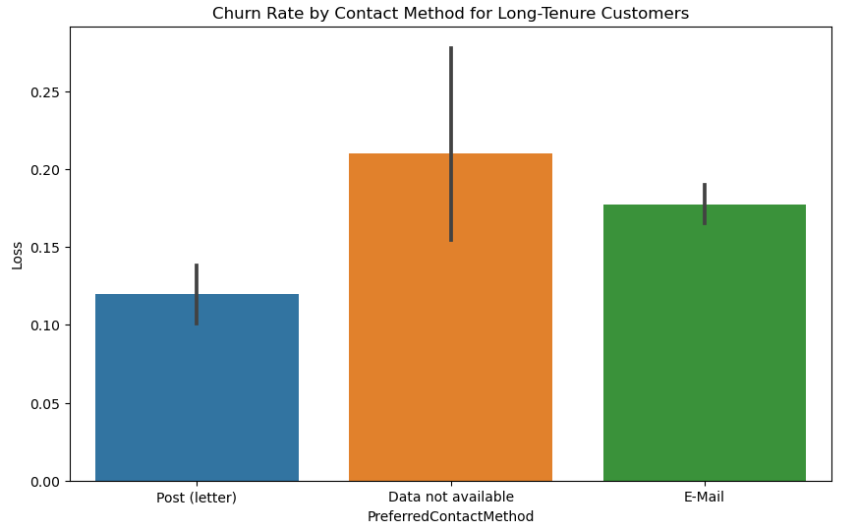
Customer Segmentation (Behavioural Analysis)
Short Tenure Customers
Long Tenure Customers

Slide 12
Customer Segmentation (Behavioural Analysis)
Payment Frequency:
Payment frequency profoundly impacts customer loyalty. While weekly payments initially seem to deter new users, those who continue beyond the short term phase adjust well, suggesting an initial period of discomfort that may require additional support or incentives. Conversely, the high churn rate for quarterly payments among new customers highlights the need for more frequent engagement strategies to maintain their interest and loyalty. Monthly payments consistently perform best, indicating an optimal balance of touch points for sustained customer relationships.
Recommendations: Enhance onboarding, Engagement initiatives and Feedback collection
Contact Methods:
These findings highlight the critical role of tailored communication strategies in enhancing customer retention. For short term customers, there is a clear need to refine email and direct mail strategies to reduce initial high churn rates. For long term customers, maintaining robust post letter communications could further enhance loyalty, particularly among those who prefer this traditional method. Additionally, the data suggests a review of how customer contact information is collected and utilised, as missing data correlates with higher churn across both customer groups.
Recommendations: Optimising contact methods according to customer tenure and preferences can significantly impact churn rates. A strategy that personalises communication and addresses the unique needs and behaviours of different customer segments could turn transient users into long term clients.

Slide 13
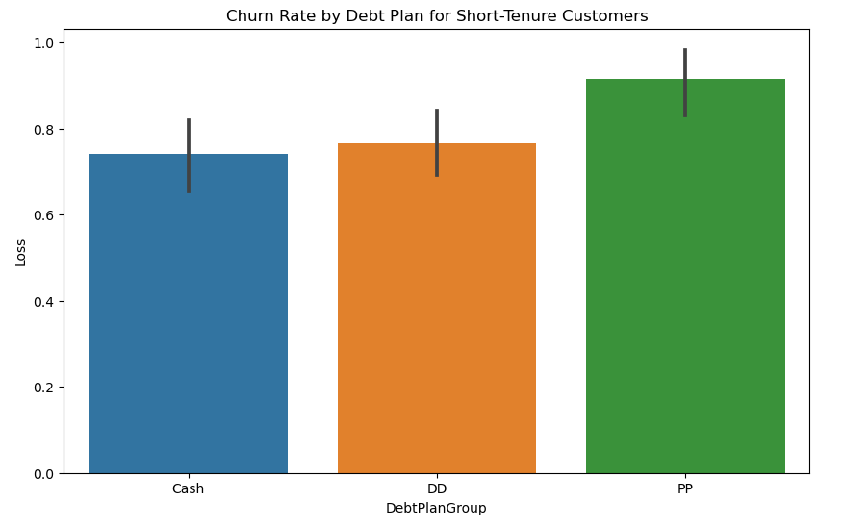
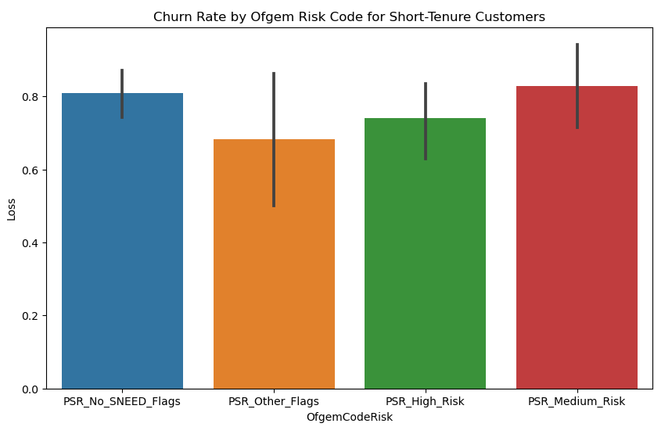
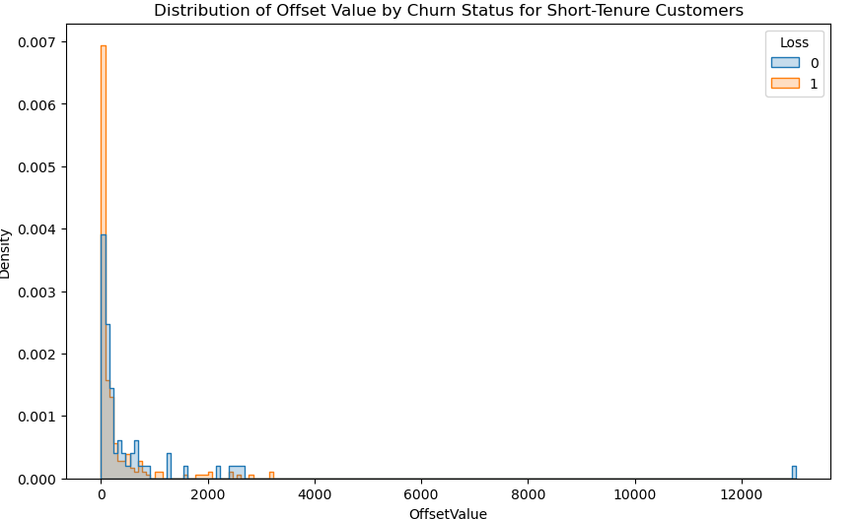
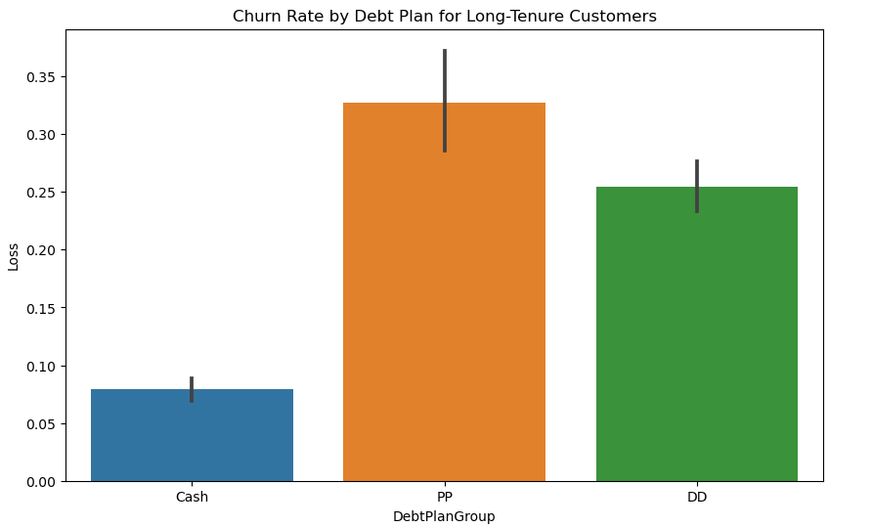
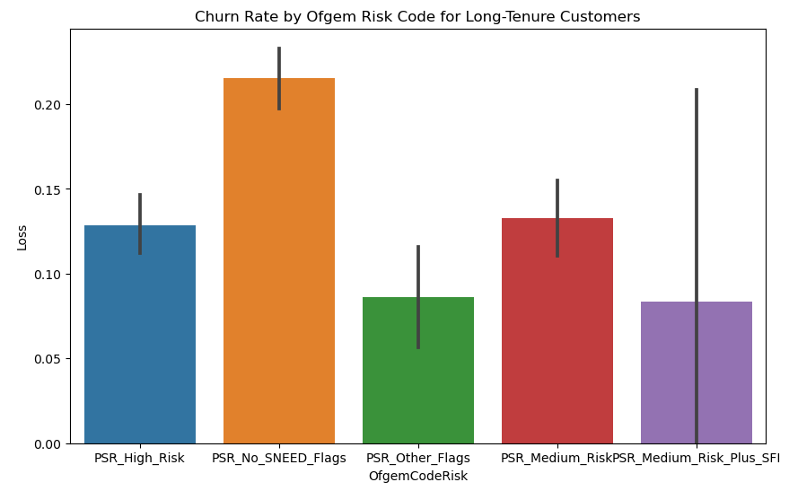
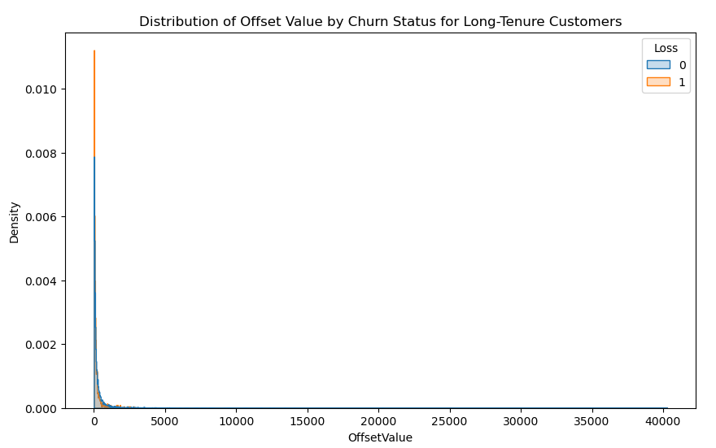
Customer Segmentation (Risk and Financial Analysis)
Short Tenure Customers
Long Tenure Customers

Slide 14
Customer Segmentation (Risk and Financial Analysis)
Debt Plan:
The analysis indicates a clear trend where customers who choose cash or direct debit tend to have better long term retention rates compared to those on payment plans. This could suggest that while payment plans are necessary for some customers due to financial constraints, they might also lead to higher initial churn due to potential dissatisfaction with payment terms or financial hardships. For new customers, particularly those on payment plans, proactive financial engagement could be beneficial. Offering early support, flexible payment restructuring, or incentives for switching to more stable payment methods like direct debit counld enhance customer satisfaction and reduce churn. The stark contrast in churn rates for long-term customers across different payment methods suggests that stability in financial transactions correlates with customer loyalty. Encouraging customers to adopt direct debit might combine the convenience they seek with the stability the business needs.
Ofgem Risk Codes:
The data highlights the critical importance of targeted, risk based support strategies, particularly during the early stages of the customer cycle. High risk and medium risk customers require immediate and sustained engagement to mitigate their vulnerabilities. Over time, these efforts appear to be effective, as evidenced by the significantly lower churn rates among long term customers. However, the consistently high churn among short term customers, even those considered lower risk, suggests a need for more proactive and comprehensive early intervention strategies to improve overall retention.
Offset Value:
For short tenure customers, having a low offset value seems to be associated with a higher likelihood of churn. This suggests that customers with lower outstanding balances may be more likely to leave, possibly due to dissatisfaction or lack of engagement early in their relationship with the company. For long tenure customers, offset value does not seem to have a strong influence on whether they churn. The overlapping distributions suggest that factors other than Offset Value play a more significant role in determining churn for customers who have been with the company for a longer time.

Slide 15
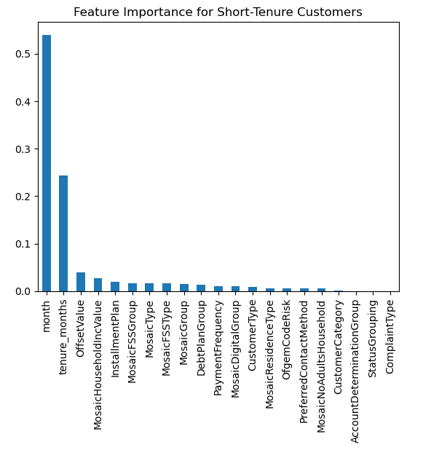
Feature Importance (Short Term Customers)
The stark emphasis on 'month' and 'tenure_months' paints a clear picture of a critical early phase in the customer-company relationship. This can be narratively framed as a 'vulnerability window' where customers are assessing whether to continue or discontinue the service. Effective onboarding processes, timely check-ins, and initial customer satisfaction surveys could be instrumental in extending the tenure of these customers.
Financial Health Support: The significant weight of 'offset value' tells a story of financial pressure influencing churn. Crafting strategies such as flexible payment options, proactive financial support, and perhaps early credit counseling for customers showing signs of financial stress can be a storyline that resonates with stakeholders looking to reduce churn.
Tailored Communications and Offers: For features like 'Mosaic household income' and 'installment plan', personalized marketing strategies that consider these aspects can be developed. For instance, customers in lower income brackets might benefit from cost-saving tips and loyalty discounts, while those on installment plans may appreciate flexible terms during financially tough months.
Engagement and Retention Initiatives: Leveraging this data, a narrative can be built around targeted engagement and retention initiatives. For example, knowing that customers with certain 'Mosaic' profiles are more likely to churn, customized offers or services can be designed to meet their specific needs and preferences.

Slide 16
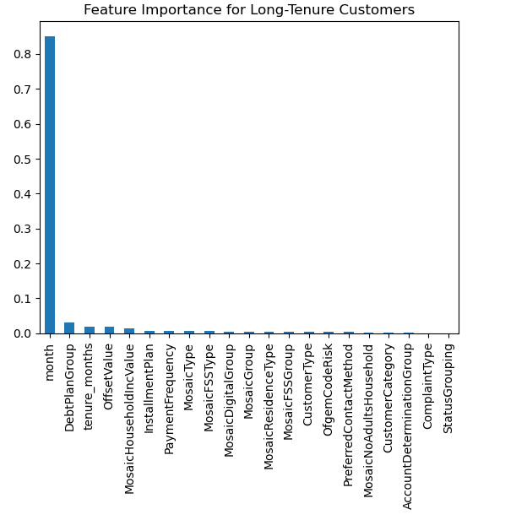
Feature Importance (Long Term Customers)
Temporal Strategies for Retention:
The plot clearly points to the need for temporal-based retention strategies. Given the significant role of the 'month,' businesses should analyse which months show higher churn rates and why. Tailored marketing campaigns, special offers, or proactive customer service outreach during these high-risk periods could mitigate churn.
Financial Flexibility for Loyalty:
The prominence of the 'debt plan group' emphasizes the need for financial strategies tailored to long-term customers. Offering loyalty discounts, renegotiating terms, or proactive financial check-ins can provide the flexibility that resonates with this group, potentially reducing churn.
Holistic Engagement:
Although less critical, the influence of socioeconomic and demographic factors ('mosaic household income', 'Mosaic type') suggests a need for holistic engagement strategies that address the diverse backgrounds and circumstances of long-term customers. Customised experiences and communications can enhance satisfaction and loyalty.

Slide 17
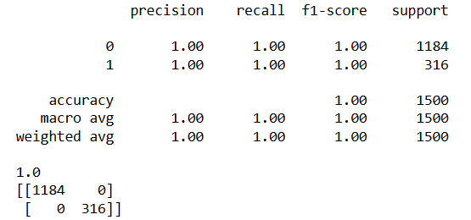
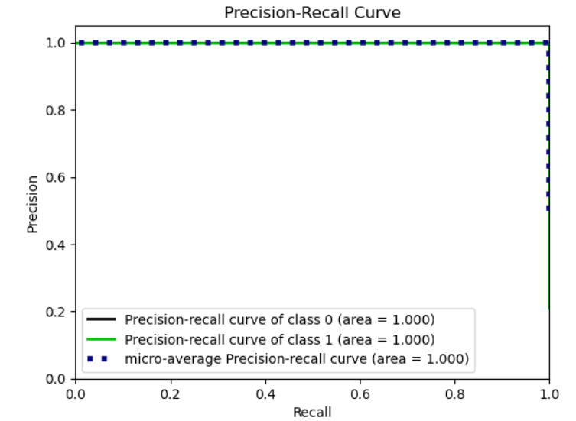
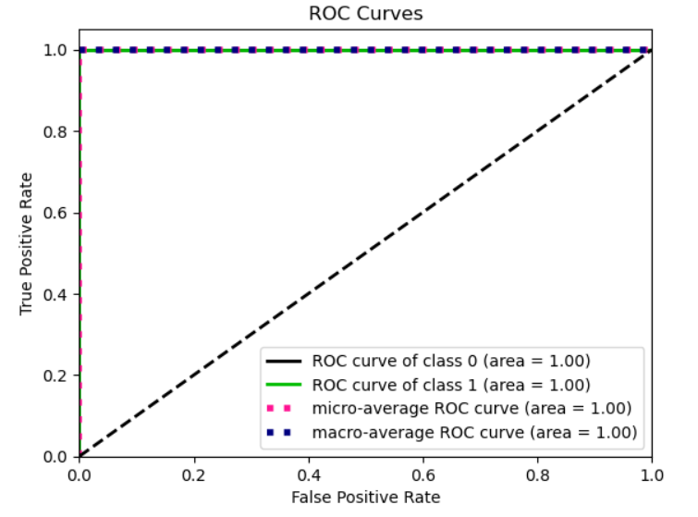
Modeling
I have used XGBoost Classifier for modeling.
In our analysis, the model achieved perfect precision and recall, as shown by both the Precision-Recall and ROC curves, each with an area of 1.0.
This indicates that the model has perfectly learned to distinguish between customers who will churn and those who will not, with no errors in prediction.
However, such results, while impressive, also warrant caution. In real-world applications, especially with large and complex datasets, a model that performs perfectly might be overfitting, meaning it has learned the training data too well, including noise and specific patterns that don't generalize to new, unseen data.
Therefore, while our current model performance is excellent, we should validate it further using entirely unseen data to ensure it generalizes well and truly offers value for predicting customer churn.

Slide 18
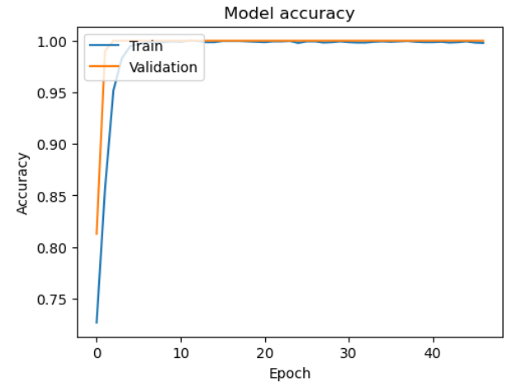
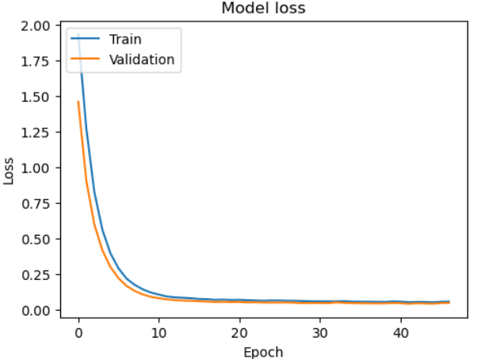
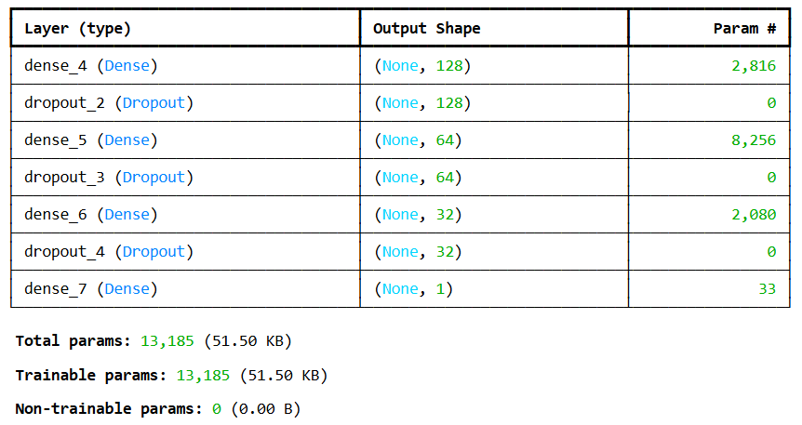
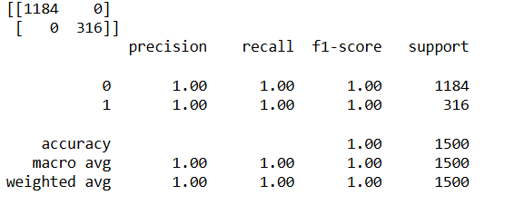
Modeling
I have also tried implementing Neural Network.
The model is performing exceptionally well, as indicated by the accuracy graph where both training and validation accuracy reach to close 100%. This indicates that the model is highly effective at distinguishing between the classes.
The fact that both training and validation accuracy and loss are nearly identical suggests that the model is not over fitting. Over fitting would typically show a large gap between training and validation metrics, where training accuracy is high and validation accuracy is low.
Causes for high accuracy: The model might be working with a dataset where the classes are easily separable, possibly due to very strong or clear patterns in the data. While there's no immediate sign of over fitting, such high accuracy might still warrant checking for data leakage, where information from the validation set could be inadvertently included in the training set.

Slide 19
Conclusion
Key Insights for Customer Churn:
Early tenure Vulnerability – Analysis shows a critical window in the first 20 months of customer engagement where churn risk is heightened.
Seasonal Fluctuations – Peaking in months 5 and 6, followed by a decline due to effective retention initiatives, suggesting that our actions are well aligned with customer expectations.
Segment specific Trends – Newer customers, both domestic and SME are at higher risk of churning.
Payment Methods Impact – The choice of payment method significantly affects customer retention. Direct Debits exhibit lower churn, indicating the stability and convenience in payment methods.
Financial Engagement Needs – Customers facing financial pressures, especially on payment plans, exhibit higher initial churn rate.
Strategic Recommendations for Enhanced Retention:
Strengthen onboarding and Early engagement – Implement robust onboarding processes including personalised communications and targeted offers to address unique needs within the first 20 months. Enhance customer experience during this vulnerable phase to build strong foundation for long term loyalty.
Seasonal Engagement Initiatives – Develop targeted marketing campaigns and special offers tailored to the months where churn peaks are observed.
Optimise Payment Frequency and Methods – Encourage the adoption of direct debit by offering incentives, as it aligns with lower churn rate. Additionally provide support for customers on quarterly payment plans to reduce their higher churn rate.
Tailored Communication for different segments – Refine communication strategies based on customer preferences and behaviours across different segments.
Proactive Financial Support – Offer flexible payment restructuring and early financial advice, particularly to new customers on payment plans. This can help alleviate financial pressures and improve satisfaction, thereby reducing churn.

Slide 20
Thank You

Slide 21


