Slide 1


Team Name : Unique_coders
Team Leader Name : Sriram Lohith
Problem Statement : Development of Unified Platform for Consumers - A single integrated platform that combines smart metering data with connected appliance management, enabling consumers to:
Monitor real-time energy usage.
Control appliances (turn ON/OFF, schedule operations).
Optimize consumption using time-of-day tariffs and smart recommendations.
Gain visibility on energy savings and carbon footprint.

Slide 2

EnergiSync: The Unified, Intelligent Super App
Core Vision: A single, Super App that unifies smart meter data, connected appliance insights, and home automation controls.
Proactive Orchestration: Moves beyond simple monitoring to actively optimize energy consumption in real time using AI.
Consumer Empowerment: Provides real-time control, visibility on energy costs, and tracking of sustainability impact (carbon footprint).
PoC Structure: Built using React Native (Frontend), Python FastAPI (Backend), and AWS IoT Core (for device simulation).
Scalability: Designed with a serverless architecture ready for integration with DISCOMs and scaling to millions of users.

Slide 3
How different is it from any of the other existing ideas?
Existing apps are passive aggregators; EnergiSync is a proactive, AI-Orchestrated Super App.
We shift focus from reporting past usage to predicting and optimizing future consumption in real-time.
Integration of financial features (P2P sharing, OCR Bill Audit) moves beyond simple utility management.
How will it be able to solve the problem?
Unification: Eliminates app-fragmentation by consolidating all data and control into one UI.
Guaranteed Savings: Dynamic Tariff Optimization Engine uses AI to automatically shift appliance use to lowest-cost hours.
Trust & Transparency: The Photo Bill Buster feature addresses the fundamental consumer pain point of bill errors and hidden charges.
USP (Unique Selling Proposition) of the proposed solution
AI-Orchestrated Optimization: Delivers a demonstrated 10-15% cost savings via intelligent scheduling.
Electricity Sharing with Neighbors: The first platform enabling P2P micro-grid energy transactions.
Instant Bill Audit: OCR-based auditing and one-tap complaint filing for bill accuracy

Slide 4
List of features offered by the solution
I. Core Energy Management
Unified Real-Time Monitoring Dashboard
Appliance Control and Automation (ON/OFF, Scheduling)
Dynamic Tariff Optimization Engine (AI-Powered)
Billing Simulation and Savings Tracker
Personalized Insights and Anomaly Detection
Seamless Onboarding and Integration
II. Unique & Disruptive Features
Photo Bill Buster (OCR Audit & Complaint Filing)
Electricity Sharing with Neighbors (P2P Trading)
Predictive Load Management (Weather/Price Anticipation)

Slide 5
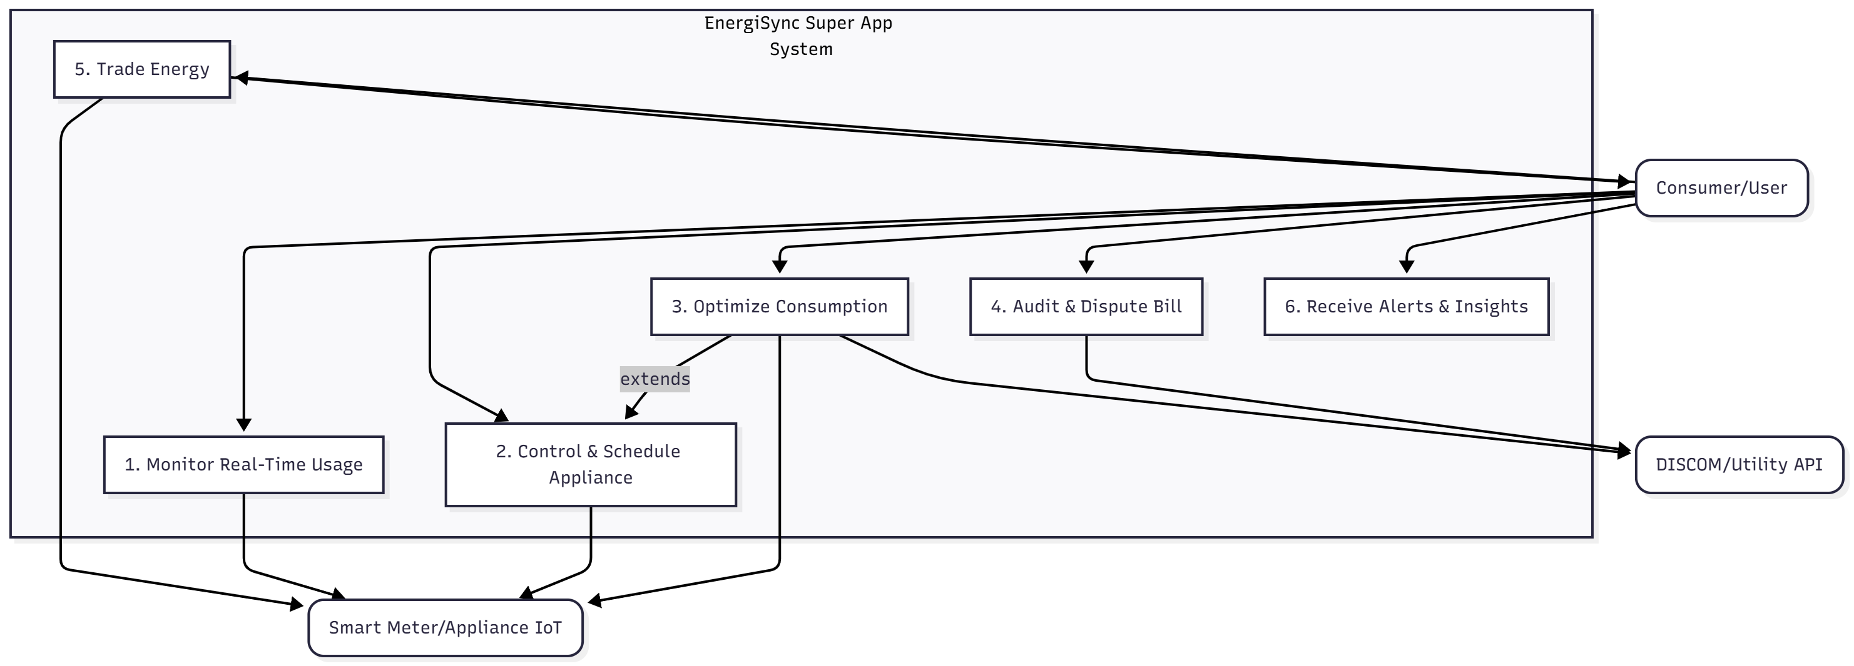
Process flow diagram or Use-case diagram

Slide 6
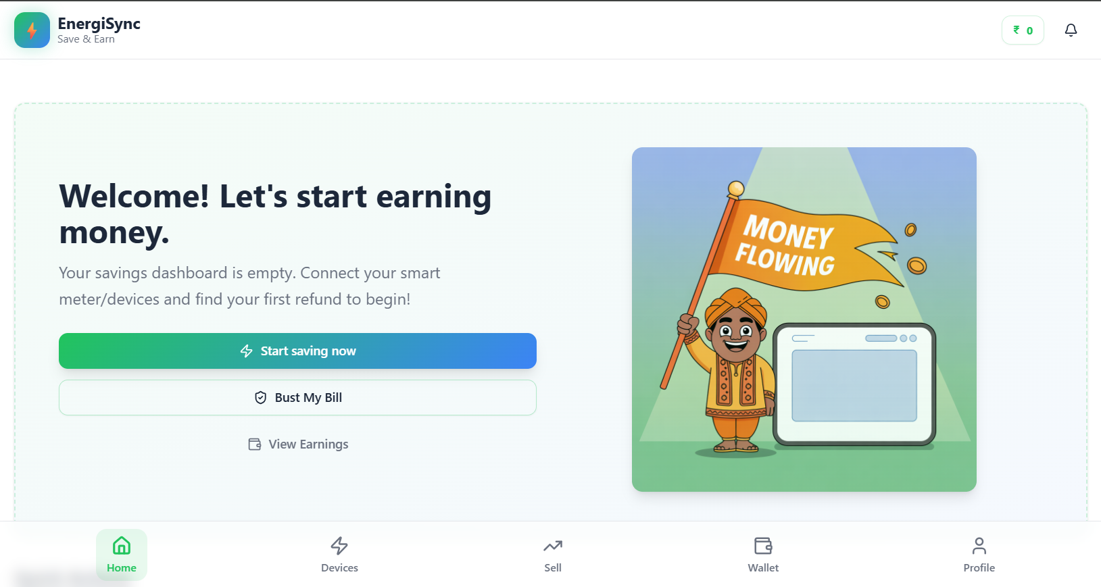
Wireframe of the proposed solution

Slide 7
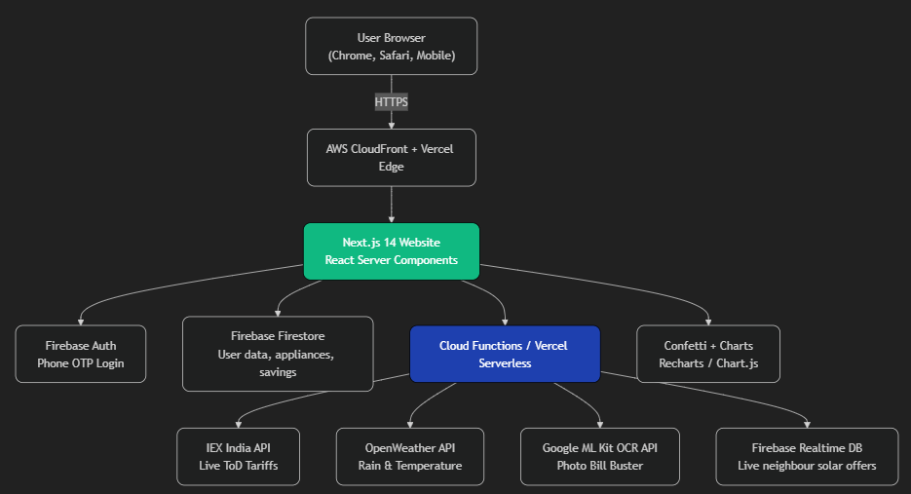
Architecture diagram of the proposed solution

Slide 8
Technologies to be used in the solution:
I. Frontend (Mobile App & Web Portal)
React Native / React: Used for a single codebase approach.
D3.js / Recharts: Used for high-performance data visualization, rendering the real-time usage graphs.
II. Backend & Core Logic
Python (FastAPI): Selected for building the high-speed, asynchronous API layer..
TensorFlow Lite: For deploying the core Optimization Engine (AI) model, allowing for lightweight and fast energy consumption predictions.
PostgreSQL: Chosen as the robust database for storing smart meter data and P2P transaction records.
OCR Libraries (e.g., Tesseract/Google Vision API): Integrated specifically for the Photo Bill Buster feature to accurately read and parse data from paper bills.
III. IoT & Cloud Infrastructure
AWS IoT Core: The managed service used as the secure gateway to ingest real-time data from all Smart Meters and connected appliances via MQTT.
MQTT Protocol: The lightweight messaging protocol used for reliable, two-way communication between the devices and the cloud.

Slide 9
Impact of EnegiSync:
Average Indian family today: ₹48,000 electricity bill per year
With EnegiSync (just open in browser):
Saves ₹36,000 – ₹72,000 every year (ToD shifting + Solar energy selling)
Final result: Bill becomes lower that the past expenses.
Family puts ₹48,000 – ₹108,000 extra in their pocket every single year.

Slide 10
