Slide 1

Gokaraju Rangaraju Institute of Engineering and Technology
(Autonomous) Department of Information Technology
A Project on
Efficient Image Captioning with Attention Mechanisms: Leveraging CNN’s And Simplified GRU’s
Guide
Dr. R. V. S. S. S. NAGINI
Associate Professor
Team Members
(21241A1256) Sriram Chiliveri
(21241A1246) P. Mahesh Babu
(21241A1265) Yenamala Varshit

Slide 2
Contents
Abstract
Literature Survey
Proposed System
UML Diagrams
Source Code
Input
Output

Slide 3
Abstract
This project aims to address the need for automatic image captioning to assist visually impaired individuals, enhance social networks, and improve image search results. By generating semantically accurate captions, it bridges the gap between visual data and textual understanding, offering practical applications in accessibility and content-driven technologies.

Slide 4
Literature Survey

Slide 5
Long-term Recurrent Convolutional Networks for Visual Recognition and Description
Link: https://www.sciencedirect.com/science/article/pii/S131915782200413X
Year of Publication: 2015
Authors: Donahue et al GIST:
This model processes visual data from the Flickr30k dataset, where CNNs capture image features and LSTMs sequentially generate captions.
However, the sequential nature of LSTMs leads to slower training and inference times, limiting its use for real-time applications. The authors suggest that transformer-based models could improve the speed and efficiency of caption generation by enabling parallelization of processes.

Slide 6
Deep Visual-Semantic Alignments for Generating Image Descriptions
Link: https://essay.utwente.nl/81483/1/Reesink_MA_EEMCS.pdf
Year of Publication: 2015
Authors: Karpathy and Fei-Fei
GIST:
A model that aligns image regions with corresponding words or phrases in sentences using the Flickr30k dataset.
The approach leverages pre-trained CNNs for visual feature extraction but lacks sufficient fine-tuning of these CNNs, which leads to less precise alignments between image regions and textual descriptions.

Slide 7
Image Caption with Region-based Attention and Scene Factorization
Link: https://ieeexplore.ieee.org/abstract/document/8603840
Year of Publication: 2016
Authors: Jin et al.
GIST:
This approach, applied to the Flickr30k dataset, improves caption accuracy by incorporating both local and global information.
However, the region-based attention mechanism struggles to effectively capture the global context, limiting the model's ability to generate coherent captions for complex scenes.
The authors suggest that transformer models, with their ability to process both local and global contexts simultaneously, could address this limitation.

Slide 8
Video Captioning with Attention-Based LSTM and Semantic Consistency
Link: https://www.sciencedirect.com/science/article/pii/S2667096820300045
Year of Publication:2017
Authors: Gao et al.
GIST:
This model proposed an attention-based LSTM model to generate video captions, with a focus on maintaining semantic consistency.
While this model is effective for videos, its complexity is an obstacle for single-image captioning tasks
The authors argue that simpler, more optimized models should be developed for image captioning, avoiding the computational overhead associated with video captioning models.

Slide 9
Predicting Visual Features from Text for Image and Video Caption Retrieval
Link:https://www.researchgate.net/publication/224357046_Quantitative_Assessment_of_the_Accuracy_of_3D_Face_Shape_Reconstruction
Year of Publication: 2018
Authors: Dong et al.
GIST:
This model introduced a framework for image caption retrieval by aligning visual and textual features.
Their approach, based on the Flickr8k dataset, focuses on caption retrieval rather than generation.
While effective for retrieval tasks, this model is less suited for generating unique and coherent captions, a limitation that the authors highlight.

Slide 10
Image Captioning: From Structural Tetrad to Translated Sentences
Link:https://www.researchgate.net/publication/334488787_On_Learning_3D_Face_Morphable_Model_from_In-the-Wild_Images
Year of Publication: 2019
Authors: Guo et al.
GIST:
This paper proposes a simplified approach to image captioning by using deep learning techniques on the Flickr8k dataset.
Their method utilizes a structural tetrad approach but struggles with more complex or abstract visual information

Slide 11
VD-SAN: Visual-Densely Semantic Attention Network for Image Caption Generation
Link: https://openaccess.thecvf.com/content_cvpr_2019/html/Dou_End-To-End_3D_Face_CVPR_2019_paper.html
Year of Publication: 2019
Authors: He et al.
GIST:
The VD-SAN model, which utilizes densely connected semantic attention networks to improve image captioning accuracy on the Flickr30k dataset.
While the model achieves high performance in attention to significant image areas, its computational complexity and resource demands make it less suitable for deployment on resource-constrained devices.

Slide 12
Proposed System
The proposed system aims to automatically generate meaningful captions for images by integrating advanced deep learning techniques.
It utilizes a pretrained Convolutional Neural Network (CNN), such as Inception v3, for efficient feature extraction. A Recurrent Neural Network (RNN) with Gated Recurrent Units (GRU) is employed for translating these features into accurate text descriptions.
Additionally, an attention mechanism is incorporated to focus on specific regions of the image, enhancing the relevance and quality of the generated captions.
This system is designed to bridge the gap between visual data and textual understanding effectively.

Slide 13
UML Diagrams

Slide 14
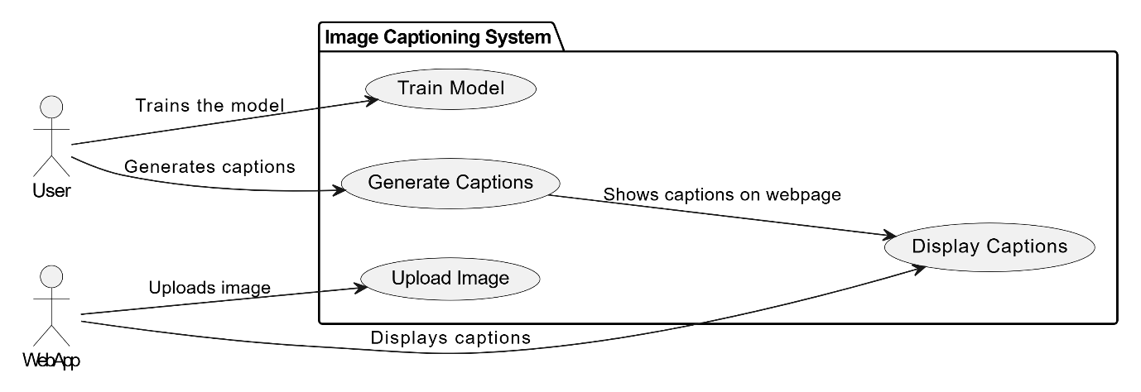
Use Case Diagram

Slide 15
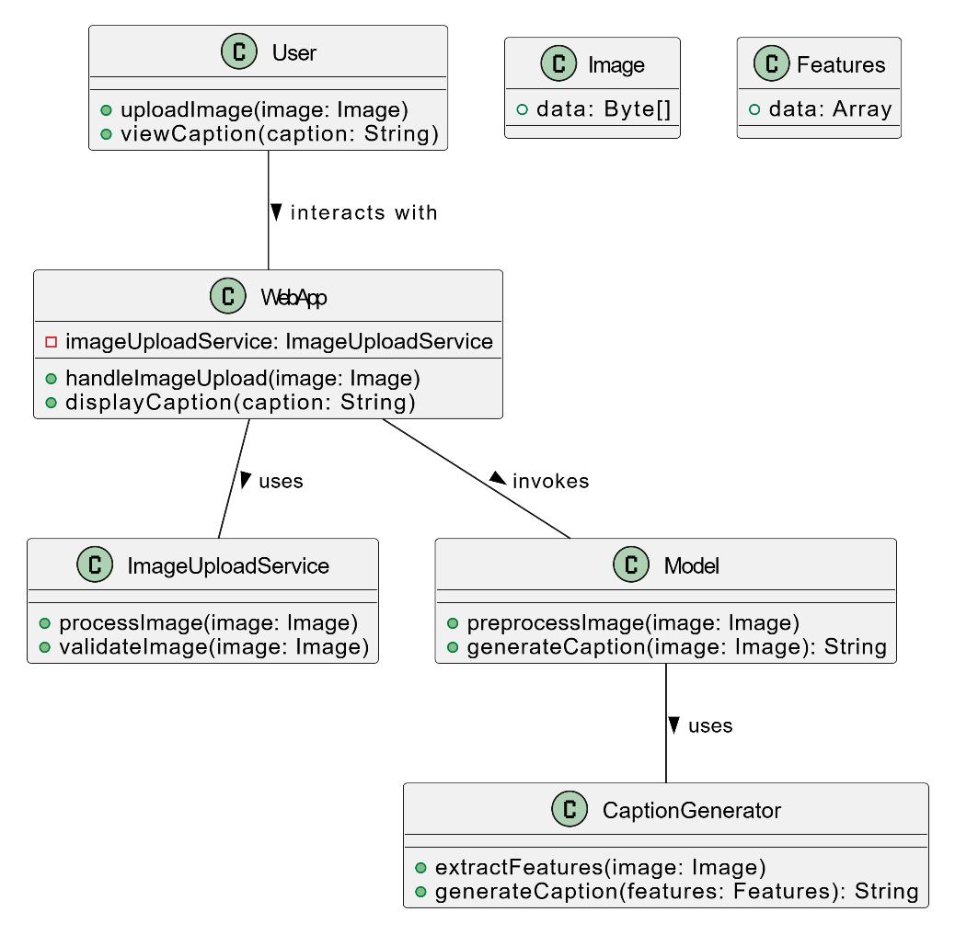
Class Diagram

Slide 16
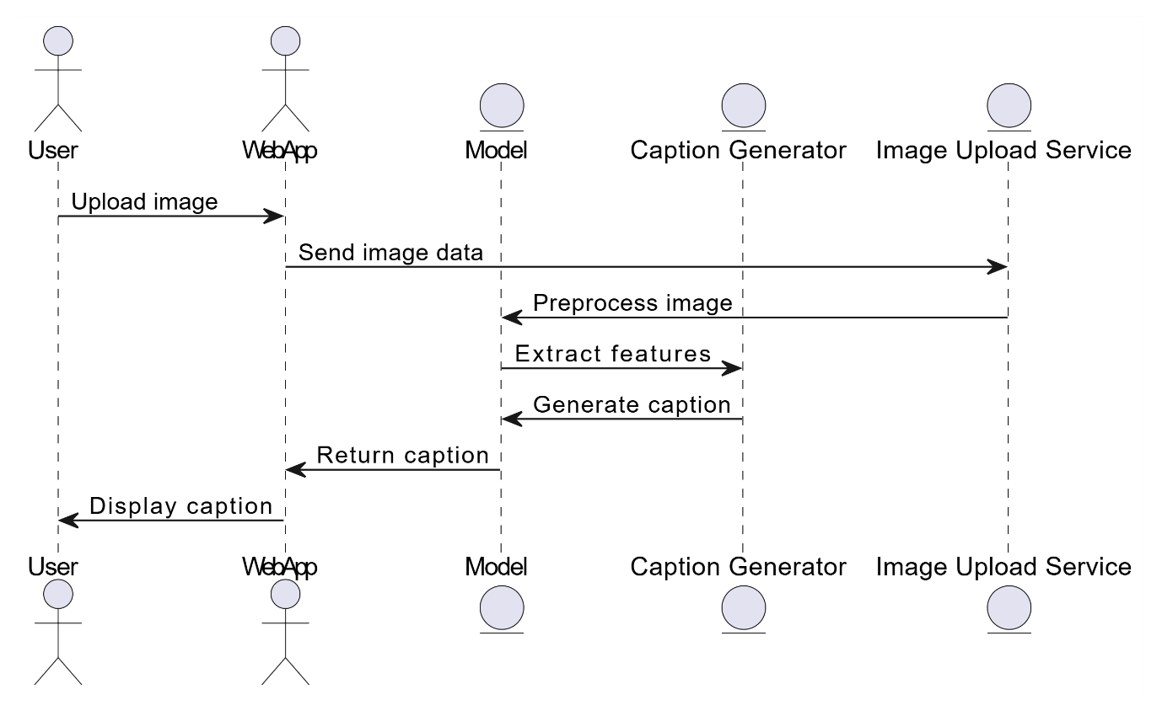
Sequence Diagram

Slide 17
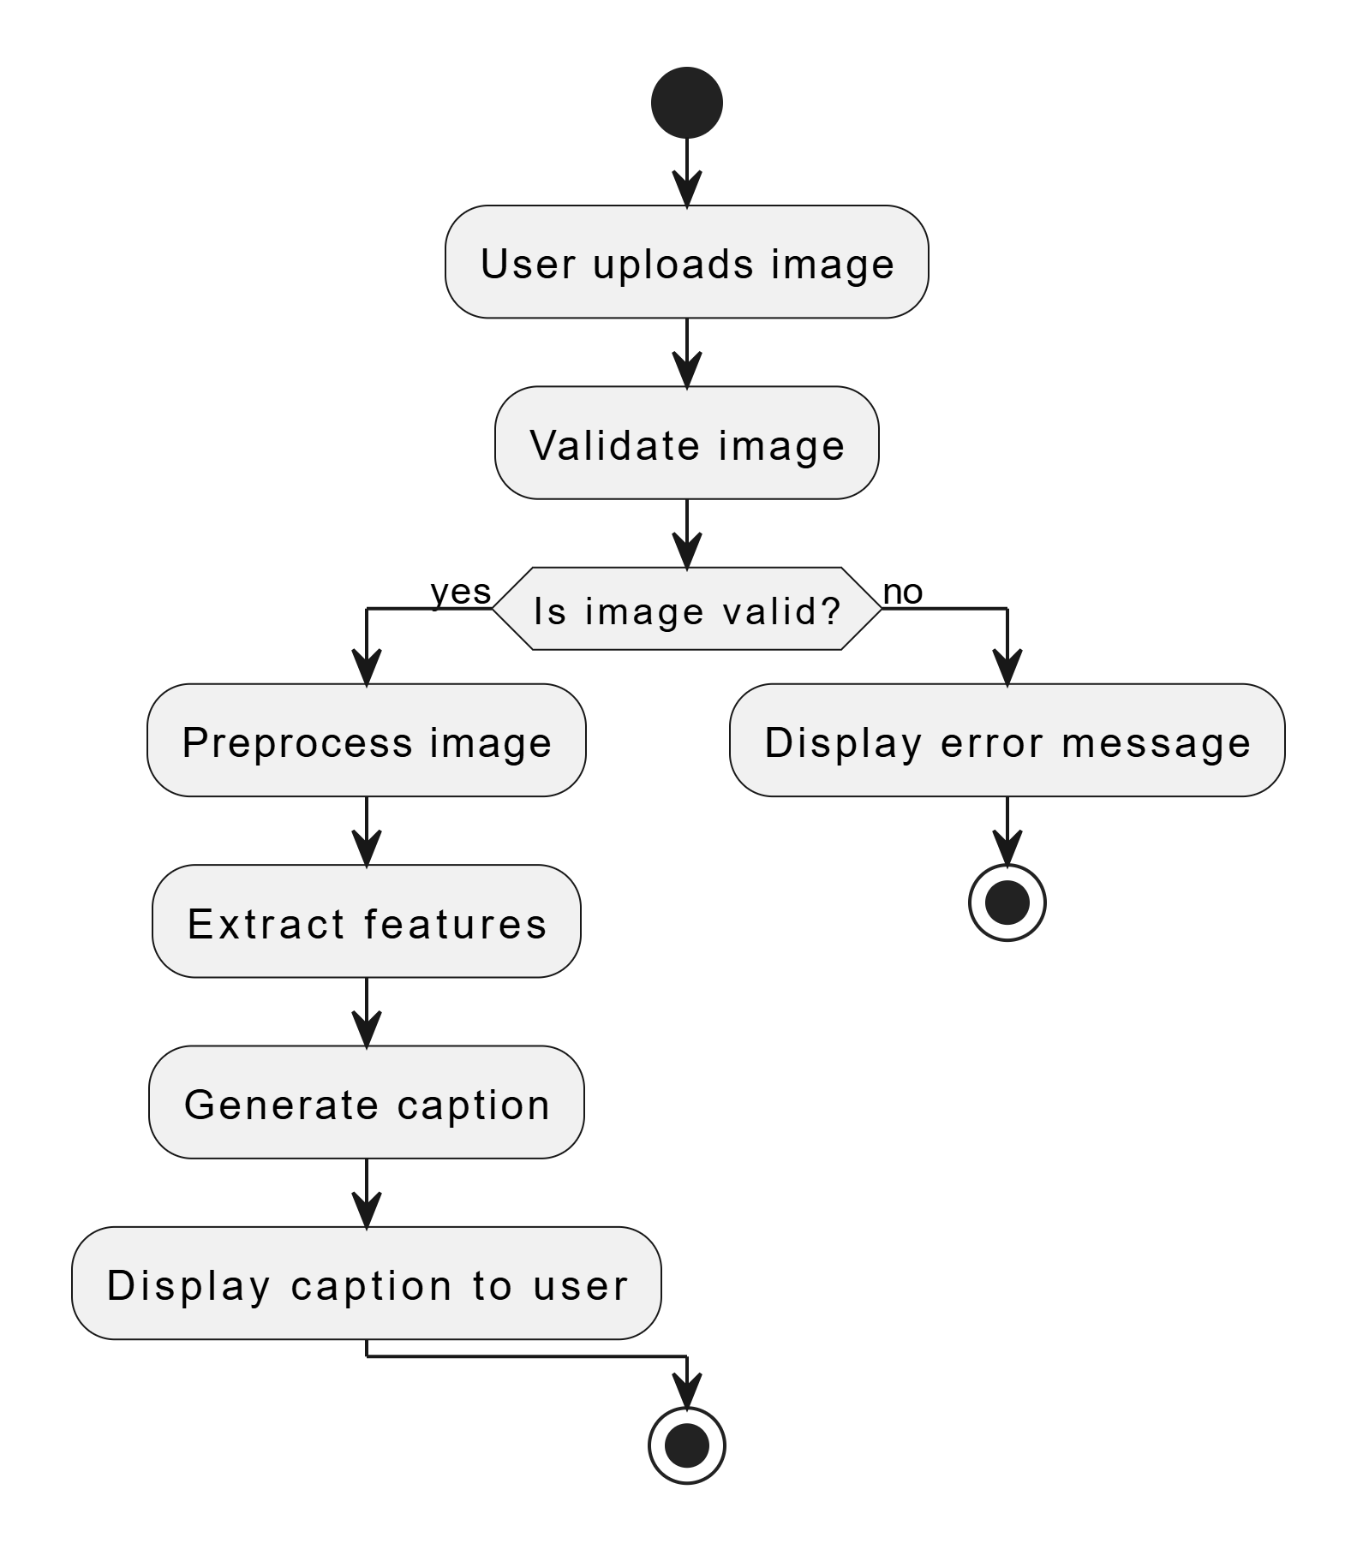
Activity Diagram

Slide 18
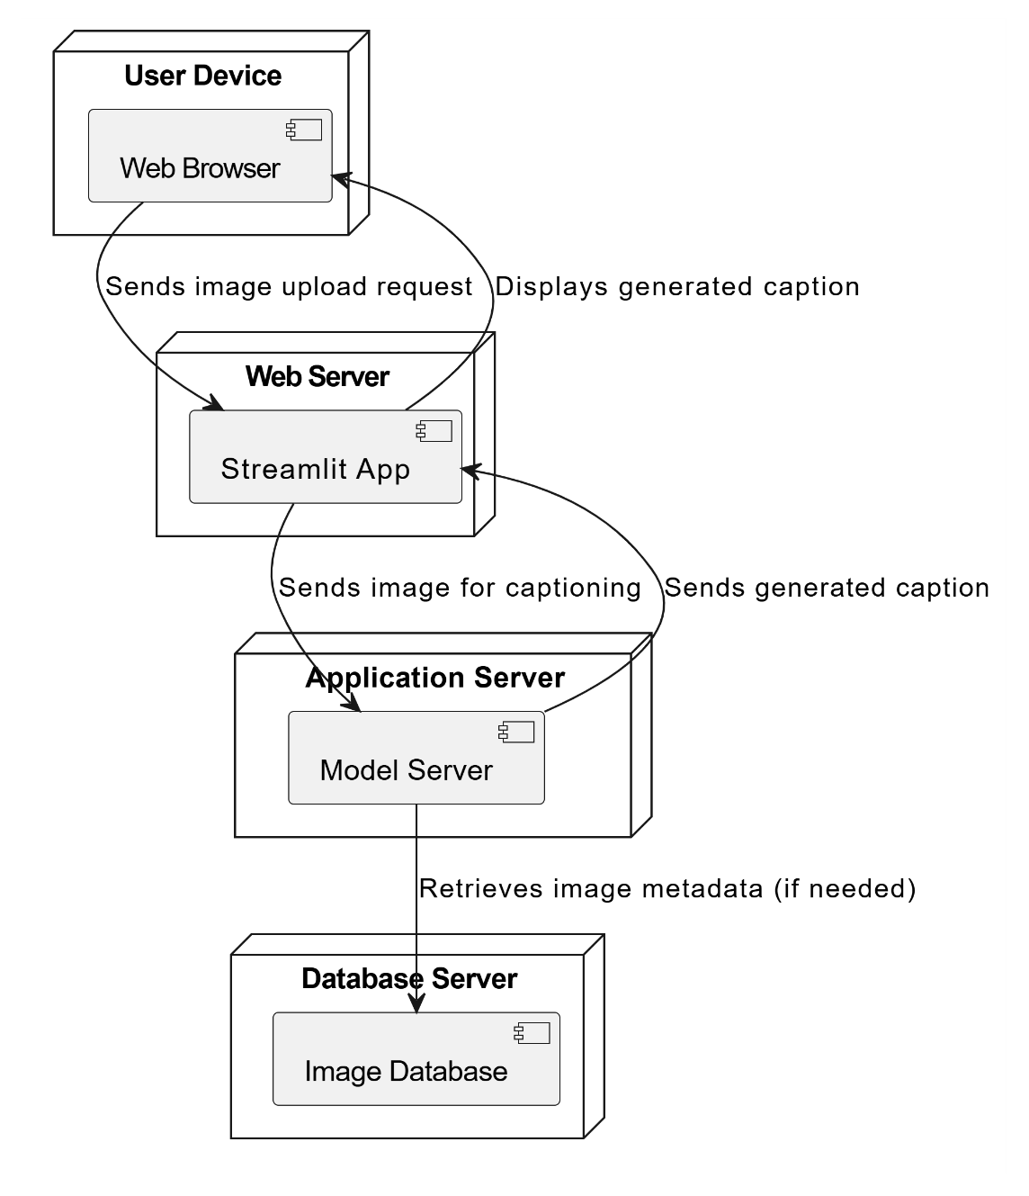
Deployment Diagram

Slide 19
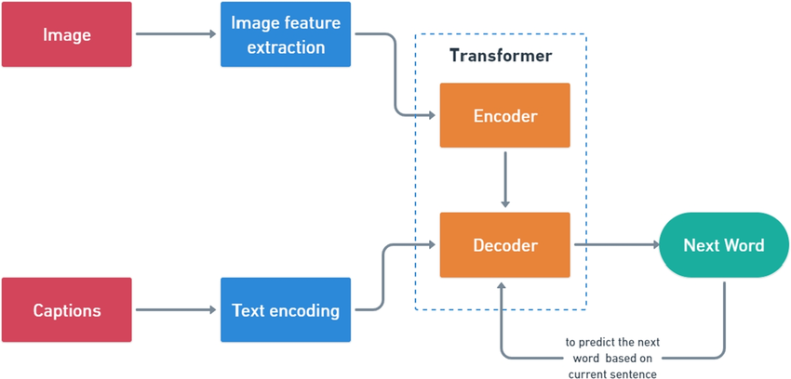
Architecture Diagram

Slide 20
Source Code

Slide 21
System Specifications
Software:
Using Python 3 in Google Colab, Jupyter Notebook IDE using Libraries of PyTorch, TensorFlow, numpy.
Hardware:
A system with a minimum of 8GB RAM, and a good GPU to train the model faster.

Slide 22
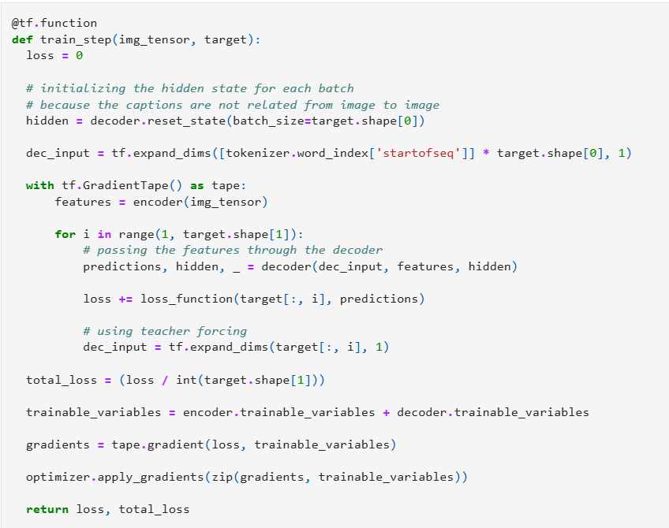
Training the model

Slide 23
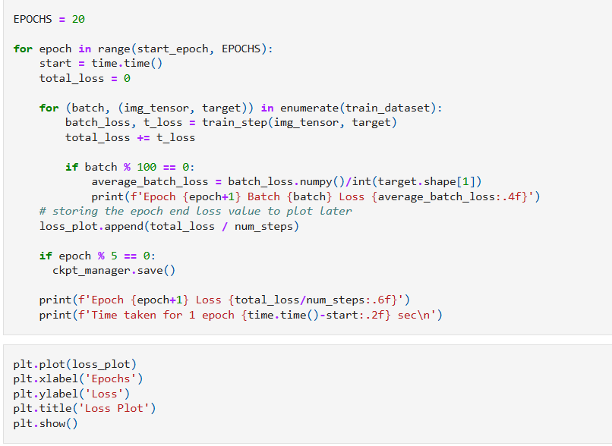
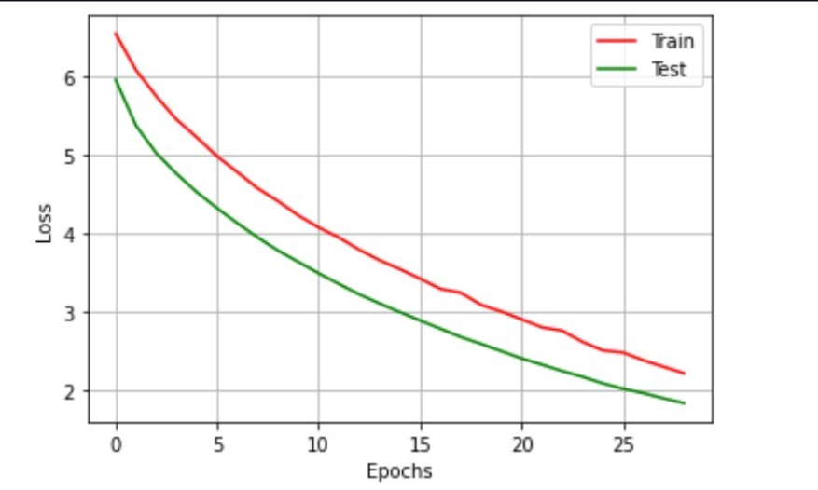
Implementation

Slide 24
INPUT

Slide 25
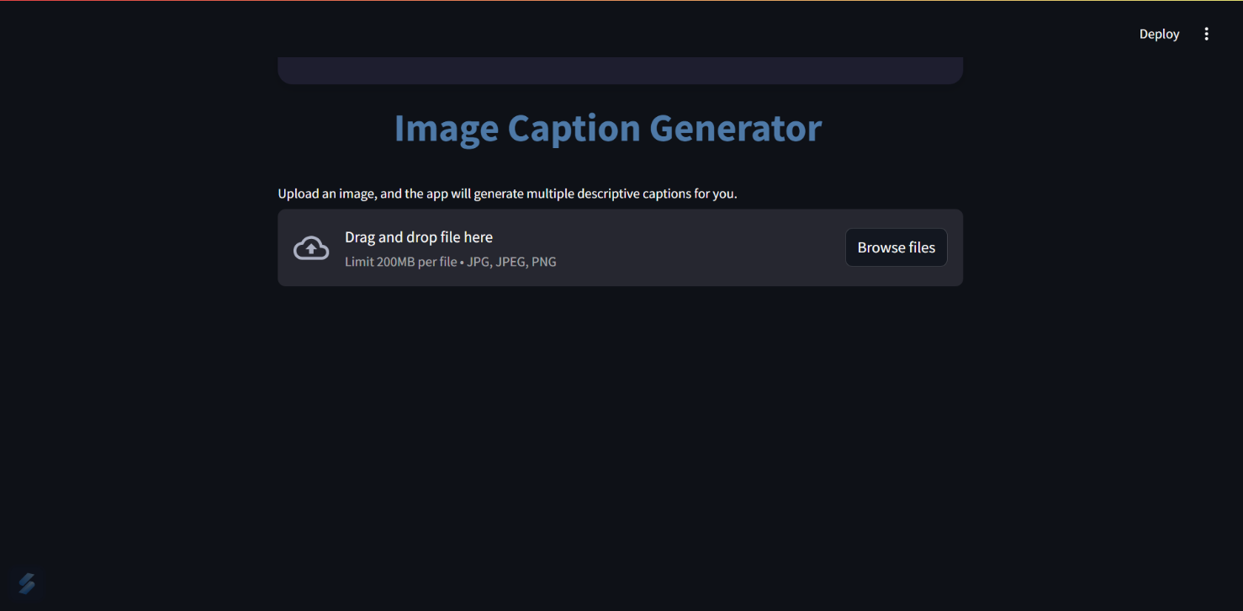
Home Page

Slide 26
OUTPUT

Slide 27
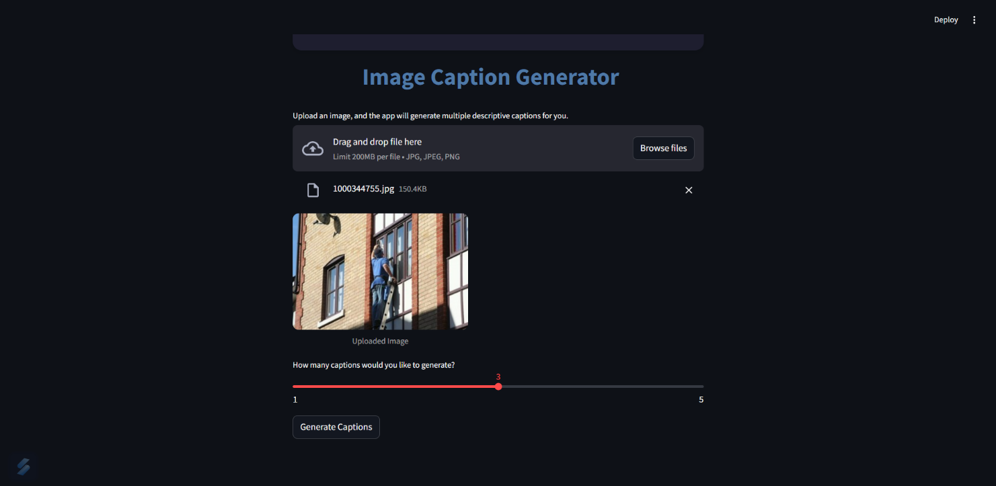
Initial output

Slide 28
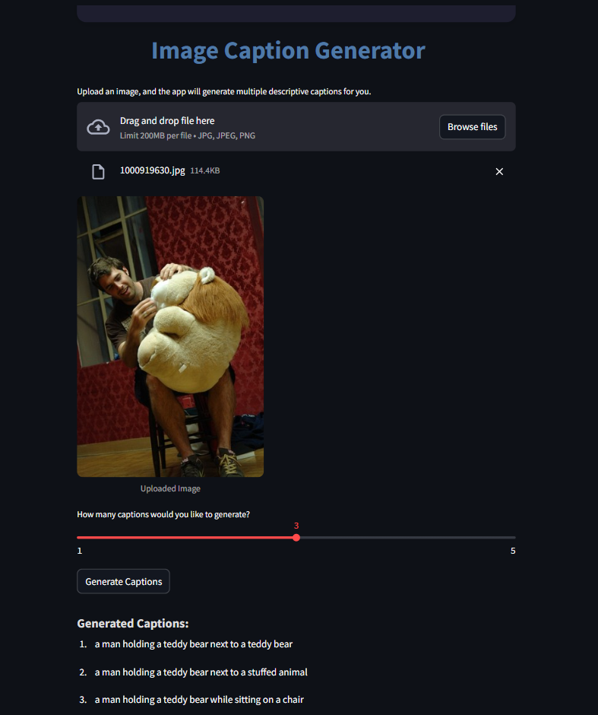
Final output

Slide 29
Thank You!

