Slide 1
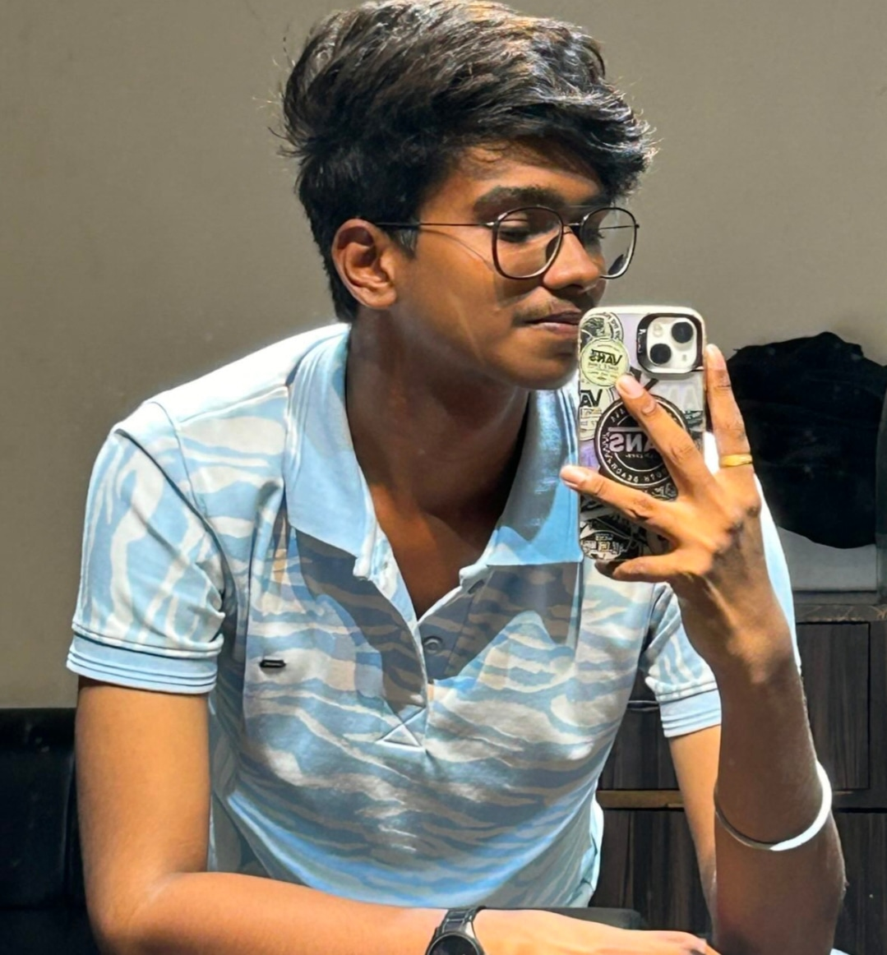
Who am I
Subtitle:S.Sri Ram Prakash

Slide 2
Introduction
Greeting:
It is my great pleasure to welcome you all to our event.I would like to take a moment with you thank you for coming.
Hook:
“Don’t wait for the opportunity”

Slide 3
Personal Background
Origin: I was born and raised in Virudhunagar.
Family: I have a small family with four members.

Slide 4
Education
School attended: K.Kamarajar.mat.hr.sec.school Sivakasi Virudhunagar District.
Degrees and certificate: I completed c,c++ program and I have tha certificate.

Slide 5
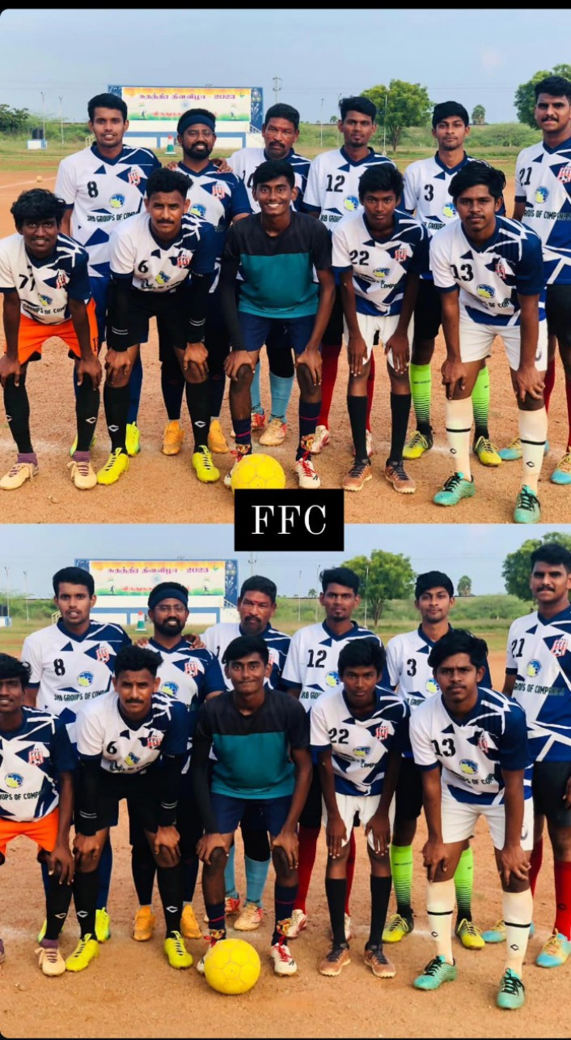
Accomplishments
Accomplishments: I am a state level selection football player

Slide 6
Skills and Expertise
Hard skills: I can communicate with others languages like tamil and english.

Slide 7
Intrest and hobbies
Personal Intrest: Hangout with friends.
Hobbies: watching Anime.

Slide 8
Values and beliefs
Core values: Born to travel the world.

Slide 9
Goals and aspirations
Short term goal : I want to select in state team.
Long term goal : I want to join in IT company with highest package.
Dreams : Travel the world with partner.

Slide 10
Gratitude
Gratitude : Parents

Slide 11
Conclusion

