Slide 1

VERITAS AI
Agentic Fake News Detection
with Real-Time Web Verification
Combining LLM reasoning with live search to verify claims as they break — not months after training data was collected.
Sriram S • AI & Data Science Engineer • Panimalar Engineering College
github.com/sriram263

Slide 2



The Challenge of Modern Fact-Checking
Why static AI models fall short against fast-moving misinformation
Knowledge Cutoff
Standard LLMs cannot verify breaking news — their training data is frozen at a fixed point in time.
Hallucinations
AI models often invent plausible-sounding facts when asked about events outside their training data.
Velocity of Fake News
Misinformation spreads across social platforms far faster than any human fact-checking team can respond.
Veritas AI | Agentic Fact-Checking
2

Slide 3



Introducing Veritas AI
An autonomous agent that searches, reasons, and verifies — in one pass
Agentic Retrieval
Cognitive Judge
Color-Coded Verdicts
Autonomously queries live news sources via Tavily RAG to gather the last 365 days of evidence.
Claude-3-Haiku parses the retrieved evidence and reasons about consistency with the claim.
Instant readability through REAL / FAKE / UNCERTAIN cards with a confidence score.
Veritas AI | Agentic Fact-Checking
3

Slide 4

Under the Hood: System Architecture
Four stages, end to end, from a headline to a verdict
→
→
→
Input
Search (Runner)
Reasoning (Judge)
Display
User submits a
headline or claim
Tavily fetches top 5
live articles
Claude-3-Haiku weighs
evidence vs. claim
Streamlit renders a
verdict card or chat
Casual Chat Mode: greetings and general questions are answered naturally, ignoring search results. News Verification Mode: factual claims are parsed into a structured JSON response inside <VERDICT_JSON> tags.
Veritas AI | Agentic Fact-Checking
4

Slide 5

Tech Stack & Core Integrations
Frontend
Reasoning API
Streamlit
OpenRouter → Claude-3-Haiku
Wide-layout responsive UI with a custom CSS injector for verdict cards and animations.
Chat completion endpoint used as the cognitive judge over retrieved evidence.
RAG Engine
Data & Logic
tavily-python
Python 3.10+, BeautifulSoup, dotenv
News-optimized search client returning clean titles, URLs, and snippets for grounding.
Parses session logs, strips HTML for exports, and manages configuration/secrets.
Veritas AI | Agentic Fact-Checking
5

Slide 6
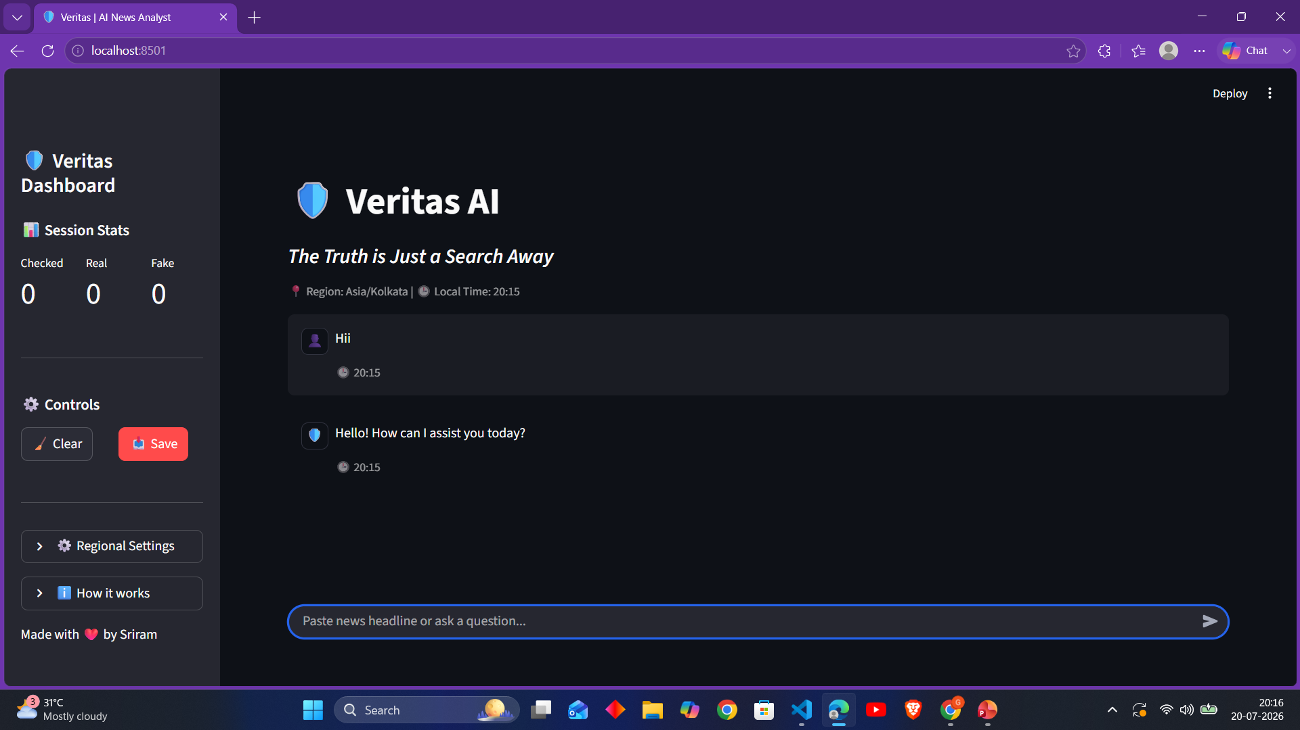
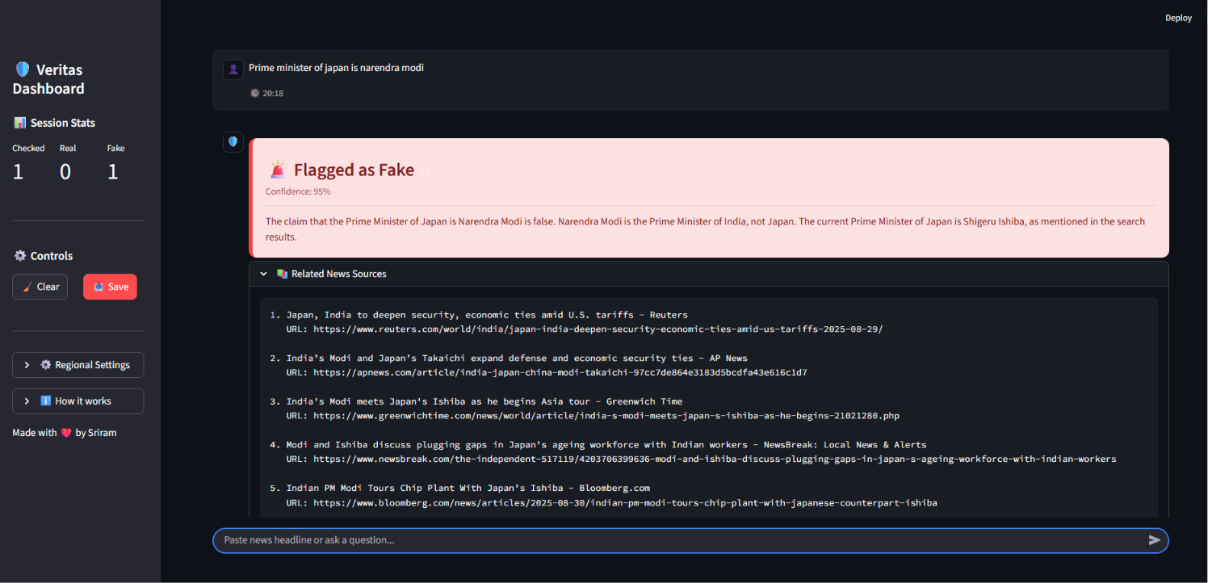
Intelligent Intent Classification
One model, two response formats — no separate classifier needed
Casual Chat Mode
News Verification Mode
Greetings or general questions (“Hi”, “Who are you?”) get a natural, friendly plain-text reply — search results are ignored entirely.
Factual claims trigger a structured response wrapped in <VERDICT_JSON> tags — verdict, confidence score, and cited sources.
🖼 Screenshot: chat bubble response to a casual greeting like “Hi, who are you?”
🖼 Screenshot: color-coded verdict card generated for a factual news claim
Veritas AI | Agentic Fact-Checking
6

Slide 7
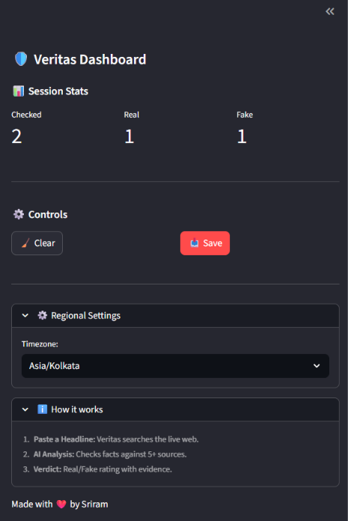

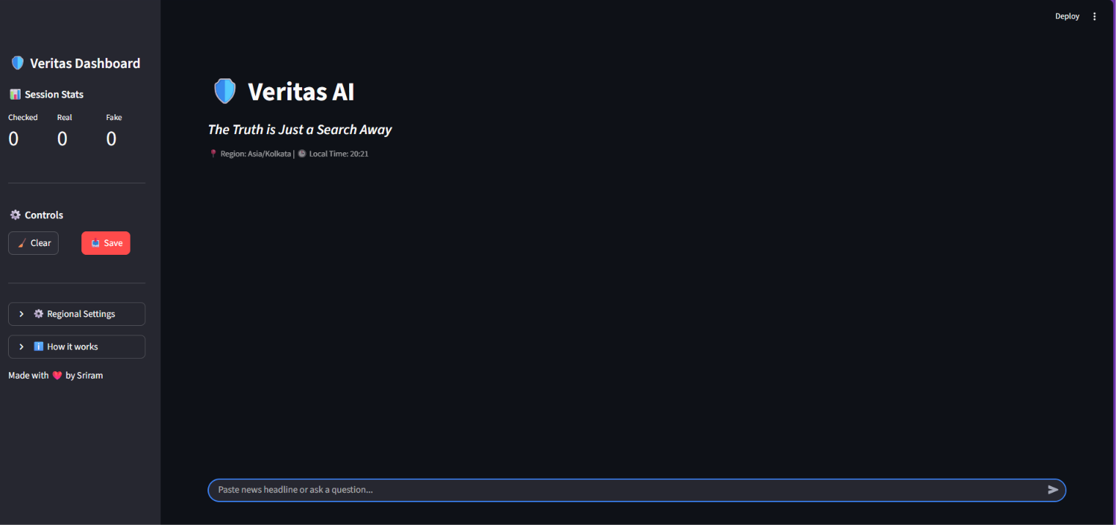
Interactive Control Dashboard
Live Counters — Real-time metrics for claims checked, verified real, and flagged fake.
Clear / Save — Reset the session instantly, or export a full plaintext transcript.
Localization — Selectable timezones (e.g. India/Kolkata, US/Pacific) with a live clock.
🖼 Screenshot: full dashboard view with timezone selector and verdict history
🖼 Screenshot: left sidebar showing live session counters and controls
Veritas AI | Agentic Fact-Checking
7

Slide 8

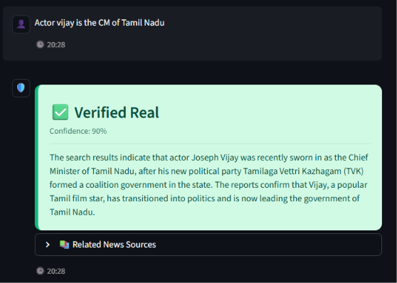
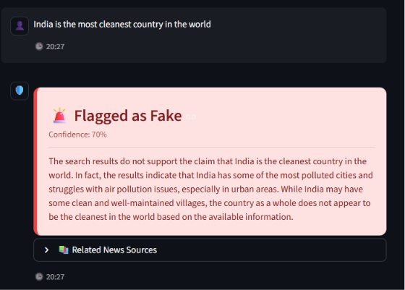
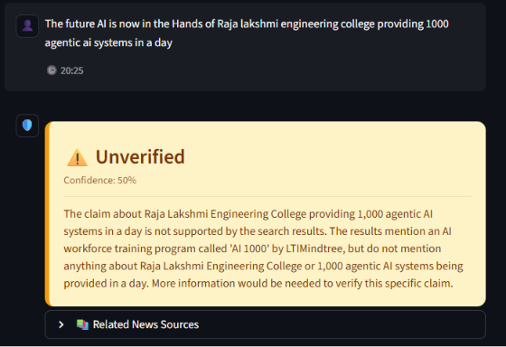
How Claims Are Classified
Three verdict categories, each with a distinct visual signal
REAL
FAKE
UNCERTAIN
Facts supported by search sources, shown with a higher confidence rating.
Content contradicted by search results, with a detailed explanation of inconsistencies.
Insufficient corroborating evidence found in recent news sources.
🖼 Screenshot: real verdict card as rendered in the app
🖼 Screenshot: fake verdict card as rendered in the app
🖼 Screenshot: uncertain verdict card as rendered in the app
Veritas AI | Agentic Fact-Checking
8

Slide 9


Roadmap for Veritas AI
Where the project goes from here
Multi-Agent Consensus
Image / Video Verification
Social Media Listeners
Advanced Analytics
Consult Claude, Llama-3, and GPT-4, then vote on the final verdict.
Multimodal checks to catch deepfakes and altered graphics.
Auto-ingest trending headlines from platform APIs like X or Reddit.
Charts plotting verdict distribution and accuracy trends over time.
Veritas AI | Agentic Fact-Checking
9

Slide 10
Empowering Information Integrity
Real-time agentic fact-checking, bridging the gap between static LLM reasoning and the live web.
Questions?
Live Link:
https://fakenewsdetector-mquvolhshspvhjm6efthjm.streamlit.app/
Sriram S • github.com/sriram263 • anusriram2706@gmail.com

