Slide 1

CMR COLLEGE OF ENGINEERING & TECHNOLOGY
Kandlakoya, Medchal, Hyderabad - 501401
Department of Cyber Security
VISUAL VAULT
Name of the student Roll No
E. Sriram 21H51A6208
B. Charan Teja Goud 21H51A6260
M. Varun 22H55A6214
Batch - 01
Under esteemed guidance of
DR. R. Venkateswara Reddy
(Associate Professor and HOD, CSC (Cyber Security)

Slide 2
OUTLINE
Abstract
Introduction
Literature Review
Problem Statement
Existing Solutions
Research Objective
System Requirements
Hashing Techniques
Methodology
Project Scope and Limitations
References
1
Notes:
2

Slide 3
ABSTRACT
Traditional password systems are vulnerable to shoulder surfing, where attackers observe the password entry process. This project enhances security by integrating image-based authentication with hashed password segments. Users choose a password, which is hashed and divided into segments embedded within up to twelve selected images. During authentication, users select the images in the correct sequence to reconstruct the hashed password. This method obscures password entry from onlookers and leverages the ease of image recognition over memorizing complex passwords. By allowing flexible image selection, this approach offers personalized security and reduces cognitive load, providing a robust solution against shoulder surfing.
2
Notes:
3

Slide 4
INTRODUCTION
Traditional text-based passwords are vulnerable to various attacks such as brute force, dictionary attacks, and phishing. Despite using strong cryptographic hashing and salting techniques, the reliance on memorizing complex passwords remains a significant usability issue.
Challenges:
Security Risks: Text-based passwords are prone to being guessed or stolen.
User Experience: Users struggle to create and remember complex passwords, leading to poor security practices like password reuse.
Phishing Attacks: Users can be tricked into revealing their passwords on fake websites.
3
Notes:
4

Slide 5
LITERATURE REVIEW
“Our (in)Secure Web: Ali Mohamed Eljetlawi; Norafida Ithnin - Graphical Password: Prototype Usability Survey - 2008 International Conference on Advanced Computer Theory and Engineering.
Moreover, the use of images as passwords enhances resistance to guessing attacks. Graphical passwords are more challenging for attackers to guess or crack using automated techniques due to the sheer number of possible combinations when using images. The visual nature of this authentication method introduces an added layer of complexity, making it more difficult for attackers to exploit common password vulnerabilities.
4
Notes:
5

Slide 6
PROBLEM STATEMENT
Create a secure authentication system with image-based password entry and hashed segments to prevent shoulder surfing.
5
Notes:
6

Slide 7
EXISTING SOLUTIONS
Two-Factor Authentication (2FA): This system adds an extra layer of security by requiring not only a password but also another verification method, like a code sent to a mobile device or biometric data.
Biometric Authentication: Utilizes unique physical characteristics like fingerprints, facial recognition, or iris scans for user identification.
Single Sign-On (SSO): Enables users to access multiple applications with a single set of login credentials, reducing the need for multiple passwords.
Password Managers: Tools that store and manage passwords, often generating and storing complex and unique passwords for various accounts.
Time-Based One-Time Passwords (TOTP): Generates temporary codes that expire after a short period, providing an additional layer of security.
6
Notes:
7

Slide 8
RESEARCH OBJECTIVE
Evaluation of Security: Assess the level of security offered by graphical passwords concerning common cyber threats, such as brute-force attacks, shoulder-surfing, and social engineering.
User Experience and Usability: Investigate user interactions, understanding how users perceive and interact with graphical password systems, and identify potential usability issues or user preferences.
Memorability and Recall: Analyze the memorability and recall of graphical passwords compared to traditional text-based passwords, understanding how easily users can remember and reproduce their chosen graphical passwords.
Authentication Effectiveness: Evaluate the overall effectiveness of graphical passwords in real-world scenarios, considering their application across different devices and usage environments.
7
Notes:
8

Slide 9
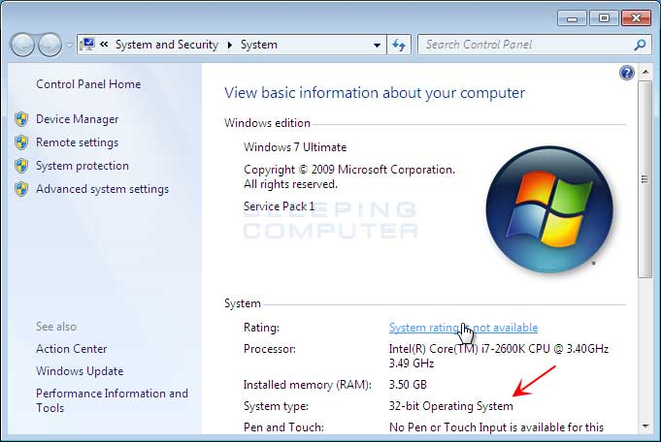

SYSTEM REQUIREMENTS
System 64 bit with 16 GB RAM
HTML, CSS, Java Script
A web browser
8
Notes:
9

Slide 10
HASHING TECHNIQUES
Hashing is a fundamental technique used in computer security to protect passwords. It involves converting a password into a fixed-size string of characters, which appears random, using a cryptographic hash function. This process is one-way, meaning the original password cannot be easily retrieved from the hashed value.
Key Aspects of Hashing:
Deterministic: For a given input, the hash function always produces the same output. This ensures that the same password will always result in the same hash, allowing the system to verify passwords by comparing their hashes.
Fixed Output Length: No matter the size of the input, the output of the hash function is always of a fixed length. For example, SHA-256 produces a 256-bit (32-byte) hash value.
9
Notes:
10

Slide 11
HASHING TECHNIQUE
3. Avalanche Effect: A good hash function ensures that even a tiny change in the input (like changing one character in a password) results in a drastically different hash output. This makes it difficult for attackers to find two different inputs that produce the same hash.
Common Hash Functions:
SHA-256 (Secure Hash Algorithm 256-bit): Produces a 256-bit hash value. It's widely used due to its balance of security and efficiency.
SHA-512: Produces a 512-bit hash value, providing higher security at the cost of more computational power.
MD5 (Message Digest Algorithm 5): Produces a 128-bit hash value. Although faster, it's now considered insecure for password hashing due to vulnerabilities to collision attacks.
10
Notes:
11

Slide 12
METHODOLOGY
Registration:
User sets a password.
Password is hashed using a secure hash function (e.g., SHA-256).
Hash is distributed across selected images.
Images and their hash segments are stored in the database.
Login:
User selects the same images.
System retrieves and combines hash segments from images.
Combined hash is compared with the stored hash.
If the hashes match, access is granted.
Key Benefits:
Enhances security by combining cryptographic hashing with image-based verification.
Prevents plaintext password storage.
Adds an engaging visual element to the authentication process.
11
Notes:
12

Slide 13
PROBLEM SCOPE & LIMITATIONS
Problem Scope:
Usability and Memorability: User Experience: Assessing how users interact with graphical passwords, considering factors such as ease of use, user satisfaction, and efficiency.
Memorability: Investigating the ability of users to remember graphical passwords over time compared to traditional text-based passwords.
Security: Strength of Authentication: Evaluating the effectiveness of graphical passwords in providing a secure authentication mechanism.
Vulnerabilities: Identifying potential vulnerabilities, such as shoulder surfing, smudge attacks, and other methods that could compromise the security of graphical passwords.
User Interface and Integration: The project should have a user-friendly interface where users can interact with the different functionalities.
12
Notes:
13

Slide 14
Problem Scope and Limitations
Limitations:
Difficulty in Password Recovery: Recovering a forgotten graphical password can be more challenging compared to traditional text-based passwords, especially if robust recovery mechanisms aren’t in place.
Shoulder Surfing: Users might be vulnerable to shoulder surfing, where someone can observe and replicate the drawn patterns or selected images.
13
Notes:
14

Slide 15
References
The Design and Analysis of Graphical Passwords
Authors: D. Davis, M. Monrose, A. Reiter
Published in: USENIX Security Symposium, 2004.
Authors: Sonia Chiasson, Elizabeth Stobert, Robert Biddle, P.C. van Oorschot
Published in: ACM Computing Surveys (CSUR), 2016
PassPoints: Design and longitudinal evaluation of a graphical password system
14
Notes:
15

