Slide 1
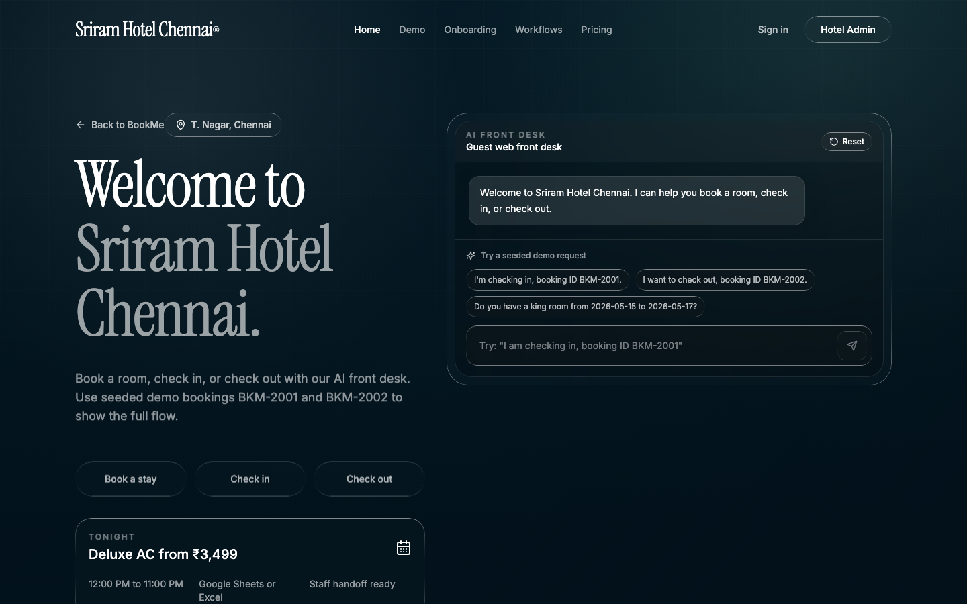
BU.330.760 GENAI FINAL PROJECT
BookMe turns a hotel website into an AI front desk.
A narrow, tool-grounded workflow for independent hotels: guests book, check in, and check out through natural language while staff keep control.
Guest web link
Reservation tools
Staff handoff
Live artifact: Sriram Hotel Chennai guest site
BookMe
01/05
Notes:
Hi everyone, my project is BookMe. It is an AI front desk for independent hotels.
The workflow is intentionally narrow: guests can book a room, check in, or check out from one web link.
The key point is that BookMe is not a general chatbot. It is connected to reservation tools, so it can verify bookings, room availability, prices, and status instead of making those up.

Slide 2
THE FRONT-DESK BOTTLENECK
Small hotels still run guest requests through manual lookup.
Guest asks
Staff searches
Staff updates
“I’m checking in”
Sheet / PMS / register
Status, room, payment
The expensive part is not conversation. It is translating messy guest messages into safe reservation actions during busy front-desk hours.
Baseline
Failure mode
Opportunity
Constraint
Manual
Slow + brittle
Focused
No guessing
Guest calls or messages; staff searches spreadsheets and updates status by hand.
Repetitive work is easy to delay, miss, or update incorrectly during rush hours.
Automate routine booking, check-in, and checkout while escalating risky cases.
The AI must use tools for prices, booking IDs, status, and availability.
BookMe
02/05
Notes:
The user is an independent hotel owner or front-desk team.
The problem is that many smaller hotels still handle routine guest requests manually. A guest calls, sends a message, or waits at the desk. Staff then search a spreadsheet, PMS, or register and update the status by hand.
For this assignment, I kept the scope narrow. BookMe focuses only on booking, check-in, and checkout because those are repetitive, high-volume workflows where tool-grounded GenAI can help.

Slide 3
SOLUTION DESIGN
Natural language on top. Deterministic hotel tools underneath.
Tool contract
lookup_guest(identifier)
check_availability(dates, room)
create_booking(after confirmation)
checkin_guest(booking_id)
The model routes intent, asks for missing details, and calls tools. Business state changes happen only through the reservation layer.
checkout_guest(booking_id)
Guest chat
→
LLM router
→
Hotel tools
→
Staff view
Free-form request: booking, check-in, checkout.
Classifies intent and asks follow-up questions.
Lookup, availability, create booking, check-in, checkout.
Admin dashboard and manual override when needed.
BookMe
03/05
Notes:
BookMe is built as a Next.js web app. The guest message goes to an API route, and the LLM decides whether to ask a follow-up question or call a tool.
The important design choice is that the AI cannot invent operational data. Room prices, booking IDs, availability, guest status, check-in, and checkout all come from tools.
So the AI handles the messy language, but the reservation layer handles the business action.

Slide 4
EVALUATION
BookMe wins on routine workflows and stops at human-risk boundaries.
Test case
Baseline
BookMe behavior
Result
What worked
Valid check-in
Manual sheet lookup
Reservation verified; status updated
Pass
Routine requests with clear reservation data.
Checkout
Staff closes stay
Receipt-style summary returned
Pass
Availability question
Form or phone call
Dates parsed; rate quoted
Pass
Bad booking ID
Staff searches manually
No match; asks for better identifier
Pass
Where humans stay in
Past-date booking
Staff judgment
Refuses invalid start date
Pass
Refunds, disputes, payment issues, ID review, cancellations.
Refund / dispute
Manager handles
Escalates to staff
Human
BookMe
04/05
Notes:
For evaluation, I compared BookMe against the baseline of a manual spreadsheet or front-desk workflow.
I tested realistic examples: valid check-in, checkout, availability, bad booking ID, and a past-date booking request.
BookMe worked best when the data existed and the workflow was routine. It either completed the task through tools or safely stopped. For risky cases like refunds, disputes, payments, cancellations, or ID review, the correct behavior is human handoff.

Slide 5
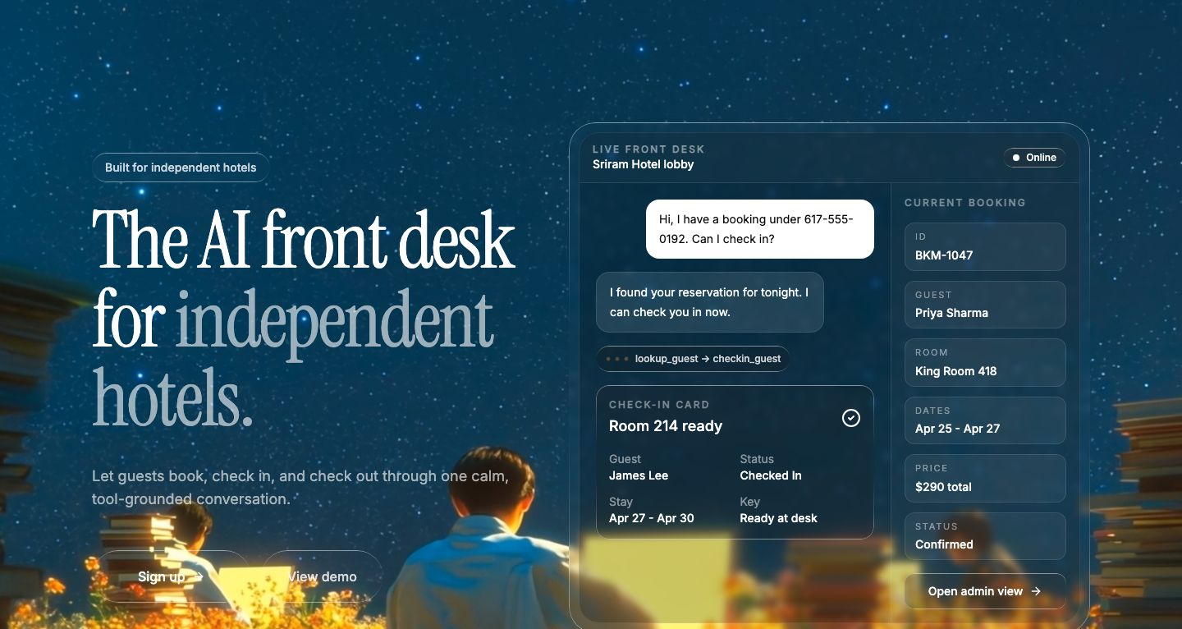
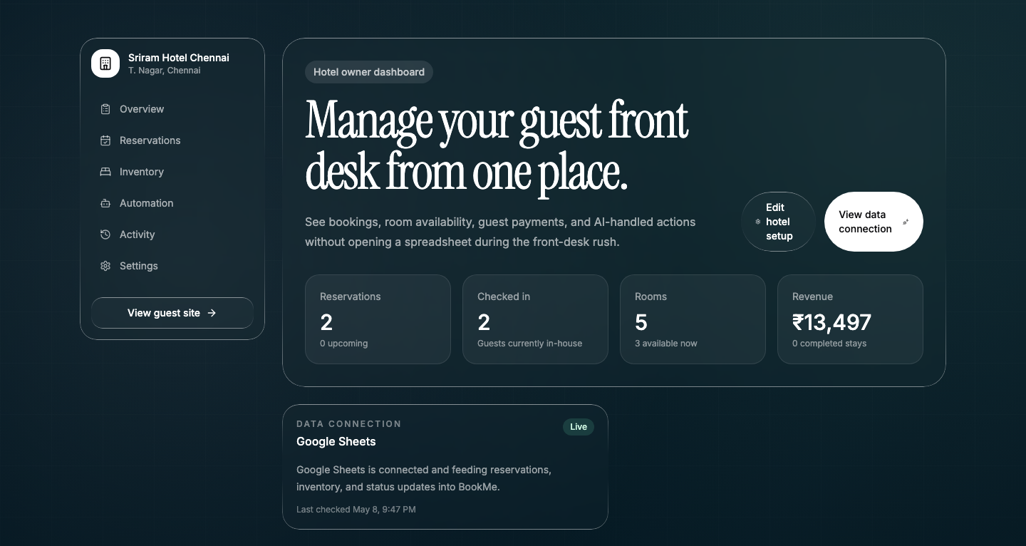
ARTIFACT SNAPSHOT
A working hosted app, not a notebook.
The repo includes app code, prompts/tool routes, setup instructions, evaluation notes, smoke tests, and hosted demo links.
Try it live
bookme-vercel.vercel.app
Landing
Guest AI front desk
Owner dashboard
Takeaway: GenAI becomes useful when it is attached to one business workflow and grounded in tools.
BookMe
05/05
Notes:
The final artifact is a hosted Next.js app.
There is a public landing page, a guest-facing hotel site for Sriram Hotel Chennai, an AI front-desk chat, and a hotel owner dashboard.
The GitHub repository includes the code, prompts, tool-backed API routes, setup instructions, and evaluation notes. The main takeaway is that BookMe shows GenAI being useful inside one specific business workflow, grounded in tools rather than just free-form text.

