Slide 1
WELCOME
SIMPLE RESTAURANT MENU PAGE

Slide 2
OBJECTIVE
To design and develop a simple Restaurant Menu webpage using HTML and CSS.
To display food items, and prices.
To improve skills in webpage layout design and styling.
To create an attractive and user-friendly menu interface.

Slide 3
TOOLS USED
HTML- To create the structure of the restaurant menu
CSS- To style and design the menu page
VISUAL STUDIO CODE- Code editor used for development
WEB BROWSER- To test and view the webpage

Slide 4
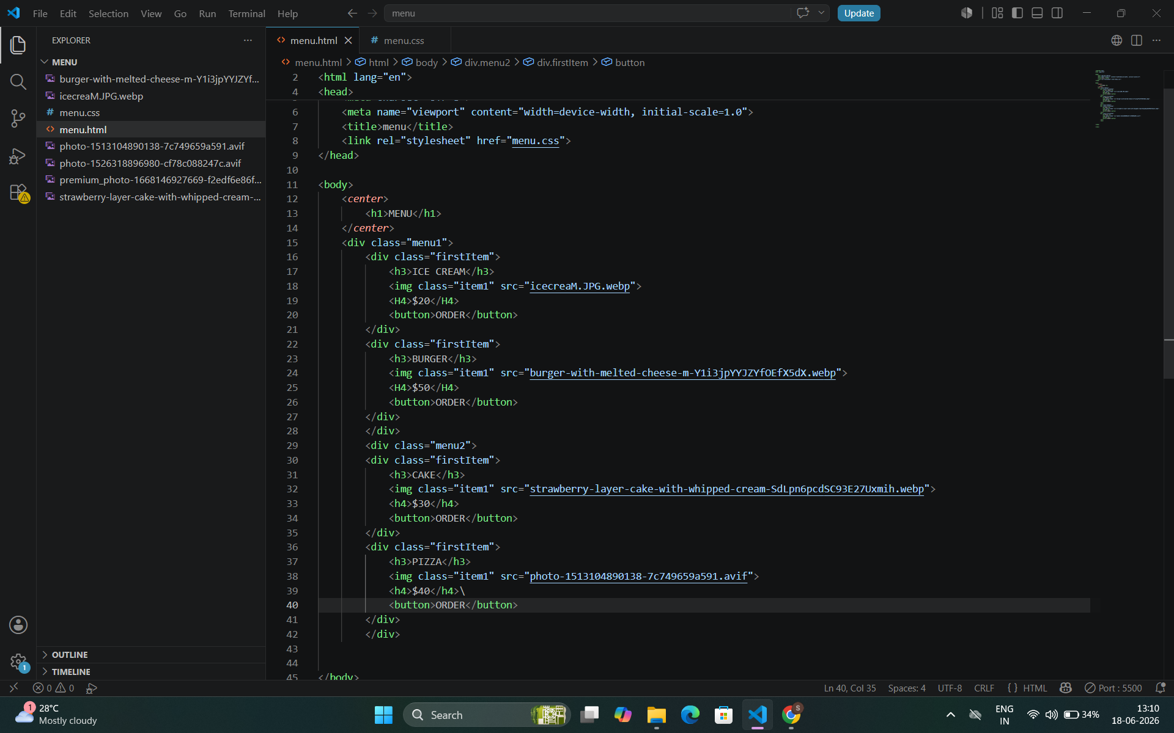
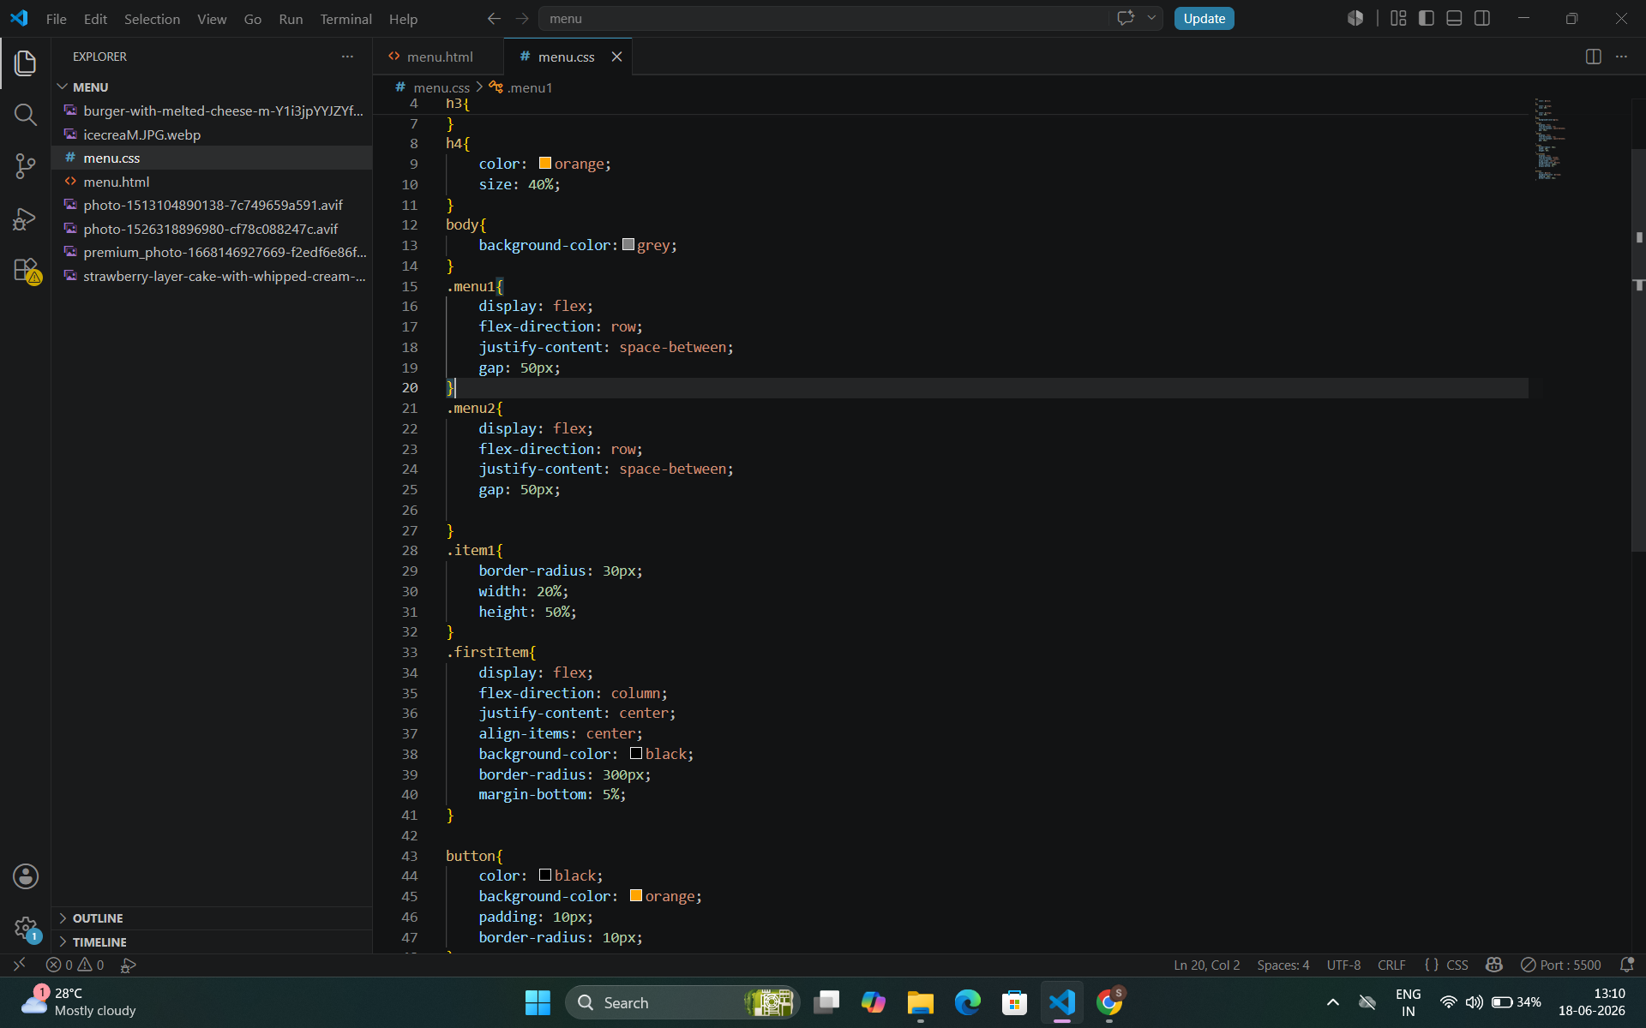
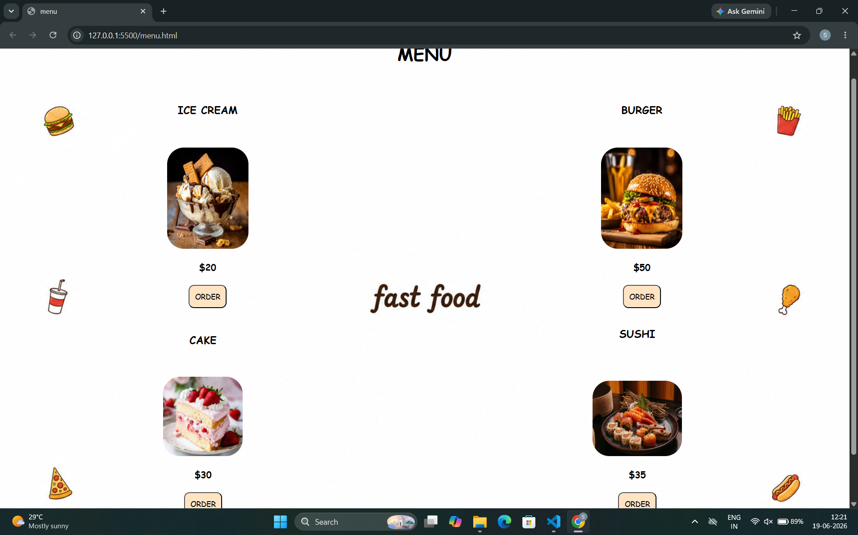
SCREEN SHOTS:

Slide 5
THANKYOU

