Slide 1
WELCOME
LOGIN PAGE

Slide 2
OBJECTIVE
To design and develop a simple Login Page using HTML and CSS.
To provide a user-friendly interface for entering login credentials.
To understand the basics of web page structure and styling.
To improve skills in front-end web development using HTML and CSS.

Slide 3
TOOLS USED
HTML- TO CREATE A STRUCTURE OF LOGIN PAGE
CSS- TO STYLE THE LOGIN PAGE
VISUAL STUDIO CODE- CODE EDITOR USED FOR DEVELOPMENT
WEB BROWSER- TO VIEW THE LOG IN PAGE

Slide 4
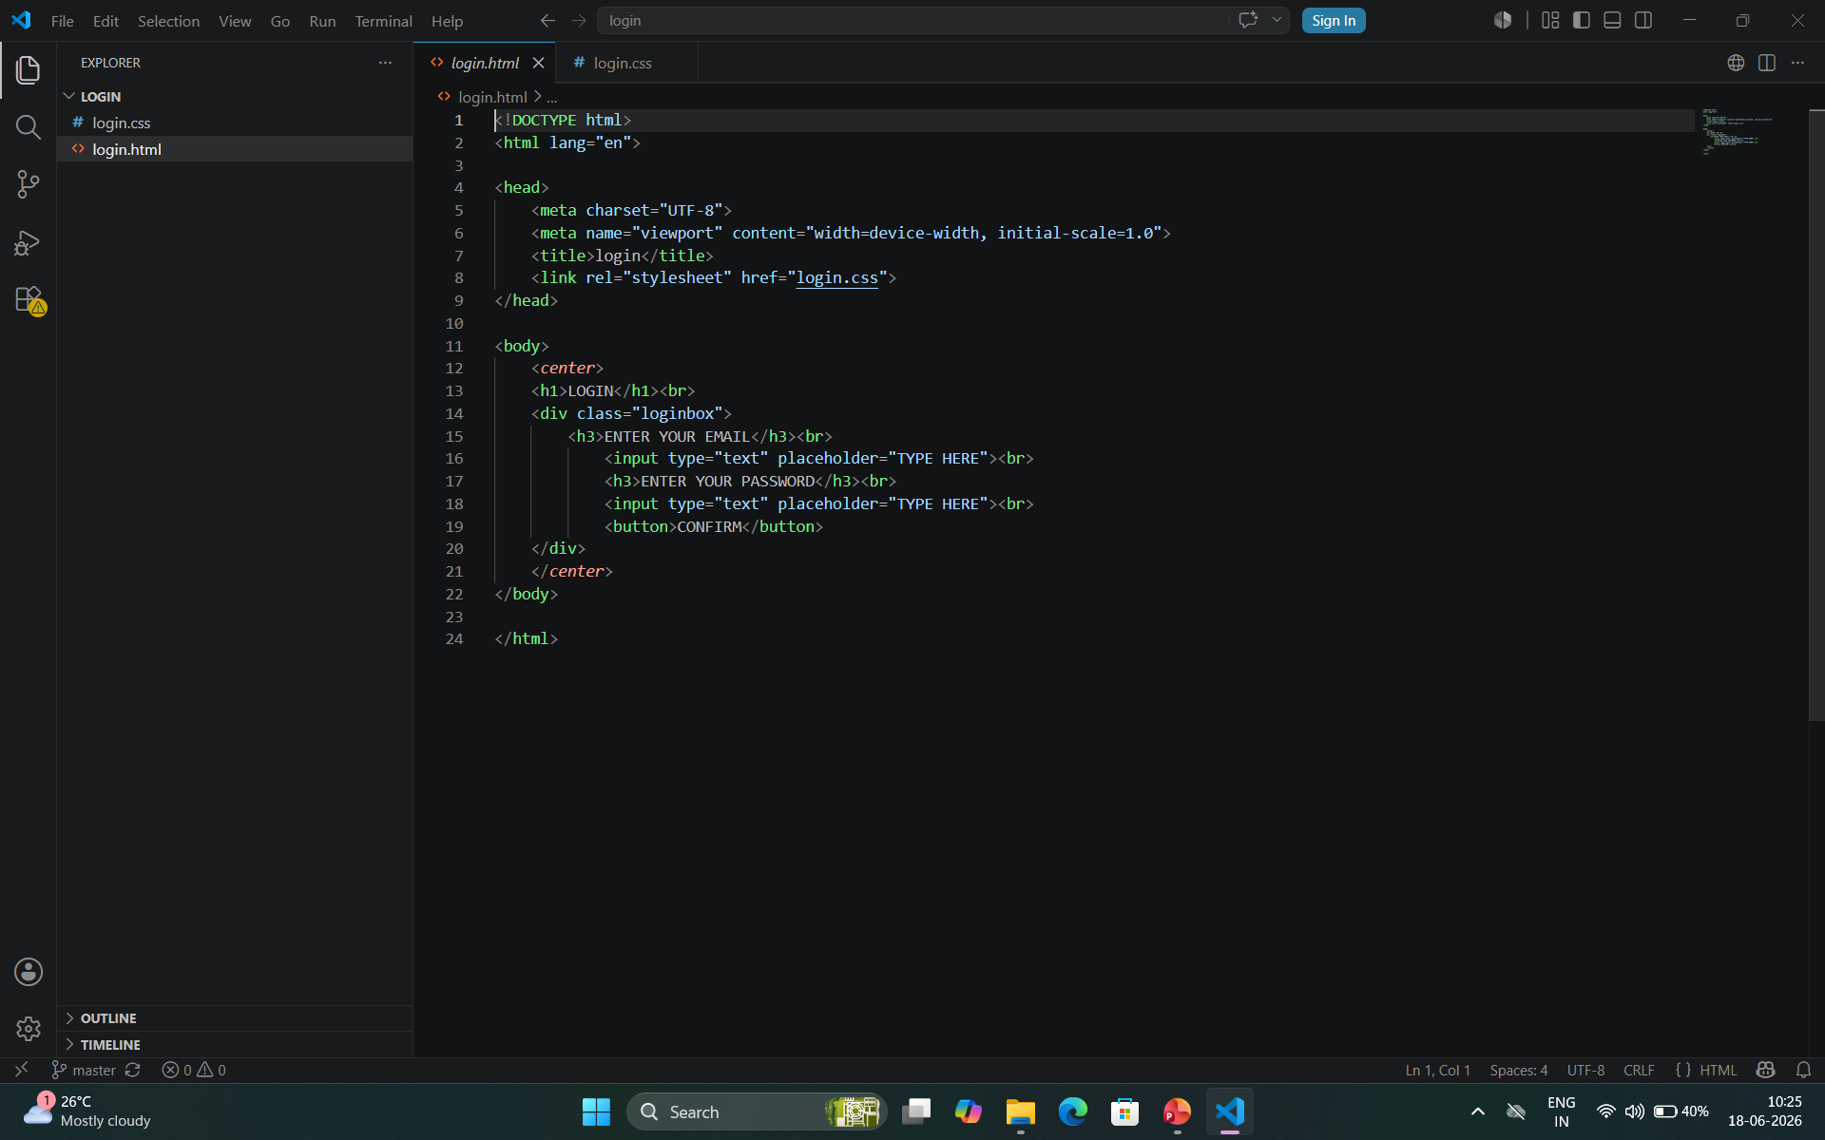
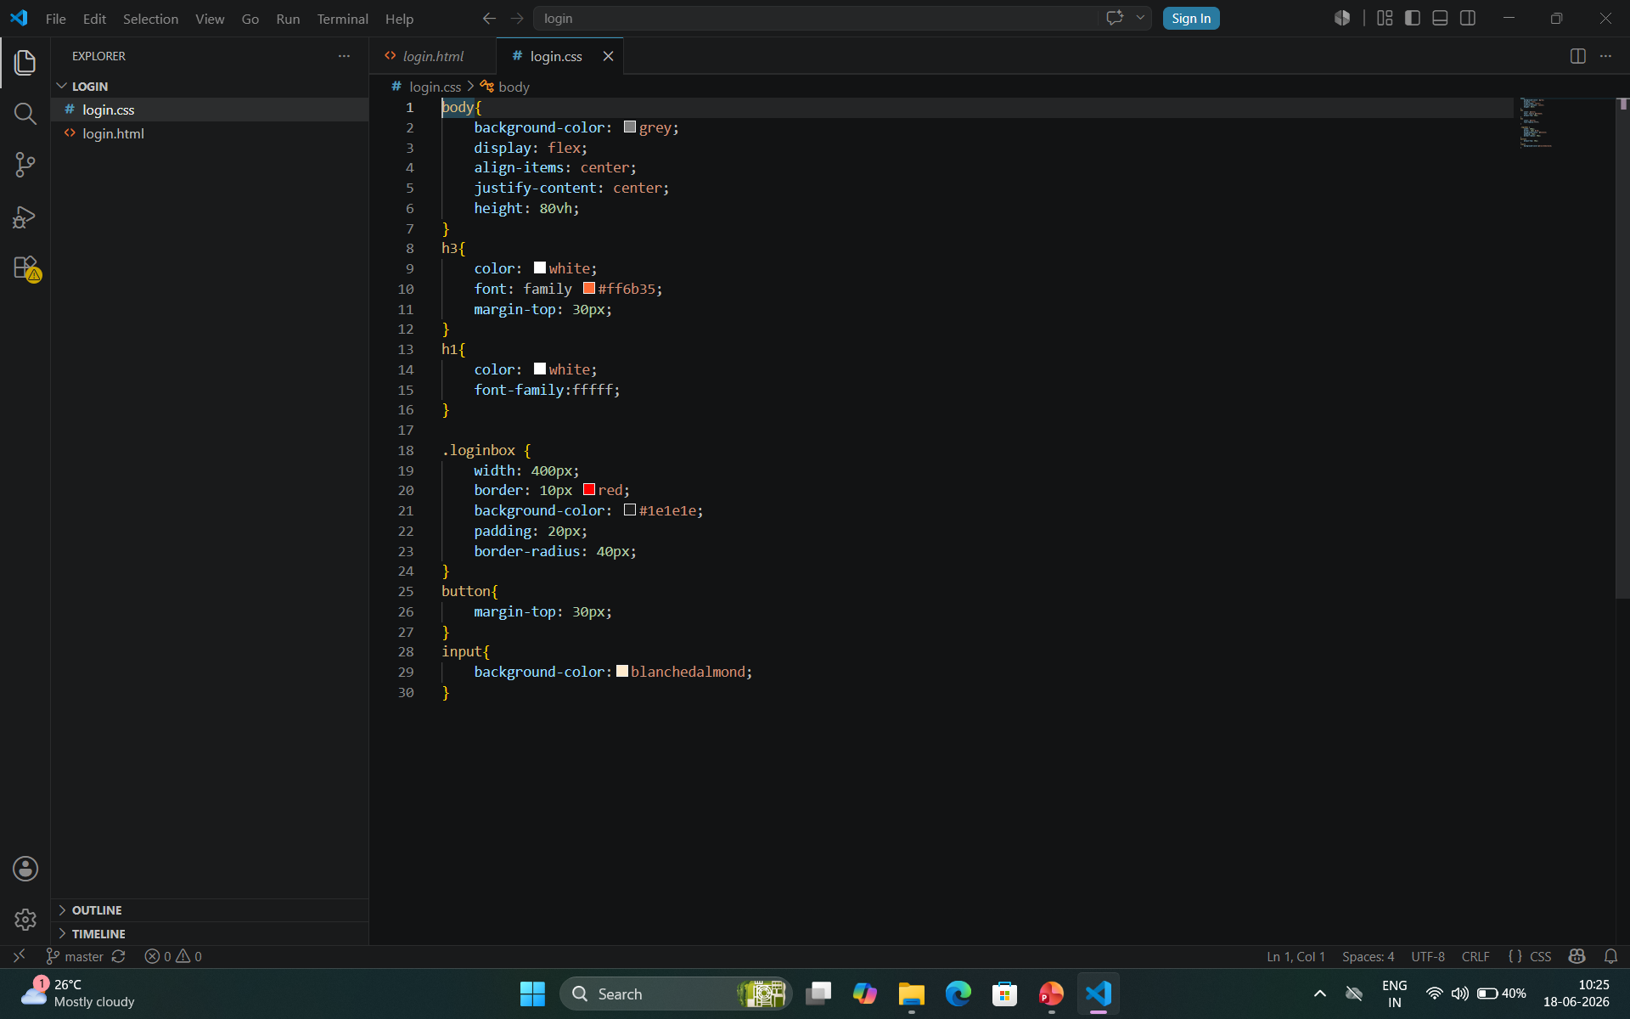
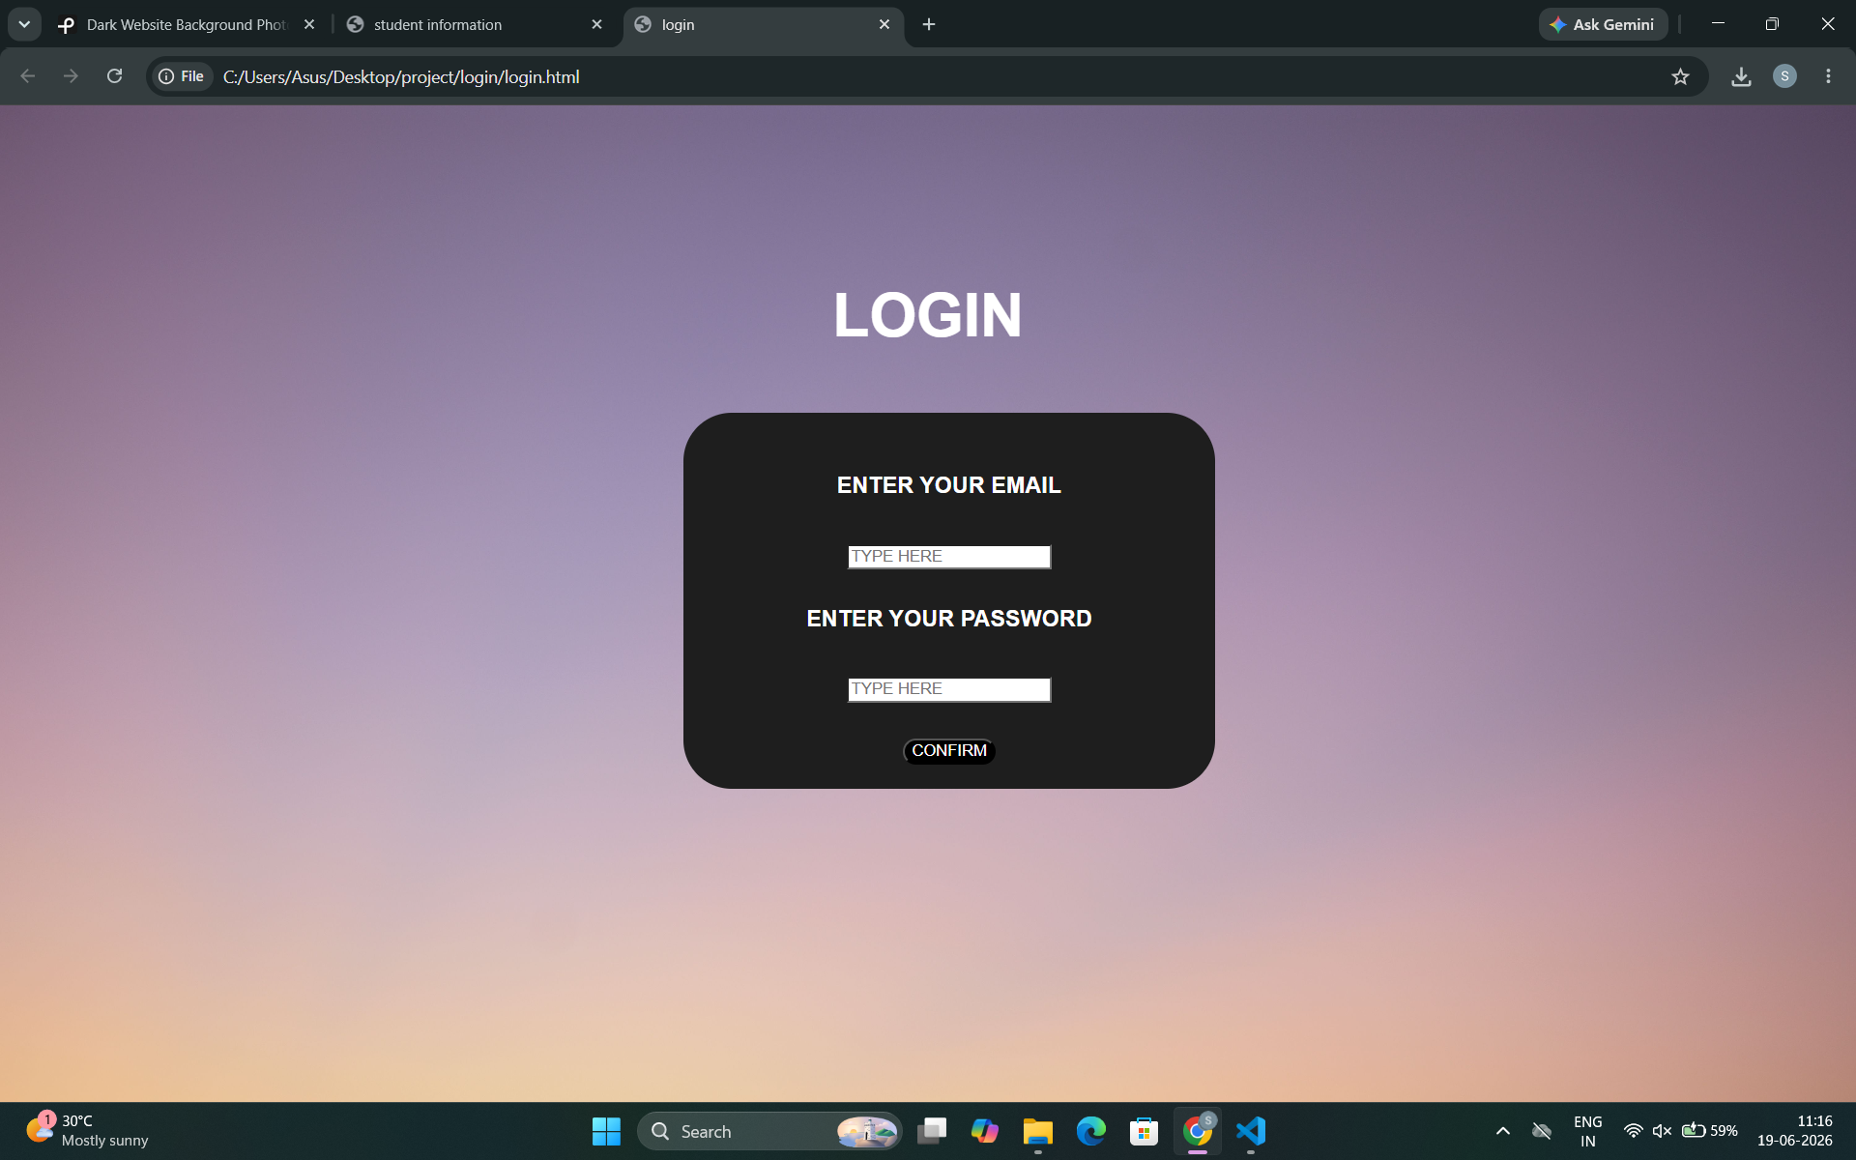
SCREEN SHOTS:

Slide 5
THANKYOU

